Slide 1


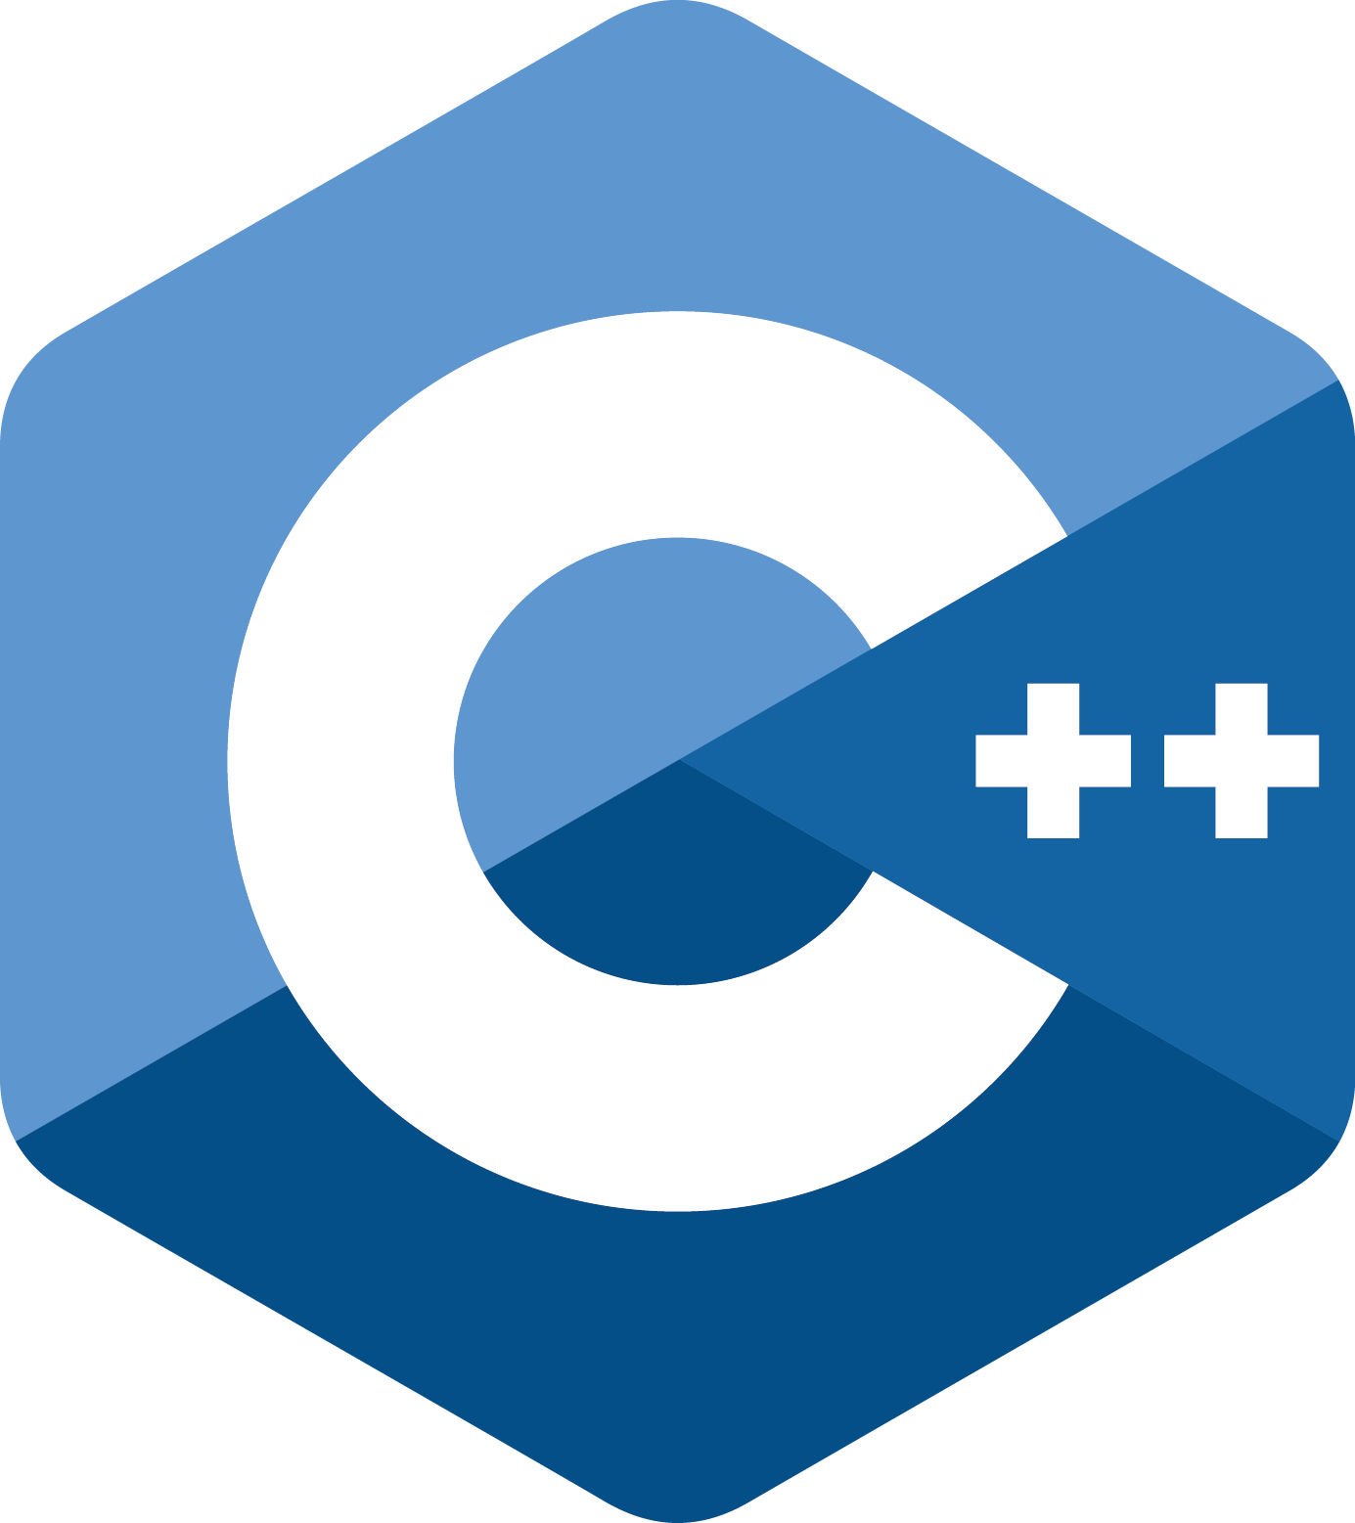
C++
Afonso Castro
Filipe Moreira
Ricardo Cerqueira

Slide 2
C++ (Basic Syntax)
Data types and Variable Definitions
Operators
Control Flow
Loops
Functions
Strings
Vectors
Classes

Slide 3

BASIC SYNTAX

Slide 4
Basic Syntax
#include <iostream> // This imports the functionalities implemented in the "iostream" library int main() { // Program execution starts here std::cout << "Hello, World!" << std::endl; /* This causes the message "Hello World!" to
appear on screen */ return 0; // This returns the 0 value }

Slide 5
Data Types and Variable Definition

Slide 6
Data Types
Type | Keyword | Possible Values
Boolean | bool | true, false
Character | char | A, b, C, ., \n, \t, \\
Integer | int | 1, 0x10, 0123, -1
Floating Point | float | 3.1415, 31415E-4
Double Floating Point | double | 3.14159265359
Valueless | void | -
String | char* (more on this later) | “Hello, world”

Slide 7
Escape Sequence Codes
Escape Sequence | Meaning
\\ | \ character
\’ | ‘ character
\” | “ character
\n | Newline
\r | Carriage Return
\t | Horizontal Tab
\v | Vertical Tab

Slide 8
Variable Definition
type variable;
It’s possible to define several variables of the same type in the same line.
int i, j, k; char c, ch; float f, salary; double d;
It’s also possible to initialize them:
int i = 0;

Slide 9
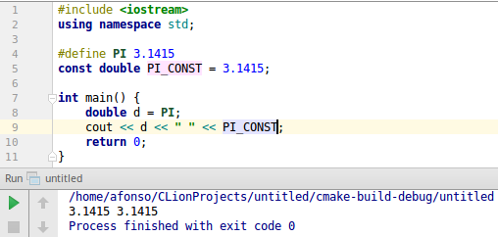
#define and const
The define preprocessor allows us to define constant values, which are then replaced by the preprocessor in the code. The const value allows us to define constant variables in compile time.
They are very similar usage-wise, but in C++, usually, const is preferred, due to having a type and respecting the concept of scope.

Slide 10
Data Sizes
Keyword | Meaning
signed | All values
unsigned | Non-negative values
long | Long Size
short | Short Size

Slide 11
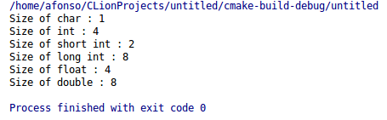
Data Sizes
#include <iostream> using namespace std; int main() { cout << "Size of char : " << sizeof(char) << endl; cout << "Size of int : " << sizeof(int) << endl; cout << "Size of short int : " << sizeof(short int) << endl; cout << "Size of long int : " << sizeof(long int) << endl; cout << "Size of float : " << sizeof(float) << endl; cout << "Size of double : " << sizeof(double) << endl; return 0; }

Slide 12
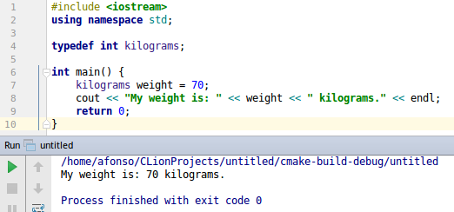
Keyword typedef
The typedef keyword allows us to define our own names for existing types.

Slide 13
Operators

Slide 14
Arithmetic Operators
Operator | Meaning | Example
+ | Adds two operands | 6 + 3 = 9
- | Subtracts the second operand from the first | 6 - 3 = 3
* | Multiplies two operands | 6 * 3 = 18
/ | Divides the first operand by the second | 6 / 3 = 2
% | Remainder of an integer division | 6 % 3 = 0
++ | Increases a value by 1 | a = 6; a++ // a = 7

Slide 15
Relational Operators
Operator | Meaning | Example
== | Returns true if first operand is equal to the second. | 1 == 2 // false
!= | Returns true if first operand is not equal to the second. | 1 != 2 // true
> | Returns true if first operand is greater than the second. | 1 > 2 // false
< | Returns true if first operand is smaller than the second. | 1 < 2 // true
>= | Returns true if first operand is greater than or equal the second. | 1 >= 2 // false
<= | Returns true if first operand is smaller than or equal the second. | 1 <= 2 // true

Slide 16
Logical Operators
Operator | Meaning | Example
&& | Returns true if the first AND second operands are true. | (1 > 2) && (2 > 1) // false
|| | Returns true if the first OR second operands are true. | (1 > 2) || (2 > 1) // false
! | Returns true if the operand is false, and false otherwise. | !(1 > 2) // true

Slide 17
Assignment Operators
Operator | Meaning | Example
= | It’s the operator used for assignment. | int c = 5 // c = 5
+= | Assigns the result of the addition to the first operand | a += b // a = a + b
-= | Assigns the result of the subtraction to the first operand | a -= b // a = a - b
*= | Assigns the result of the multiplication to the first operand | a *= b // a = a * b
/= | Assigns the result of the division to the first operand | a /= b // a = a / b
%= | Assigns the result of the modulo to the first operand | a %= b // a = a%b

Slide 18
Operators Precedence
Category | Operators
Unary | !, ~, ++, --
Multiplicative | *, /, %
Additive | +, -
Shift | <<, >>
Relational | <, <=, >, >=
Equality | ==, !=

Slide 19
Control Flow

Slide 20
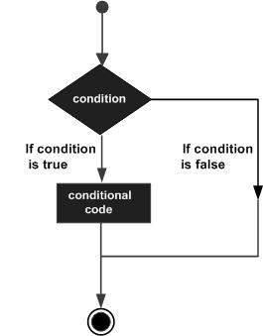
Control Flow
In C++, control flow is done in four ways:
if statements
if...else statements
switch statements
Conditional operator

Slide 21
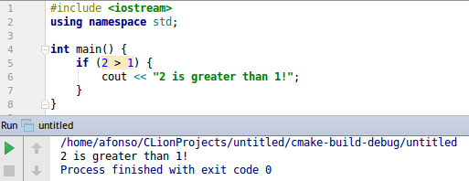
If statement
if(boolean_expression) { // statement(s) will execute if the boolean expression is true }

Slide 22
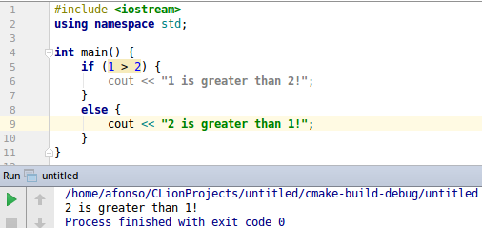
If..else statement
if(boolean_expression) { // statement(s) will execute if the boolean expression is true } else { // statement(s) will execute if the boolean expression is false }

Slide 23
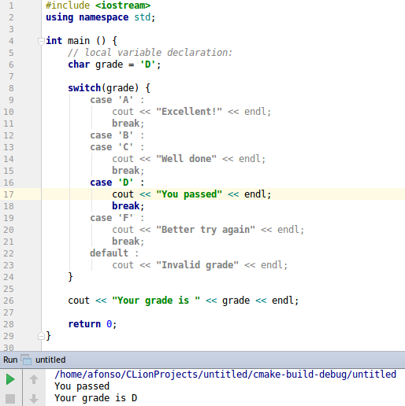
Switch statement
switch(expression){ case constant-expression : //statement(s); break; //optional case constant-expression : //statement(s); break; //optional // you can have any number of case statements. default : //optional statement(s); }

Slide 24
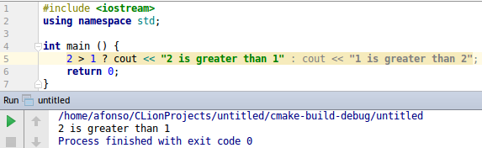
Conditional Operator
Exp1 ? Exp2 : Exp3;

Slide 25
Loops

Slide 26
Loops
In C++, three types of loop exist:
while loop
for loop
do … while loop
The following loop control statements also exist:
break
continue
goto

Slide 27
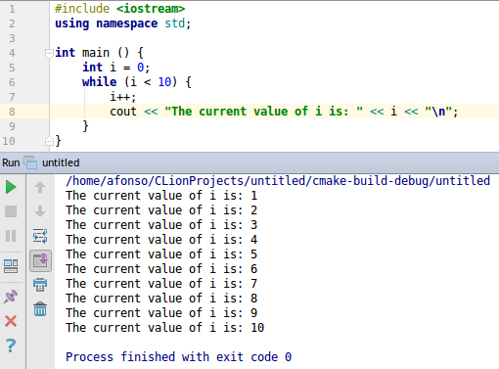
While Loop
while(condition){ statement(s); }

Slide 28
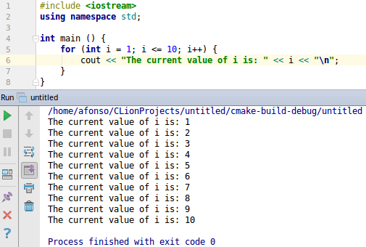
For Loop
for (initial_value; condition; increment) { statement(s); }

Slide 29
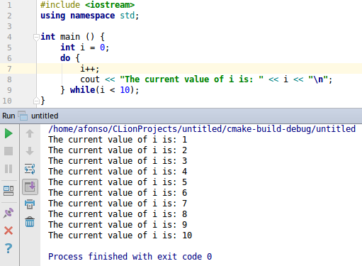
Do… While Loop
do { statement(s); } while( condition );

Slide 30
Loop control statements
break
Terminates the current loop, transferring execution to the statement immediately after the loop.
It also works for the switch statement seen before.
continue
Terminates the current iteration of the loop, transferring execution to the loop condition evaluation phase

Slide 31
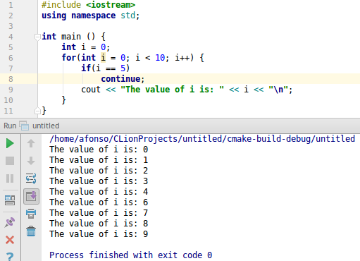
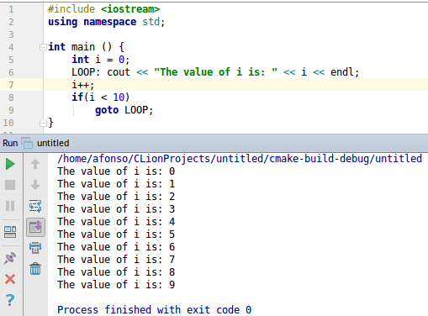
Loop control statements

Slide 32
Functions

Slide 33

Define a function
returnType name ( typeP1 parameter1, typeP2 parameter2, ...) { statements }

Slide 34

Declare a Function
Function declaration, is done to tell the compiler about the existence of the function. A declaration includes the function's return type, its name and parameter list.

Slide 35
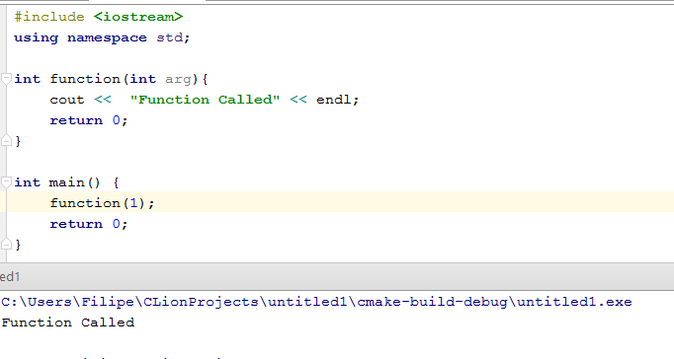
Call a function
When we create a function, we define what the function does. To use the function we must call it. When a function is called (with its arguments, if applicable), program execution is transferred to the beginning of the function.

Slide 36
Functions arguments
The arguments to a function are values that can be passed to the function to be used as input information.
You can pass arguments by:
Value
Reference

Slide 37
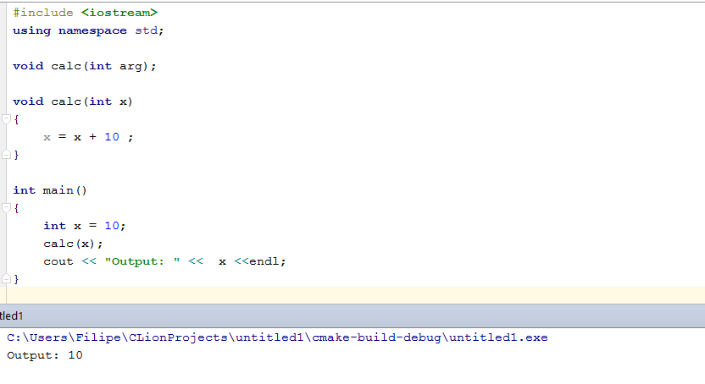
Value
Pass by value when the function does not want to modify the parameter and the value is easy to copy.

Slide 38
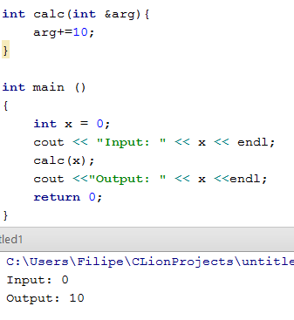
Reference
A reference to a variable is treated exactly the same as the variable itself, any changes made to the reference are passed through to the argument!

Slide 39
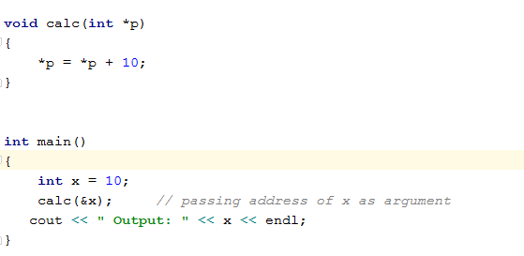
Passing pointers as arguments
Pointers are said to "point to" the variable whose address they store.
An interesting property of pointers is that they can be used to access the variable they point to directly. This is done by preceding the pointer name with the dereference operator (*).

Slide 40
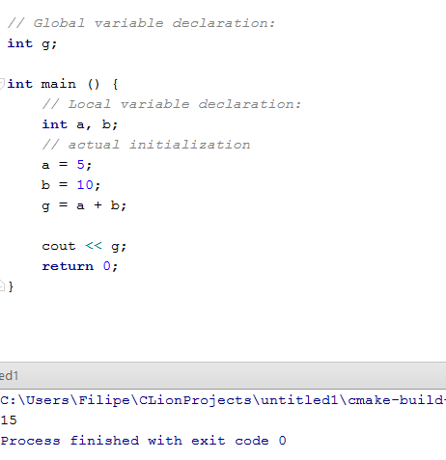
Scope of Variables
Local Variables
Global Variables

Slide 41
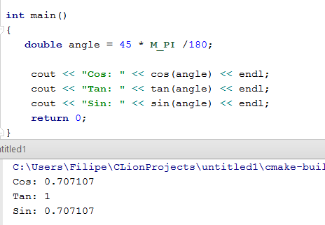
Cos, Tan, Sin

Slide 42
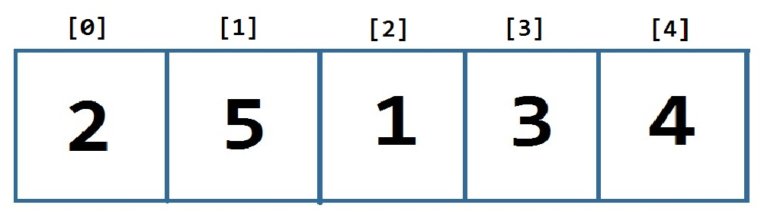
Arrays
An array is a series of elements of the same type placed in contiguous memory locations that can be individually referenced by adding an index to a unique identifier.
By using an array the five int values are stored in contiguous memory locations, and all five can be accessed using the same identifier, with the proper index.

Slide 43
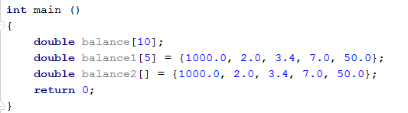
Declare and Define an Array
type arrayName[arraySize];

Slide 44
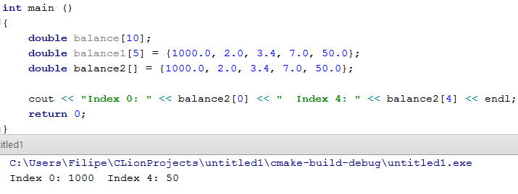
Access an Array Element

Slide 45
C-strings
In C programming, an array of characters is called a string. A string is terminated by a null character /0. For example "c string tutorial" would be represented as:
Some common string manipulation functions in C are:
strcpy, strcat, strlen, strcmp, strchr, strstre

Slide 46
Strings C++
Function | Meaning
+= | Extends the string by appending additional characters at the end of its current value:
find | Searches the string for the first occurrence of the sequence, if found return the position if not it return npos.
c_str | Returns a pointer to an array that contains a null-terminated sequence
substr | The substring is the portion of the object that starts at character position pos and spans len characters.
Size | Returns the length of the string, in terms of bytes.

Slide 47
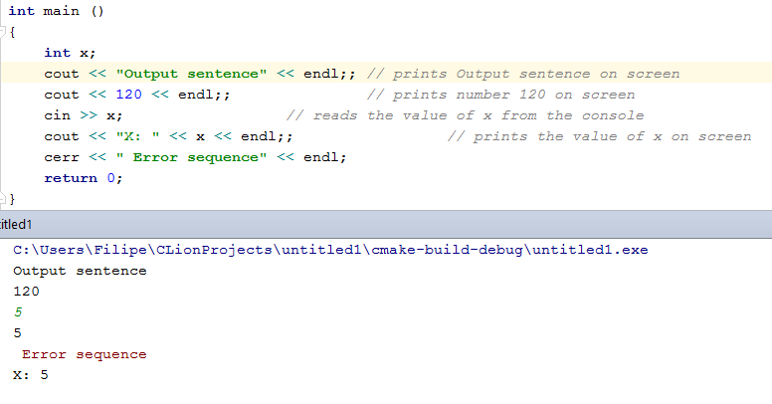
Input/output
Stream | Meaning
cin | standard input stream
cout | standard output stream
cerr | standard error (output) stream

Slide 48
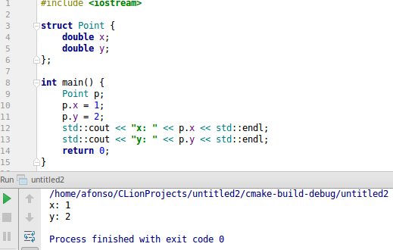
Structs
Often, it is useful to aggregate various data in a single variable. A struct defines a mold for a new data type that contains other data types. Each field can then be accessed by its name using “.”

Slide 49
Classes

Slide 50
Classes
Classes, like structs in C, are blueprints for new datatypes. They add the ability to define their behaviour through class functions.
They are the main method used to implement components in software systems.
Classes include their data fields, functions and constructors, which are special functions that initialize instances of that class, which are called objects.
Fields and functions are accessed with “.” or “->” for pointers.

Slide 51
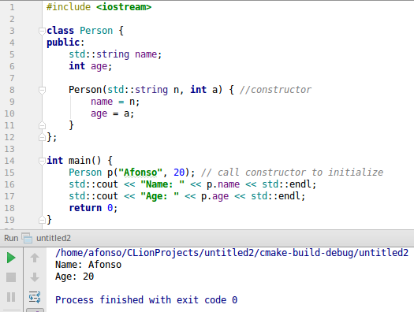
Classes

Slide 52
Classes - functions
Are defined just like any other function, but inside the scope of the class.
Can access the fields of the object they were invoked on.
The this keyword refers to a pointer to this object.

Slide 53
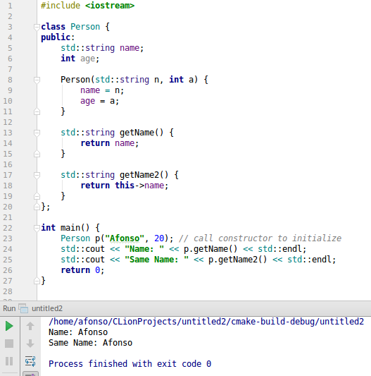
Classes - functions

Slide 54
Classes: Visibility
Programmers interact with classes in two ways, which may overlap:
Author: Implements the class and so needs full access to all data.
User: Uses the class and so should only access what they actually need.
A fundamental concept of classes is visibility: It controls where the classes fields and functions can be accessed.
Types of visibility:
public: can be accessed anywhere the class is visible
private: can only be accessed in the functions of the class
protected: can be accessed in the functions of the class or derived classes
These help manage unnecessary complexity by hiding it and to isolate implementation details from user code.

Slide 55
Classes - Operator Overloading
Operator overloading allows the operators already defined in the language to be used with our classes.
It is implemented by creating a function with the keyword operator followed by the operator to be overloaded.

Slide 56
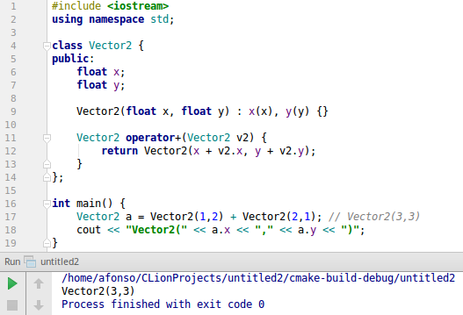
Classes - Operator Overloading

Slide 57
Classes: Inheritance
We can additional functionality to a class by inheriting from it. This lets us add additional fields and functions.
Usually, class B inherits from class A when B is a subtype of A.

Slide 58
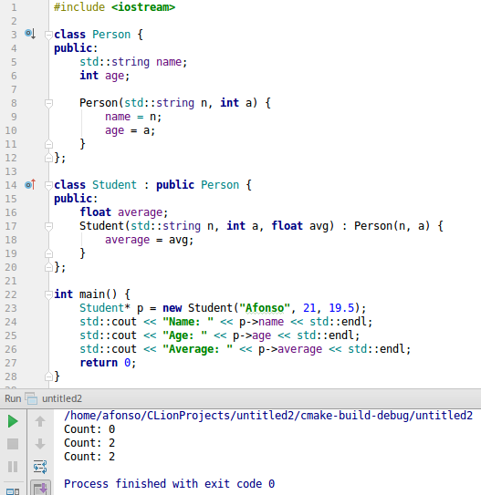
Classes: Inheritance

Slide 59
THANK YOU!

