Slide 1
Lare - A new technology for stateful single-page applications
Bachelorthesis
Jonas Braun
Oberseminar
2015-08-06
Notes:
Hello and welcome.
I‘,m Jonas Braun and i will present my bachelorthesis, called
Lare - a new technology or stateful single-page appliacation,

Slide 2
Outline
Motivation
Lare
Implementation
Evaluation
Results
Conclusion and future work
Notes:
We will take a look at the motivitation of my thesis
After that i will introduce Lare, the main technique in my finish
We then go a bit deeper into the implementation
Afterwards we will watch the methodology i used to benchmark Lare
And analyse the results
At the end i will give a short conclusion and talk about possible future work

Slide 3
Outline
Motivation
Lare
Implementation
Evaluation
Results
Conclusion and future work
Notes:
Let‘s start with the motivation

Slide 4
Introduction: Motivation
HTTP
Does not support dynamic content updates
AJAX as a compromise is complicated
Multiple endpoints
Not SEO friendly
Overhead at implementation
State of the art: PJAX, Client-side MVC (AngularJS)
Another solution: Lare
Generic AJAX-engine to get rid of the overhead
SEO friendly with just one endpoint
Notes:
- since 1999 HTTP did not evolve in case of synchronicity
pages are loaded and rendered completely
Doesn‘t support dynamic updates
w/o additional techniques
Asynchronous JavaScript and XML is just a compromise
It needs a special endpoint
It‘s not SEO friendly
A lot of overhead when implementing
Ajax-Engine
HTML / JSON renderer
At the moment there a several techniques to improve this:
PJAX (Pushstate AJAX) which only can replace one container at a time
Client-Side MVCs (like AngularJS) which need multiple endpoints
Another solution could be: Lare
AJAX, optimized to get rid of it‘s overhead
SEO friendly
just one endpoint
which means one point to maintain

Slide 5
Introduction: Fundamentals
Lare - A new technology for
stateful single-page applications
Single-page applications
Load one page completely
Update only content which should be changed
Normally do not update the URL when changing the page
No Bookmarks, Sharing or Indexing
Stateful
Every page has it‘s own URL
URL gets updated when changing the page
Typeaheads, e.g. do not update the URL
Notes:
Let‘s look at the name of my thesis
Let‘s start with single-page applications
Load one page completely
including resources like images, stylesheets
Update the content which needs to be changed
No full reload is needed anymore
Often the URL is not updated
You can not share it with friends
You can not bookmark it
Google can not index it
Stateful
Every page has it‘s own URL
URL gets updated when page changes
- e.g. when clicking on a link, but not on typeahead
Normal web history as you would expect

Slide 6
Outline
Motivation
Lare
Implementation
Evaluation
Results
Conclusion and future work

Slide 7
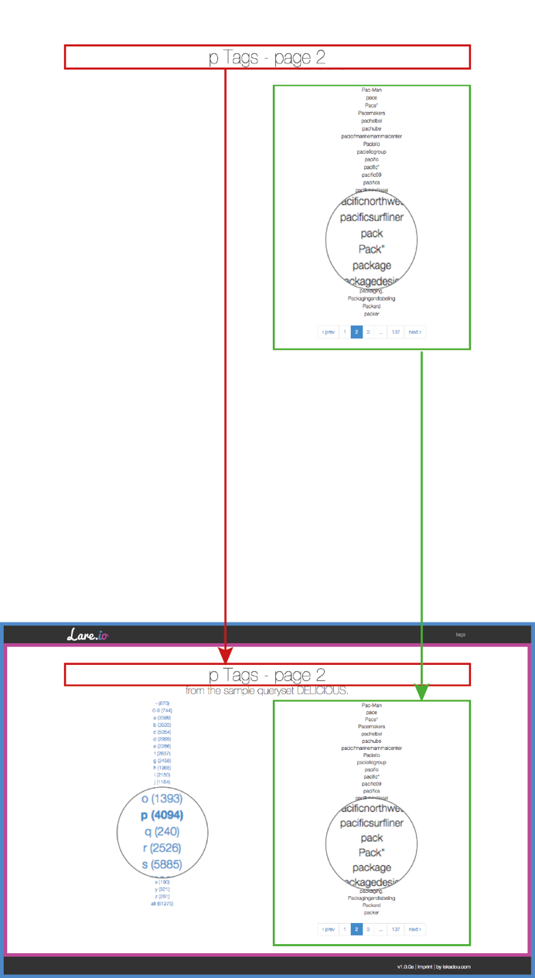
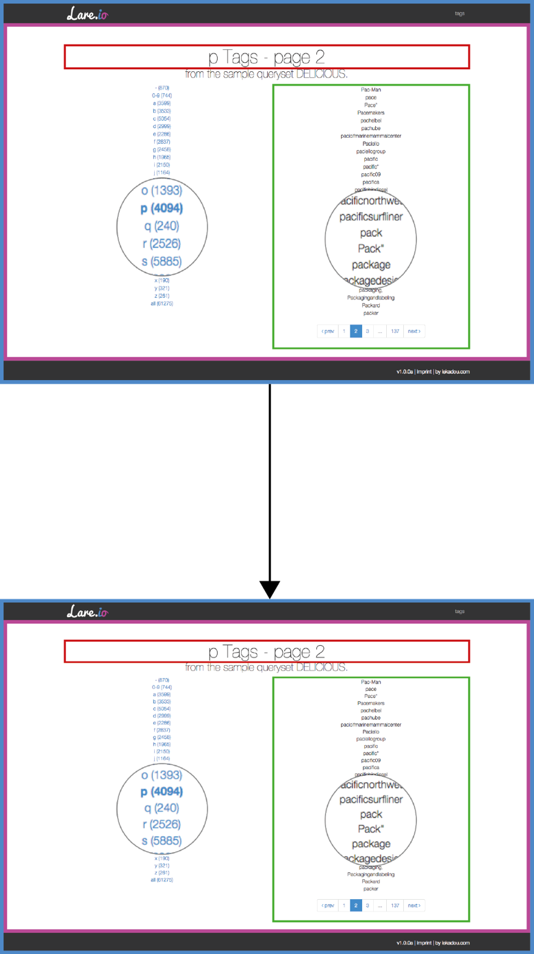
Lare
Lightweight asynchronous replacement engine (1/4)
Common HTTP request
Lare request
Notes:
At the left side you can see common HTTP requests,
They always replace the whole HTML DOM
At the right side only the changed content gets updated

Slide 8
Lare
Lightweight asynchronous replacement engine (2/4)
Lare-Frontend
Hijacks request
Adds the current page‘s name as
HTTP-X-Lare HTTP-header field
e.g. Namespace.of.this.view
Sends request to web server
(with running Lare-Backend)
...
Interprets response
Replaces containers
Notes:
PJAXR-Frontend (normally jquery-pjaxr)
Hijacks request
For example EventListener on <a>
Adds the current page‘s name to a HTTP-Header
Name is defined per page
Name should be in hierarchical Namespace
Sends asynchronous request to a webserver
With PJAXR-backend
Explained next
Interprets response
Replaces the matching containers
by id
XPATH due to dynamic changes not consistent enough
quite easy

Slide 9
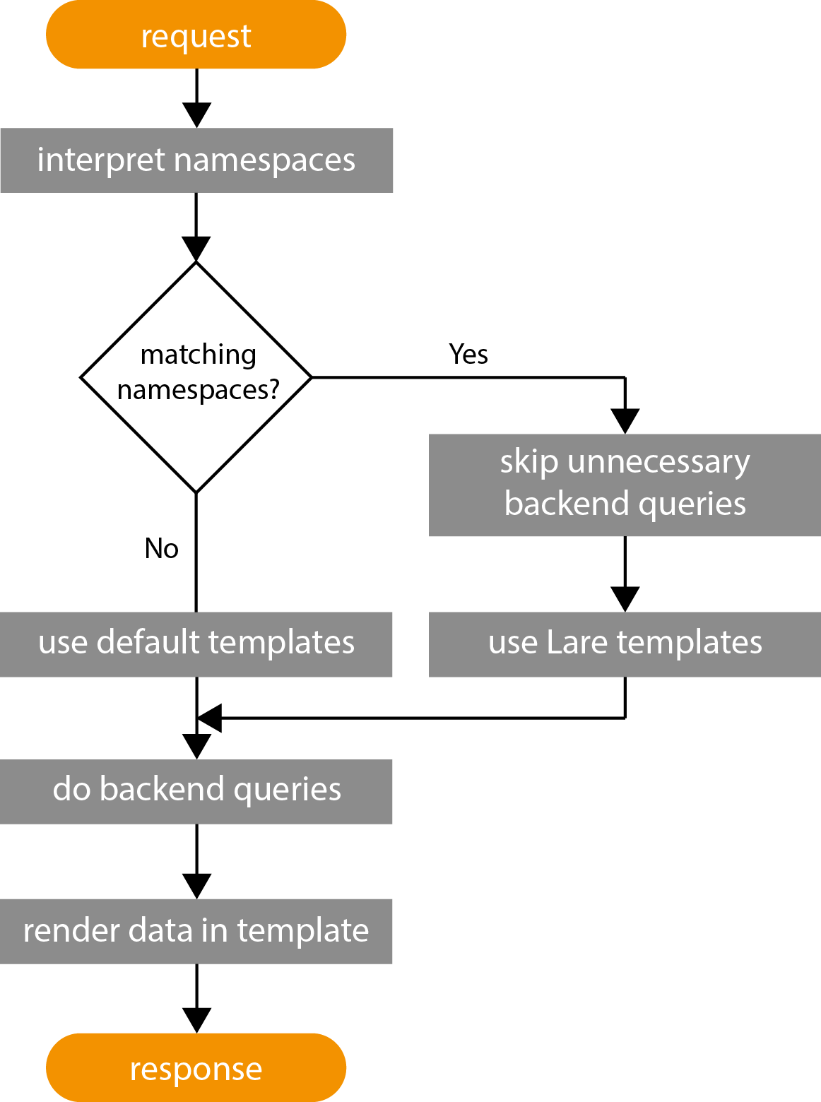
Lare
Lightweight asynchronous replacement engine (3/4)
Lare-Backend
Retrieves request
Decides which content should be responded
Makes necessary backend queries
Renders changed content as HTML
Notes:
PJAXR-Backend (specific per web framework)
Retrieves request
Including the current page‘s name in the HTTP-Header
Decides which content should be responded
by comparing namespace of header and namespace of requested page
Makes necessary backend queries
Renders the needed containers as HTML

Slide 10
Lare
Lightweight asynchronous replacement engine(3/4)
Why Lare?
Advantages of AJAX
Lower load times of „further“ requests
Less traffic
Avoid
Second endpoint of AJAX requests
Implementation of AJAX-engine
Specific search-engine optimization for AJAX
(e.g. headless browser snapshots)
Notes:
With PJAXR?
you have the advantages of AJAX
lower load times of "further" requests
less traffic
HTTP-request itself
No need to reload resouces, etc.
You can avoid:
A Second endpoint of AJAX requests
The implementation of an AJAX-engine, frontend
The Optimization for search-engines for AJAX

Slide 11
Lare
Lightweight asynchronous replacement engine (4/4)
What we need for Lare?
Each page of web application needs
One URL to reach it (for normal and Lare requests)
A specific name in an hierarchical namespace
A HTML structure matching the hierarchical namespace
Lare-Frontend
Lare-Backend
Notes:
What do we needa for Lare:
You need for each page
One URL to reach it (for normal and Lare requests)
- You dont need a special API URL or Hashbang
As Tim Berners-Lee said in 1999: Cool URLs dont change.
A specific name in an hiearchical Namespace
A HTML structure matching the hierarchical namespace
A well structured web application has this
Even for CSS styles
You additionally need a Lare-Front and a Backend
Should be provided

Slide 12
Outline
Motivation
Lare
Implementation
Evaluation
Results
Conclusion and future work

Slide 13
Implementation
PHP-Lare
General backend implementation for PHP
Can be used in every PHP project
Twig-Lare
Extension for Twig templating engine
Based on PHP-Lare
lare.js
JavaScript frontend based on jQuery
Notes:
What did i implement in the thesis?
PHP-Lare
General implementation for PHP
Can be used in every PHP project
Twig-Lare
Extension for Twig templating engine
Base on PHP-Lare
Hides PHP-Lare API in Twig-Templates
To become more maintainable
Together with Stephan Groß i implemented jquery-pjaxr
The predecessor of lare.js
I made it more generic and compatible in browsers

Slide 14
Implementation
Usage
Composer / Packagist
require “lare_team/twig_lare“: “1.0.0“
Twig-Template
{% lare_extends DEFAULT_TPL NAMESPACE LARE_TPL %}
Controller
Lare::set_namespace(“Namespace.of.this.view“);
if (Lare:matches(“Namespace“)) { // Backend queries }
HTML
$(document).lare(‘a‘);
Notes:
- What is the result of these implementations?
What do i need to do to use it?
Add a requirement in Composer
Add a Twig tag
In the Controller youi need to set a name
If you want to reduce unnecessary backend queries, you can test namespaces in the controller
That‘s it
In Detail:
Compser
You require „“iekadou/twig_pjaxr“: version into composer.json
Twig-Template
You decide which template should be extended, and which namespace has to be matched
Default Template for not matching
Pjaxr template for matching namespace
Controller
Use PHP-PJAXR API to set the namespace
To avoid backend queries
Test if the namespaces are matching
Avoid them if they are not needed

Slide 15
Outline
Motivation
Lare
Implementation
Evaluation
Results
Conclusion and future work

Slide 16
Evaluation
Sample web applications
PHP, Twig and Mysql with Delicious dataset
AngularJS, PHP API and Mysql with Delicious dataset
Curl
Analyze HTTP-response times w/o resources
Window.performance
Analyze web page retrieval incl. resources
Selenium
Record-and-play test suite for webdriver tests
Notes:
- Methodology to test PJAXR:
PJAXR only needs in a web application, so i implemented one
With PHP, Twig and Mysql
and used the Delicious dataset
Then Selenium to test if PHP-PJAXR and Twig-PJAXR are working
Curl to analyze the HTTP-response times
Window performance for web page retrieval including resources
To make it more maintainable and repeatable
We used SELENIUM

Slide 17
Evaluation
Test suites
Static pages without database queries
Dynamic pages with database queries
Common HTTP requests
Lare requests
Page-to-page requests
AngularJS requests
Enabled and disabled caching layers:
Database (Mysql)
Template (Twig / AngularJS)
Notes:
What does the test suite consist of?
Static pages without database queries
Dynamic pages with database queries
Initial requests
PJAXR requests
Site-to-site requests
Enabled and disabled caching layers:
Mysql Query cache
Twig template cache
Angular JS is a client side MVC framework
those frameworks are currently the base of the fastest web applications

Slide 18
Outline
Motivation
Lare
Implementation
Evaluation
Results
Conclusion and future work
Notes:
Lets come to the Results

Slide 19
cURL results
Tested URLs | Common | Lare | DB-Caching
/ to /imprint/ | 63.2ms | 56.8ms | no
/ to /imprint/ | 62.3ms | 57.9ms | yes
/imprint/ to /tags/p/1/ | 1245.4ms | 1244.5ms | no
/imprint/ to /tags/p/1/ | 82.0ms | 79.9ms | yes
/tags/p/1/ to /tags/p/2/ | 1243.0ms | 101.4ms | no
/tags/p/1/ to /tags/p/2/ | 82.4.0ms | 65.3ms | yes
Notes:
DESCRIPTION OF THE DIAGRAM
We see load times of different page-to-page requests and if db caching is enabled or not
Let‘s first talk about static pages
No big difference, DB-Caching does not matter
/imprint/ to /tags/p/1/ is a static-to-dynamic request,
No big difference again
Again db caching does not influence the results
no query can be avoided
Related dynamic pages show the effect of lare (last two lines)
Especially when database caching is disabled
in this case 8%

Slide 20
Selenium results
Tested URLs | Common | Initial AngularJS | Lare | AngularJS | DB-Caching
/ to /imprint/ | 92.58ms | 190.05ms | 44.53ms | 19.25ms | no
/ to /imprint/ | 94.07ms | 194.71.ms | 43.24ms | 19.12ms | yes
/imprint/ to /tags/p/1/ | 1352.86ms | 1494.67ms | 1243.33ms | 1216.88ms | no
/imprint/ to /tags/p/1/ | 150.41ms | 356.22ms | 55.79ms | 32.68ms | yes
/tags/p/1/ to /tags/p/2/ | 1345.50ms | 1499.23ms | 83.71ms | 65.33ms | no
/tags/p/1/ to /tags/p/2/ | 153.83ms | 368.67ms | 46.86ms | 31.28ms | yes
Notes:
When it comes to full web page retrievals the effect changes a bit
Static pages have something around 40% less load time
caused by the resources which are not needed to be loaded again
Related dynamic pages again have a really good performance
Only about 5% of the load time
Overall you can see AnuglarJS always takes a bit longer on initial requests
This can be explained by
Data that is retrieved after the AJAX engine is loaded by the engine
Frontend templates to be loaded
On further requests ist always a bit faster,
The server does not have to render data into template, and so on

Slide 21
Outline
Motivation
Lare
Implementation
Methodology
Evaluation
Conclusion and future work

Slide 22
Conclusion and future work
Conclusion
Varying load times:
5% to 95% relatively to normal requests
Backend queries are the main reason:
Less backend queries result in lower load times
But sometimes no backend queries can be avoided
Future work
Load tests of 10000 concurrent users as proposed in [BMVD08]
More backends for different web frameworks
Currently available: Django, Spring.io, PHP (Twig)
Proposal of single-page applications in HTML6
without JavaScript
Notes:
FIVE TO NINTEY-FIVE PERCENT

Slide 23
Thank you for your attention!
Jonas Braun

Slide 24
Find my thesis
Bachelor Thesis
https://github.com/iekadou/bachelor-thesis/
Sample web application
Colloquium
Thesis
lare.js
https://github.com/lare-team/lare.js/
PHP-Lare
https://github.com/lare-team/php-lare/
Twig-Lare
https://github.com/lare-team/twig-lare/
Notes:
/

Slide 25
Sources
AngularJS
https://angularjs.org/ (Accessed 05.08.2015)
Selenium
http://www.seleniumhq.org/ (Accessed 05.08.2015)
jQuery
http://jquery.com/ (Accessed 05.08.2015)
References
[BMVD08]: Engin Bozdag, Ali Mesbah, and Arie Van Deursen. Performance testing of data delivery techniques for ajax applications. Techni- cal report, Delft University of Technology, Software Engineering Research Group, 2008.
[BL98]: Tim Berners-Lee. Cool URLs don‘t change. 1998
[KKW07]: Jonas Kluge, Frank Kargl, and Michael Weber. The effects of the ajax technology on web application usability. In WEBIST (2), pages 289–294, 2007.
[DFK⁺09]Cristian Duda, Gianni Frey, Donald Kossmann, Reto Matter, and Chong Zhou. Ajax crawl: Making ajax applications searchable. In Data Engineering, 2009. ICDE’09. IEEE 25th International Con- ference on, pages 78–89. IEEE, 2009.
[Goo14]: Google Inc. Ajax crawling - getting started. https://developers.google.com/webmasters/ajax- crawling/docs/getting-started, 2014. accessed on 2015-07-28.

