Slide 1
PJAXR – A new technology for stateful single-page applications
Bachelorthesis
Jonas Braun
2015-06-01

Slide 2
Outline
Motivation
PJAXR
Implementation
Methodology
Results
Conclusion and future work

Slide 3
Outline
Motivation
PJAXR
Implementation
Methodology
Results
Conclusion and future work

Slide 4
Introduction: Motivation
HTTP 1.1 (1999)
Does not support dynamic content updates
AJAX as a compromise is complicated
Diagram – page, endpoint
Multiple endpoints
Not SEO friendly
Overhead when implementing it
Solution: PJAXR
Optimizing AJAX to get rid of the overhead
SEO friendly with just one endpoint
Notes:
- since 1999 HTTP did not evolve
pages are loaded completely and displayed
Doesn‘t support dynamic updates
AJAX is just a compromise
It needs a special endpoint
It‘s not SEO friendly
A lot of overhead when implementing
Ajax-Engine
HTML / JSON renderer
I offer you PJAXR
AJAX, optimized to get rid of it‘s overhead
SEO friendly
just one endpoint

Slide 5
Introduction: Fundamentals
PJAXR - A new technology for
stateful single-page applications
Single-page applications
Load one page of the application completely
Update only content which should be changed
URL does not get updated when changing the page
No Sharing, No Indexing
Stateful
Every page has it‘s own URL
URL gets updated when following to a new page(!)
Notes:
Name of the thesis
Let‘s start with single-page applications
Load one page completely
including resources like images, stylesheets
Update the content which needs to be changed
No full reload is needed anymore
Often the URL is not updated
You can not share it with friends
You can not bookmark it
Google can not index it
Stateful
Every page has it‘s own URL
URL gets updated when page changes
- e.g. when clicking on a link, but not on typeahead
Normal web history as you would expect

Slide 6
Outline
Motivation
PJAXR
Implementation
Methodology
Results
Conclusion and future work

Slide 7
PJAXR
Pushstate AJAX extended Replacements (1/4)
PJAXR-Frontend
Hijacks request
Adds the current page‘s name as HTTP-X-PJAXR-Namespace HTTP-header field
e.g. Namespace.of.this.view
Sends request to web server with PJAXR-Backend
...
Interprets response
Replaces containers
Notes:
PJAXR-Frontend (normally jquery-pjaxr)
Hijacks request
For example EventListener on <a>
Adds the current page‘s name to a HTTP-Header
Name is defined per page
Name should be in hierarchical Namespace
Sends asynchronous request to a webserver
With PJAXR-backend
Explained next
Interprets response
Replaces the matching containers
by id
XPATH due to dynamic changes not consistent enough

Slide 8
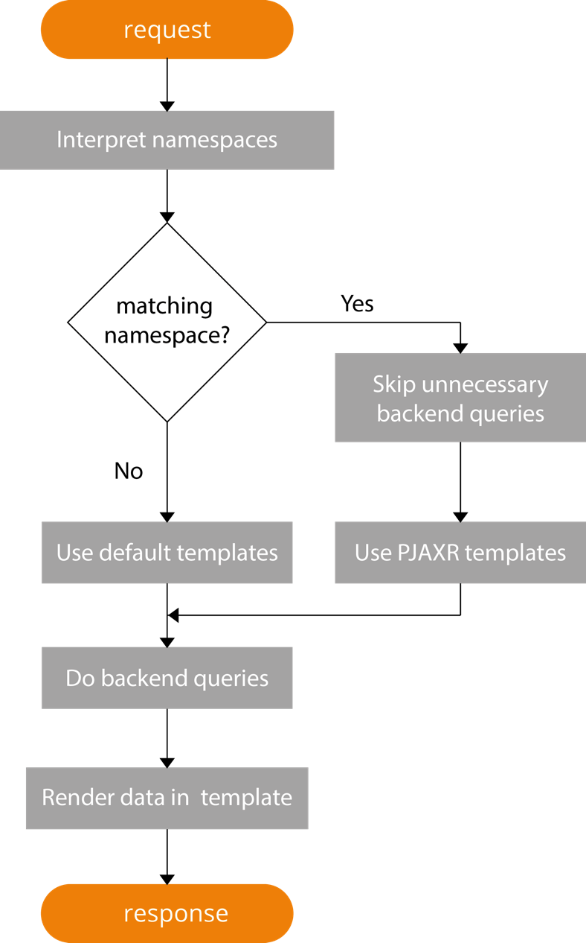
PJAXR
Pushstate AJAX extended Replacements (2/4)
PJAXR-Backend
Retrieves request
Decides which content should be responded
Makes necessary backend queries
Renders changed content as HTML
Notes:
PJAXR-Backend (specific per web framework)
Retrieves request
Including the current page‘s name in the HTTP-Header
Decides which content should be responded
by comparing namespace of header and namespace of requested page
Makes necessary backend queries
Renders the needed containers as HTML

Slide 9
PJAXR
Pushstate AJAX extended Replacements (3/4)
Why PJAXR?
Advantages of AJAX
Lower load times of „further“ requests
Less traffic
Avoid
Second endpoint of AJAX requests
Implementation of AJAX-engine
Specific search-engine optimization for AJAX
Notes:
With PJAXR?
you have the advantages of AJAX
lower load times of "further" requests
less traffic
HTTP-request itself
No need to reload resouces, etc.
You can avoid:
A Second endpoint of AJAX requests
The implementation of an AJAX-engine, frontend
The Optimization for search-engines for AJAX

Slide 10
PJAXR
Pushstate AJAX extended Replacements (4/4)
Summary
Each page of web application needs
One URI to reach it (for normal and PJAXR requests)
A specific name in an hierarchical namespace
A HTML structure matching the hierarchical namespace
PJAXR-Frontend
PJAXR-Backend
Notes:
What can we say about PJAXR:
You need for each page
A specific URI
A well structured web application has this
A specific name in an hiearchical Namespace
A HTML structure matching the hierarchical namespace
A well structured web application has this
Even for CSS styles
You additionally need a PJAXR-Fronend and a Backend
Should be provided

Slide 11
Outline
Motivation
PJAXR
Implementation
Methodology
Results
Conclusion and future work

Slide 12
Implementation
PHP-PJAXR
General backend implementation for PHP
Can be used in every PHP project
Twig-PJAXR
Extension for Twig templating engine
Based on PHP-PJAXR
Hides PHP-PJAXR API in Twig Templates
Improvement of jquery-pjaxr
Notes:
What did i implement in the thesis?
PHP-PJAXR
General implementation for PHP
Can be used in every PHP project
Twig-Pjaxr
Extension for Twig templating engine
Base on PHP-PJAXR
Hides PHP-PJAXR API in Twig-Templates
To become more user-friendly
Additionally i did some adjustments to jquery-pjaxr
To make it even more universal

Slide 13
Implementation
Result (screenshots)
Composer / Packagist
require “iekadou/twig_pjaxr“: “0.2.0“
Twig-Template
{% pjaxr_extends DEFAULT_TPL NAMESPACE PJAXR_TPL %}
Controller
Pjaxr::set_namespace(“Namespace.of.this.view“);
if (PJAXR:matches(“Namespace“)) { // Backend queries }
That‘s it =)
Notes:
- What is the result of these implementations?
What do i need to do to use it?
Add a requirement in Composer
Add a Twig tag
In the Controller youi need to set a name
If you want to reduce unnecessary backend queries, you can test namespaces in the controller
That‘s it
In Detail:
Compser
You require „“iekadou/twig_pjaxr“: version into composer.json
Twig-Template
You decide which template should be extended, and which namespace has to be matched
Default Template for not matching
Pjaxr template for matching namespace
Controller
Use PHP-PJAXR API to set the namespace
To avoid backend queries
Test if the namespaces are matching
Avoid them if they are not needed

Slide 14
Outline
Motivation
PJAXR
Implementation
Methodology
Results
Conclusion and future work

Slide 15
Methodology
Sample web application
PHP, Twig and Mysql with Delicious in it
Selenium
test PHP-PJAXR and Twig-PJAXR
Curl
Analyze HTTP-response times
Chrome Network Tools
Analyze the whole web application retrieval
Difficult to test, due to lack of automation
Notes:
- Methodology to test PJAXR:
PJAXR only needs in a web application, so i implemented one
With PHP, Twig and Mysql
and used the Delicious dataset
Then Selenium to test if PHP-PJAXR and Twig-PJAXR are working
Curl to analyze the HTTP-response times
Chrome Network Tools to analyze the whole application retrieval
Stylesheets, Images, Scripts, etc.
Overall it is difficult to test,
due to lack of automation of complete web retrievals

Slide 16
Methodology
Test suite
Static pages without database queries
Dynamic pages with database queries
Initial requests
PJAXR requests
Site-to-site requests
Enabled and disabled caching layers:
Mysql
Twig
Notes:
Test suite
Static pages without database queries
Dynamic pages with database queries
Initial requests
PJAXR requests
Site-to-site requests
Enabled and disabled caching layers:
Mysql
Twig

Slide 17
Outline
Motivation
PJAXR
Implementation
Methodology
Results
Conclusion and future work
Notes:
Lets come to the Results

Slide 18
Results
Tested URLs | Initial | Normal Site-to-Site | PJAXR
/ to / | 1.0265s | 0.9877s | 0.0038s
/tags/p/ to /tags/p/ | 2.3621s | 2.3493s | 0.0456s
/ to /imprint/ | 1.0812s | 1.0811s | 0.0040s
/ to /tags/p/ | 2.3887s | 2.3091s | 1.2404s
/tags/p/ to /tags/p/2/ | 2.3295s | 2.2887s | 0.0758s
Specifcations
It‘s faster =)
Notes:
Initial requests
Static: ~1s
Dynamic: ~2s
PJAXR requests:
Static: 0.003s
Dynamic: 0.9s
PJAXR requests:
Static: 0.003s
Dynamic: 0.9s

Slide 19
Outline
Motivation
PJAXR
Implementation
Methodology
Results
Conclusion and future work

Slide 20
Conclusion and future work
More backends for different web frameworks
Currently available: Django, Spring.io, PHP (Twig)
W3C member proposes single-page applications without JavaScript in HTML6

Slide 21
Thank you for your attention!
Jonas Braun

Slide 22
Find my thesis
Bachelor Thesis
https://github.com/iekadou/bachelor-thesis/
Sample web application
Colloquium
Thesis
Proposal
PHP-PJAXR
https://github.com/iekadou/php-pjaxr/
Twig-PJAXR
https://github.com/iekadou/twig-pjaxr/

Slide 23
Sources
...

