Slide 1


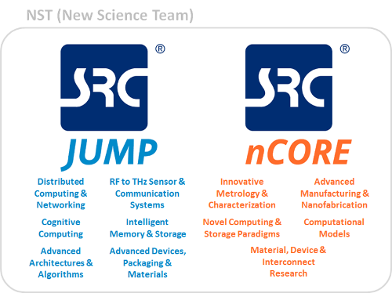

PUMA: A Programmable Ultra-efficient Memristor-based Accelerator for Machine Learning Inference
Aayush Ankit*, Izzat El Hajj††, Sai Rahul Chalamalasetti†, Geoffrey Ndu†, Martin Foltin†, R. Stanley Williams†, Paolo Faraboschi†, Wen-mei Hwu††, John Paul Strachan†, Kaushik Roy*, Dejan Milojicic†
*Purdue University, † †University of Illinois at Urbana-Champaign, †Hewlett Packard Enterprise
Motivation for Hybrid Memristor-CMOS Architecture
ML App Characteristic | MLP | LSTM | CNN | Memristor Feature
MVM Domination | ✓ | ✓ | ✓ | Analog dot-product
Memory Bound | ✓ | ✓ | × | On-die, In-memory
Memristor is a natural fit for ML app characteristics
Key memristor features:
Ultra-high storage density (~160MB/mm²)
Analog dot-product (Ohm’s law, KCL)
High write cost (latency, energy)
MVM alone cannot execute ML apps
PUMA CORE – Heterogeneous Execution
PUMA Multi-Core
Domain-specific ISA for ML for memristive systems
Low decoder overhead
Programmability
Co-locate different types of execution units: MVMU, VFU, ROM-Embedded RAM
Near/In-memory processing
General-purpose
Bit-streamed, weight-sliced MVMU: storage density - 2.72 MB/mm²
Exploits available ILP with MVM Coalescing
Dataflow (spatial) architecture
stationary weights and instructions
data movement from partial sums and neurons, between cores
Preserve storage density of memristor, to map models with on-chip memory only
1 PUMA Node key metrics : 69 MB storage, 90 mm², 577GOPS/mm², 837 GOPS/W
Results – Comparison with CPU, GPU, TPU
*Skylake (14nm), PASCAL (16nm) and TPU (28nm) are board-level measurements, PUMA (32nm) results are simulation-level measurements.
Compiler And Simulator
Acknowledgments
PUMA compiler – converts high level C++ code to PUMA assembly.
Programmability: run large-scale models on 1000s of spatial cores
Graph Partitioning (data movement optimization), register allocation, MVM Coalescing (ILP)
PUMAsim – power, performance, and functional simulator
Enables ISA and architecture validation, design-space exploration
This work was supported in part by Hewlett-Packard Labs, Palo Alto, CA; US Department of Energy (DOE); IARPA and C-BRIC, one of six centers in JUMP, a Semiconductor Research Corporation (SRC) program sponsored by DARPA.

