Slide 1

Analysis and Modeling of Collaborative Execution Strategies for Heterogeneous CPU-FPGA Architectures
Sitao Huang¹, Li-Wen Chang², Izzat El Hajj³, Simon Garcia De Gonzalo¹, Juan Gómez-Luna⁴,
Sai Rahul Chalamalasetti⁵, Mohamed El Hadedy⁶, Dejan Milojicic⁵, Onur Mutlu⁴,
Deming Chen¹, Wen-mei Hwu¹
¹University of Illinois at Urbana-Champaign, USA
²Microsoft, USA
³American University of Beirut, Lebanon
⁴ETH Zürich, Switzerland
⁵Hewlett Packard Labs, USA
⁶California State Polytechnic University, Pomona, USA
Notes:
In this work, we explore the potential of collaborative execution between CPUs and FPGAs using OpenCL high level synthesis. Based on the evaluation of different collaborative execution, we provide insights about designing CPU-FPGA applications.

Slide 2
Outline
Introduction to Collaborative Computing
Analytical Models of Collaborative Computing
Evaluation
Evaluation platform
Data partitioning vs. task partitioning
Impact of kernel replication
Key Insights
Chai Benchmarks for CPU-FPGA Systems

Slide 3
Collaborative Computing
Traditionally, accelerators (GPUs, FPGAs, etc.) have been used as offload engines
Host Processor
System Memory
PCIe
Accelerators
Host processor offloads computation tasks to accelerators
Notes:
Traditionally, accelerators (including FPGAs) have been used as offload engines, where an entire kernel runs on the accelerator while the CPU remains idle, waiting for the result.

Slide 4
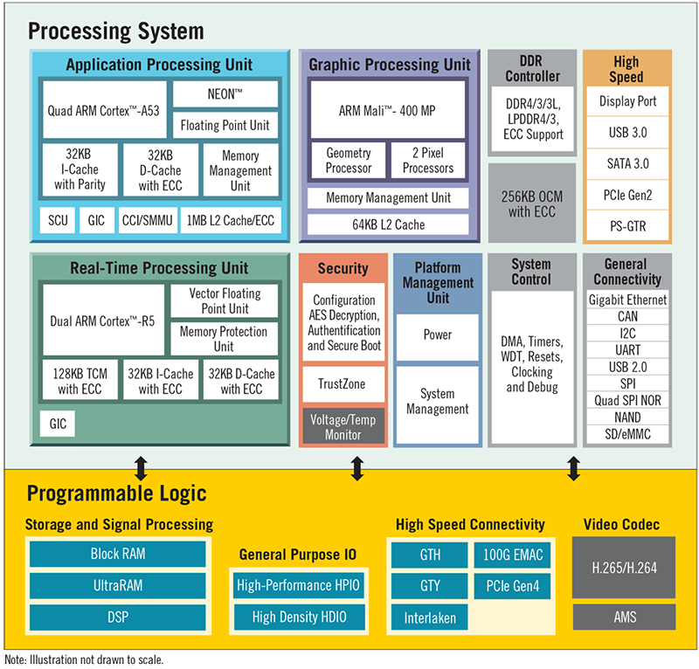
Collaborative Computing
Traditionally, accelerators (GPUs, FPGAs, etc.) have been used as offload engines
Heterogeneous architectures moving towards tighter integration
Unified memory
System-wide atomics
Xilinx Zynq UltraScale+ MPSoC
Notes:
More recently, vendors provide interconnect technologies that move heterogeneous architectures towards tighter integration (with unified memory and system-wide atomics support).
The figure on the right shows one example of tight integration of ARM CPU and FPGA in Xilinx MPSoC chip.

Slide 5
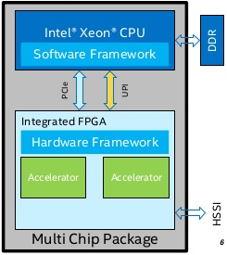
Collaborative Computing
Traditionally, accelerators (GPUs, FPGAs, etc.) have been used as offload engines
Heterogeneous architectures moving towards tighter integration
Unified memory
System-wide atomics
Tighter integration allows fine-grained collaboration
HSSI
Key challenge: identify the best CPU-FPGA collaboration strategy
Intel Xeon + FPGA Integrated Platform (MCP)
Notes:
Another example is the Intel Xeon + FPGA integrated platform, where CPU and FPGA are connected via Intel UPI interconnect and PCIe.
(click)
The trend towards tighter integration of CPUs and FPGAs enables more collaborative execution between devices. Rather than executing an entire kernel on the FPGA while the CPU is idle, collaborative execution makes better use of the overall system resources by involving both CPU threads and FPGA in the execution.
(click)
One of the key challenges of collaborative execution between CPUs and FPGAs is the identification of the best strategy for partitioning work between the CPU and the FPGA. There are two major approaches to partitioning of work, data partitioning and task partitioning. We will present both partitioning schemes in the following slides.

Slide 6
Integrated Heterogeneous Systems
Our vision of an integrated heterogeneous system:
CPU core 0
CPU core 1
…
CPU core N-1
CU
CU
CU
…
CU
CU
FPGA
GPU
L1
L1
…
L1
L1
L1
L1
…
L1
L1
Scratchpad
DMA
L2
L2
Crossbar / Coherency control
LLC
Crossbar
Non-coherent bus
DRAM controller
DRAM
DRAM
DRAM
DRAM
Coherent bus
Notes:
Our vision of an integrated heterogeneous system:
Single CPU
Multi-core CPUs
CPU + GPU
CPU + GPU + FPGA
CPU + GPU + FPGA with coherency support

Slide 7
Collaborative Patterns
data-parallel tasks
Device 1
Device 2
…
coarse-grained synchronization
…
…
sequential sub-tasks
…
…
…
Program Structure
Data Partitioning
Notes:
We illustrate the collaborative execution strategies using a simple example. In this example, a program consists of many data-parallel tasks that are applied to different data elements.
Each data-parallel task consists of multiple types of sub-tasks (two in this case), and the result of the first sub-task is required for the execution of the second sub-task.
In some cases, a program may consist of multiple phases where there is a global synchronization point across all data-parallel tasks. In OpenCL, these phases are typically expressed as separate kernels.

Slide 8
Collaborative Patterns
Device 1
Device 2
data-parallel tasks
…
…
coarse-grained synchronization
sequential sub-tasks
…
…
…
…
…
Program Structure
…
Fine-grained Task Partitioning
Notes:
Depending on the system support, the task partitioning can be fine-grained or coarse-grained.

Slide 9
Collaborative Patterns
Device 1
Device 2
data-parallel tasks
…
coarse-grained synchronization
sequential sub-tasks
…
…
Program Structure
…
Coarse-grained Task Partitioning
Notes:
Depending on the system support, the task partitioning can be fine-grained or coarse-grained.

Slide 10
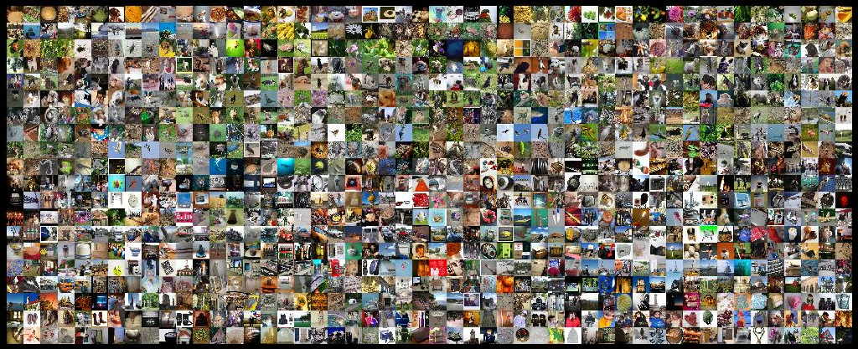
Data Partitioning
Using Canny Edge Detection (CED) as an example
Input images
CPU
Gaussian Filter
Sobel Filter
Non-maximum Suppression
Hysteresis Thresholding
CPU Implementation
Output images
Notes:
All images are processed by CPU

Slide 11
Data Partitioning
Using Canny Edge Detection (CED) as an example
Input images
CPU
FPGA
Gaussian Filter
Sobel Filter
Non-maximum Suppression
Hysteresis Thresholding
FPGA Acceleration
Output images
Notes:
CPU offloads all the computation tasks to FPGA. All images are processed by FPGA. CPU is idle.

Slide 12


Data Partitioning
Using Canny Edge Detection (CED) as an example
Input images
$$α$$
$$1−α$$
CPU
FPGA
Gaussian Filter
Gaussian Filter
Sobel Filter
Sobel Filter
Non-maximum Suppression
Non-maximum Suppression
Hysteresis Thresholding
Hysteresis Thresholding
CPU-FPGA Collaboration
Output images (CPU part)
Output images (FPGA part)
Notes:
CPU and FPGA collaboratively work on separate sets of input dataset.

Slide 13
Data Partitioning vs. Task Partitioning
Using Canny Edge Detection (CED) as an example
Input images
Input images
$$α$$
$$1−α$$
CPU
FPGA
FPGA
Gaussian Filter
Gaussian Filter
Gaussian Filter
Sobel Filter
Sobel Filter
Sobel Filter
Non-maximum Suppression
Non-maximum Suppression
CPU
Non-maximum Suppression
Hysteresis Thresholding
Hysteresis Thresholding
Hysteresis Thresholding
Output images (CPU part)
Output images (FPGA part)
Output images
Notes:
In task partitioning, both FPGA and CPU process the whole set of input data. FPGA and CPU executes different functionalities in the application.

Slide 14
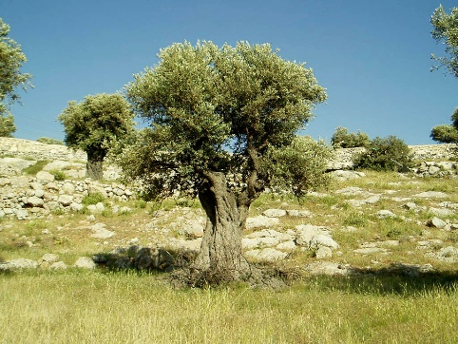
Another Data Partitioning Example: Image Histogram
CPU
FPGA
CPU
FPGA
Input pixels distributed across devices
Output bins distributed across devices
Notes:
Here is another data partitioning example. Data partitioning for image histogram can be done in two different ways: input pixels partitioning and output bins partitioning.

Slide 15
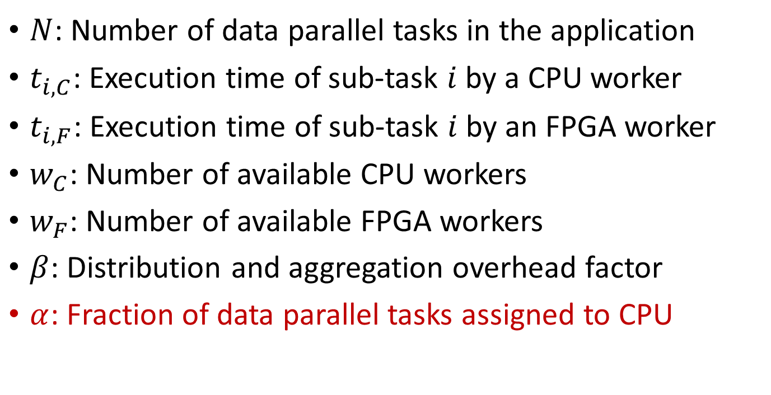
Analytical Models
$N$: Number of data parallel tasks in the application
$t_{i, C}$: Execution time of sub-task $i$ by a CPU worker
$t_{i, F}$: Execution time of sub-task $i$ by an FPGA worker
$w_{C}$: Number of available CPU workers
$w_{F}$: Number of available FPGA workers
$β$: Distribution and aggregation overhead factor
$α$: Fraction of data parallel tasks assigned to CPU
Notes:
We build analytical models to better understand the performance of different collaboration schemes.

Slide 16
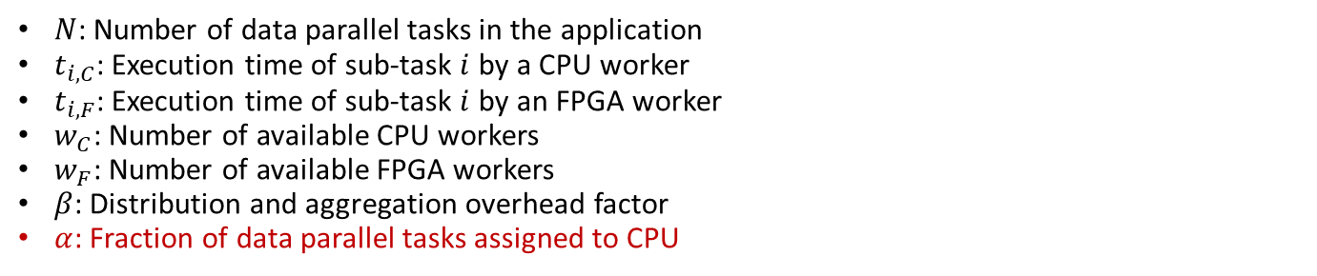

Analytical Models
Data partitioning
CPU
FPGA
$N$: Number of data parallel tasks in the application
$t_{i, C}$: Execution time of sub-task $i$ by a CPU worker
$t_{i, F}$: Execution time of sub-task $i$ by an FPGA worker
$w_{C}$: Number of available CPU workers
$w_{F}$: Number of available FPGA workers
$β$: Distribution and aggregation overhead factor
$α$: Fraction of data parallel tasks assigned to CPU
…
…
Data partitioning
The total execution time is
$$t_{\text{data}\text{, }\text{total}}=β_{\text{data}}∙max⁡\left(\frac{αN\sum_{i}{t_{i,C}}}{w_{C}},\frac{\left(1−α\right)N\sum_{i}{t_{i,F}}}{w_{F}}\right)$$
Total CPU execution time (sequential execution)
Total FPGA execution time (sequential execution)
Notes:
First of all, let’s take a look at data partitioning. The execution time is bounded by the slower device.

Slide 17
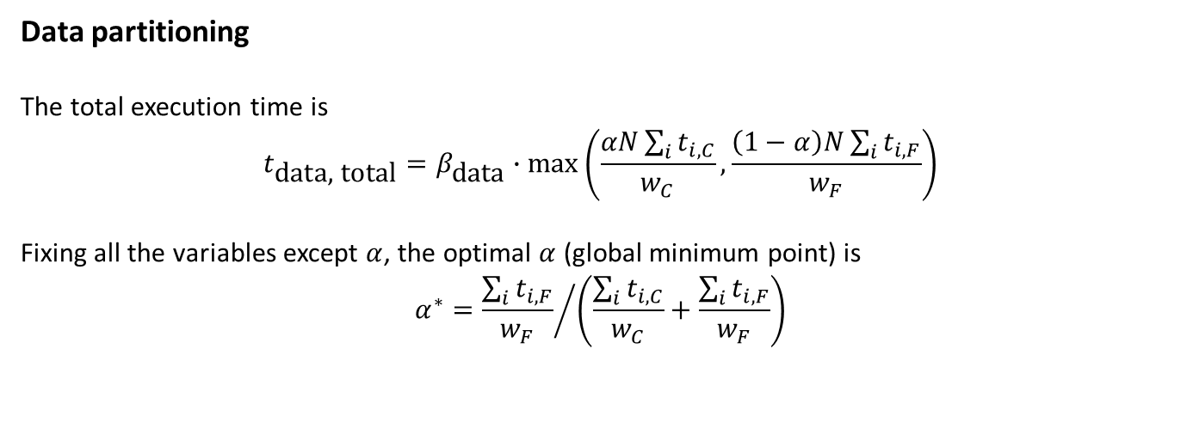
Analytical Models
Data partitioning
CPU
FPGA
$N$: Number of data parallel tasks in the application
$t_{i, C}$: Execution time of sub-task $i$ by a CPU worker
$t_{i, F}$: Execution time of sub-task $i$ by an FPGA worker
$w_{C}$: Number of available CPU workers
$w_{F}$: Number of available FPGA workers
$β$: Distribution and aggregation overhead factor
$α$: Fraction of data parallel tasks assigned to CPU
…
…
Data partitioning
The total execution time is
$$t_{\text{data}\text{, }\text{total}}=β_{\text{data}}∙max⁡\left(\frac{αN\sum_{i}{t_{i,C}}}{w_{C}},\frac{\left(1−α\right)N\sum_{i}{t_{i,F}}}{w_{F}}\right)$$
Fixing all the variables except $α$, the optimal $α$ (global minimum point) is
$$α^{∗}={\frac{\sum_{i}{t_{i,F}}}{w_{F}}}/{\left(\frac{\sum_{i}{t_{i,C}}}{w_{C}}+\frac{\sum_{i}{t_{i,F}}}{w_{F}}\right)}$$
Workloads of CPU and FPGA workers are balanced
Notes:
The optimal $α$ is obtained when the workloads of CPU and FPGA workers are balanced

Slide 18
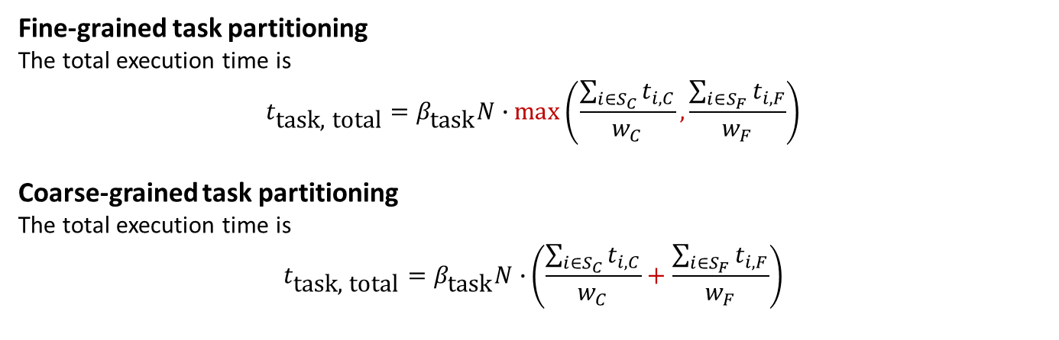
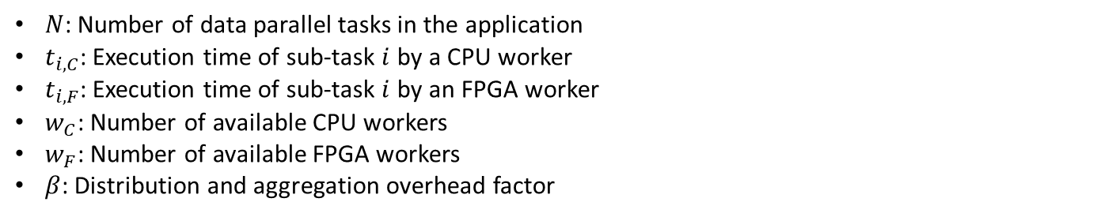
Analytical Models
Fine-grained
task partitioning
Coarse-grained
task partitioning
CPU
FPGA
CPU
FPGA
$N$: Number of data parallel tasks in the application
$t_{i, C}$: Execution time of sub-task $i$ by a CPU worker
$t_{i, F}$: Execution time of sub-task $i$ by an FPGA worker
$w_{C}$: Number of available CPU workers
$w_{F}$: Number of available FPGA workers
$β$: Distribution and aggregation overhead factor
…
…
…
…
Fine-grained task partitioning
The total execution time is
$$t_{\text{task}\text{, }\text{total}}=β_{\text{task}}N∙max⁡\left(\frac{\sum_{i∈S_{C}}{t_{i,C}}}{w_{C}},\frac{\sum_{i∈S_{F}}{t_{i,F}}}{w_{F}}\right)$$
Coarse-grained task partitioning
The total execution time is
$$t_{\text{task}\text{, }\text{total}}=β_{\text{task}}N∙⁡\left(\frac{\sum_{i∈S_{C}}{t_{i,C}}}{w_{C}}+\frac{\sum_{i∈S_{F}}{t_{i,F}}}{w_{F}}\right)$$
…
(Assume sub-tasks are very fine-grained)
Notes:
For fine-grained task partitioning, we assume sub-tasks are very fine-grained, and this way CPU and FPGA can collaborate closely, and the execution on two devices are perfectly overlapped. Therefore the execution time is bounded by the slower device.
For coarse-grained task partitioning, the execution time for multiple tasks are the sum of execution time of each task.

Slide 19


Chai Benchmark Suite
Chai: Collaborative Heterogeneous Applications for Integrated-architectures
Chai benchmark suite:
chai-benchmarks.github.io
14 benchmarks covers data partitioning, fine-grain task partitioning, and coarse-grain task partitioning patterns
OpenCL, C++ AMP, and CUDA versions
Unified memory and system-wide atomic versions and traditional discrete architecture versions

Slide 20
Evaluated Chai Benchmarks
Benchmark | Description | Strategy
CED-D | Canny Edge Detection | Data Partitioning
CED-T | Canny Edge Detection | Task Partitioning
RSC-D | Random Sample Consensus | Data Partitioning
RSC-T | Random Sample Consensus | Task Partitioning
BS | Bézier Surface | Data Partitioning
HSTO | Image Histogram | Data Partitioning
SSSP | Single-Source Shortest Path | Task Partitioning
TQ | Task Queue System (Synthetic) | Task Partitioning
TQH | Task Queue System (Histogram) | Task Partitioning
OpenCL-D (OpenCL discrete architecture) versions of these benchmarks are used.

Slide 21
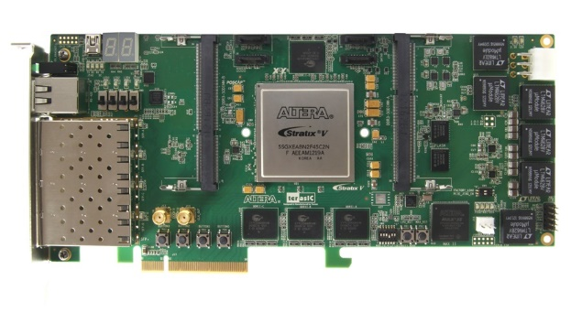
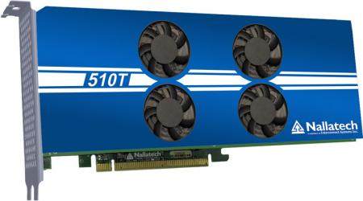
Evaluation Platforms
 | Platform A | Platform B
FPGA Board | Terasic DE5-Net | Nallatech 510T
FPGA Chip | Intel Stratix V GX | Intel Arria 10 GX
On-Board Memory | 4 GB (DDR3) | 8 GB (DDR4)
Host CPU | Intel Xeon E3-1240 v3 | Intel Xeon E5-2650 v3
Host Memory | 8 GB (DDR3) | 96 GB (DDR4)
Interface | PCIe gen3.0 x8 | PCIe gen3.0 x8
Notes:
We evaluated CPU-FPGA collaborative computing schemes on two systems with PCIe-based FPGAs. One system has one Intel Stratix 5 FPGA, the other has one Intel Arria 10 FPGA. Both FPGAs are high-end FPGAs. Arria 10 FPGA is larger and has much more DSPs than Stratix V FPGA (1518 DSPs vs. 256 DSPs, ~6 times difference). Besides, Arria 10 FPGA has harden floating-point DSPs which make floating-point operations faster.

Slide 22
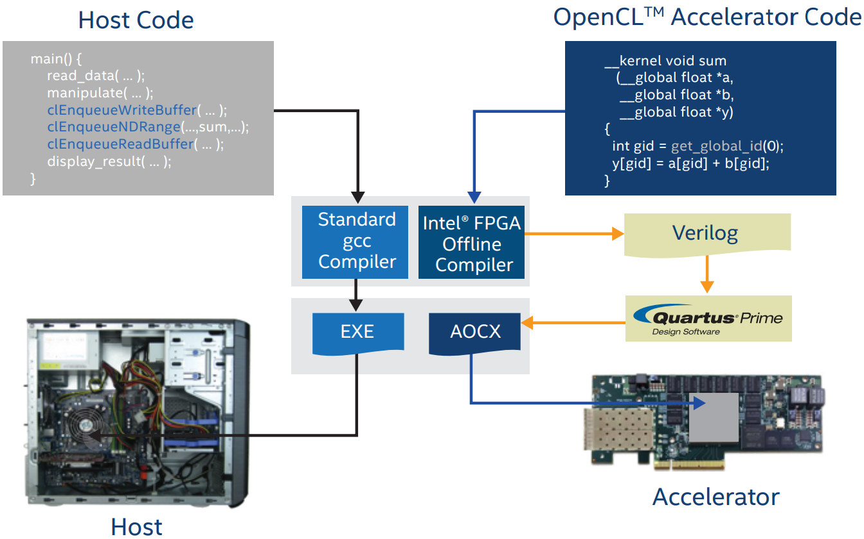
Intel OpenCL SDK for FPGA
Intel OpenCL SDK for FPGA is used to compile and synthesize host executable and FPGA design
Notes:
We use Intel OpenCL SDK for FPGA is used to compile and synthesize host executable and FPGA design.
The OpenCL host code is compiled with standard gcc compiler,
The OpenCL kernel code is synthesized to FPGA design.
After FPGA is programed, the FPGA can be invoked as OpenCL device from CPU side.

Slide 23
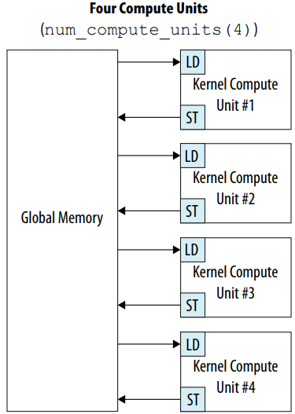
Compute Unit Replication
OpenCL kernels are synthesized to compute units on FPGA
The compute units on FPGA can be replicated by adding num_compute_units attribute in the OpenCL kernel code
num_compute_units attribute modifies the number of compute units to which work-groups can be scheduled, which also modifies the number of times a kernel accesses global memory
We evaluate the impact of compute unit replication
Intel® FPGA SDK for OpenCL™ Best Practices Guide

Slide 24

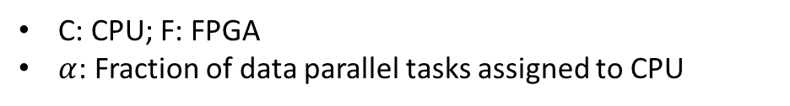
Evaluation: Canny Edge Detection (Data Partitioning)
optimal
$$α$$
Dynamic data partitioning: assigning batch of data parallel tasks to idle devices, achieving dynamic workload balance
C: CPU; F: FPGA
$α$: Fraction of data parallel tasks assigned to CPU
Notes:
We measure the overall execution time for different data partitioning fractions ($α$). The best $α$ among 0.0 ~ 1.0 is roughly 0.4. We also use dynamic data partitioning: assigning batch of data parallel tasks to idle devices, achieving dynamic workload balance. This works best since the workloads are perfectly balanced between CPU and FPGA.

Slide 25
Evaluation: Canny Edge Detection (Data Partitioning and Task Partitioning)
Notes:
Here we compare all the different collaborative schemes for Canny Edge Detection.

Slide 26
Evaluation: Random Sample Consensus (Data Partitioning and Task Partitioning)
Notes:
Reason for Stratix V performs better than Arria 10: The board support package for the Arria 10 FPGA board is not mature enough.

Slide 27
Bézier Surface (BS, Data Partitioning)
Notes:
Best $α$ is roughly 0.6.

Slide 28
Histogram (HSTO, Output Data Partitioning)
Notes:
In the histogram example, the performance on CPU and FPGA are roughly the same. The performance is not sensitive to $α$ in this case.

Slide 29
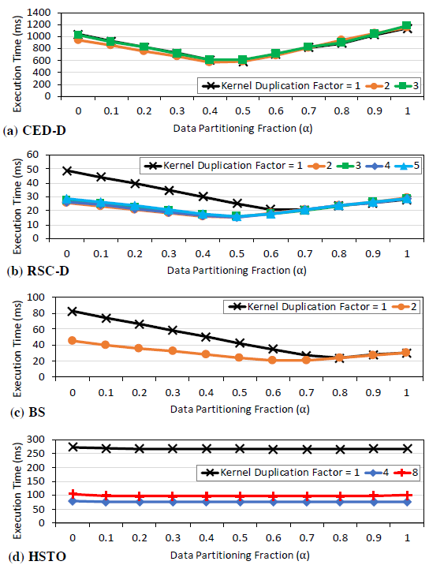
Kernel Replication – Data Partitioning
We evaluated the performance under different kernel replication factors.
Notes:
CED-D: not sensitive to kernel replication.
RSC-D and HSTO: after some point, further kernel replication won’t help.

Slide 30
Kernel Replication – Task Partitioning
We evaluated the performance under different kernel replication factors.
SSSP
TQ
TQH
Notes:
SSSP contains much more atomic operations than TQ and TQH. The overhead of atomic operation in OpenCL SDK for FPGA is high.

Slide 31
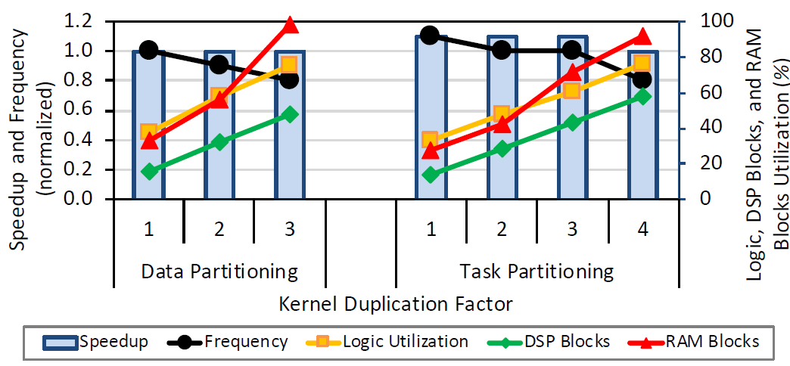
Impact of Replication
Canny Edge Detection
Kernel Replication Factor
Replication factor for this application has little impact on performance
Further profiling reveals the reason of performance saturation is the saturation of the memory bandwidth
Task partitioning can afford a larger replication factor
Notes:
The FPGA resources are not the bottleneck in this example. The reason of performance saturation is the saturation of the memory bandwidth.

Slide 32
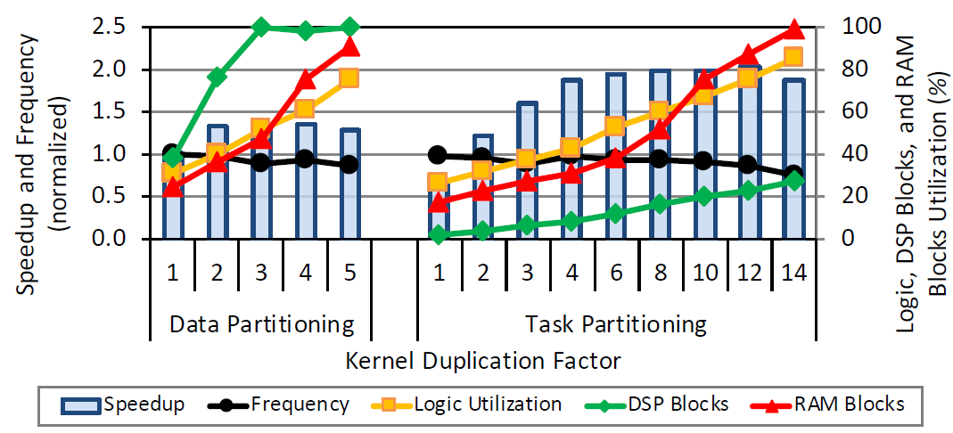
Impact of Replication
Random Sample Consensus
Kernel Replication Factor
Replication improves performance of this application
Bounding resource: DSP blocks
Task partitioning releases the pressure on DSP block and thus can afford a larger replication factor
Notes:
the first stage of RSC-D performs a large amount of floating-point computations. In data partitioning, DSP blocks are the bounding resources.
In task-partitioning, we offload the first stage of RSC to CPU, then FPGA resource utilization drops significantly (compared to data partitioning). This enables further replication and better performance.

Slide 33
Key Insights
Collaborative execution is beneficial
Data partitioning requires careful choice of partitions to provide the highest performance
Task partitioning generally enables more kernel replication on the FPGA than data partitioning
Data partitioning inflicts less burden on programmers and has less communication overhead than task partitioning
OpenCL stack provides a convenient programming model while there is still room for better programmability and higher performance
Notes:
Based on the performance evaluations we have conducted, we summarize five insights for developers of CPU-FPGA systems.
(1) Collaborative execution is beneficial
(2) Data partitioning requires careful choice of partitions to provide the highest performance
(3) Task partitioning generally enables more kernel replication on the FPGA than data partitioning
(4) Data partitioning inflicts less burden on programmers and has less communication overhead than task partitioning
(5) OpenCL stack provides a convenient programming model while there is still room for better programmability and higher performance

Slide 34

Chai Project
Papers:
Analysis and Modeling of Collaborative Execution Strategies for Heterogeneous CPU-FPGA Architectures. ICPE’19. (this work)
Collaborative Computing for Heterogeneous Integrated Systems. ICPE’17 Vision Track.
Chai: Collaborative Heterogeneous Applications for Integrated-architectures. ISPASS’17.
Chai Benchmark Suite:
Website: chai-benchmarks.github.io
Code: github.com/chai-benchmarks/chai
Online Forum: groups.google.com/d/forum/chai-dev
Notes:
All the synthesizable OpenCL code have been released in Chai benchmark suite.

Slide 35

Analysis and Modeling of Collaborative Execution Strategies for Heterogeneous CPU-FPGA Architectures
Sitao Huang¹, Li-Wen Chang², Izzat El Hajj³, Simon Garcia De Gonzalo¹, Juan Gómez-Luna⁴,
Sai Rahul Chalamalasetti⁵, Mohamed El Hadedy⁶, Dejan Milojicic⁵, Onur Mutlu⁴,
Deming Chen¹, Wen-mei Hwu¹
¹University of Illinois at Urbana-Champaign, USA
²Microsoft, USA
³American University of Beirut, Lebanon
⁴ETH Zürich, Switzerland
⁵Hewlett Packard Labs, USA
⁶California State Polytechnic University, Pomona, USA
Thanks!

