Slide 1

PUMA: A Programmable Ultra-efficient Memristor-based Accelerator for Machine Learning Inference
Aayush Ankit^{1,3}, Izzat El Hajj^{2,4}, Sai Rahul Chalamalasetti³, Geoffrey Ndu³, Martin Foltin³, R. Stanley Williams³, Paolo Faraboschi³, Wen-mei Hwu⁴, John Paul Strachan³, Kaushik Roy¹, Dejan S Milojicic³
Purdue University¹
American University of Beirut²
Hewlett Packard Enterprise³
University of Illinois at Urbana-Champaign⁴

Slide 2
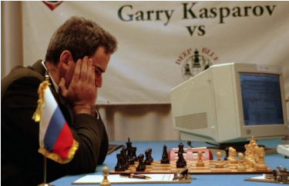
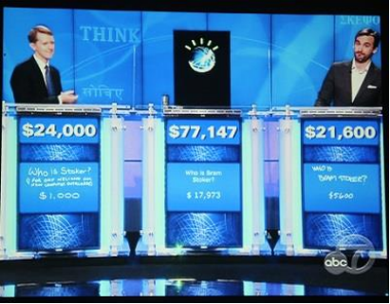
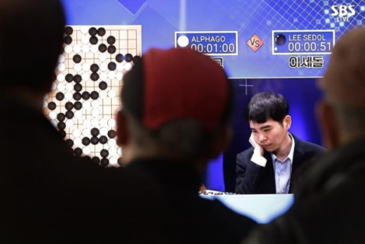
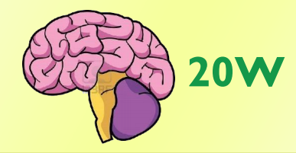
Motivation: Human vs. Machine Chronicles
1997
2011
2016
IBM Deep Blue vs. Kasparov
IBM RS/6000 32-node server
~15000W
IBM Watson vs. Ritter & Jennings
90 Power 750 Express servers ~200000W
Google AlphaGo vs. Sedol
(1920 CPUs, 280 GPUs)
~300000W
Algorithm performance moving closer
Hardware cost moving farther
“Aspirations have grown faster than the technology available to satisfy them”.

Slide 3
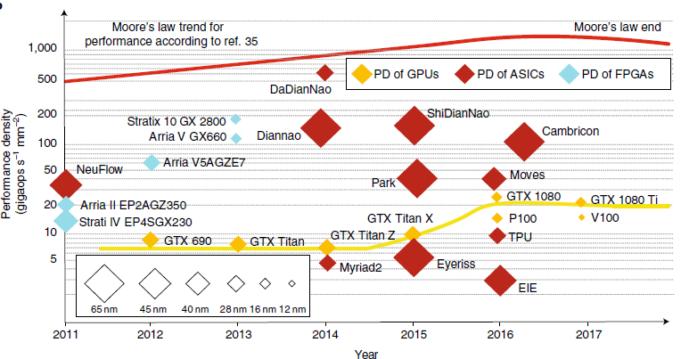
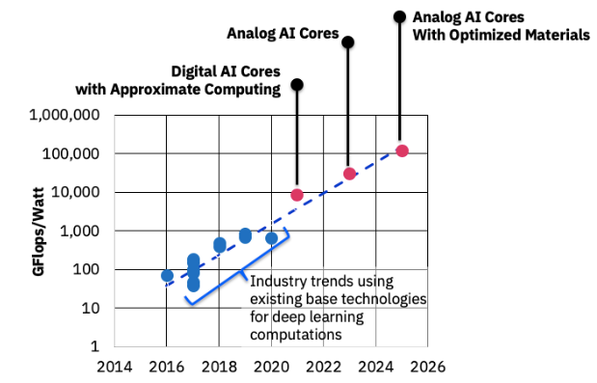
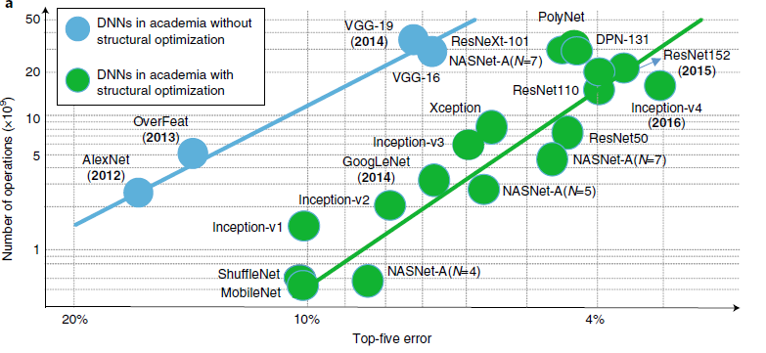



Motivation: Need to Look Beyond CMOS Digital Accelerators
Analog PIM
Ref: IBM AI Hardware Research (https://www.ibm.com/blogs/research)
Industrial presence
ML models are growing faster than CMOS hardware.

Slide 4
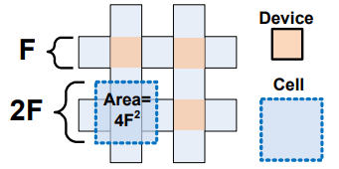
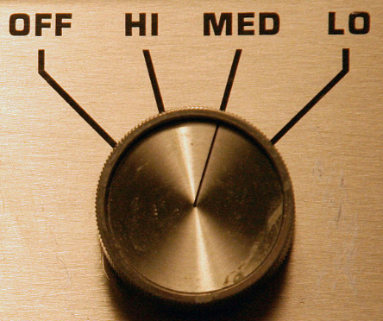
Background: Memristive Crossbars
States
Memristor = Memory + Resistor
Memory aspects:
High Density + On-Die Storage
Compact cell structure
Tunable Resistance
Array Density: 160MB/mm²
Mitigates off-chip data access
Cell area is 4F² vs 120F² for CMOS (SRAM).
2-6 bits per cell vs 1-bit for CMOS (SRAM).
>100×
30×
6×

Slide 5
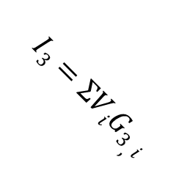

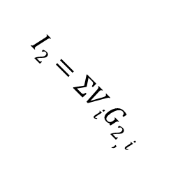
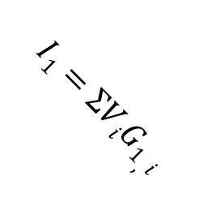
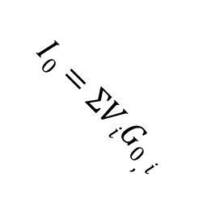
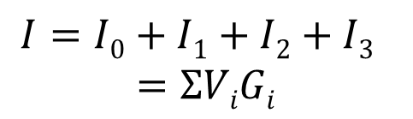
Background: Memristive Crossbars
V₀
V₀
G_{0,0}
G_{1,0}
G_{2,0}
G_{3,0}
V
G₀
V₁
V₁
G
G_{0,1}
G_{1,1}
G_{2,1}
G_{3,1}
G₁
V₂
V₂
$$I=V∗G$$
G_{0,2}
G_{1,2}
G_{2,2}
G_{3,2}
G₂
Compute Aspects:
Analog Multiplication
V₃
V₃
G_{0,3}
G_{1,3}
G_{2,3}
G_{3,3}
G₃
$$I=I0+I1+I2+I3$$
$$=ΣViGi$$
Analog MVM: 1.34pJ/op*
Efficient compute
$$I0=ΣViG0,i$$
$$I2=ΣViG2,i$$
$$I1=ΣViG1,i$$
$$I3=ΣViG3,i$$
>4×
Analog Dot Product
Analog Matrix Vector Multiplication (MVM)
*32nm technology

Slide 6
Background: Past Memristive Based Accelerators
DAC
Past accelerators: RENO [DAC’15], ISAAC and PRIME [ISCA’16] achieve significant benefits over CMOS accelerators for limited applications (1 or 2).
Memristive crossbars are not drop-in replacement of traditional memory structures (Cache, Register File).
General purpose ML architecture ? ☹
Programmability ? ☹
PUMA is the first general-purpose and programmable accelerator with memristive crossbars.
DAC
DAC
DAC
MVM Unit (MVMU):
Add peripherals to interface crossbar with digital domain.
INT
INT
INT
INT
Multiplexer
ADC
Shift-&-Add

Slide 7
PUMA Architecture: Spatial scalability
Expensive writes
writes consume orders of magnitude more energy/latency than CMOS (SRAM)
Limited endurance
typically 10^9 writes, CMOS has infinite endurance
Costly writes to memristive crossbars are alleviated in spatial architecture
Model doesn’t change during inference (trained once, millions of inference)
High storage density enables spatial architecture
State-of-the-art apps can be mapped in ~GPU die area, if the high storage density can be retained at system-level

Slide 8
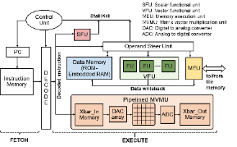
PUMA Architecture: Spatial scalability
Shared Memory
Tile Control Unit
Instruction Memory
Data
Attribute Buffer
PUMA Tile
(Multi-core with Shared Memory)
FIFO
Write mux
Read mux
Memory Controller
to/from Router
FIFO
Receive Buffer
CORE 0
CORE 1
CORE 2
CORE 4
CORE N

Slide 9
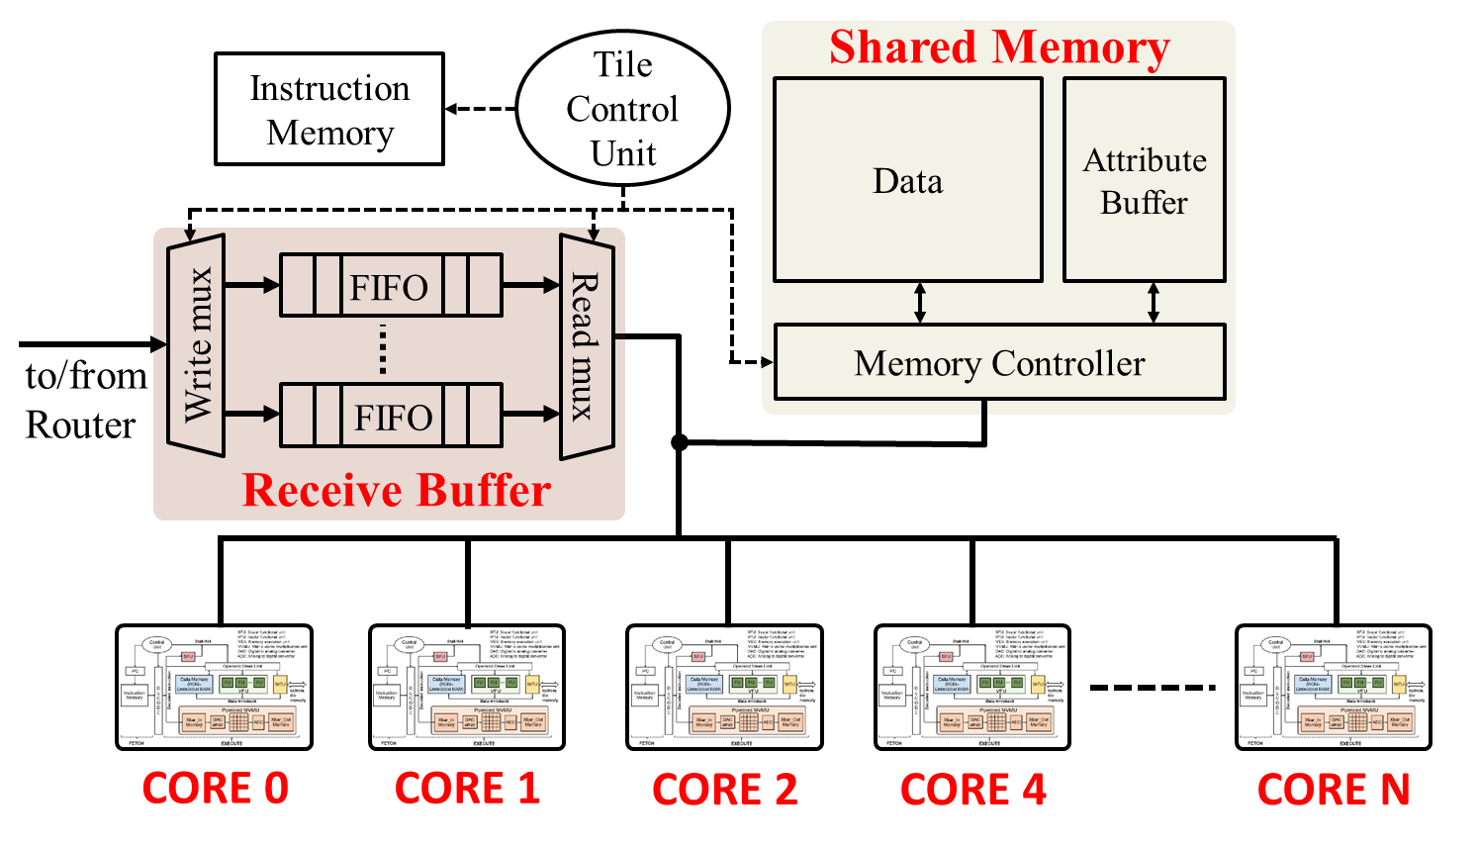
PUMA Architecture: Spatial scalability
Network on Chip
Massively parallel accelerator –> Amenable to Data-Level Parallelism -> Highly efficient ML inference

Slide 10
Key challenges
Enable general-purpose and programmable architecture while preserving the crossbar storage density
Memristive technology has orders of magnitude higher area-efficiency than CMOS technology, for both storage and compute
Storage density drops from 160MB/mm² at array-level to 2.6MB/mm² at MVMU-level (ISAAC, ISCA’16) !!!
Optimize data movements
Weights remain stationary, but partial sums and activations lead to data movements
Spatiality incurs high cost for data movement between cores
Proposal: Architecture-ISA-Compiler codesign.

Slide 11
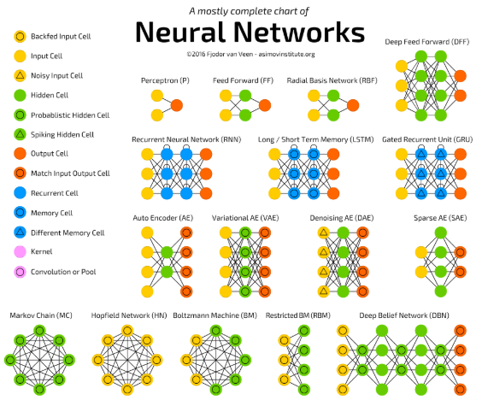
Contribution 1: Domain-specific ISA
Large variety of ML workloads
Support Vector Machines
Neural Networks (>27)
…
State machine approach to represent a functional block, leads to high decoding overheads when scope of workloads is large
So many workloads, share many low-level operations
ISA for ML for memristive architecture
Fine grain instructions compose to make an ML workload
Low area-overhead decoder and programmability
http://www.asimovinstitute.org/neural-network-zoo/
*Figure shows partial list

Slide 12
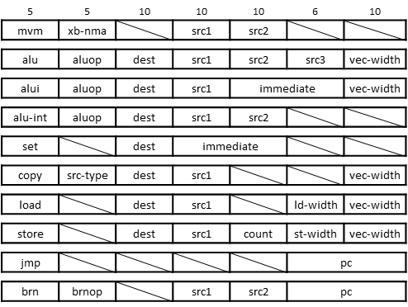
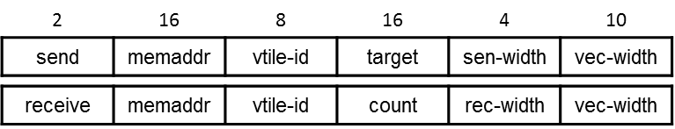
Contribution 1: Domain-specific ISA
Compute
Data Move (Intra-Tile): over shared bus, shared memory
Control: loops in workloads with MVMU reuse (weight reuse)
Data Move (Inter-Tile): over network on chip.
Compute
Data Move
(Intra-Tile)
Wide instructions
Large register address space to support memristive crossbars (very-wide SIMD)
vector width keeps instruction memory low in spatial architecture
Control
Data Move
(Inter-Tile)

Slide 13
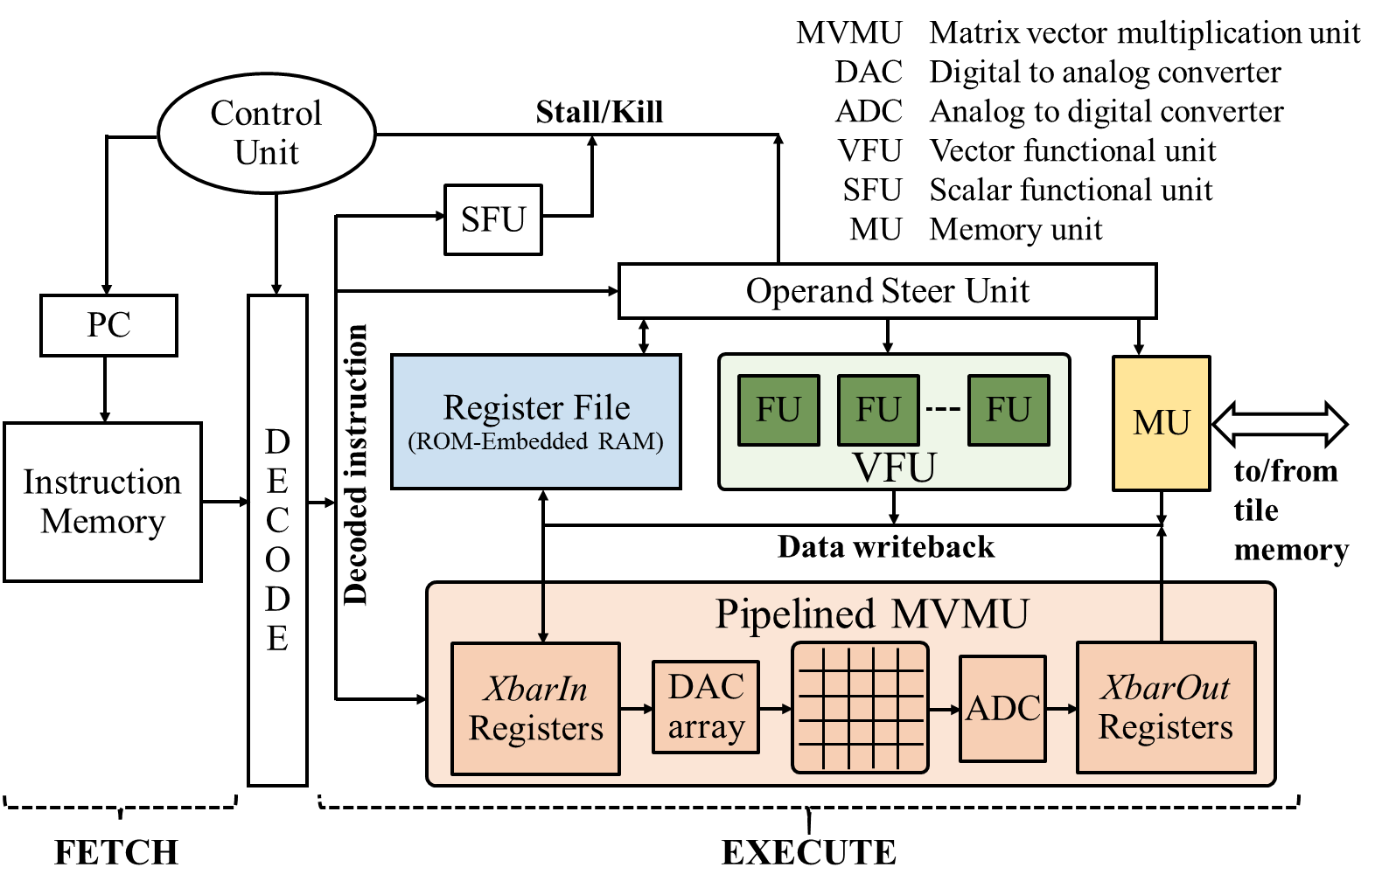


Contribution 1: Domain-specific ISA
1 Layer MLP
MLP maps on one MVMU
x
LD $m_{i}1, x, n
MVM 0b01
ALU_SIG $1, $m_{o}1, n
ST $1, a
$$z=Mx$$
z
$$a=Sig(z)$$
a
MLP maps on multiple MVMUs/Cores
MVM 0b01
// for all partial sums
LD xxx // bring partial sums from other cores
ALU_ADD xxx // accumulate partial sums
ALU_SIG $1, $m_{o}1, n
PUMA Core
Larger matrices require more data movements to compute effective MVM.

Slide 14

Contribution 2: Hybrid Core
1 Layer LSTM
x
h^{t}
$$z=M[x, ht]$$
z
3 Vector Multiply
1 Vector Add
2 Tanh
1 Sigmoid
c^{t}
h^{t+1}
MVMU alone cannot execute ML apps.
Vector operations: require previous writes to crossbar
Transcendental operations: MVMU (even with writes) can do add/multiply only.
Propose core designed with hybrid memristive and CMOS technologies.
Hybrid analog-digital core: general-purpose
Co-locating execution units reduces data movements (near-memory)

Slide 15
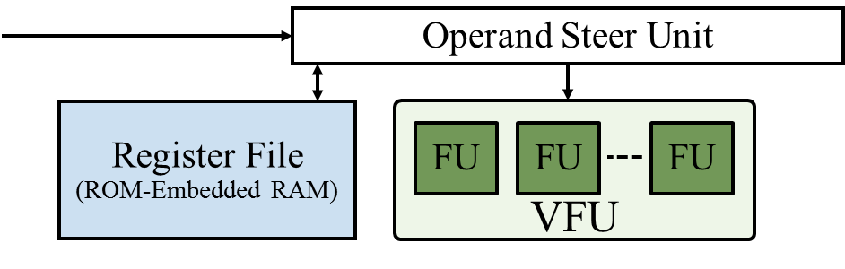
Contribution 2: Hybrid Core
(déjà vu) Preserving storage density - Memristive and CMOS technology have orders of magnitude disparity in area-efficiency.
Decoded
instruction
ALU_ADD $d1, $s1, $s2, n
A[0] = B[0] + C[0]
A[1] = B[1] + C[1]
Temporal SIMD
Low width VFU saves area
Wide vector instruction have low fetch/decode/instruction storage overhead
VFU needs to be fast enough to not be a bottleneck for MVMU
ML workloads: all other operations (vector, transcendental) are preceded by MVM

Slide 16
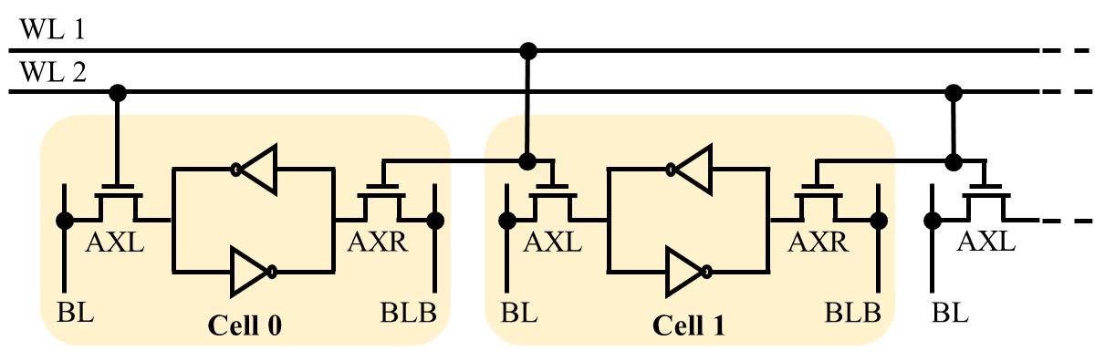
Contribution 2: Hybrid Core
Register file buffers operands and becomes an on-demand transcendental function unit (sig, tanh, etc.)
Multiple cycles (2-3), needs to be fast enough for MVMU.
Add an extra worldline to every row (~1% array area overhead, sense-amps unchanged)
RAM: Activate both wordlines - WL1 and WL2
ROM: storage depends on AXL’s connection to wordline WL1
Write 0s (both wordline active)
Selectively write 1s (WL1 active)
Read data (typical RAM read)
Restore RAM data (ROM read is destructive)

Slide 17
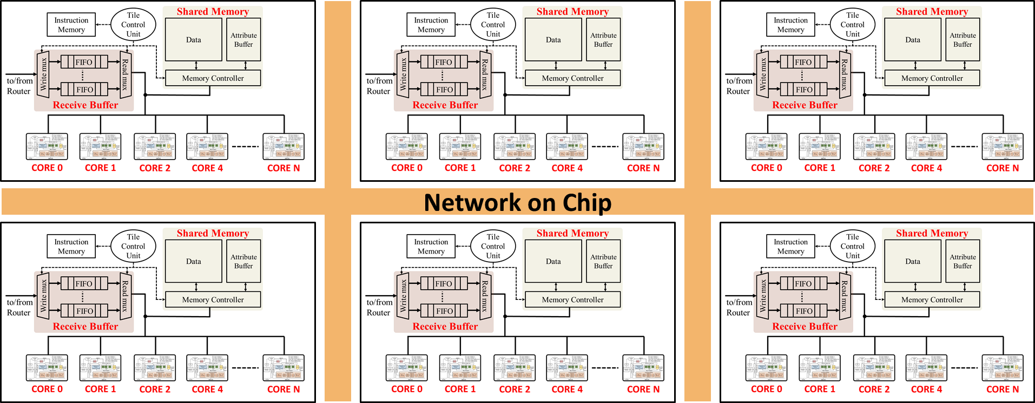
Contribution 3: Compiler optimizations
Programmability: traditional programming models not suitable for spatial architecture.
Writing different code for each core/tile is not scalable as applications grow.
Optimizations:
Graph partitioning: optimizing for data movements
MVM Coalescing: extract available ILP
Compiler

Slide 18
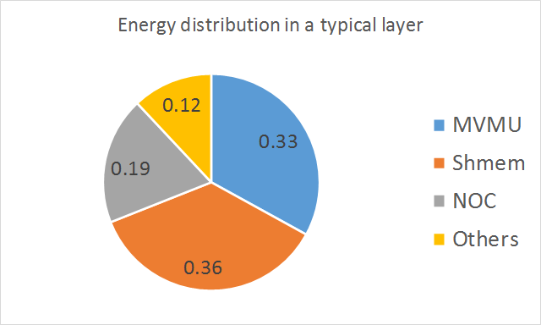
Contribution 3: Compiler optimizations
Data movement is analogous to memory hierarchy in traditional systems, highest contributor in energy profile.
First level of graph partitioning, optimizing for locality and inter-core communication (LD/ST).
Second level of graph partitioning, optimizing for locality and inter-tile communication (Send/Receive).
LD/ST
MVM
MVM
CORE 0
CORE 1
Tile 0
Send/Receive
LD/ST
MVM
MVM
CORE N
CORE N+1
Tile N

Slide 19
Contribution 3: Compiler optimizations
MVM instructions consume high latency
MVM Coalescing
Schedule the required LDs, coalesce the MVMs
Area-efficiency, alternatively score-boarding is too expensive.
Instruction | Cycles
LD/ST | >24
ALU | 128 - 384
MVM | 2304
Send/Receive | variable
LD $m_{i}1, x, n
MVM 0b01
ALU_SIG $1, $m_{o}1, n
ST $1, a
LD $m_{i}2, x, n
MVM 0b10
ALU_SIG $2, $m_{o}2, n
ST $2, a
LD $m_{i}1, x, n
LD $m_{i}2, x, n
MVM 0b11
ALU_SIG $1, $m_{o}1, n
ST $1, a
MVM 0b10
ALU_SIG $2, $m_{o}2, n
ST $2, a

Slide 20
Results: Inference Energy (Batch size = 1)
CNNs show upto 13.0× reduction (least).
High weight reuse, even at batch-size 1.
MLPs show upto 80.1× reduction.
No weight reuse, small models.
LSTMs show upto 2446× reduction.
Little Weight reuse, large models (billions of parameters).
PUMA achieves massive reduction in inference energy across all platforms for all benchmarks.

Slide 21
ASIC Comparison
Google TPU comparison
Cost of generality, programmability
20.7% lower power efficiency and 29.2% lower area efficiency than ISAAC.
Modest cost increase over past memristive accelerators, significantly improves applicability of memristive crossbars.

Slide 22
Conclusion
First general-purpose and ISA-programmable accelerator built with hybrid CMOS-Memristive technology.
Architecture-ISA-Compiler Codesign
Many other optimizations (input shuffling, spatial pipelining, inter-core synchronization, register allocation etc.) and detailed results in paper.
Goals
Constraints
General-purpose
Programmability
Domain Specific ISA
Domain Specific ISA
Storage Density
Hybrid Core
Compiler Optimizations
Data Movement
Hybrid Core
Compiler Optimizations

Slide 23







Toolchain for Memristive Accelerators
Integrated with Open Neural Network Exchange to execute models from various DNN frameworks
github.com/illinois-impact/puma-compiler
PUMA Compiler
PUMA ISA
Questions?
PUMA Simulator
github.com/Aayush-Ankit/puma-simulator

