Slide 1
2023 International Conference on Parallel Architectures and Compilation Techniques
SimplePIM:
A Software Framework for Productive and Efficient Processing-in-Memory
Jinfan Chen, Juan Gómez Luna, Izzat El Hajj, Yuxin Guo, Onur Mutlu
https://arxiv.org/pdf/2310.01893.pdf
https://github.com/CMU-SAFARI/SimplePIM
juang@ethz.ch
Monday, October 23, 2023

Slide 2
Executive Summary
Processing-in-Memory (PIM) promises to alleviate the data movement bottleneck
Real PIM hardware is now available, e.g., UPMEM PIM
However, programming real PIM hardware is challenging, e.g.:
Distribute data across PIM memory banks,
Manage data transfers between host cores and PIM cores, and between PIM cores,
Launch PIM kernels on the PIM cores, etc.
SimplePIM is a high-level programming framework for real PIM hardware
Iterators such as map, reduce, and zip
Collective communication with broadcast, scatter, and gather
Implementation on UPMEM and evaluation with six different workloads
Reduction, vector add, histogram, linear/logistic regression, K-means
4.4x fewer lines of code compared to hand-optimized code
Between 15% and 43% faster than hand-optimized code for three workloads
Source code: https://github.com/CMU-SAFARI/SimplePIM

Slide 3
Outline
Processing-in-memory
and PIM programming
SimplePIM:
A high-level programming framework for processing-in-memory
Evaluation

Slide 4
Processing-in-Memory (PIM)
PIM is a computing paradigm that advocates for memory-centric computing systems, where processing elements are placed near or inside the memory arrays
Real-world PIM architectures are becoming a reality
UPMEM PIM, Samsung HBM-PIM, Samsung AxDIMM, SK Hynix AiM, Alibaba HB-PNM
These PIM systems have some common characteristics:
There is a host processor (CPU or GPU) with access to (1) standard main memory, and (2) PIM-enabled memory
PIM-enabled memory contains multiple PIM processing elements (PEs) with high bandwidth and low latency memory access
PIM PEs run only at a few hundred MHz and have a small number of registers and small (or no) cache/scratchpad
PIM PEs may need to communicate via the host processor

Slide 5
A State-of-the-Art PIM System
In our work, we use the UPMEM PIM architecture
General-purpose processing cores called DRAM Processing Units (DPUs)
Up to 24 PIM threads, called tasklets
32-bit integer arithmetic, but multiplication/division are emulated*, as well as floating-point operations
64-MB DRAM bank (MRAM), 64-KB scratchpad (WRAM)
* 8-bit integer multiplication is natively supported

Slide 6
Programming a PIM System (I)
Example: Hand-optimized histogram with UPMEM SDK
... // Initialize global variables and functions for histogram
int main_kernel() {
if (tasklet_id == 0)
mem_reset(); // Reset the heap
... // Initialize variables and the histogram
T *input_buff_A = (T*)mem_alloc(2048); // Allocate buffer in scratchpad memory
for (unsigned int byte_index = base_tasklet; byte_index < input_size; byte_index += stride) {
// Boundary checking
uint32_t l_size_bytes = (byte_index + 2048 >= input_size) ? (input_size - byte_index) : 2048;
// Load scratchpad with a DRAM block
mram_read((const __mram_ptr void*)(mram_base_addr_A + byte_index), input_buff_A, l_size_bytes);
// Histogram calculation
histogram(hist, bins, input_buff_A, l_size_bytes/sizeof(uint32_t));
}
...
barrier_wait(&my_barrier); // Barrier to synchronize PIM threads
... // Merging histograms from different tasklets into one histo_dpu
// Write result from scratchpad to DRAM
if (tasklet_id == 0)
if (bins * sizeof(uint32_t) <= 2048)
mram_write(histo_dpu, (__mram_ptr void*)mram_base_addr_histo, bins * sizeof(uint32_t));
else
for (unsigned int offset = 0; offset < ((bins * sizeof(uint32_t)) >> 11); offset++) {
mram_write(histo_dpu + (offset << 9), (__mram_ptr void*)(mram_base_addr_histo +
(offset << 11)), 2048);
}
return 0;
}

Slide 7
Programming a PIM System (II)
PIM programming is challenging
Manage data movement between host DRAM and PIM DRAM
Parallel, serial, broadcast, and gather/scatter transfers
Manage data movement between PIM DRAM bank and scratchpad
8-byte aligned and maximum of 2,048 bytes
Multithreaded programming model
Inter-thread synchronization
Barriers, handshakes, mutexes, and semaphores
Our Goal
Design a high-level programming framework that abstracts these hardware-specific complexities and provides a clean yet powerful interface for ease of use and high program performance

Slide 8
Outline
Processing-in-memory
and PIM programming
SimplePIM:
A high-level programming framework for processing-in-memory
Evaluation

Slide 9
The SimplePIM Programming Framework
SimplePIM provides standard abstractions to build and deploy applications on PIM systems
Management interface
Metadata for PIM-resident arrays
Communication interface
Abstractions for host-PIM and PIM-PIM communication
Processing interface
Iterators (map, reduce, zip) to implement workloads

Slide 10
Management Interface
Metadata for PIM-resident arrays
array_meta_data_t describes a PIM-resident array
simple_pim_management_t for managing PIM-resident arrays
lookup: Retrieves all relevant information of an array
register: Registers the metadata of an array
free: Removes the metadata of an array
array_meta_data_t* simple_pim_array_lookup(const char* id,
simple_pim_management_t* management);
void simple_pim_array_register(array_meta_data_t* meta_data,
simple_pim_management_t* management);
void simple_pim_array_free(const char* id, simple_pim_management_t* management);

Slide 11
The SimplePIM Programming Framework
SimplePIM provides standard abstractions to build and deploy applications on PIM systems
Management interface
Metadata for PIM-resident arrays
Communication interface
Abstractions for host-PIM and PIM-PIM communication
Processing interface
Iterators (map, reduce, zip) to implement workloads

Slide 12
Host-to-PIM Communication: Broadcast
SimplePIM Broadcast
Transfers a host array to all PIM cores in the system
void simple_pim_array_broadcast(char* const id, void* arr, uint64_t len,
uint32_t type_size, simple_pim_management_t* management);

Slide 13
Host-to-PIM Communication: Scatter/Gather
SimplePIM Scatter
Distributes an array to PIM DRAM banks
SimplePIM Gather
Collects portions of an array from PIM DRAM banks
void simple_pim_array_scatter(char* const id, void* arr, uint64_t len,
uint32_t type_size, simple_pim_management_t* management);
void* simple_pim_array_gather(char* const id, simple_pim_management_t* management);

Slide 14
PIM-PIM Communication: AllReduce
SimplePIM AllReduce
Used for algorithm synchronization
The programmer specifies an accumulative function
void simple_pim_array_allreduce(char* const id, handle_t* handle,
simple_pim_management_t* management);

Slide 15
PIM-PIM Communication: AllGather
SimplePIM AllGather
Combines array pieces and distributes the complete array to all PIM cores
void simple_pim_array_allgather(char* const id, char* new_id,
simple_pim_management_t* management);

Slide 16
The SimplePIM Programming Framework
SimplePIM provides standard abstractions to build and deploy applications on PIM systems
Management interface
Metadata for PIM-resident arrays
Communication interface
Abstractions for host-PIM and PIM-PIM communication
Processing interface
Iterators (map, reduce, zip) to implement workloads

Slide 17
Processing Interface: Map
Array Map
Applies map_func to every element of the data array
void simple_pim_array_map(const char* src_id, const char* dest_id,
uint32_t output_type, handle_t* handle, simple_pim_management_t* management);

Slide 18
Processing Interface: Reduction
Array Reduction
The map_to_val_func function transforms an input element to an output value and an output index
The acc_func function accumulates the output values onto the output array
void simple_pim_array_red(const char* src_id, const char* dest_id,
uint32_t output_type, uint32_t output_len, handle_t* handle,
simple_pim_management_t* management);

Slide 19
Processing Interface: Zip
Array Zip
Takes two input arrays and combines their elements into an output array
void simple_pim_array_zip(const char* src1_id, const char* src2_id,
const char* dest_id, simple_pim_management_t* management);

Slide 20
SimplePIM’s UPMEM Implementation
Communication interface
SimplePIM automatically handles alignment requirements and inserts padding as needed
Processing interface
Array map
Invokes PIM cores and PIM threads, and handles PIM DRAM-scratchpad transfers
Array reduction
Shared accumulator reduction
Thread-private accumulator reduction
Array zip
Lazy approach to minimize data copying

Slide 21
General Code Optimizations
Strength reduction
Loop unrolling
Avoiding boundary checks
Function inlining
Adjustment of data transfer sizes

Slide 22
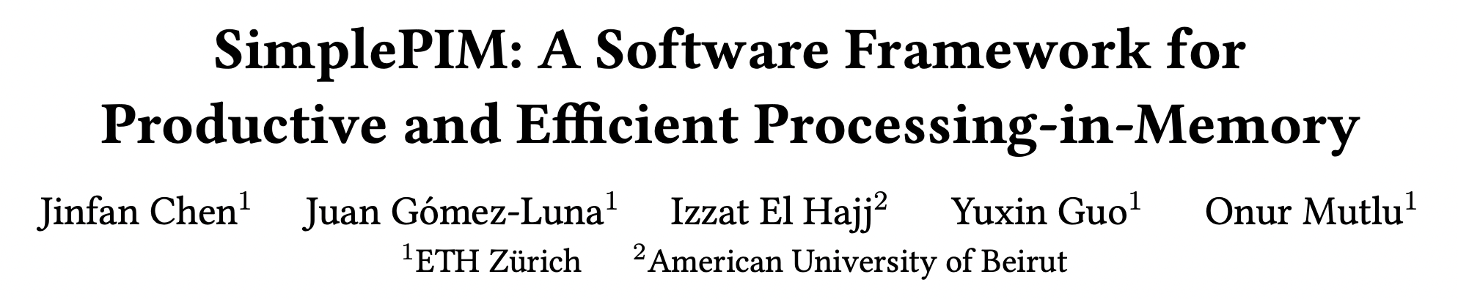
More in the Paper
Strength reduction
Loop unrolling
Avoiding boundary checks
Function inlining
Adjustment of data transfer sizes
https://arxiv.org/pdf/2310.01893.pdf

Slide 23
Outline
Processing-in-memory
and PIM programming
SimplePIM:
A high-level programming framework for processing-in-memory
Evaluation

Slide 24
Evaluation Methodology
Evaluated system
UPMEM PIM system with 2,432 PIM cores with 159 GB of PIM DRAM
Real-world Benchmarks
Vector addition
Reduction
Histogram
K-Means
Linear regression
Logistic regression
Comparison to hand-optimized codes in terms of programming productivity and performance

Slide 25
Productivity Improvement (I)
Example: Hand-optimized histogram with UPMEM SDK
... // Initialize global variables and functions for histogram
int main_kernel() {
if (tasklet_id == 0)
mem_reset(); // Reset the heap
... // Initialize variables and the histogram
T *input_buff_A = (T*)mem_alloc(2048); // Allocate buffer in scratchpad memory
for (unsigned int byte_index = base_tasklet; byte_index < input_size; byte_index += stride) {
// Boundary checking
uint32_t l_size_bytes = (byte_index + 2048 >= input_size) ? (input_size - byte_index) : 2048;
// Load scratchpad with a DRAM block
mram_read((const __mram_ptr void*)(mram_base_addr_A + byte_index), input_buff_A, l_size_bytes);
// Histogram calculation
histogram(hist, bins, input_buff_A, l_size_bytes/sizeof(uint32_t));
}
...
barrier_wait(&my_barrier); // Barrier to synchronize PIM threads
... // Merging histograms from different tasklets into one histo_dpu
// Write result from scratchpad to DRAM
if (tasklet_id == 0)
if (bins * sizeof(uint32_t) <= 2048)
mram_write(histo_dpu, (__mram_ptr void*)mram_base_addr_histo, bins * sizeof(uint32_t));
else
for (unsigned int offset = 0; offset < ((bins * sizeof(uint32_t)) >> 11); offset++) {
mram_write(histo_dpu + (offset << 9), (__mram_ptr void*)(mram_base_addr_histo +
(offset << 11)), 2048);
}
return 0;
}

Slide 26
Productivity Improvement (II)
Example: SimplePIM histogram
// Programmer-defined functions in the file "histo_filepath"
void init_func (uint32_t size, void* ptr) {
char* casted_value_ptr = (char*) ptr;
for (int i = 0; i < size; i++)
casted_value_ptr[i] = 0;
}
void acc_func (void* dest, void* src) {
*(uint32_t*)dest += *(uint32_t*)src;
}
void map_to_val_func (void* input, void* output, uint32_t* key) {
uint32_t d = *((uint32_t*)input);
*(uint32_t*)output = 1;
*key = d * bins >> 12;
}
// Host side handle creation and iterator call
handle_t* handle = simple_pim_create_handle("histo_filepath", REDUCE, NULL, 0);
// Transfer (scatter) data to PIM, register as "t1"
simple_pim_array_scatter("t1", src, bins, sizeof(T), management);
// Run histogram on "t1" and produce "t2"
simple_pim_array_red("t1", "t2", sizeof(T), bins, handle, management);

Slide 27
Productivity Improvement (III)
Lines of code (LoC) reduction
 | SimplePIM | Hand-optimized | LoC Reduction
Reduction | 14 | 83 | 5.93×
Vector Addition | 14 | 82 | 5.86×
Histogram | 21 | 114 | 5.43×
Linear Regression | 48 | 157 | 3.27×
Logistic Regression | 59 | 176 | 2.98×
K-Means | 68 | 206 | 3.03×
SimplePIM reduces the number of lines of effective code
by a factor of 2.98× to 5.93×

Slide 28
Performance Evaluation (I)
Weak scaling analysis
SimplePIM achieves comparable performance for reduction, histogram, and linear regression
SimplePIM outperforms hand-optimized implementations for vector addition, logistic regression,
and k-means by 10%-37%

Slide 29
Performance Evaluation (II)
Strong scaling analysis
SimplePIM scales better than hand-optimized implementations for reduction, histogram, and linear regression
SimplePIM outperforms hand-optimized implementations for vector addition, logistic regression,
and k-means by 15%-43%

Slide 30
Variants of Array Reduction
Shared accumulator version versus thread-private version for histogram
The thread-private version is up to 70% faster than the shared accumulator version for histograms of 256-1024 bins
The number of active PIM threads of the thread-private version reduces after 1024 bins due to limited scratchpad size

Slide 31
Discussion
SimplePIM is devised for PIM architectures with
A host processor with access to standard main memory and PIM-enabled memory
PIM processing elements (PEs) that communicate via the host processor
The number of PIM PEs scales with memory capacity
SimplePIM emulates the communication between PIM cores via the host processor
Other parallel patterns can be incorporated in future work
Prefix sum and filter can be easily added
Stencil and convolution would require fine-grained scatter-gather for halo cells
Random access patterns would be hard to support

Slide 32
SimplePIM: arXiv Version
https://arxiv.org/pdf/2310.01893.pdf

Slide 33
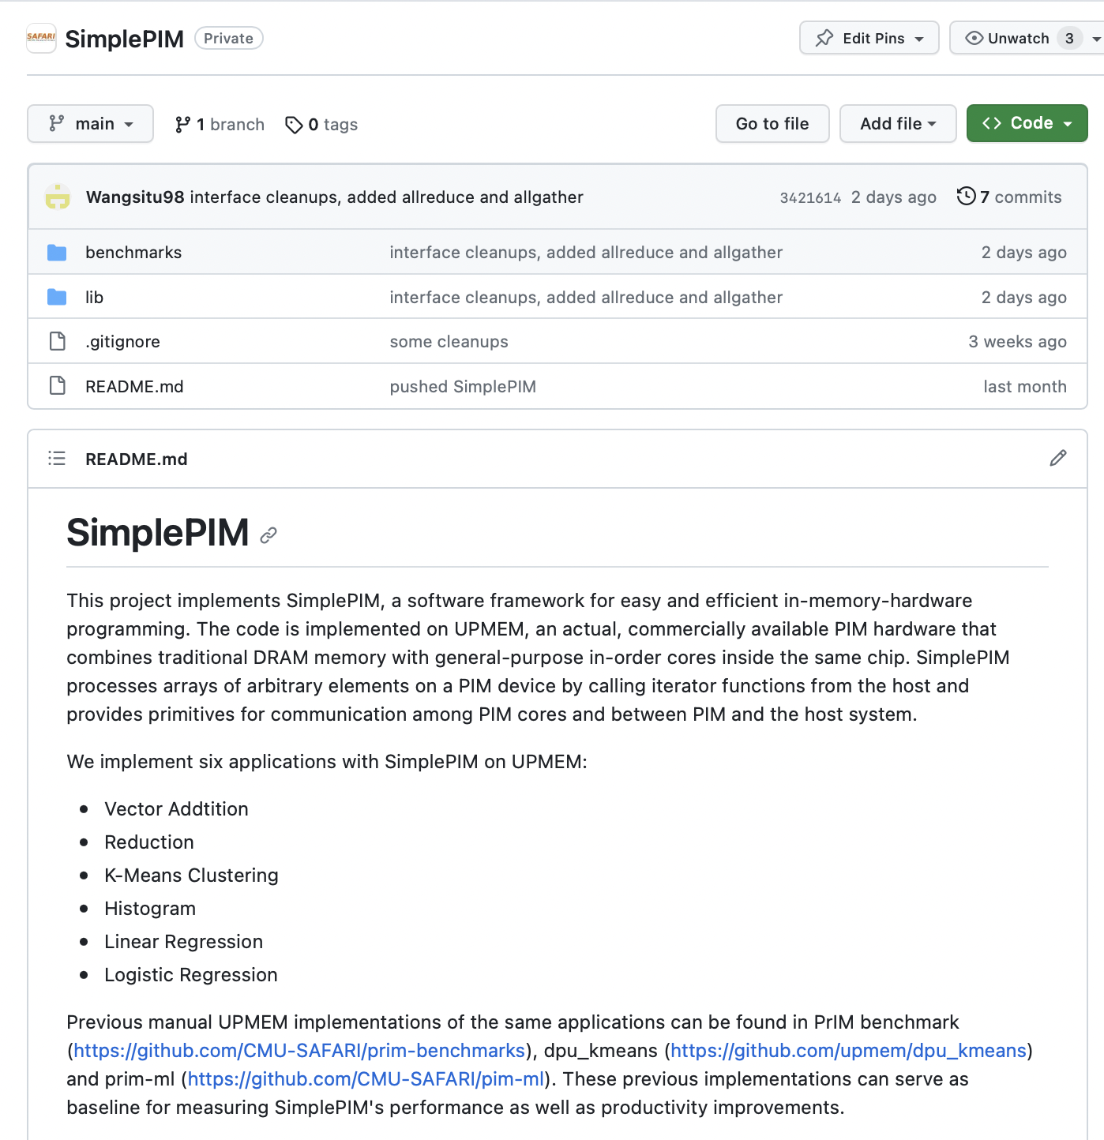
Source Code
https://github.com/CMU-SAFARI/SimplePIM

Slide 34
Executive Summary
Processing-in-Memory (PIM) promises to alleviate the data movement bottleneck
Real PIM hardware is now available, e.g., UPMEM PIM
However, programming real PIM hardware is challenging, e.g.:
Distribute data across PIM memory banks,
Manage data transfers between host cores and PIM cores, and between PIM cores,
Launch PIM kernels on the PIM cores, etc.
SimplePIM is a high-level programming framework for real PIM hardware
Iterators such as map, reduce, and zip
Collective communication with broadcast, scatter, and gather
Implementation on UPMEM and evaluation with six different workloads
Reduction, vector add, histogram, linear/logistic regression, K-means
4.4x fewer lines of code compared to hand-optimized code
Between 15% and 43% faster than hand-optimized code for three workloads
Source code: https://github.com/CMU-SAFARI/SimplePIM

Slide 35
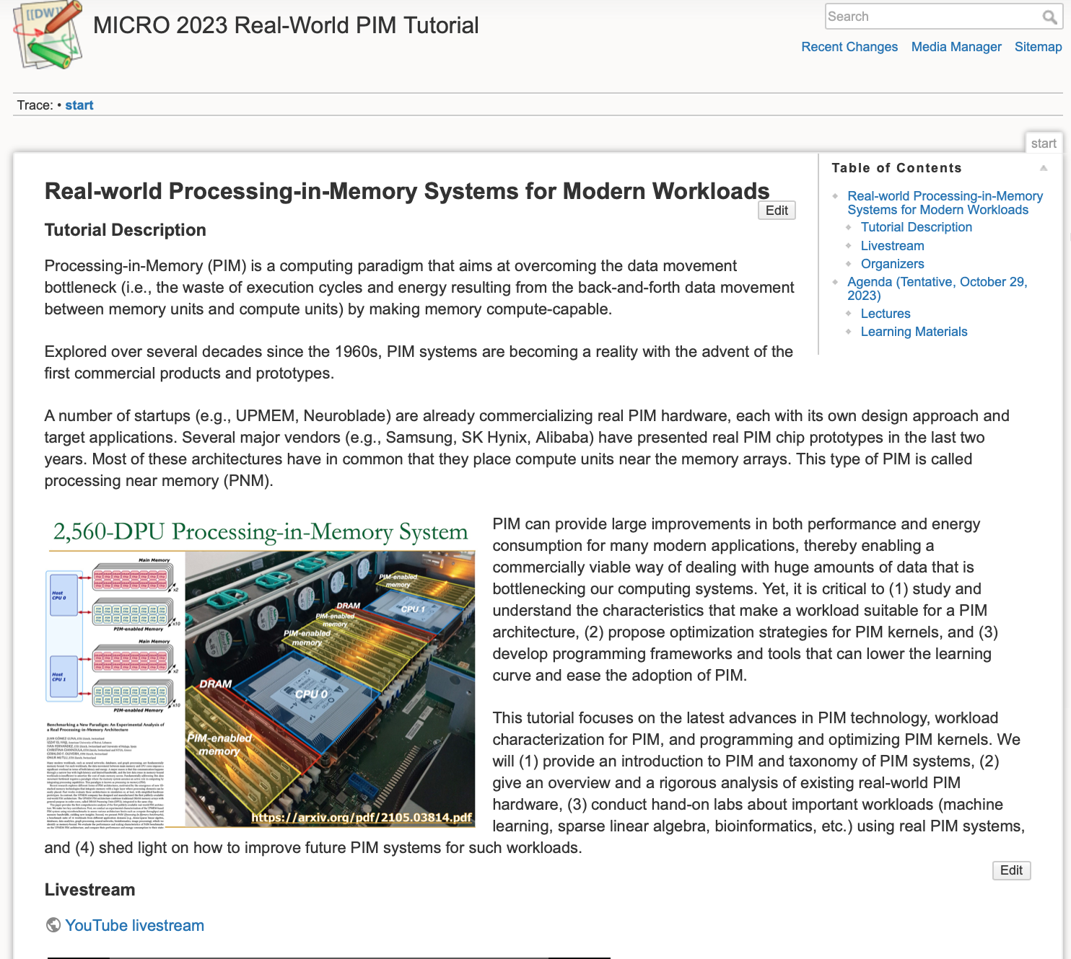
Real PIM Tutorial (MICRO 2023)
October 29th: Lectures + Hands-on labs + Invited lectures
https://youtube.com/live/ohU00NSIxOI?feature=share
https://events.safari.ethz.ch/micro-pim-tutorial/doku.php?id=start

Slide 36
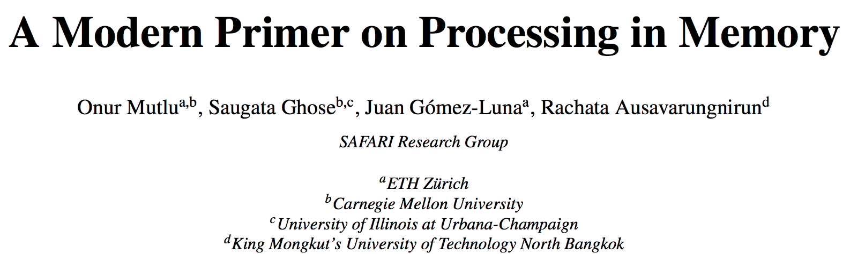
PIM Review and Open Problems
Onur Mutlu, Saugata Ghose, Juan Gomez-Luna, and Rachata Ausavarungnirun, "A Modern Primer on Processing in Memory" Invited Book Chapter in Emerging Computing: From Devices to Systems - Looking Beyond Moore and Von Neumann, Springer, 2023
https://arxiv.org/pdf/1903.03988.pdf

Slide 37
2023 International Conference on Parallel Architectures and Compilation Techniques
SimplePIM:
A Software Framework for Productive and Efficient Processing-in-Memory
Jinfan Chen, Juan Gómez Luna, Izzat El Hajj, Yuxin Guo, Onur Mutlu
https://arxiv.org/pdf/2310.01893.pdf
https://github.com/CMU-SAFARI/SimplePIM
juang@ethz.ch
Monday, October 23, 2023

