Slide 1




Parallelizing Maximal Clique Enumeration on GPUs
PACT 2023
Mohammad Almasri*†, Yen-Hsiang Chang*†, Izzat El Hajj‡ Rakesh Nagi†, Jinjun Xiong†§, and Wen-mei Hwu†¶
*Both authors contributed equally to this research †University of Illinois at Urbana-Champaign, Urbana, IL, USA ‡American University of Beirut, Beirut, Lebanon §University at Buffalo, Buffalo, NY, USA ¶Nvidia Corporation, Santa Clara, CA, USA

Slide 2



BACKGROUND
OUR SOLUTIONS
EVALUATION

Slide 3




Maximal Clique Enumeration (MCE)
Clique: A complete subgraph
Maximal Clique: A clique that is not contained in a larger clique
Maximal Clique Enumeration: Find all maximal cliques in an undirected graph $G$
B
B
B
D
C
D
C
D
C
A
A
A
F
E
F
E
F
E
Input $G$
Maximal clique
$$\{A, B, C, D\}$$
Maximal clique
$$\{A, E, F\}$$

Slide 4
MCE Applications
Wide range of applications:
Community Detection: Community detection in complex networks via clique conductance [1]
Bioinformatics: Predicting interactions in protein networks by completing defective cliques [2]
Electronic Design Automation: Fast, Nearly Optimal ISE Identification With I/O Serialization Through Maximal Clique Enumeration [3]
Epidemiology: Networks and the epidemiology of infectious disease [4]
Graph Compression: Compact structure for sparse undirected graphs based on a clique graph partition [5]
…

Slide 5
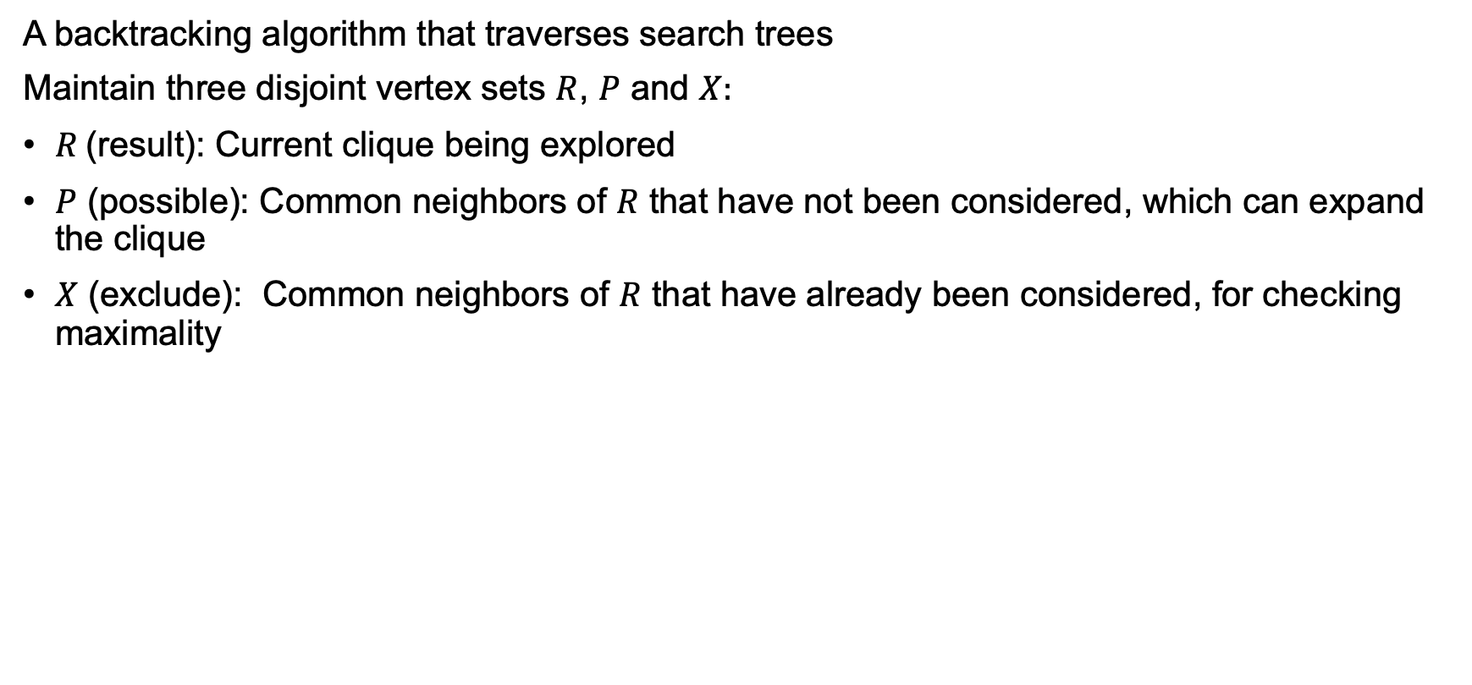
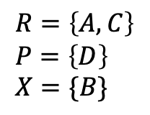

Bron-Kerbosch (BK) Algorithm [6]
A backtracking algorithm that traverses search trees
Maintain three disjoint vertex sets $R$, $P$ and $X$:
$R$ (result): Current clique being explored
$P$ (possible): Common neighbors of $R$ that have not been considered, which can expand the clique
$X$ (exclude): Common neighbors of $R$ that have already been considered, for checking maximality
B
A
Input $G$
Search tree
D
C
B
C
D
E
F
$$R=\left\{A, C\right\} \\ P=\left\{D\right\} \\ X=\{B\}$$
A
F
E
[6] C. Bron and J. Kerbosch, “Algorithm 457: finding all cliques of an undirected graph,” Communications of the ACM, vol. 16, no. 9, pp. 575–577, 1973.

Slide 6

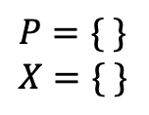
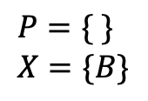
Bron-Kerbosch (BK) Algorithm
Input $G$
Search tree
B
A
B
C
D
E
F
D
C
B
C
D
E
F
C
D
D
F
A
C
D
D
F
D
$$P=\{ \} \\ X=\{B\}$$
F
E
D
$$P=\{ \} \\ X=\{ \}$$
Maximal clique

Slide 7

BK + pivoting [6]
Issue in BK: Many branches are useless
If a pivot $v_{pivot}$ is chosen from $P$, we only need to search from $P − {N(v}_{pivot})$
Typically select pivot having the largest number of neighbors also in $P$
Pivot can also be chosen from $X$ [7]
B
A
B
C
D
E
F
D
C
B
C
D
E
F
A
C
D
F
F
E
D
[6] C. Bron and J. Kerbosch, “Algorithm 457: finding all cliques of an undirected graph,” Communications of the ACM, vol. 16, no. 9, pp. 575–577, 1973.
[7] E. Tomita, A. Tanaka, and H. Takahashi, “The worst-case time complexity for generating all maximal cliques and computational experiments,” Theoretical computer science, vol. 363, no. 1, pp. 28–42, 2006.

Slide 8

BK with other optimizations [8]
Independent first-level subtrees: Each search tree at the first level determine its $P$ and $X$ independently
A
B
C
D
E
F
B
C
D
E
F
C
D
D
F
C
D
D
F
D
D
[8] Eppstein, D., Löffler, M., & Strash, D. (2010). Listing all maximal cliques in sparse graphs in near-optimal time. Algorithms and Computation: 21st International Symposium, ISAAC 2010, Jeju Island, Korea, December 15-17, 2010, Proceedings, Part I 21, 403–414.

Slide 9



BK with other optimizations [8]
Degeneracy ordering:
The search tree grows based on the size of $P$ at each level
Reorder vertices by minimizing the maximum number of neighbors being ordered afterward.
In real-world graphs, degeneracy $d$ is way less than maximum degree $Δ$
$$[A, B, C, D, E, F]$$
B
$$[E, F, B, C, D, A]$$
B
D
C
D
C
A
A
F
E
F
E
[8] Eppstein, D., Löffler, M., & Strash, D. (2010). Listing all maximal cliques in sparse graphs in near-optimal time. Algorithms and Computation: 21st International Symposium, ISAAC 2010, Jeju Island, Korea, December 15-17, 2010, Proceedings, Part I 21, 403–414.

Slide 10

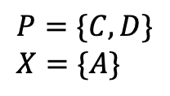
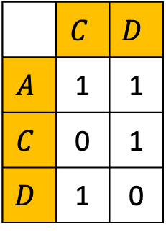
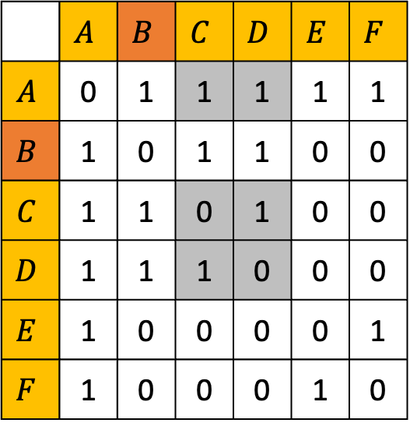
BK with other optimizations [8]
Induced subgraphs:
For each independent first level subtree, build a subgraph recording connections between $P∪X$ and $P$
 | $$A$$ | $$B$$ | $$C$$ | $$D$$ | $$E$$ | $$F$$
$$A$$ | 0 | 1 | 1 | 1 | 1 | 1
$$B$$ | 1 | 0 | 1 | 1 | 0 | 0
$$C$$ | 1 | 1 | 0 | 1 | 0 | 0
$$D$$ | 1 | 1 | 1 | 0 | 0 | 0
$$E$$ | 1 | 0 | 0 | 0 | 0 | 1
$$F$$ | 1 | 0 | 0 | 0 | 1 | 0
$$P=\{C, D\} \\ X=\{A\}$$
 | $$C$$ | $$D$$
$$A$$ | 1 | 1
$$C$$ | 0 | 1
$$D$$ | 1 | 0
B
B
D
C
C
D
A
D
F
E
[8] Eppstein, D., Löffler, M., & Strash, D. (2010). Listing all maximal cliques in sparse graphs in near-optimal time. Algorithms and Computation: 21st International Symposium, ISAAC 2010, Jeju Island, Korea, December 15-17, 2010, Proceedings, Part I 21, 403–414.

Slide 11
Recent CPU solution
“Manycore Clique Enumeration with Fast Set Intersections” [9]
Strength:
SIMD-accelerated hash-join-based set intersections
Use Threading Building Blocks (TBB) to exploit parallelism
Recreate induced subgraphs at each recursive call​ to improve locality
Open source and best performance reported
Weakness:
Building hash adjacency lists of the input graph takes a long time, but it is only recorded in the read graph time and not reported in the results
[9] J. Blanuša, R. Stoica, P. Ienne, and K. Atasu, “Manycore clique enumeration with fast set intersections,” Proceedings of the VLDB Endowment, vol. 13, no. 12, pp. 2676–2690, 2020.

Slide 12
Recent GPU solution
“Accelerating the Bron-Kerbosch algorithm for maximal clique enumeration using GPUs” [10]
Strength:
Fine-grained parallelism by building primitives
BFS approach favorable on GPU
Weakness:
Not scalable to large graphs due to the nature of BFS and the space complexity
High overheads due to moving data between CPU and GPU
Not open source and only evaluated on small graphs on old GPU
[10] Y.-W. Wei, W.-M. Chen, and H.-H. Tsai, “Accelerating the Bron-Kerbosch algorithm for maximal clique enumeration using GPUs,” IEEE Transactions on Parallel and Distributed Systems, vol. 32, no. 9, pp. 2352–2366, 2021.

Slide 13
Main Challenges of MCE on GPUs
Parallelism &
Scalability
Memory
Management
Load Balance

Slide 14


BACKGROUND
OUR SOLUTIONS
EVALUATION

Slide 15
Parallelism and Scalability
Adopt the backbone of previous paper of k-clique enumeration (KCE) on GPU [11]
For each SM, launch max number of concurrent blocks
Assign first-level subtrees to idle blocks and have each block perform DFS
Threads within the block collaborate to build induced subgraphs (binary encoded), perform set operations and find pivots (divide into subwarp granularity if applicable)
[11] M. Almasri, I. E. Hajj, R. Nagi, J. Xiong, and W. Hwu, “Parallel k-clique counting on gpus,” in Proceedings of the 36th ACM International Conference on Supercomputing, 2022, pp. 1–14.

Slide 16
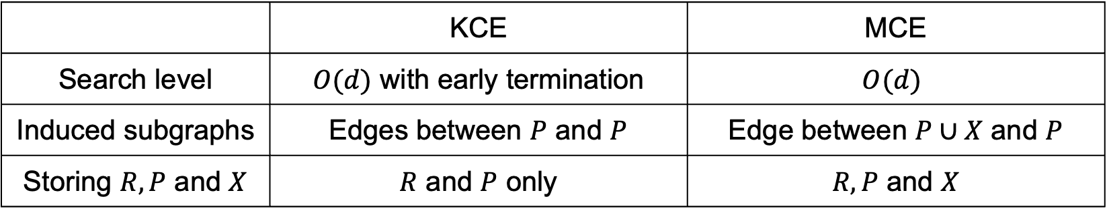
Difference between KCE and MCE
 | KCE | MCE
Search level | $O(d)$ with early termination | $$O(d)$$
Induced subgraphs | Edges between $P$ and $P$ | Edge between $P∪X$ and $P$
Storing $R, P$ and $X$ | $R$ and $P$ only | $R, P$ and $X$

Slide 17

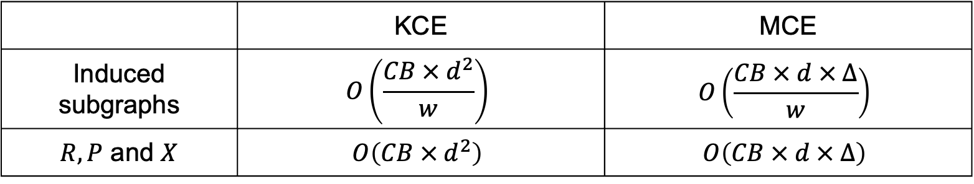
Memory management
$CB$: # concurrent blocks on GPU
$w$: word size
$d$: degeneracy
$Δ$: maximum degree
Recall that $d≪Δ$ in real-world graphs
 | KCE | MCE
Induced subgraphs | $$O\left(\frac{CB × d^{2}}{w}\right)$$ | $$O\left(\frac{CB × d × Δ}{w}\right)$$
$R, P$ and $X$ | $$O\left(CB × d^{2}\right)$$ | $$O\left(CB × d × Δ\right)$$

Slide 18

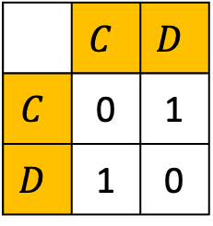

Induced subgraphs
 | $$C$$ | $$D$$
$$A$$ | 1 | 1
$$C$$ | 0 | 1
$$D$$ | 1 | 0
IPX: induced subgraphs between $P∪X$ and $P$
More memory needed $O\left(\frac{CB × d × Δ}{w}\right)$
Set operations using bit-wise operations
IP: induced subgraphs only between $P$ and $P$
Less memory needed $O\left(\frac{CB × d^{2}}{w}\right)$
Updating $X$ needs to access original graph
IPX
 | $$C$$ | $$D$$
$$C$$ | 0 | 1
$$D$$ | 1 | 0
IP

Slide 19

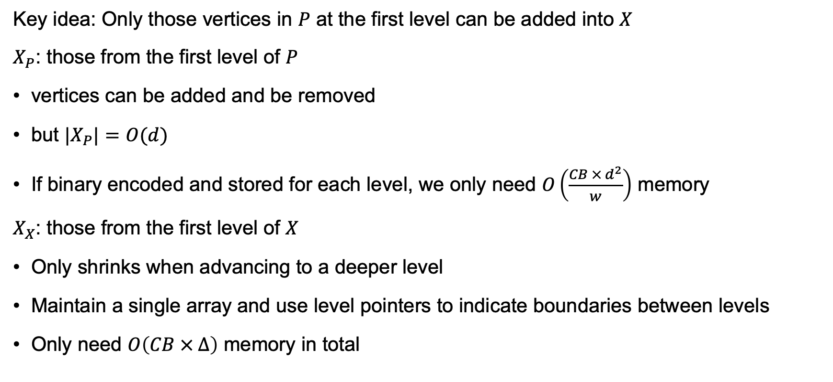
Splitting $X$
Key idea: Only those vertices in $P$ at the first level can be added into $X$
$X_{P}$: those from the first level of $P$
vertices can be added and be removed
but ${|X}_{P}|=O(d)$
If binary encoded and stored for each level, we only need $O\left(\frac{CB × d^{2}}{w}\right)$ memory
$X_{X}$: those from the first level of $X$
Only shrinks when advancing to a deeper level
Maintain a single array and use level pointers to indicate boundaries between levels
Only need $O\left(CB × Δ\right)$ memory in total

Slide 20

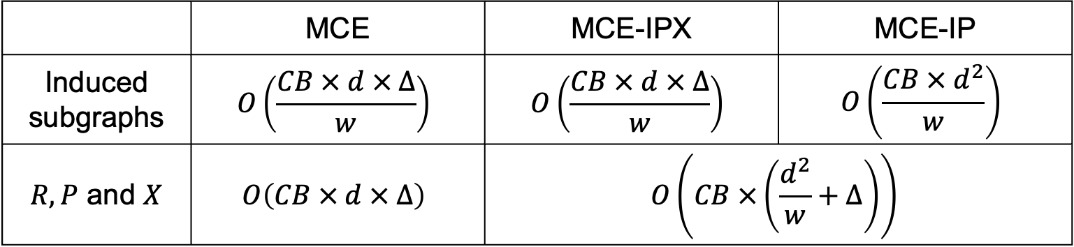
Memory management -- Summary
$CB$: number of concurrent blocks on GPU
$d$: degeneracy
$Δ$: maximum degree
$w$: word size
Recall that $d≪Δ$ in real-world graphs
 | MCE | MCE-IPX | MCE-IP
Induced subgraphs | $$O\left(\frac{CB × d × Δ}{w}\right)$$ | $$O\left(\frac{CB × d × Δ}{w}\right)$$ | $$O\left(\frac{CB × d^{2}}{w}\right)$$
$R, P$ and $X$ | $$O\left(CB × d × Δ\right)$$ | $$O\left(CB ×\left(\frac{d^{2}}{w}+Δ\right)\right)$$

Slide 21
Load balance
In k-clique [11], load imbalance is addressed by extracting subtrees from the second level
We try the same idea for MCE, but it is not enough
Search trees only start to branch at very deep levels
Dynamic load balancing using work list is not suitable
Number of subtasks grows exponentially
Data needed to represent a subtask is huge
[11] M. Almasri, I. E. Hajj, R. Nagi, J. Xiong, and W. Hwu, “Parallel k-clique counting on gpus,” in Proceedings of the 36th ACM International Conference on Supercomputing, 2022, pp. 1–14.

Slide 22
Worker list instead of work list
We design a worker list instead
When a block is idle, put its ID into the list
Whenever a block is branching, get some idle blocks from the list and offload branches
Benefits:
Number of active tasks is bounded by the number of blocks
No need to tune the capacity of the list, but only tune the offload policy

Slide 23
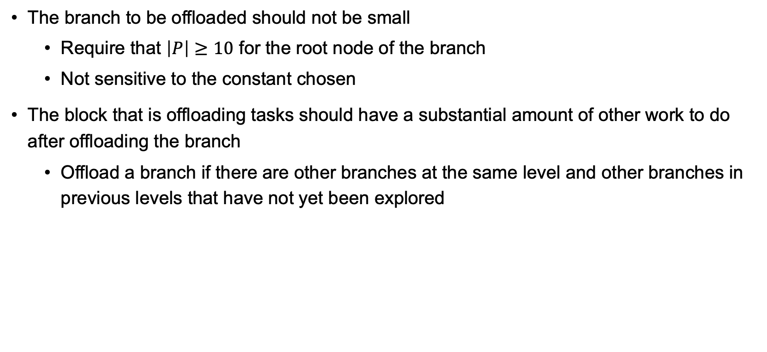
Policy
The branch to be offloaded should not be small
Require that $\left|P\right|≥10$ for the root node of the branch
Not sensitive to the constant chosen
The block that is offloading tasks should have a substantial amount of other work to do after offloading the branch
Offload a branch if there are other branches at the same level and other branches in previous levels that have not yet been explored

Slide 24

BACKGROUND
OUR SOLUTIONS
EVALUATION

Slide 25
Performance Evaluation
Compare against “Manycore Clique Enumeration with Fast Set Intersections” [9]
A dual-socket Intel Xeon Skylake platform with 48c/96t and 360 GB of main memory
We evaluate our GPU kernels on V100 GPU with 32 GB DRAM
Both include pre-processing time but not read graph time
[9] J. Blanuša, R. Stoica, P. Ienne, and K. Atasu, “Manycore clique enumeration with fast set intersections,” Proceedings of the VLDB Endowment, vol. 13, no. 12, pp. 2676–2690, 2020.

Slide 26
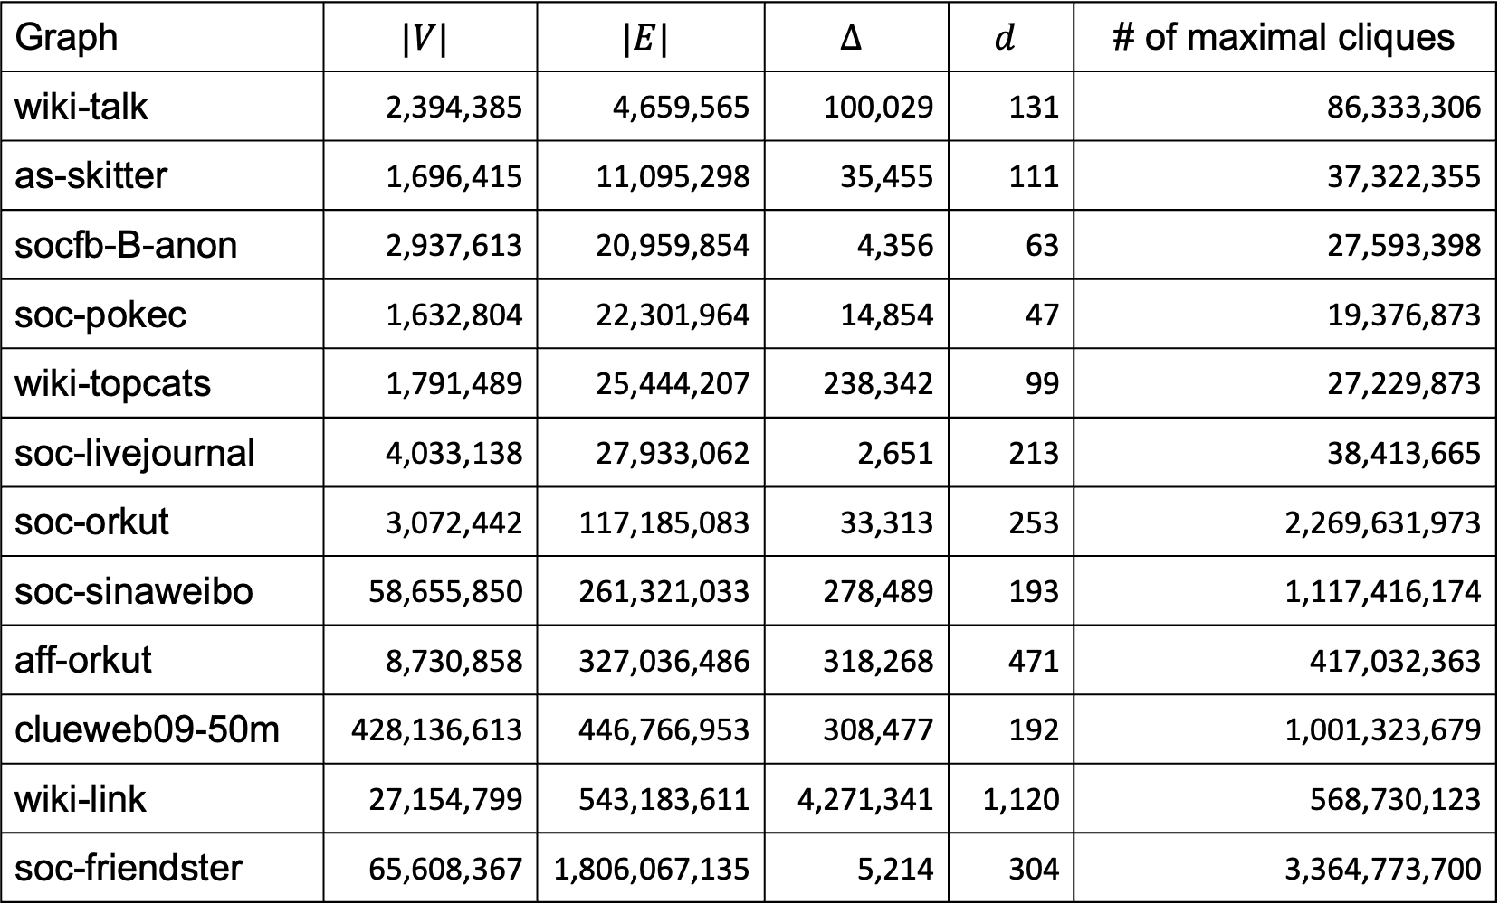
Graph | $$|V|$$ | $$|E|$$ | $$Δ$$ | $$d$$ | # of maximal cliques
wiki-talk | 2,394,385 | 4,659,565 | 100,029 | 131 | 86,333,306
as-skitter | 1,696,415 | 11,095,298 | 35,455 | 111 | 37,322,355
socfb-B-anon | 2,937,613 | 20,959,854 | 4,356 | 63 | 27,593,398
soc-pokec | 1,632,804 | 22,301,964 | 14,854 | 47 | 19,376,873
wiki-topcats | 1,791,489 | 25,444,207 | 238,342 | 99 | 27,229,873
soc-livejournal | 4,033,138 | 27,933,062 | 2,651 | 213 | 38,413,665
soc-orkut | 3,072,442 | 117,185,083 | 33,313 | 253 | 2,269,631,973
soc-sinaweibo | 58,655,850 | 261,321,033 | 278,489 | 193 | 1,117,416,174
aff-orkut | 8,730,858 | 327,036,486 | 318,268 | 471 | 417,032,363
clueweb09-50m | 428,136,613 | 446,766,953 | 308,477 | 192 | 1,001,323,679
wiki-link | 27,154,799 | 543,183,611 | 4,271,341 | 1,120 | 568,730,123
soc-friendster | 65,608,367 | 1,806,067,135 | 5,214 | 304 | 3,364,773,700

Slide 27
Evaluation – Speedup

Slide 28
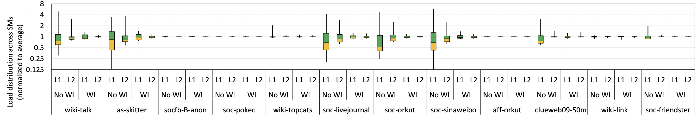
Evaluation – Load balance

Slide 29
Evaluation – Load balance

Slide 30
Scaling to multi-GPUs
Static division of independent first- or second-level subtrees to each GPU
Round-robin fashion to avoid vertices sharing similar properties
No communication between GPUs when running kernels
Do not include pre-processing time, since we only scale MCE kernels to multi-GPUs

Slide 31
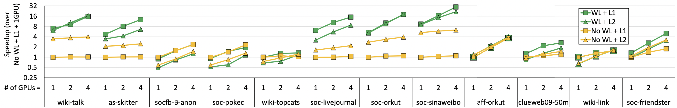
Evaluation – Scalability

Slide 32
Evaluation – Scalability

Slide 33
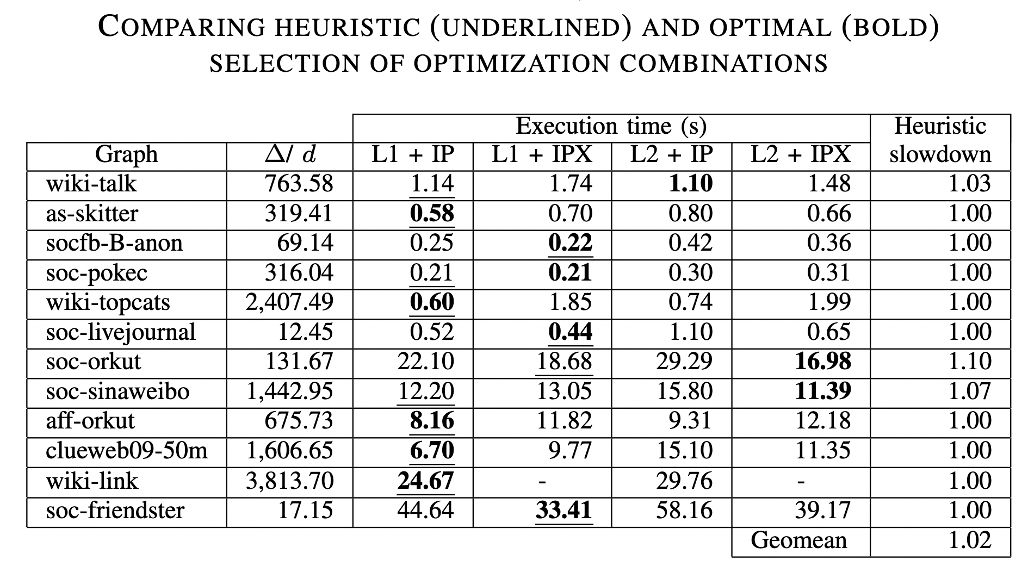
Evaluation – Choice of optimizations

Slide 34

Summary
Highly efficient GPU solution to MCE
Evaluate trade-offs between different paradigms of induced subgraphs
Maintain only one copy of excluding set $X$ across levels to reduce memory footprint
Design a worker list to deal with load imbalance
Single GPU solution outperforms the state-of-the-art parallel CPU implementation by a geometric mean of $4.1 ×$ (up to $10.2 ×$) on V100 and $4.9 ×$ (up to $16.7 ×$) on A100
Scalable to multiple GPUs
Open-sourced to enable further research on accelerating MCE
Available, functional and reproduced

Slide 35
Future directions
Solve load imbalance for building induced subgraphs
Investigate distributed setup for solving larger graphs
Extend the functionality of worker list to other problems suffering from load imbalance
Acknowledgments
We thank Zaid Qureshi and Amir Nassereldine for their insights and technical assistance.
This work is supported in part by the IBM-Illinois Center for Cognitive Computing Systems Research (C3SR).
Izzat El Hajj acknowledges the support of the University Research Board of the American University of Beirut (AUB-URB-104391-26749).
Jinjun Xiong acknowledges the support of NSF (FuSe-TG 2235364) and the joint support of NSF and IES through AI4ExceptionalEd (2229873).
We are also grateful to NVIDIA's Applied Research Accelerator Program for donating A100 GPUs that were helpful in the final testing stages of this work.

Slide 36
References
[1] Z. Lu, J. Wahlström, and A. Nehorai, “Community detection in complex networks via clique conductance,” Scientific reports, vol. 8, no. 1, p. 5982, 2018.
[2] H. Yu, A. Paccanaro, V. Trifonov, and M. Gerstein, “Predicting interactions in protein networks by completing defective cliques,” Bioinformatics, vol. 22, no. 7, pp. 823–829, 2006.
[3] A. K. Verma, P. Brisk, and P. Ienne, “Fast, nearly optimal ISE identification with I/O serialization through maximal clique enumeration,” IEEE Transactions on Computer-Aided Design of Integrated Circuits and Systems, vol. 29, no. 3, pp. 341–354, 2010.
[4] L. Danon, A. Ford, T. House, C. Jewell, M. Keeling, G. Roberts, J. Ross, and M. Vernon, “Networks and the epidemiology of infectious disease,” Interdisciplinary Perspectives on Infectious Diseases, vol. 2011, p. 284909, 2011.
[5] F. Glaria, C. Hernández, S. Ladra, G. Navarro, and L. Salinas, “Compact structure for sparse undirected graphs based on a clique graph partition,” Information Sciences, vol. 544, pp. 485–499, 2021.
[6] C. Bron and J. Kerbosch, “Algorithm 457: finding all cliques of an undirected graph,” Communications of the ACM, vol. 16, no. 9, pp. 575–577, 1973.
[7] E. Tomita, A. Tanaka, and H. Takahashi, “The worst-case time complexity for generating all maximal cliques and computational experiments,” Theoretical computer science, vol. 363, no. 1, pp. 28–42, 2006.
[8] Eppstein, D., Löffler, M., & Strash, D. (2010). Listing all maximal cliques in sparse graphs in near-optimal time. Algorithms and Computation: 21st International Symposium, ISAAC 2010, Jeju Island, Korea, December 15-17, 2010, Proceedings, Part I 21, 403–414.
[9] J. Blanuša, R. Stoica, P. Ienne, and K. Atasu, “Manycore clique enumeration with fast set intersections,” Proceedings of the VLDB Endowment, vol. 13, no. 12, pp. 2676–2690, 2020.
[10] Y.-W. Wei, W.-M. Chen, and H.-H. Tsai, “Accelerating the Bron-Kerbosch algorithm for maximal clique enumeration using GPUs,” IEEE Transactions on Parallel and Distributed Systems, vol. 32, no. 9, pp. 2352–2366, 2021.
[11] M. Almasri, I. E. Hajj, R. Nagi, J. Xiong, and W. Hwu, “Parallel k-clique counting on gpus,” in Proceedings of the 36th ACM International Conference on Supercomputing, 2022, pp. 1–14.

Slide 37


Parallelizing Maximal Clique Enumeration on GPUs
THANK YOU!
QUESTIONS?
Mohammad Almasri*†, Yen-Hsiang Chang*†, Izzat El Hajj‡ Rakesh Nagi†, Jinjun Xiong†§, and Wen-mei Hwu†¶

