Slide 1

ARE WE THERE YET?
Predicting if Executing Applications are Near Completion
Mohammad Sonji¹, Mohammed Baydoun¹, Safaa Diab¹, Amir Nassereldine¹, Pedro Bruel², Aditya Dhakal², Rolando Pablo Hong Enriquez², Gourav Rattihalli², Diman Zad Tootaghaj², Gallig Renaud², Barbara Chapman², Fatima K. Abu Salem¹, Eitan Frachtenberg², Dejan Milojicic², Izzat El Hajj¹
¹AUB – ²HPE
The 17th ACM/SPEC International Conference on Performance Engineering (ICPE)
May 8, 2026

Slide 2

Overview
Are We There Yet?
Predicting if Executing Applications are Near Completion
Importance Of Execution Time Estimation
Schedulers
Resource Managers
Users
Execution Time Estimation → Quite complicated!

Slide 3
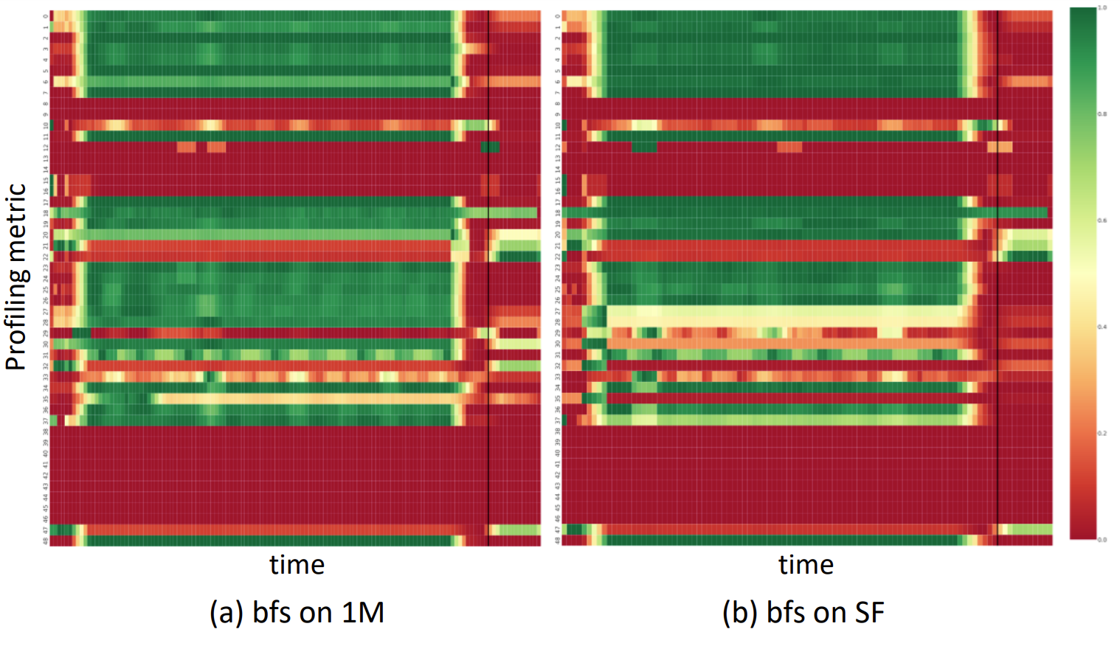
Overview
Are We There Yet?
Predicting if Executing Applications are Near Completion
Importance Of Execution Time Estimation
Rationale
Workaround: Near completion prediction
Difference
Consistency
Similarity

Slide 4
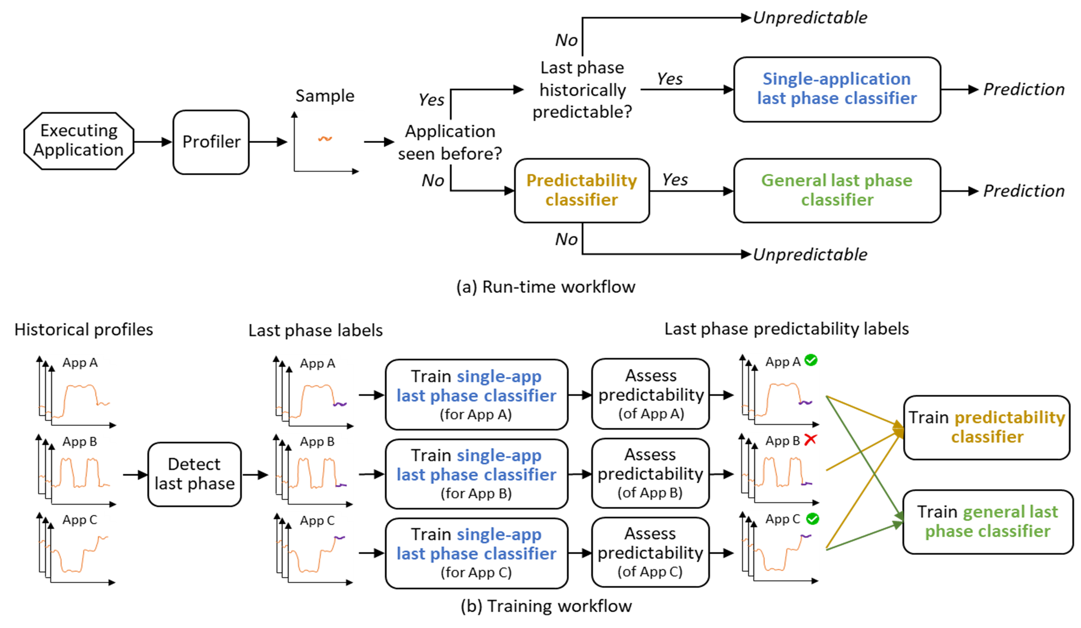
Overview
Are We There Yet?
Predicting if Executing Applications are Near Completion
Importance Of Execution Time Estimation
Rationale
Workflow

Slide 5
Overview
Are We There Yet?
Predicting if Executing Applications are Near Completion
Importance Of Execution Time Estimation
Rationale
Workflow
Unpredictable
No
Has accurate classifier?
Yes
Single-application
last phase classifier
Sample
Yes
Prediction
Executing
Application
Profiler
Application seen before?
No
Predictability classifier
Yes
General last phase classifier
Prediction
No
Unpredictable

Slide 6

Overview
Are We There Yet?
Predicting if Executing Applications are Near Completion
Importance Of Execution Time Estimation
Rationale
Workflow
Application profiles
Last phase labels
Last phase predictability labels
App A
App A
Evaluate classifier
(of App A)
App A
Train single-app
last phase classifier
(for App A)
Train predictability classifier
App B
App B
Evaluate classifier
(of App B)
App B
Detect last phase
Train single-app
last phase classifier
(for App B)
Train general last phase classifier
App C
App C
App C
Train single-app
last phase classifier
(for App C)
Evaluate classifier
(of App C)

Slide 7
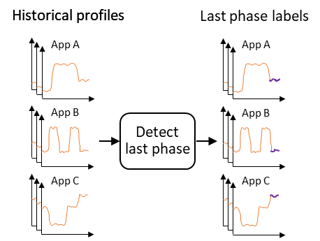
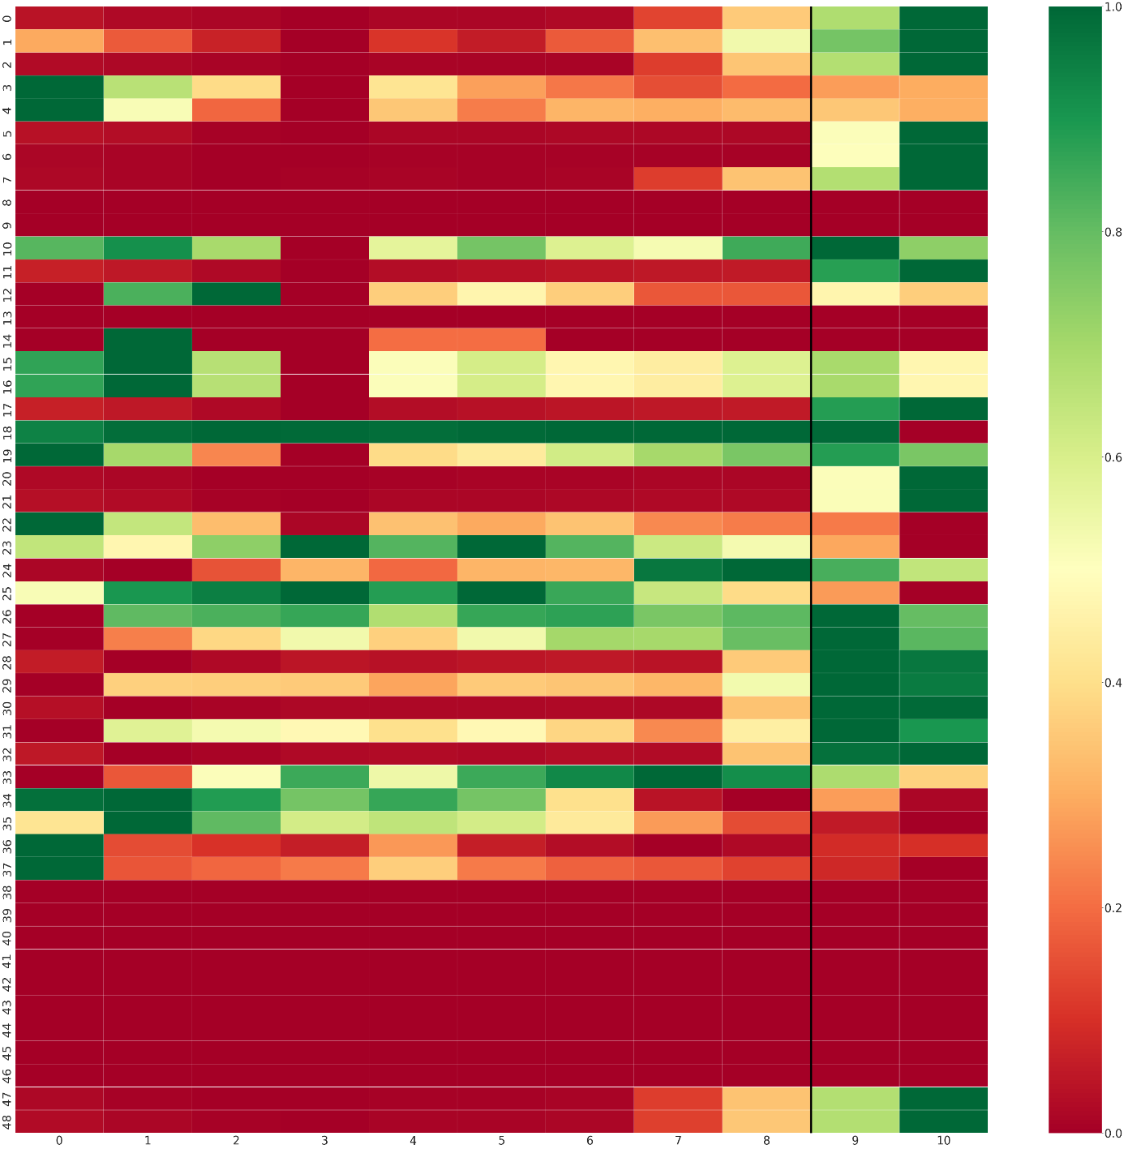
Overview
Are We There Yet?
Predicting if Executing Applications are Near Completion
Importance Of Execution Time Estimation
Rationale
Workflow
Last Phase Detection
0, 0, 0, 0, 0, 0, 0, 0, 0, 1, 1

Slide 8
Overview
Are We There Yet?
Predicting if Executing Applications are Near Completion
Importance Of Execution Time Estimation
Rationale
Workflow
Last Phase Detection
Classifiers
Classifiers
 | Single-Application | General | Predictability
Usage | Historical data available | Unseen Application | Any
Input | 1 run | 1 application | 1 application
Labels | In / out of last phase |  | Predictable / Unpredictable
Output | Near completion / In Progress

Slide 9









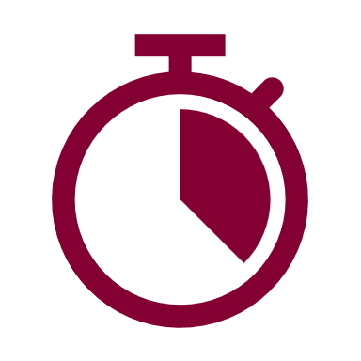
Overview
Are We There Yet?
Predicting if Executing Applications are Near Completion
Importance Of Execution Time Estimation
Rationale
Workflow
Last Phase Detection
Classifiers
Methodology
CPU: dual-socket Intel Xeon Platinum 8358 CPU system with 2 sockets (64 threads in total)
Metrics collection tool: Linux Perf tool ; #samples: 5; sampling rate: 200ms
Memory: 512GB of main memory
Metrics collected: 48 profiling metrics
Benchmarks: 44 OpenMP representative of scientific computing applications, or Spark benchmarks used for data analytics
ML models: RNNs, XGBoost, Dummy
Suites: 6 benchmark suites and libraries, with multiple datasets each
Cross Validation: Leave-One-Group-Out
Runtime: from 1.85s to 22.6min (mean=94.01s)
Data: 3 runs per benchmark per dataset

Slide 10
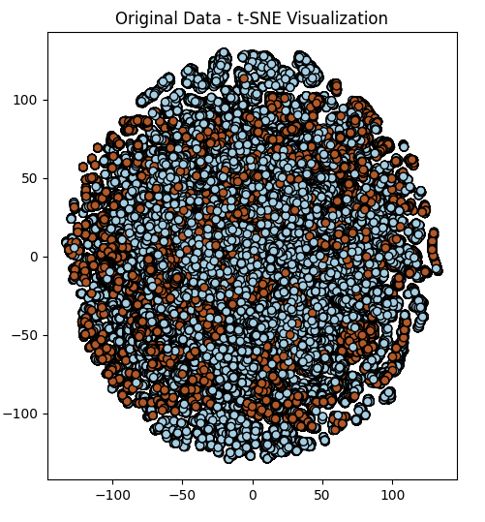
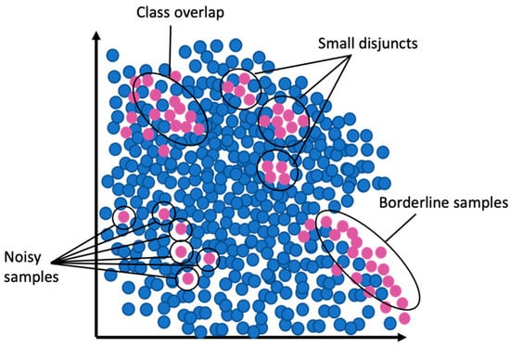
Recap
Are We There Yet?
Predicting if Executing Applications are Near Completion
Importance Of Execution Time Estimation
Rationale
Workflow
Last Phase Detection
Classifiers
Methodology
Small disjuncts typically adds complexity to the sampling problem due to the uneven distribution of instances among them.

Slide 11
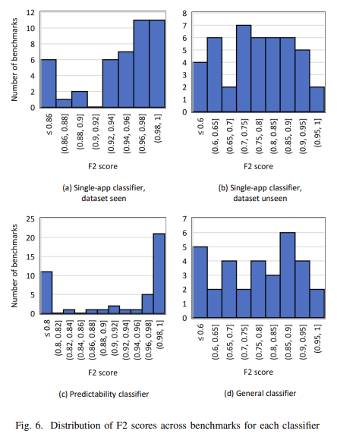
Evaluation:
Results
Are We There Yet?
Predicting if Executing Applications are Near Completion
Mean F2-score | Single-app Classifiers |  | Predictability Classifier | General Classifier
 | Dataset seen | Dataset unseen
 | 0.94 | 0.77 | 0.82 | 0.77

Slide 12
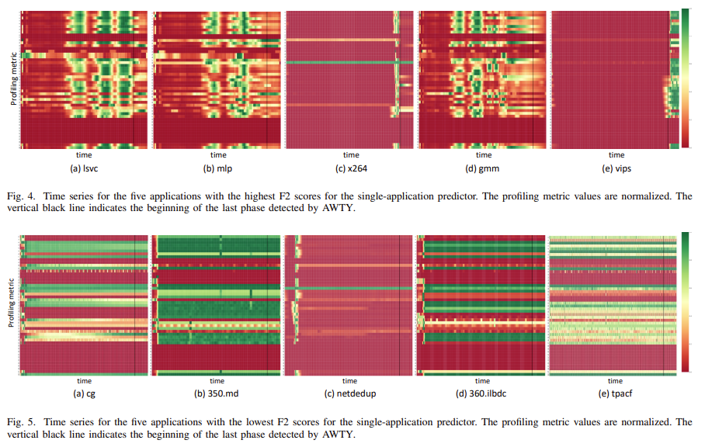



Evaluation:
Single-app Classifiers
Are We There Yet?
Predicting if Executing Applications are Near Completion
Clear last phase
Last phase not clear
Our workflow screens these cases out and reports that it cannot make accurate predictions for these applications.

Slide 13
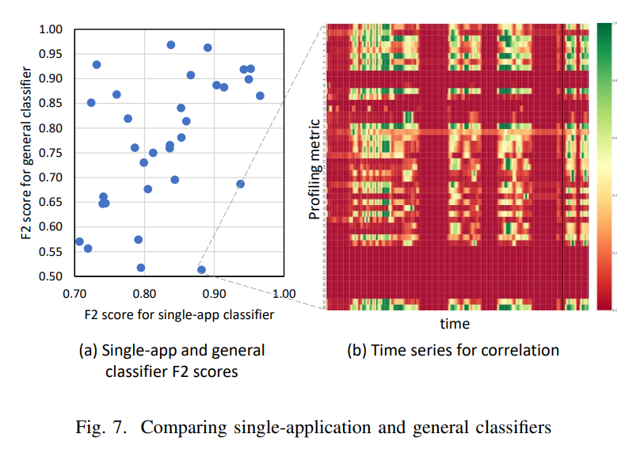
Evaluation: Predictability and general Classifiers
Are We There Yet?
Predicting if Executing Applications are Near Completion
Predictability classifier exhibits high prediction quality
Our rationale that different applications may have similar behavior at the end of their execution which can assist with prediction is valid.

Slide 14
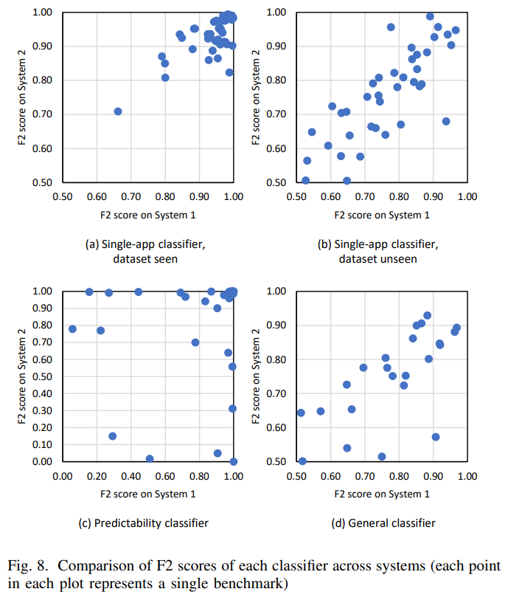
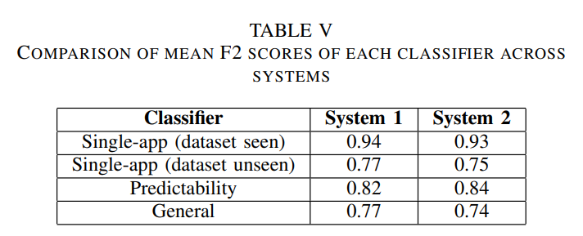
Evaluation:
Replication Study
Are We There Yet?
Predicting if Executing Applications are Near Completion
CPU: dual-socket Intel Xeon Platinum 8358 CPU system with 2 sockets (64 threads in total)
CPU: dual-socket AMD EPYC 7532 CPU system with 2 sockets (64 threads in total)
Memory: 512GB of main memory
Memory: 512GB of main memory
Metrics collected: 54 profiling metrics
Metrics collected: 48 profiling metrics

Slide 15
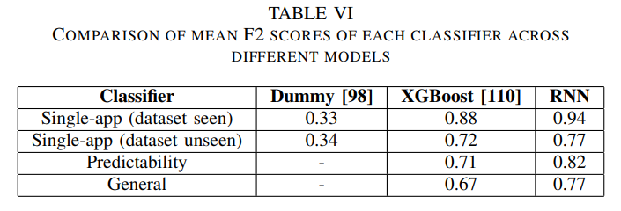
Evaluation:
Comparison to Other Models
Are We There Yet?
Predicting if Executing Applications are Near Completion
Purpose:
RNN: memory (temporal dependencies)
XGBoost: efficient, flexible
Dummy: for reference
Note: none of the single-application classifiers have an F2 score above 0.7 for the dummy classifier, which is why we do not train a predictability classifier and a general classifier!

Slide 16
Conclusion
Are We There Yet?
Predicting if Executing Applications are Near Completion
A workflow for predicting whether an executing application is near completion.
analyze historical application profiles to find their last phases
train classifiers that predict near completeion
The workflow includes
single-application classifiers for seen applications
Usage
At run time, an executing application is profiled, and its profiling samples are passed to the classifiers
general classifier for non-seen applications

Slide 17
Conclusion
Are We There Yet?
Predicting if Executing Applications are Near Completion
A workflow for predicting whether an executing application is near completion.
analyze historical application profiles to find their last phases
train classifiers that predict near completeion
The workflow includes
single-application classifiers for seen applications
Usage
At run time, an executing application is profiled, and its profiling samples are passed to the classifiers
resource managers: to decide if an application that has exceeded its time budget should be killed or given more slack time to finish
general classifier for non-seen applications
Interest

Slide 18
ARE WE THERE YET?
Predicting if Executing Applications are Near Completion
Mohammad Sonji¹, Mohammed Baydoun¹, Safaa Diab¹, Amir Nassereldine¹, Pedro Bruel², Aditya Dhakal², Rolando Pablo Hong Enriquez², Gourav Rattihalli², Diman Zad Tootaghaj², Gallig Renaud², Barbara Chapman², Fatima K. Abu Salem¹, Eitan Frachtenberg², Dejan Milojicic², Izzat El Hajj¹
¹AUB – ²HPE
The 17th ACM/SPEC International Conference on Performance Engineering (ICPE)
May 8, 2026
Thank you

