Slide 1



OASIS: Optimal Allocation Strategy for Inference Services in Cloud Environments
Viyom Mittal, Mohammed Baydoun, Alok Mishra, Pavana Prakash, Gourav Rattihalli, Aditya Dhakal, Eitan Frachtenberg, Izzat El Hajj, Michalis Faloutsos, Dejan Milojicic

Slide 2






How can a cloud provider optimize resource use in providing language model as services?
High Energy Consumption: GPUs draw high power even when idle
Variable Query Traffic: GPUs draw high power even when idle; millions of daily requests compound costs
Query Heterogeneity: Different queries have vastly different resource needs
Multi-Tenancy: Must share GPUs efficiently; time-slicing vs MIG vs Software Batching
Goal: Minimize total operational cost (hardware + energy) while meeting all SLO constraints

Slide 3

OASIS: Two-Phase Methodology
Phase 1: Pre-Deployment Profiling
Profile model across
- Query types
- Hardware configs
- GPU frequencies
- Batch sizes
Phase 2: Runtime Query Routing & Provisioning
- Classify incoming queries
- Compute GPU requirements
- Decide MIG vs. Full GPU
- Dynamically provision

Slide 4
Query Type Classification (τ = 500 tokens)
 | Small Output (< τ) | Large Output (> τ)
Small Input (< τ) | SISO: Short Q&A, paraphrasing (minimal compute) | SILO: Story generation, essays (memory-intensive generation)
Large Input (> τ) | LISO: Summarization, classification (compute-intensive prefill) | LILO: Translation, long rewriting (intensive throughout)

Slide 5
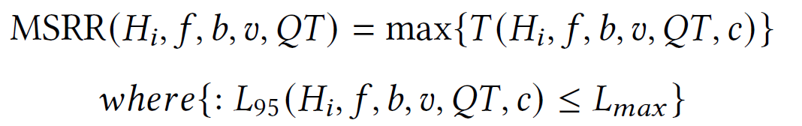
Phase 1: Pre-Deployment Profiling
Profiling Procedure:
Define parameter space:
- GPU freq {855-1410 MHz}
- Batch {16-64}
- Variants {standard, prefix-caching, chunked-prefill}
2. Sweep each query type (LISO, SILO) separately
3. For each parameter dimension, vary one parameter while keeping others fixed.
3. Ramp concurrency from low → high
4. Measure P95 latency, throughput, power, energy/token
5. Determine Max Serviceable Request Rate meeting SLO
6. Record MSRR, Power and energy/token in the Hardware Cost Table (HCT)

Slide 6
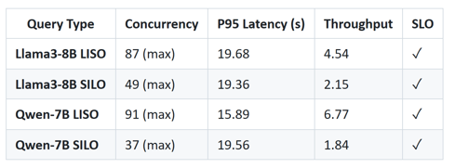
Phase 1: Experiments
Aim: Study impact of query type on throughput
Setup:
SLO: P95 should be less than 20 seconds
Constants: GPU (A100), frequency (default 1410MHz), model (Llama3-8B, Qwen-7B)
Variables: Query type (LISO vs SILO), concurrency (ramp until SLO violated)
Observation 1: LISO achieves **2.1× higher throughput** than SILO.
Observation 2: Qwen-7B has **1.5× higher LISO throughput** than Llama3-8B.
Takeaway: Per-model, per-query-type profiling is essential

Slide 7
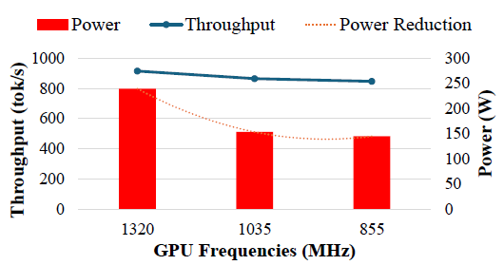
Phase 1: Experiments
Aim: Study impact of GPU frequency reduction on throughput
Setup:
SLO: P95 should be less than 20 seconds
Constants: model (Llama-3-8B), GPU (A100)
Variables: GPU frequency {1320, 1035, 855} MHz
Observation: Reducing frequency from 1320→855 MHz: 39% power reduction with only 7% decrement in throughput
Takeaway: Frequency tuning can result in major cost savings with minimal throughput reduction

Slide 8
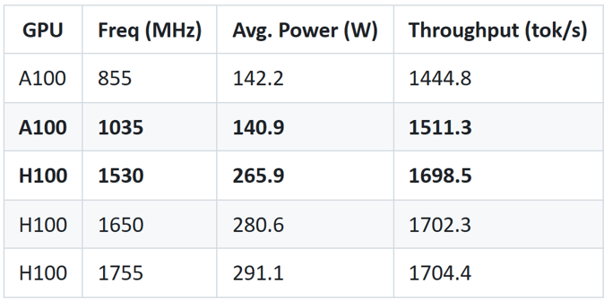
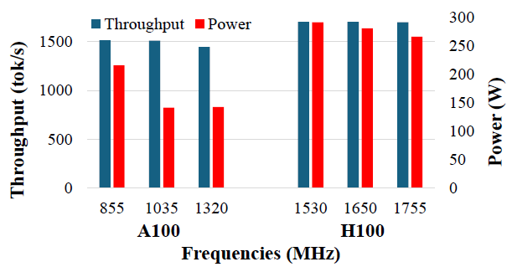
Phase 1: Experiments
Aim: Hardware Platform Comparison (A100 vs H100)
Setup:
SLO: P95 should be less than 20 seconds
Constants: model (Yi-6B), SLO (20s)
Variables: GPU platform (A100 vs H100), frequency
Observation: H100 provides **+12% throughput** but consumes **+89% more power** vs A100
Takeaway: Hardware selection requires workload and model specific analysis

Slide 9
Phase 1: Experiments
Aim: Study cross-Model Energy Efficiency
Observation: 1.4× energy across models at identical GPU frequency.
Aim: Determine if MIG-based GPU sharing can reduce power when serving multiple models simultaneously
Observation: MIG achieves **42–43% power reduction** (saves 197W) for LISO workload
Takeaway: Architecture matters more than just parameter count. Per-model profiling remains essential.
Takeaway: Scale down can help in power savings when dealing with SLMs.

Slide 10
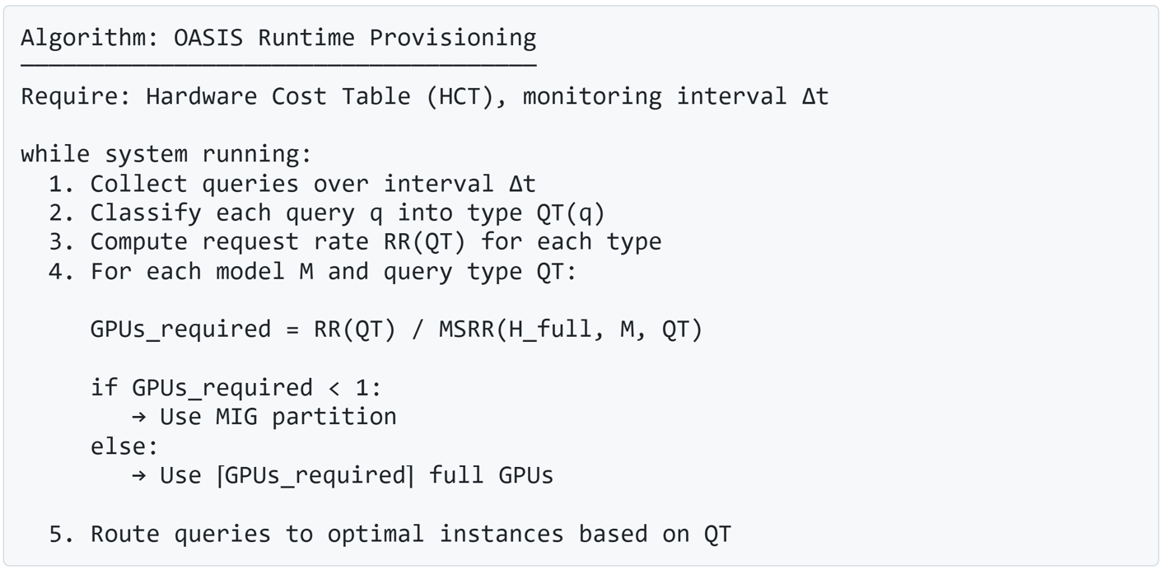
Phase 2: Runtime Adaptation Algorithm

Slide 11
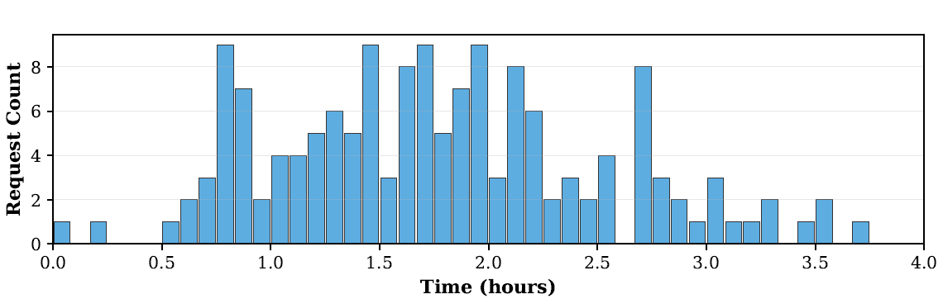
Phase 2: Real campus workload evaluation
Setup:
A100-80GB: Full GPU vs. MIG (half GPU)
vLLM v0.6.3 + Meta-Llama-3-8B-Instruct
BurstGPT dataset: 4-hour daytime trace, 153 requests
Bursty traffic: CV = 1.70
Query distribution:
SISO: 64.7%
SILO: 5.9%
LISO: 29.4%
LILO: 0%
94.1% queries have small output.

Slide 12
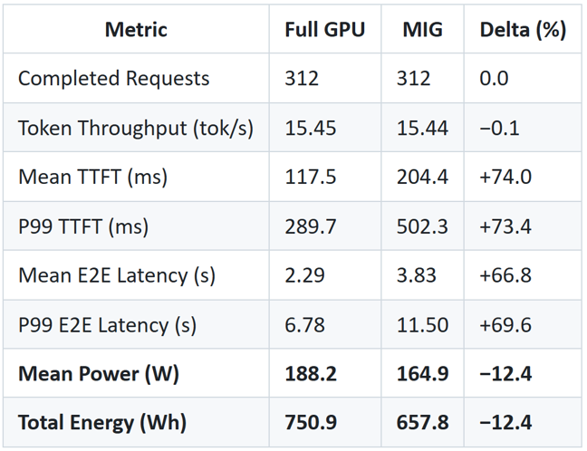
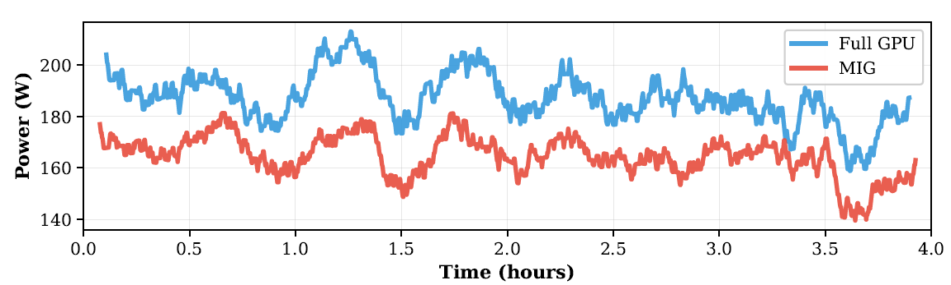
Phase 2: Real campus workload evaluation
Observations:
The MIG configuration maintains identical throughput
TTFT and E2E latency increase but remain within acceptable bounds
Mean power consumption reduces by 12.4%.
Takeaway: Significant power savings can be achieved while remaining SLO compliant.

Slide 13
Conclusion
Each parameter reveals actionable optimization opportunities:
GPU Frequency: Most impactful knob: −39% power, −7% throughput, +34% energy efficiency
Query Type: LISO sustains 2.1× higher throughput than SILO; uniform provisioning wastes resources or violates SLOs
Model Architecture: 1.4× energy variation (86.1–118.4 mJ/tok) across 7B-15B models at identical hardware settings
Hardware Platform: Not always "bigger is better": H100 gives +12% throughput but costs +89% power vs A100 - Highly traffic dependent
Deployment Strategy (MIG vs Full GPU): 12.4% power reduction on real campus trace
Future work:
Multi-parameter joint optimization
Workload prediction & proactive adaptation
Cross-GPU architecture support

Slide 14

Thank you!
For follow-up questions:
viyom.mittal@hpe.com

