Slide 1

Serverless Graph Analytics on Multi‑Instance GPUs
Mohammad Sonji (AUB), Mohammed Baydoun (AUB), Aditya Dhakal (HPE), Gourav Rattihalli (HPE), Dejan Milojicic (HPE), Izzat El Hajj (AUB)
The Workshop on Graphs, Architectures, Programming, and Learning (GrAPL’25)
June 4, 2025

Slide 2
Serverless Graph Analytics on Multi-Instance GPU
Serverless Computing
Graph Analytics
Relieves infraX
management
burden
Pay-per-use
billing
Important
workload
Sharing of resources
Performance isolation
Multi-Instance GPU

Slide 3
Serverless Graph Analytics on Multi-Instance GPU
Serverless Computing
Graph Analytics
Relieves infraX
management
burden
Pay-per-use
billing
Important
workload
Most works focused on CPU systems
Part of broader performance analyses
Sharing of resources
Performance isolation
Most works focused on ML inference
Our work:
Performance analysis of serverless graph analytics on multi-instance GPU
Multi-Instance GPU

Slide 4


Experimental Setup
Container orchestration: Kubernetes
NVIDIA GPU Operator assists with interaction with MIG
Serverless computing framework: Knative
Open source with wide community support
Focus on Kubernetes integration
Graph processing framework for GPUs: Tigr
Extend Tigr to listen to HTTP requests
Gunrock and cuGraph can also be supported and they have more functions than Tigr. Our evaluation shows that Tigr is the most performant.

Slide 5

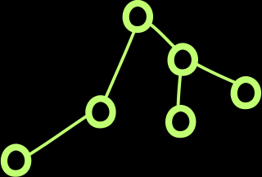

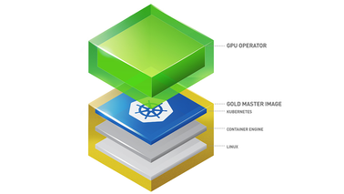


Experimental Setup
GPU
App A pods pool
Keep dataset cached in GPU memory
MIG slices
Client HTTP request
{App A, Graph B}
GPU Operator
CPU RAM
Containerized Tigr function
Keep dataset cached in main memory

Slide 6
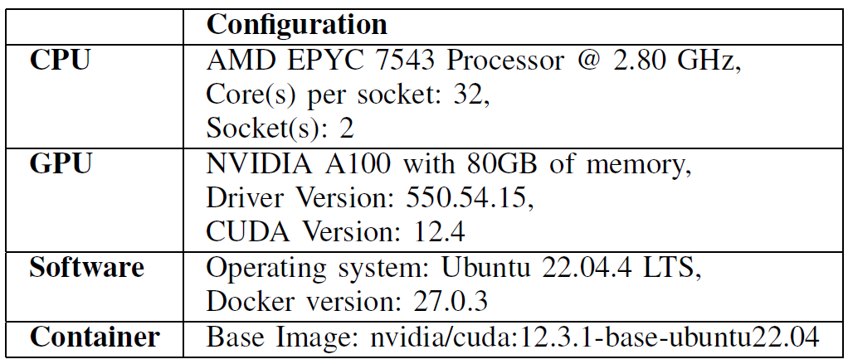
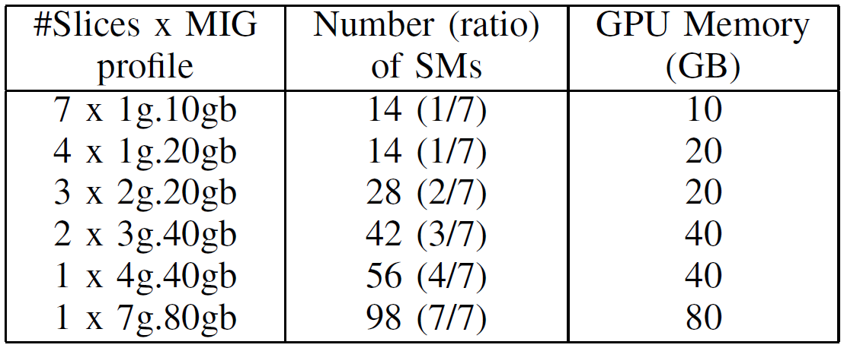
Evaluation Methodology
Hardware and Software Configurations
Milti-instance GPU (MIG) Configurations

Slide 7
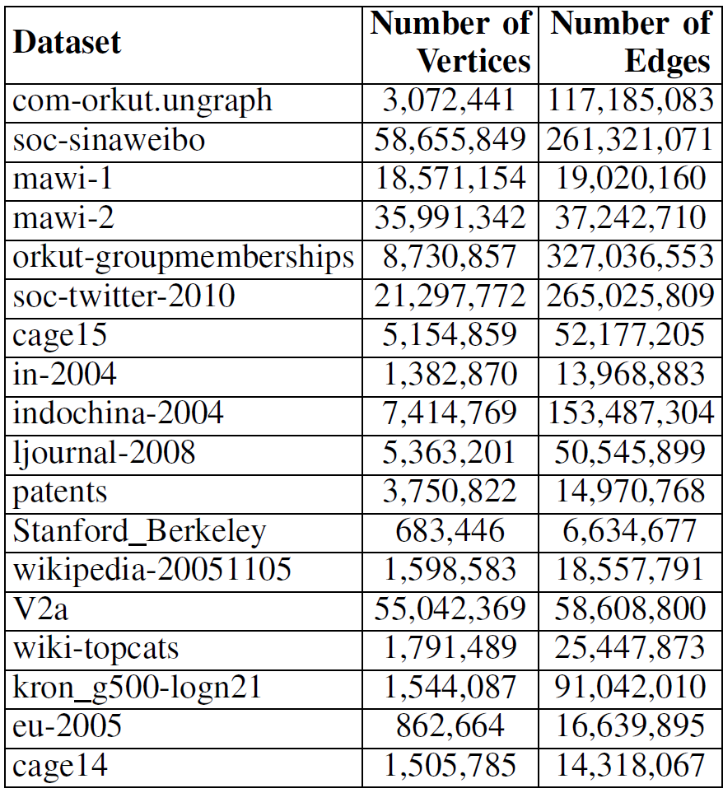
Evaluation Methodology
Functions supported in Tigr:
Breadth First Search (BFS)
Betweenness Centrality (BC)
Connected Components (CC)
Pagerank (PR)
Single Source Shortest Path (SSSP)
Single Source Widest Path (SSWP)
Use Hey for load generation
Datasets

Slide 8
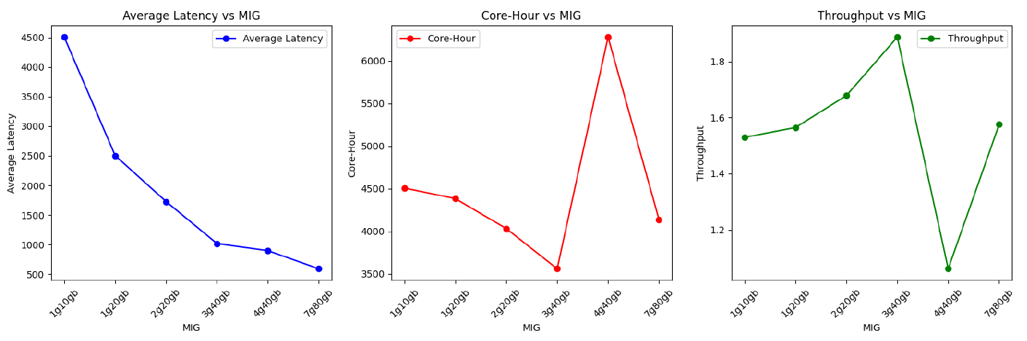
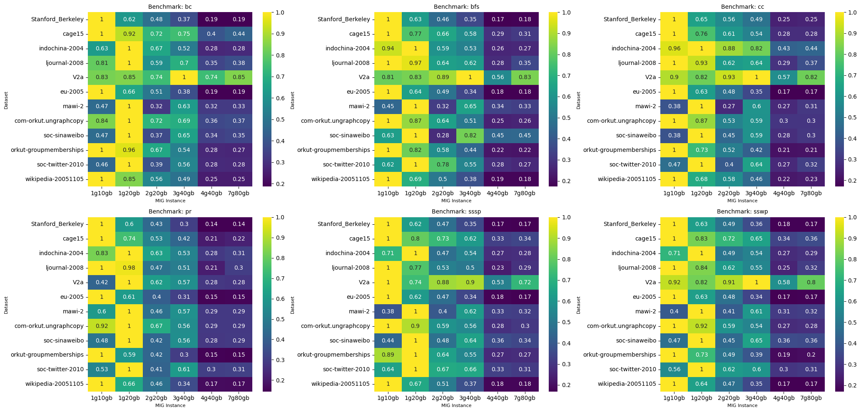
Evaluation: BFS function on V2a graph datasets
Inversely proportional to efficiency
x7
x4
x3
x2
x1
x1
Normalized throughput
Observation #1: Superlinear speedup from having larger L2 cache slice
Observation #2: Diminishing resource utilization for larger slices

Slide 9
Evaluation: BFS Function on Each Dataset
x7
x4
x3
x2
x1
x1
Observation #3: Best MIG configuration depends on the dataset

Slide 10
Evaluation: Each Function on Each Dataset
Observation #4: Best MIG configuration depends on the function invoked (to a lesser extent)

Slide 11
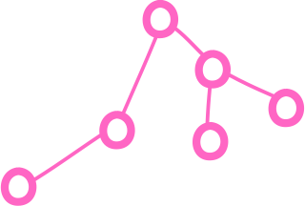
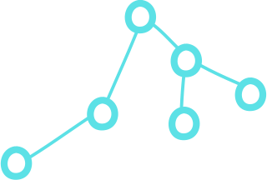
Experimental Setup With Multiple Functions and Datasets
GPU
App A pods pool
Cache as many dataset in memory as possible with LRU replacement
MIG slices
Client HTTP request
{App A, Graph B}
GPU Operator
CPU RAM
Containerized Tigr function

Slide 12
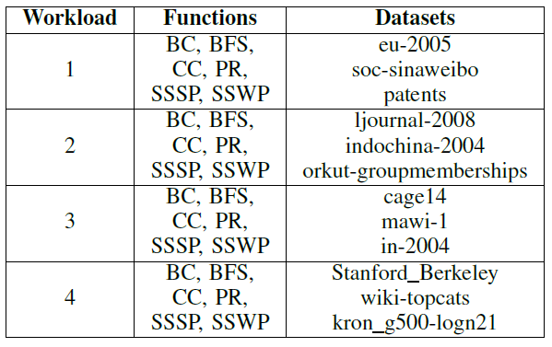
Evaluation Methodology with Multiple Functions and Datasets
Randomly select among mixture of functions and datasets:
Use a real invocation trace published by the Systems Infrastructure Research lab at Huawei’s Edinburgh Research Center

Slide 13
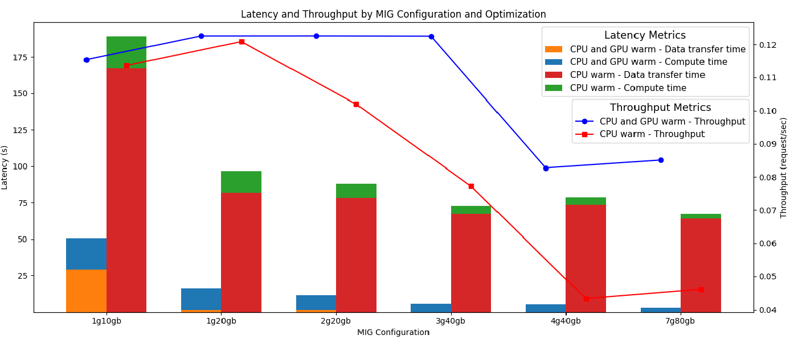
Evaluation: Workload #1 Performance Breakdown
Observation #5: Caching datasets in GPU memory is essential for performance
Observation #6: Small instances suffer from insufficient memory leading to thrashing of datasets

Slide 14
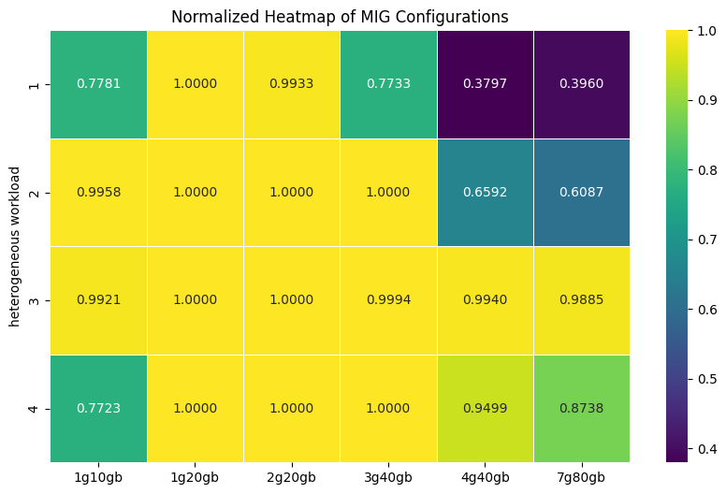
Evaluation: Multiple Functions and Datasets

Slide 15
Conclusion and Future Work
First study on the interaction between serverless computing, graph analytics, and multi-instance GPU
Best MIG configuration depends on dataset, function invoked, and number of datasets being accessed simultaneously
Smaller instances suffer from small L2 cache slices for large datasets
Smaller instances suffer from insufficient memory when there are many datasets
Larger instanced face diminishing resource utilization
Future work:
Performance models to select the best MIG configuration for a given workload
Dynamic reconfiguration of MIG to adapt to changing workload

Slide 16
Serverless Graph Analytics on Multi‑Instance GPUs
Mohammad Sonji (AUB), Mohammed Baydoun (AUB), Aditya Dhakal (HPE), Gourav Rattihalli (HPE), Dejan Milojicic (HPE), Izzat El Hajj (AUB)
The Workshop on Graphs, Architectures, Programming, and Learning (GrAPL’25)
June 4, 2025

