Slide 1

Predicting Performance Variability
Mohammed Baydoun (AUB), Mohammad Sonji (AUB), Pedro Bruel (HPE), Dejan Milojicic (HPE), Eitan Frachtenberg (HPE), Izzat El Hajj (AUB)
The International Workshop on Automatic Performance Tuning (iWAPT’25)
June 3, 2025

Slide 2
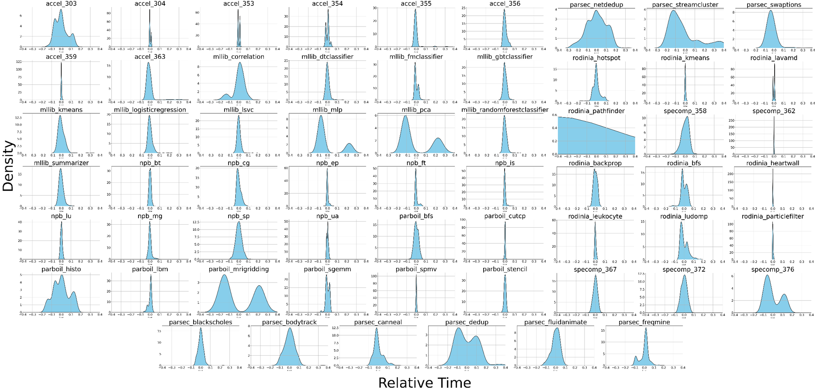
Motivation: Computer Applications have Performance Variability

Slide 3
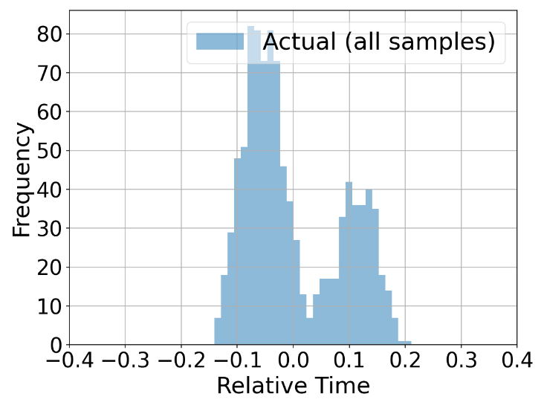
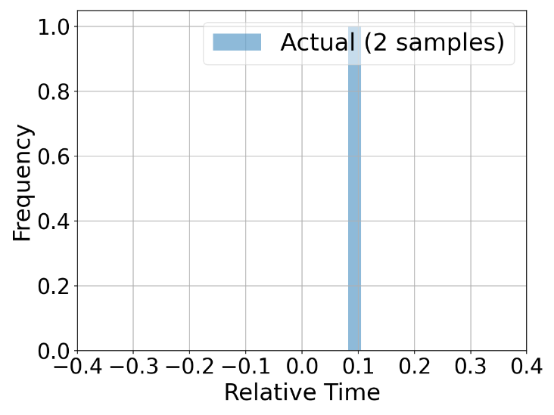
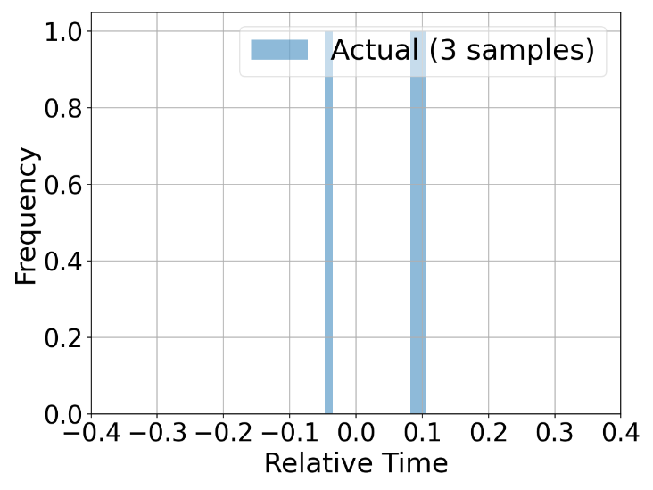
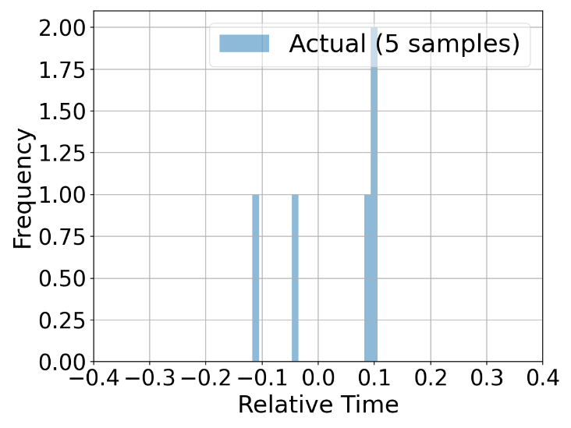
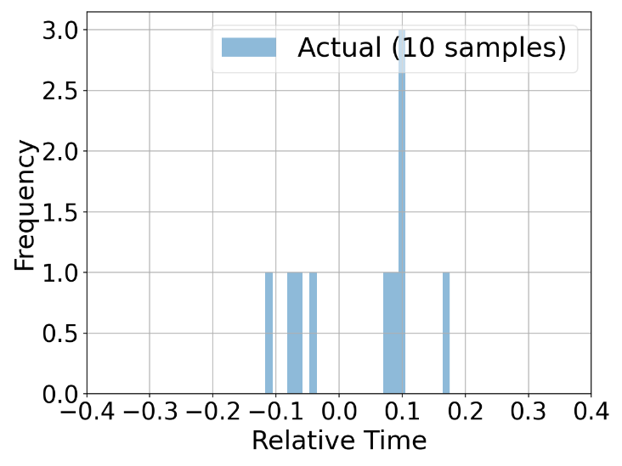
Motivation: Many Samples are Needed to Measure an Accurate Distribution
Measured distribution from 1,000 samples
Measured distribution from 2 samples
Measured distribution from 3 samples
Measured distribution from 5 samples
Measured distribution from 10 samples

Slide 4
Research Question
What if we do not have the resources to run the application many times on the system?
Can we predict the performance distribution from just a few samples?
Can we predict the performance distribution from running on another system?
Train model by learning from other applications
Prediction Model
App
…
density
performance

Slide 5
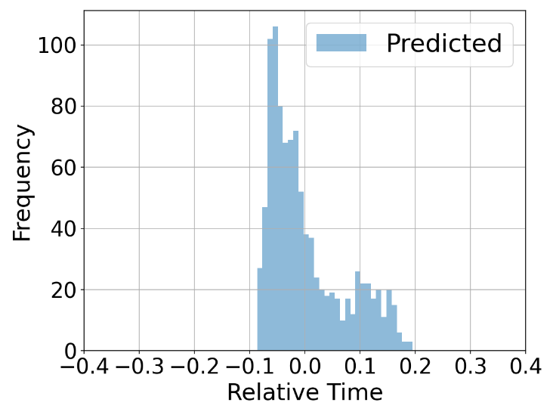
Sneak Peak at Results
Measured distribution from 1,000 samples
Measured distribution from 2 samples
Measured distribution from 3 samples
Measured distribution from 5 samples
Measured distribution from 10 samples
Predicted distribution from 10 samples

Slide 6
Predicting Performance Distribution from Few Samples
Profiler
Prediction Model
App
run | metrics |  |  |  |  | perfor-mance
 | m₁ | m₂ | m₃ | … | m_{k}
1
2
3
density
performance
How to represent an application’s profile as a feature vector?
Which model to use?
What data to train it with?
How to represent a performance distribution as a feature vector?

Slide 7
Predicting Performance Distribution from Few Samples
Profiler
Prediction Model
App
run | metrics |  |  |  |  | perfor-mance
 | m₁ | m₂ | m₃ | … | m_{k}
1
2
3
density
performance
How to represent an application’s profile as a feature vector?
Which model to use?
What data to train it with?
How to represent a performance distribution as a feature vector?

Slide 8
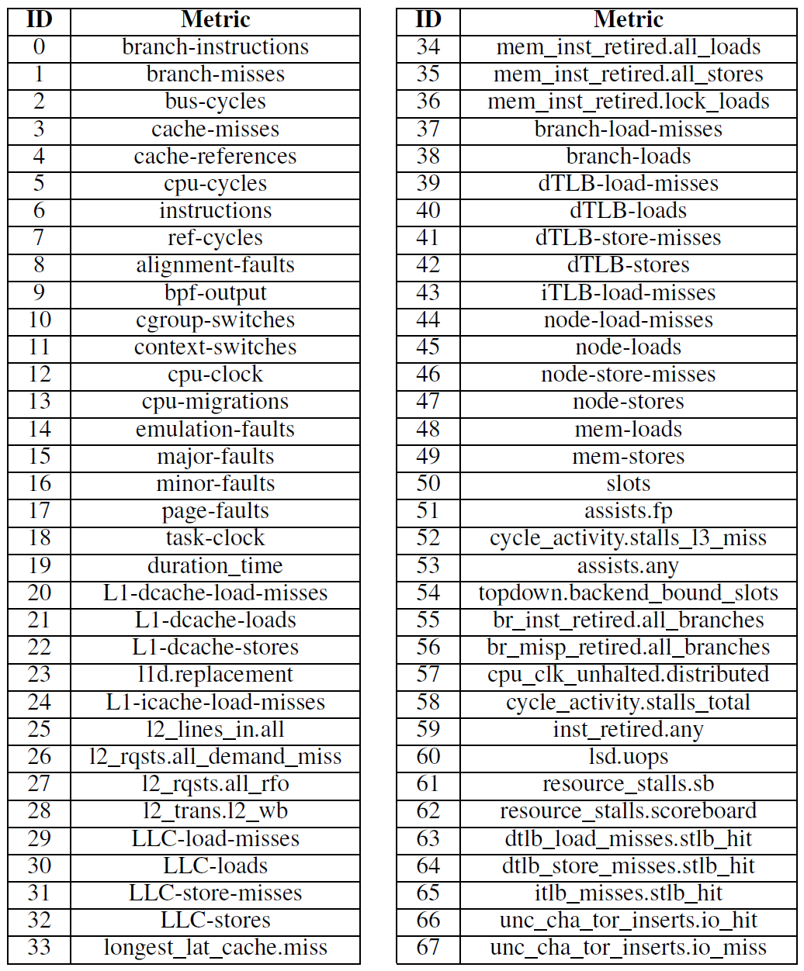
Representing an Application’s Profile
Application-independent hardware and software metrics (68 metrics from from Linux perf)
Instruction counts (branches, loads, stores, floating point, total)
Cache metrics (references, hits, misses)
Main memory metrics
TLB metrics
Relative metrics normalized per second
Unify model across applications with different durations
If multiple samples, mean, standard deviation, skewness, kurtosis
Higher order moments did not improve results

Slide 9
Predicting Performance Distribution from Few Samples
Profiler
Prediction Model
App
run | metrics |  |  |  |  | perfor-mance
 | m₁ | m₂ | m₃ | … | m_{k}
1
2
3
density
performance
How to represent an application’s profile as a feature vector?
Which model to use?
What data to train it with?
How to represent a performance distribution as a feature vector?

Slide 10
Representing the Performance Distribution
Histogram: The feature vector is the bins of a histogram of the relative time (similar to a discretized PDF)
Moments: The feature vector is the moments of the distribution (we consider the first four moments: mean, standard deviation, skewness, and kurtosis)
PyMaxEnt: Reconstruct the distribution from the moments using the principle of maximum entropy [30]
PearsonRnd: Reconstruct the distribution by drawing random numbers from the distribution in the Pearson system with these moments

Slide 11
Predicting Performance Distribution from Few Samples
Profiler
Prediction Model
App
run | metrics |  |  |  |  | perfor-mance
 | m₁ | m₂ | m₃ | … | m_{k}
1
2
3
density
performance
How to represent an application’s profile as a feature vector?
Which model to use?
What data to train it with?
How to represent a performance distribution as a feature vector?

Slide 12
Choice of Prediction Model
k-nearest neighbors (kNN)
Can deal with noisy data, which is the case for the metrics we collect
k = 15
Distance metric: cosine similarity
Random forests (RF) and extreme gradient boosting (XGBoost)
Can deal with a large and diverse set of input features

Slide 13
Predicting Performance Distribution from Few Samples
Profiler
Prediction Model
App
run | metrics |  |  |  |  | perfor-mance
 | m₁ | m₂ | m₃ | … | m_{k}
1
2
3
density
performance
How to represent an application’s profile as a feature vector?
Which model to use?
What data to train it with?
How to represent a performance distribution as a feature vector?

Slide 14
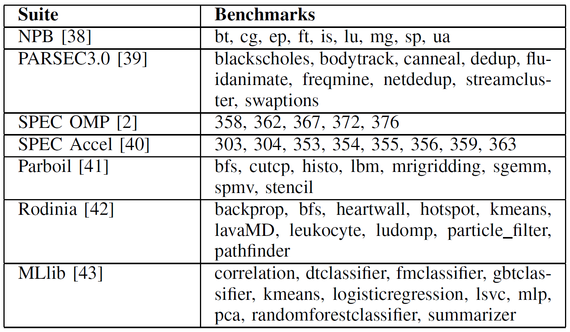
Training the Model
Use 60 benchmarks from popular HPC and data analytics applications and libraries
Run application for 1,000 repetitions (samples) to measure the distribution

Slide 15
Evaluation Methodology
Hardware specifications
Intel Xeon Platinum 8358 CPU
512GB of DDR4 RAM
64 cores total (2 sockets, 32 cores per socket)
Benchmarking conditions
The benchmarks ran on an entire node and without any interference
Error evaluation
We use cross-validation (leave-one-group-out) to assess the accuracy of the model
We use the Kolmogorov-Smirnov (KS) divergence test to assess quantify the agreement between the observed and predicted distributions (0 is a perfect match, 1 is the worst)

Slide 16
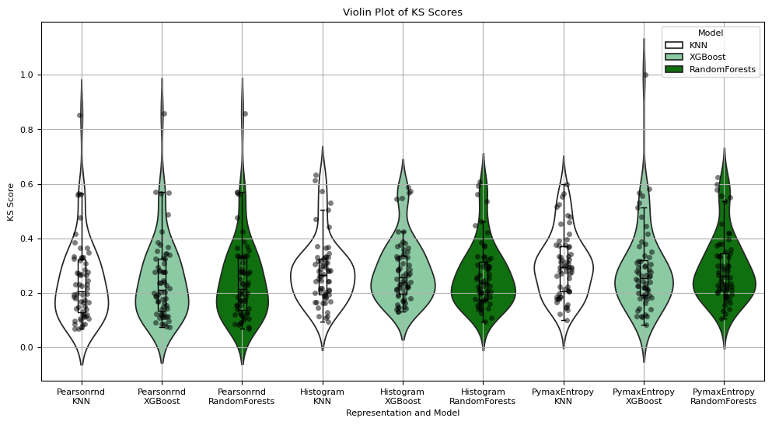
Evaluation: Model and Output Representation
Observation #1: kNN has the lowest median KS score
Observation #2: PearsonRnd has the lowest median KS score
Observation #3: Most benchmarks have KS score lower than 0.4

Slide 17
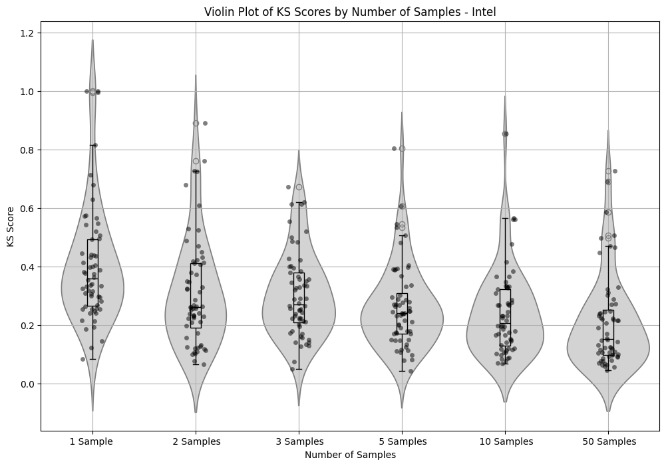
Evaluation: Number of Samples
Observation: Improved accuracy as number of samples increases
(users can trade off number of samples for accuracy)

Slide 18
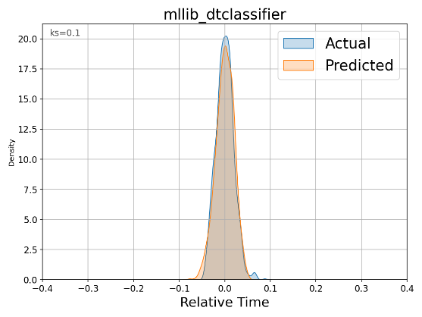
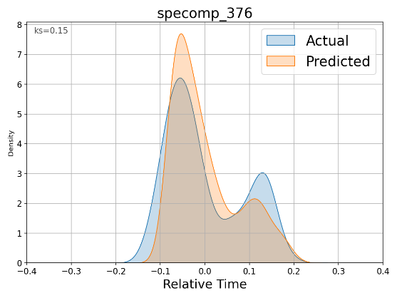
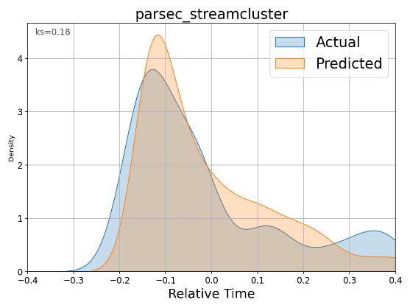
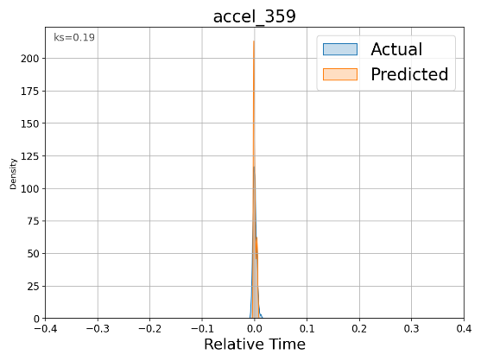
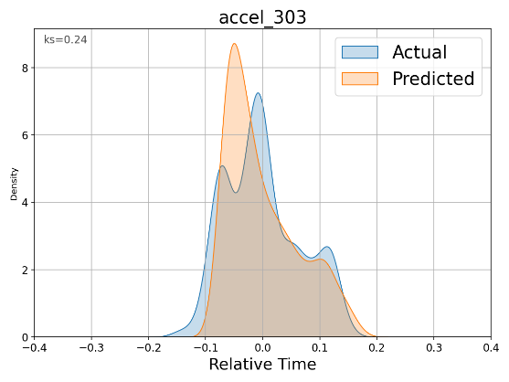
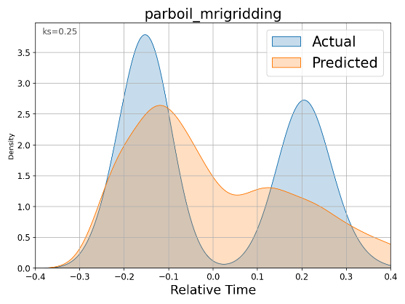
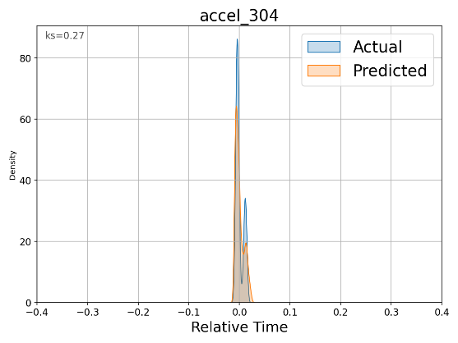
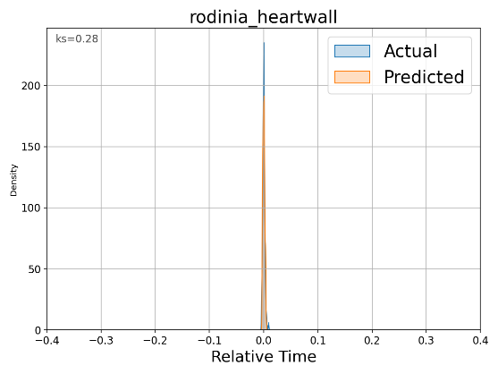
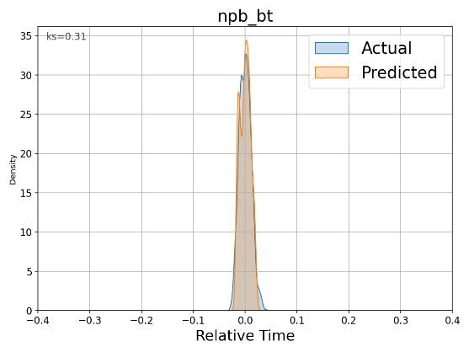
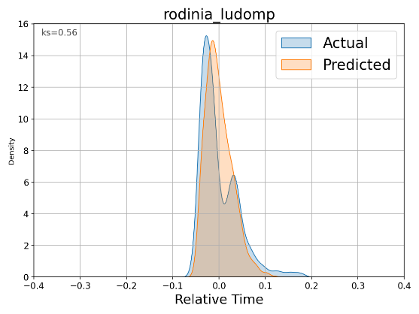
Evaluation: Examples
Observation #1: Width of the distribution predicted accurately
Observation #2: Number of modes and relative positions and sizes predicted accurately

Slide 19
Predicting Performance Distributions from Another Distribution on Another System
Profiler
System 1
Prediction Model
System 2
App
density
density
performance
performance
Same design considerations as the first use case
Input distribution includes distribution of profiling metrics, not just perfomance
Hardware specifications of the second system used
AMD EPYC 7543 CPU
512GB of DDR4 RAM
64 cores total (2 sockets, 32 cores per socket)
75 profiling metrics different from the ones on the Intel system

Slide 20
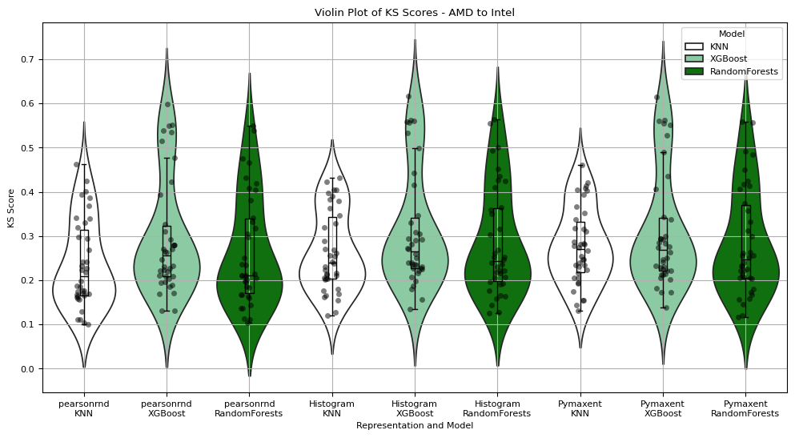
Evaluation: Model and Output Representation
Observation #1: kNN has the lowest median KS score
Observation #2: PearsonRnd has the lowest median KS score
Observation #3: Most benchmarks have KS score lower than 0.4

Slide 21
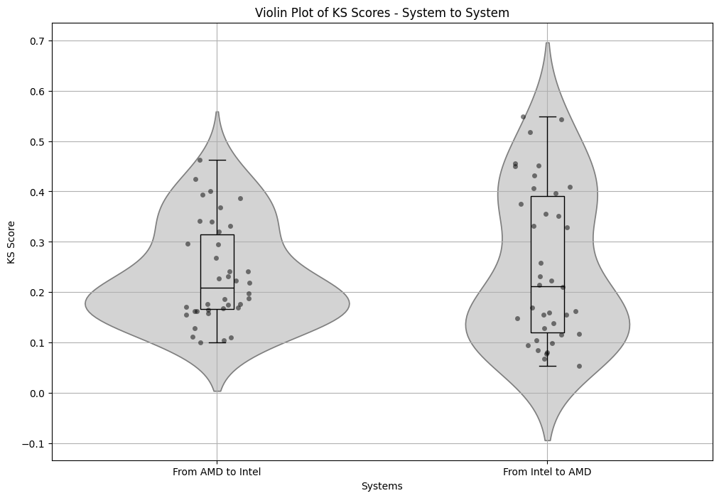
Evaluation: Direction of Prediction
Observation: Prediction accuracy differs based on direction of prediction but only slightly

Slide 22
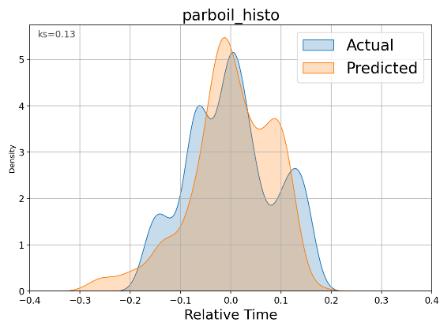
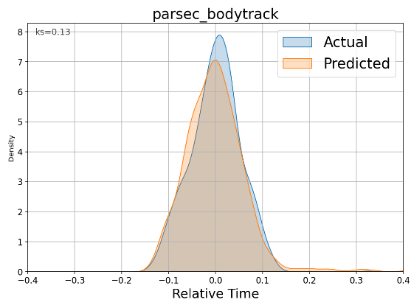
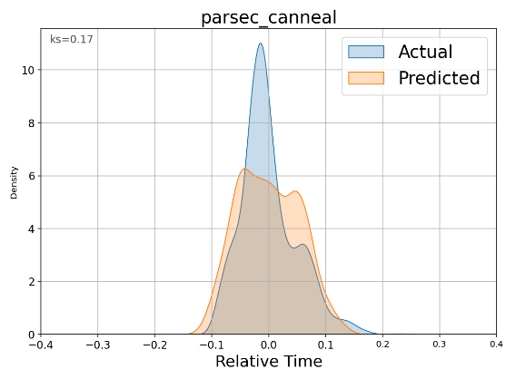
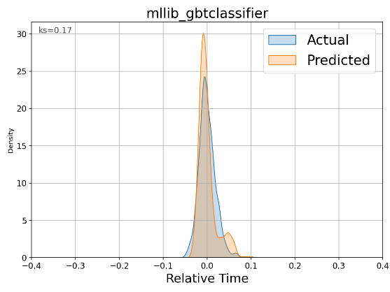
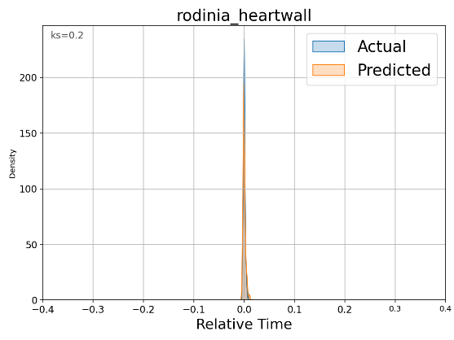
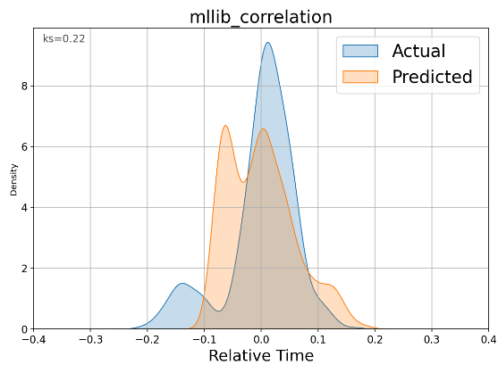
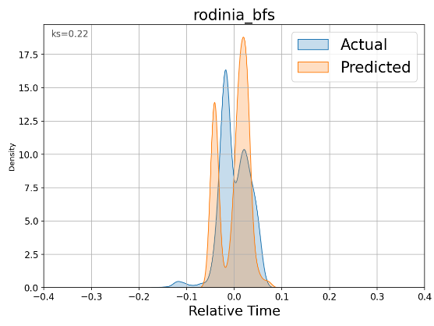
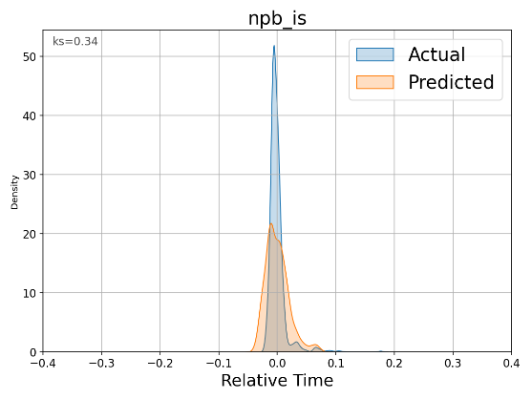
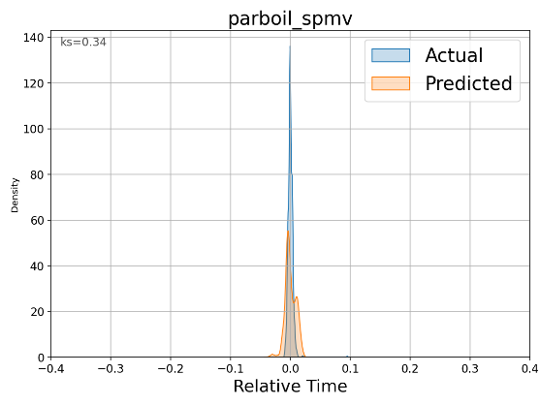
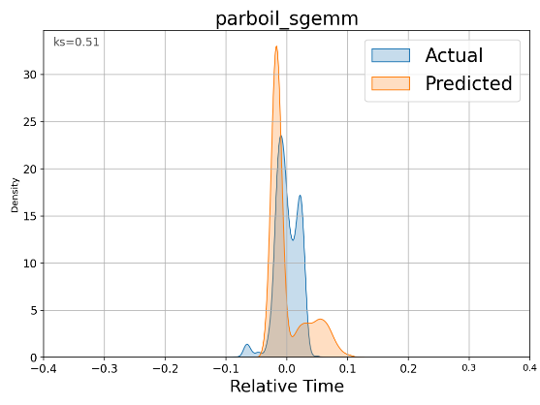
Evaluation: Examples
Observation #1: Width of the distribution predicted accurately
Observation #2: Number of modes and relative positions predicted accurately, but mixed success on their relative sizes

Slide 23
Summary and Future Work
We show that application performance variability can be predicted by learning from other applications
We use application-independent profiling and relative profiling metrics to unify model across diverse applications with different durations
We show that kNN is the best performing model and PearsonRnd is the best method for representing the distribution for the purpose of prediction
Future work:
Increase training data by covering more applications and systems
Use explainable models and leverage explanations to optimize for variability

Slide 24
Predicting Performance Variability
Mohammed Baydoun (AUB), Mohammad Sonji (AUB), Pedro Bruel (HPE), Dejan Milojicic (HPE), Eitan Frachtenberg (HPE), Izzat El Hajj (AUB)
The International Workshop on Automatic Performance Tuning (iWAPT’25)
June 3, 2025

