Slide 1
SAVI Objects: Sharing and Virtuality Incorporated
Izzat El Hajj (Illinois & HPE), Thomas B. Jablin (Illinois & MulticoreWare), Dejan Milojicic (HPE), Wen-mei Hwu (Illinois)

Slide 2
Subtype Polymorphism
Useful for handling collections of heterogeneous objects
Key feature of object-oriented programming languages supporting inheritance (e.g., C++, C#, Java, Javascript, Python, etc.)
Virtual Tables (VTs) typically used in languages only allowing single dispatch on a known set of methods (e.g., C++, C#, Java)

Slide 3
Virtual Tables (C++ example)
class A {
int x;
float y;
void foo();
virtual void bar();
virtual void baz();
};
instance of A
VT_{A}
Code
&VT_{A}
x
y
&bar
&baz
A::foo ...
A::bar ...
A::baz ...
B::baz ...
B::qux ...
class B : public A {
int z;
virtual void baz();
virtual void qux();
};
instance of B
VT_{B}
&VT_{B}
x
y
z
&bar
&baz
&qux

Slide 4
Sharing of In-Memory Objects
Shared memory regions
Memory-mapped files over traditional storage
Persistent regions over byte-addressable non-volatile memory
NVM
Process 1
Process 2
Process 1
Process 2
Process 1
Process 2
Disk

Slide 5
Virtual Tables and Sharing
VTs stored privately in the process virtual address space
invalid!
0xbead
0xbead
globals
VT_{A}(P_{c})
0xbeef
Different processes may store VT of the same type at a different address
globals
VT_{A}(P_{u})
0xbead
shared region
0xbead
shared region
Solutions proposed:
Virtual Table Duplication
Hashing-based Dynamic Dispatch
creating process (P_{c})
user process (P_{u})

Slide 6
Virtual Tables and Sharing
Boost.Interprocess Documentation:
“Virtuality forbidden
The virtual table pointer and the virtual table are in the address space of the process that constructs the object, so if we place a class with a virtual function or virtual base class, the virtual pointer placed in shared memory will be invalid for other processes and they will crash.
"
This problem is very difficult to solve, since each process needs a different virtual table pointer and the object that contains that pointer is shared across many processes. Even if we map the mapped region in the same address in every process, the virtual table can be in a different address in every process. To enable virtual functions for objects shared between processes, deep compiler changes are needed and virtual functions would suffer a performance hit. That's why Boost.Interprocess does not have any plan to support virtual function and virtual inheritance in mapped regions shared between processes”

Slide 7
Virtual Table Duplication

Slide 8
Overview
0xbead
0xbead
globals
VT_{A}(P_{c})
0xbeef
globals
VT_{A}(P_{u})
0xbead
shared region
0xbeef
shared region
creating process (P_{c})
user process (P_{u})

Slide 9
Overview
0xbead
0xbead
globals
VT_{A}(P_{c})
0xbeef
globals
VT_{A}(P_{u})
0xdeed
shared region
0xdeed
shared region
0xdeed
0xdeed
`
Duplicate virtual table (DVT) at fixed address specific to the shared region
DVTs
DVT_{A}(P_{c})
DVTs
DVT_{A}(P_{u})
creating process (P_{c})
user process (P_{u})

Slide 10
Process Entry
VT Look-up Table (VLT):
VT Look-up Table (VLT):
mangled(A) | 0xa000
mangled(B) | 0xa200
0xa000
VT_{A} (P_{c})
0xa100
mangled(A) | 0xa100
mangled(B) | 0xa300
globals
0xa200
globals
VT_{A} (P_{u})
VT_{B} (P_{c})
0xa300
VT_{B} (P_{u})
Table initialized to lookup VT addresses
creating process (P_{c})
user process (P_{u})

Slide 11
Region Mapping
VT Look-up Table (VLT):
VT Look-up Table (VLT):
mangled(A) | 0xa000
mangled(B) | 0xa200
0xa000
VT_{A} (P_{c})
0xa100
mangled(A) | 0xa100
mangled(B) | 0xa300
globals
0xa200
globals
VT_{A} (P_{u})
VT_{B} (P_{c})
0xa300
VT_{B} (P_{u})
Range Table (RT):
[0xb000,0xb800] | R₁
[0xc000,0xc400] | R₂
[0xd000,0xd400] | R₁
[0xf000,0xf400] | R₂
0xb000
R₁
0xb800
0xc000
(1) Register region in range table
(2) Map DVT fixed region and register in range table
(to be used later to allocate DVTs)
R₂
0xc400
0xd000
R₁ DVTs
0xd400
0xf000
R₂ DVTs
0xf400
creating process (P_{c})
user process (P_{u})

Slide 12
Object Construction
VT Look-up Table (VLT):
VT Look-up Table (VLT):
mangled(A) | 0xa000
mangled(B) | 0xa200
0xa000
VT_{A} (P_{c})
0xa100
mangled(A) | 0xa100
mangled(B) | 0xa300
globals
0xa200
globals
VT_{A} (P_{u})
VT_{B} (P_{c})
0xa300
VT_{B} (P_{u})
Range Table (RT):
[0xb000,0xb800] | R₁
[0xc000,0xc400] | R₂
[0xd000,0xd400] | R₁
[0xf000,0xf400] | R₂
0xb000
(3) Lookup DVT for type
(4) Set VT pointer to DVT
R₁
0xd000
0xb800
0xc000
R₁’s DVT Look-up Table (DLT):
R₂
mangled(A) | 0xd000
[First Time Only]
(1) Lookup region in range table
(2) Allocate and register fixed address for DVT (no duplication yet)
0xc400
0xd000
DVT_{A} (P_{c}, R₁)
R₁ DVTs
0xd400
0xf000
R₂ DVTs
0xf400
creating process (P_{c})
user process (P_{u})

Slide 13
Object Construction (again)
VT Look-up Table (VLT):
VT Look-up Table (VLT):
mangled(A) | 0xa000
mangled(B) | 0xa200
0xa000
VT_{A} (P_{c})
0xa100
mangled(A) | 0xa100
mangled(B) | 0xa300
globals
0xa200
globals
VT_{A} (P_{u})
VT_{B} (P_{c})
0xa300
VT_{B} (P_{u})
Range Table (RT):
[0xb000,0xb800] | R₁
[0xc000,0xc400] | R₂
[0xd000,0xd400] | R₁
[0xf000,0xf400] | R₂
0xb000
R₁
0xd000
0xb800
0xc000
0xf000
R₁’s DVT Look-up Table (DLT):
R₂
0xf200
mangled(A) | 0xd000
R₂’s DVT Look-up Table (DLT):
0xc400
mangled(A) | 0xf000
mangled(B) | 0xf200
0xd000
DVT_{A} (P_{c}, R₁)
R₁ DVTs
0xd400
Different DVTs for different regions
(otherwise would need to synchronize DVT management across all regions in all processes)
0xf000
DVT_{A} (P_{c}, R₂)
R₂ DVTs
0xf200
DVT_{B} (P_{c}, R₂)
0xf400
creating process (P_{c})
user process (P_{u})

Slide 14
Region Mapping (again)
VT Look-up Table (VLT):
VT Look-up Table (VLT):
mangled(A) | 0xa000
mangled(B) | 0xa200
0xa000
VT_{A} (P_{c})
0xa100
mangled(A) | 0xa100
mangled(B) | 0xa300
globals
0xa200
globals
VT_{A} (P_{u})
VT_{B} (P_{c})
0xa300
VT_{B} (P_{u})
Range Table (RT):
Range Table (RT):
[0xb000,0xb800] | R₁
[0xc000,0xc400] | R₂
[0xd000,0xd400] | R₁
[0xf000,0xf400] | R₂
0xb000
0xb100
[0xb100,0xb900] | R₁
[0xc100,0xc500] | R₂
[0xd000,0xd400] | R₁
[0xf000,0xf400] | R₂
R₁
0xd000
0xd000
R₁
0xb800
0xb900
0xc000
0xf000
0xc100
R₁’s DVT Look-up Table (DLT):
0xf000
R₁’s DVT Look-up Table (DLT):
shared
R₂
0xf200
R₂
mangled(A) | 0xd000
0xf200
R₂’s DVT Look-up Table (DLT):
0xc400
R₂’s DVT Look-up Table (DLT):
shared
0xc500
mangled(A) | 0xf000
mangled(B) | 0xf200
0xd000
DVT_{A} (P_{c}, R₁)
0xd000
DVT_{A} (P_{c}, R₁)
R₁ DVTs
R₁ DVTs
0xd400
0xd400
(1) Register region in range table
(2) Map DVT fixed regions and register in range table
0xf000
DVT_{A} (P_{c}, R₂)
0xf000
DVT_{A} (P_{c}, R₂)
R₂ DVTs
0xf200
R₂ DVTs
0xf200
DVT_{B} (P_{c}, R₂)
DVT_{B} (P_{c}, R₂)
0xf400
0xf400
creating process (P_{c})
user process (P_{u})

Slide 15
Dynamic Dispatch
VT Look-up Table (VLT):
VT Look-up Table (VLT):
mangled(A) | 0xa000
mangled(B) | 0xa200
0xa000
VT_{A} (P_{c})
0xa100
mangled(A) | 0xa100
mangled(B) | 0xa300
globals
0xa200
globals
VT_{A} (P_{u})
VT_{B} (P_{c})
0xa300
VT_{B} (P_{u})
Range Table (RT):
Range Table (RT):
[0xb000,0xb800] | R₁
[0xc000,0xc400] | R₂
[0xd000,0xd400] | R₁
[0xf000,0xf400] | R₂
0xb000
0xb100
[0xb100,0xb900] | R₁
[0xc100,0xc500] | R₂
[0xd000,0xd400] | R₁
[0xf000,0xf400] | R₂
R₁
0xd000
0xd000
R₁
0xb800
0xb900
0xc000
0xf000
0xc100
R₁’s DVT Look-up Table (DLT):
0xf000
R₁’s DVT Look-up Table (DLT):
shared
R₂
0xf200
R₂
mangled(A) | 0xd000
0xf200
R₂’s DVT Look-up Table (DLT):
0xc400
R₂’s DVT Look-up Table (DLT):
shared
0xc500
mangled(A) | 0xf000
mangled(B) | 0xf200
0xd000
0xd000
DVT_{A} (P_{u}, R₁)
R₁ DVTs
DVT_{A} (P_{c}, R₁)
R₁ DVTs
DVT_{A} (P_{c}, R₁)
[First Time Only]
Dispatch fault handler looks up VT and duplicates to DVT
Reasons for lazy duplication:
Avoid duplicating unused types (inefficient)
Avoid duplicating non-existent types (error)
0xd400
0xd400
0xf000
0xf000
DVT_{A} (P_{u}, R₂)
DVT_{A} (P_{c}, R₂)
DVT_{A} (P_{c}, R₂)
R₂ DVTs
0xf200
R₂ DVTs
0xf200
DVT_{B} (P_{u}, R₂)
DVT_{B} (P_{c}, R₂)
DVT_{B} (P_{c}, R₂)
0xf400
0xf400
creating process (P_{c})
user process (P_{u})

Slide 16
Object Construction (optimization)
VT Look-up Table (VLT):
VT Look-up Table (VLT):
mangled(A) | 0xa000
mangled(B) | 0xa200
0xa000
VT_{A} (P_{c})
0xa100
mangled(A) | 0xa100
mangled(B) | 0xa300
globals
0xa200
globals
VT_{A} (P_{u})
VT_{B} (P_{c})
0xa300
VT_{B} (P_{u})
Range Table (RT):
Range Table (RT):
[0xb000,0xb800] | R₁
[0xc000,0xc400] | R₂
[0xd000,0xd400] | R₁
[0xf000,0xf400] | R₂
0xb000
0xb100
[0xb100,0xb900] | R₁
[0xc100,0xc500] | R₂
[0xd000,0xd400] | R₁
[0xf000,0xf400] | R₂
R₁
0xd000
0xd000
R₁
0xb800
0xb900
0xc000
0xf000
0xc100
R₁’s DVT Look-up Table (DLT):
0xf000
R₁’s DVT Look-up Table (DLT):
shared
R₂
0xf200
R₂
mangled(A) | 0xd000
0xf200
R₂’s DVT Look-up Table (DLT):
0xc400
R₂’s DVT Look-up Table (DLT):
shared
0xc500
mangled(A) | 0xf000
mangled(B) | 0xf200
0xd000
0xd000
DVT_{A} (P_{u}, R₁)
R₁ DVTs
DVT_{A} (P_{c}, R₁)
R₁ DVTs
DVT_{A} (P_{c}, R₁)
DLT Cache:
0xd400
0xd400
DLT Cache:
Cache for fast lookup
0xf000
0xf000
DVT_{A} (P_{u}, R₂)
typeidx(A),R₁ | 0xd000
typeidx(A),R₂ | 0xf000
typeidx(B),R₂ | 0xf200
DVT_{A} (P_{c}, R₂)
DVT_{A} (P_{c}, R₂)
typeidx(A),R₁ | 0xd000
typeidx(A),R₂ | 0xf000
typeidx(B),R₂ | 0xf200
R₂ DVTs
0xf200
R₂ DVTs
0xf200
DVT_{B} (P_{u}, R₂)
DVT_{B} (P_{c}, R₂)
DVT_{B} (P_{c}, R₂)
0xf400
0xf400
creating process (P_{c})
user process (P_{u})

Slide 17
Compiler/Library Modifications
Few compiler changes and recompilation
Only transform constructors to lookup and use DVT pointers
Recompile all constructor definitions of client classes
Modify region management library mapping/unmapping functions

Slide 18
Hashing-based Dynamic Dispatch

Slide 19
Overview
hash(bar)
hash(bar)
globals
GVT(P_{c})
#
Look up function in a global virtual table (GVT) based on type and function hash value
globals
GVT(P_{u})
#
hash(A)
shared region
hash(A)
shared region
Note: Using hashing for dynamic dispatch is used in other languages but not for this purpose. We implement it in C++ to evaluate for this purpose and compare with the other approach.
creating process (P_{c})
user process (P_{u})

Slide 20
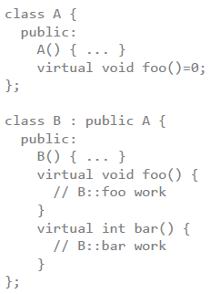
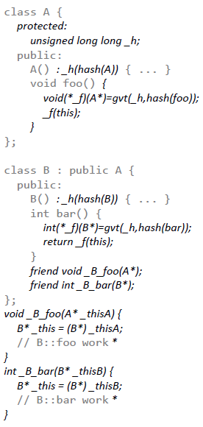
Compiler Transformation
Source-to-source

Slide 21
Compiler Transformation
Source-to-source
Top-level class declares hash value

Slide 22
Compiler Transformation
Source-to-source
Top-level class declares hash value
Constructors modified to initialize hash value

Slide 23
Compiler Transformation
Source-to-source
Top-level class declares hash value
Constructors modified to initialize hash value
Virtual functions perform global virtual table (GVT) lookup to obtain function pointer

Slide 24
Compiler Transformation
Source-to-source
Top-level class declares hash value
Constructors modified to initialize hash value
Virtual functions perform global virtual table (GVT) lookup to obtain function pointer
Virtual function bodies converted to friend functions and stored in GVT on process entry

Slide 25
Compiler Transformation
Source-to-source
Top-level class declares hash value
Constructors modified to initialize hash value
Virtual functions perform global virtual table (GVT) lookup to obtain function pointer
Virtual function bodies converted to friend functions and stored in GVT on process entry
Recompile code that: declares/defines client classes

Slide 26
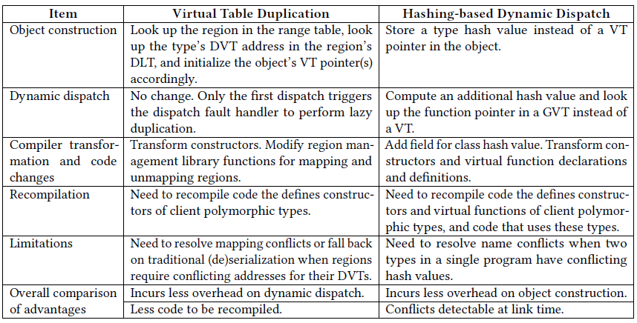
Comparison

Slide 27
Results

Slide 28
Construction Time Overhead
Range Table lookup
(a) Scalability w.r.t. the number of objects constructed
DVT lookup
(b) Scalability w.r.t. the number of regions used
(c) Scalability w.r.t. the number of polymorphic types
(d) Scalability w.r.t. the number of polymorphic functions
Duplication incurs overhead logarithmic in # region and # polymorphic types
Hashing has no overhead

Slide 29
Dynamic Dispatch Time Overhead
(a) Scalability w.r.t. the number of objects constructed
GVT lookup
(b) Scalability w.r.t. the number of regions used
GVT lookup
(c) Scalability w.r.t. the number of polymorphic types
(d) Scalability w.r.t. the number of polymorphic functions
Duplication has no overhead
Hashing incurs overhead logarithmic in # polymorphic types and # polymorphic functions per type

Slide 30
Xalan-C++ Use-case
Enabling object sharing eliminates data marshaling overhead (parsing) improving overall performance
Duplication adds more overhead to first parse (construction heavy)
Hashing adds more overhead to transformation (dispatch heavy)

Slide 31
Summary
Sharing in-memory objects is incompatible with virtual table implementations of subtype polymorphism
To solutions are proposed and compared:
Virtual Table Duplication
Hashing-based Dynamic Dispatch
Major application speedup by eliminating data marshalling at the expense of modest overheads to the rest of the application

Slide 32
Thank you! SAVI Objects: Sharing and Virtuality Incorporated
Izzat El Hajj (Illinois & HPE), Thomas B. Jablin (Illinois & MulticoreWare), Dejan Milojicic (HPE), Wen-mei Hwu (Illinois)

