Slide 1
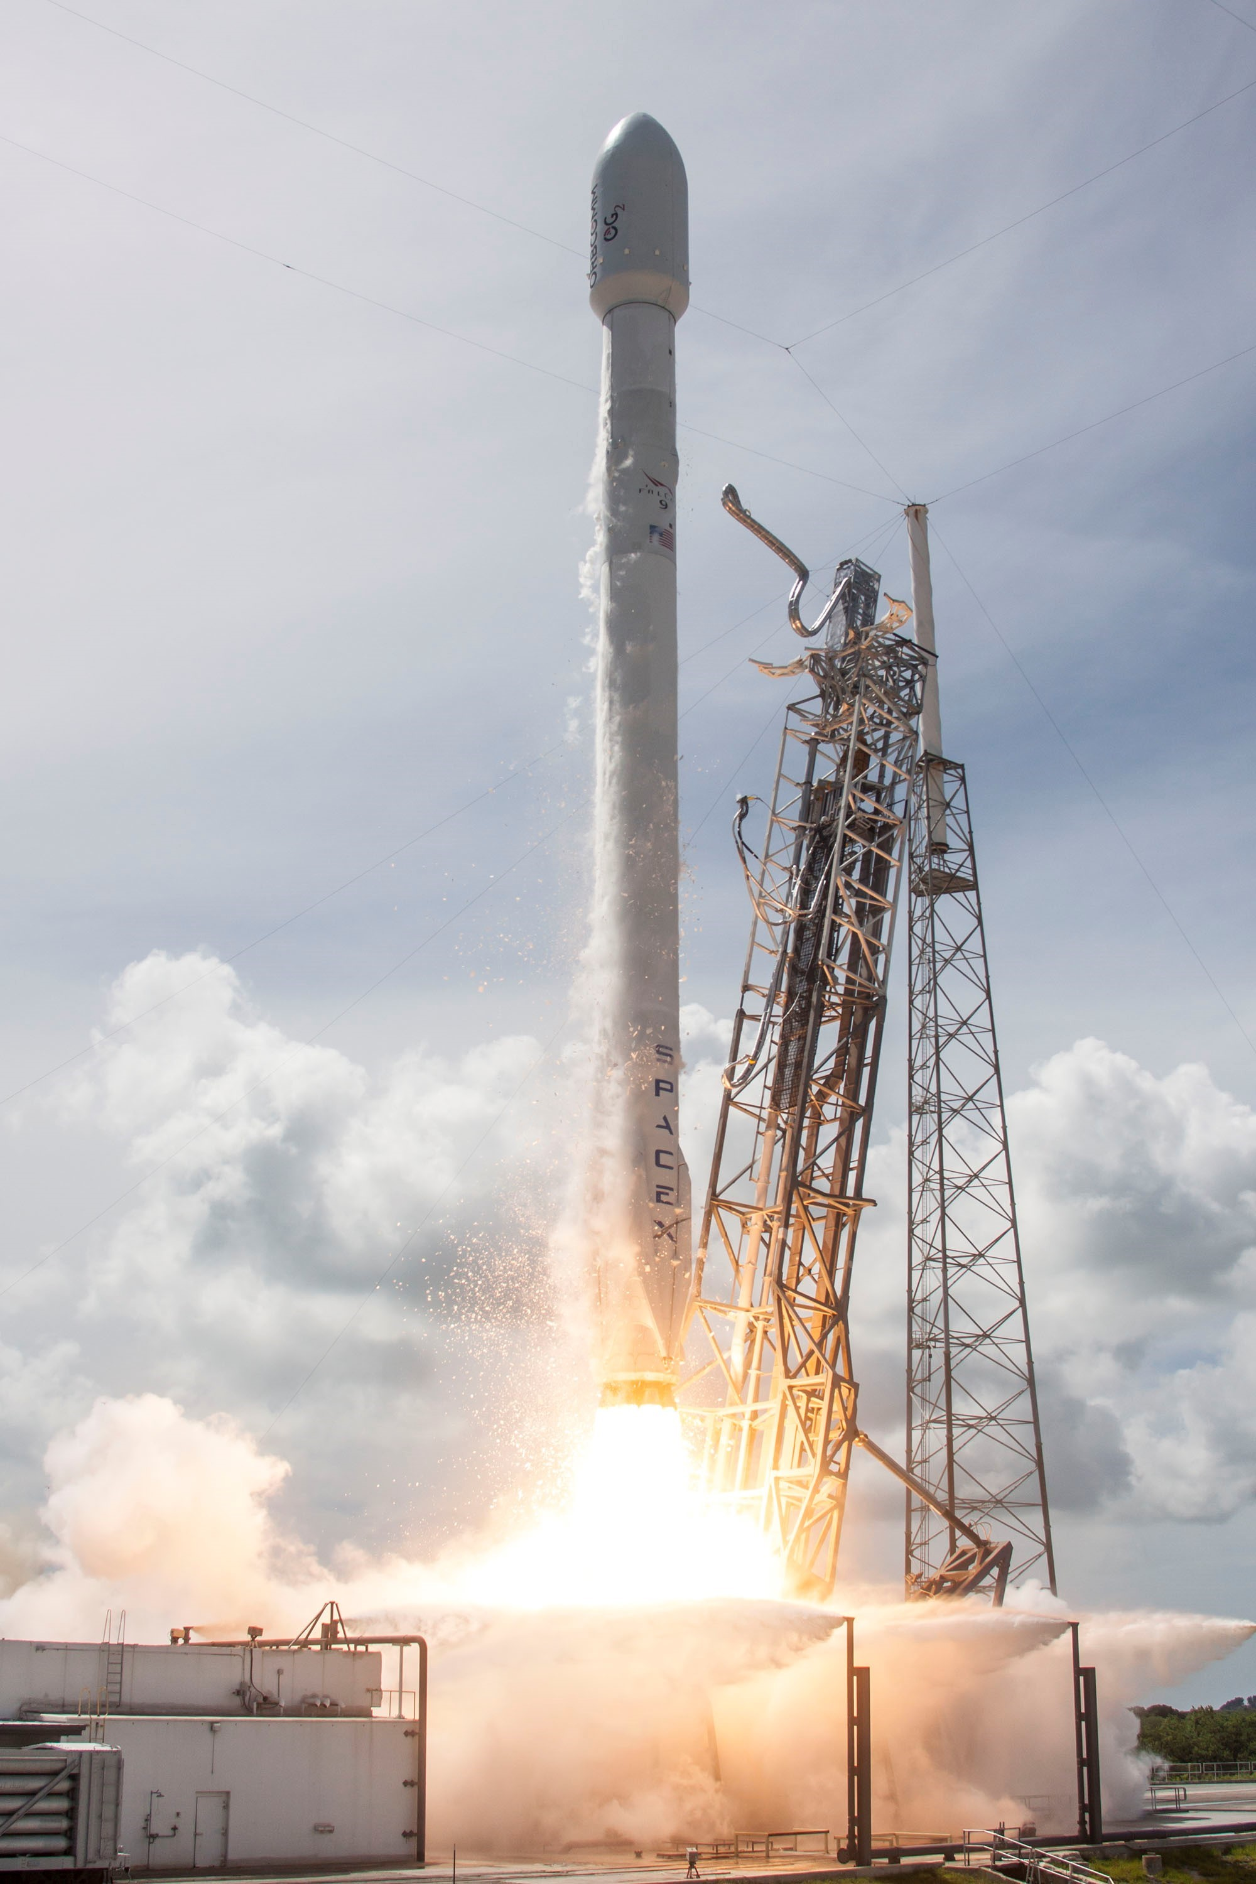




SpaceJMP: Programming with Multiple Virtual Address Spaces
Izzat El Hajj, Alexander Merritt, Gerd Zellweger,
Dejan Milojicic, Reto Achermann, Paolo Faraboschi,
Wen-mei Hwu, Timothy Roscoe, Karsten Schwan

Slide 2
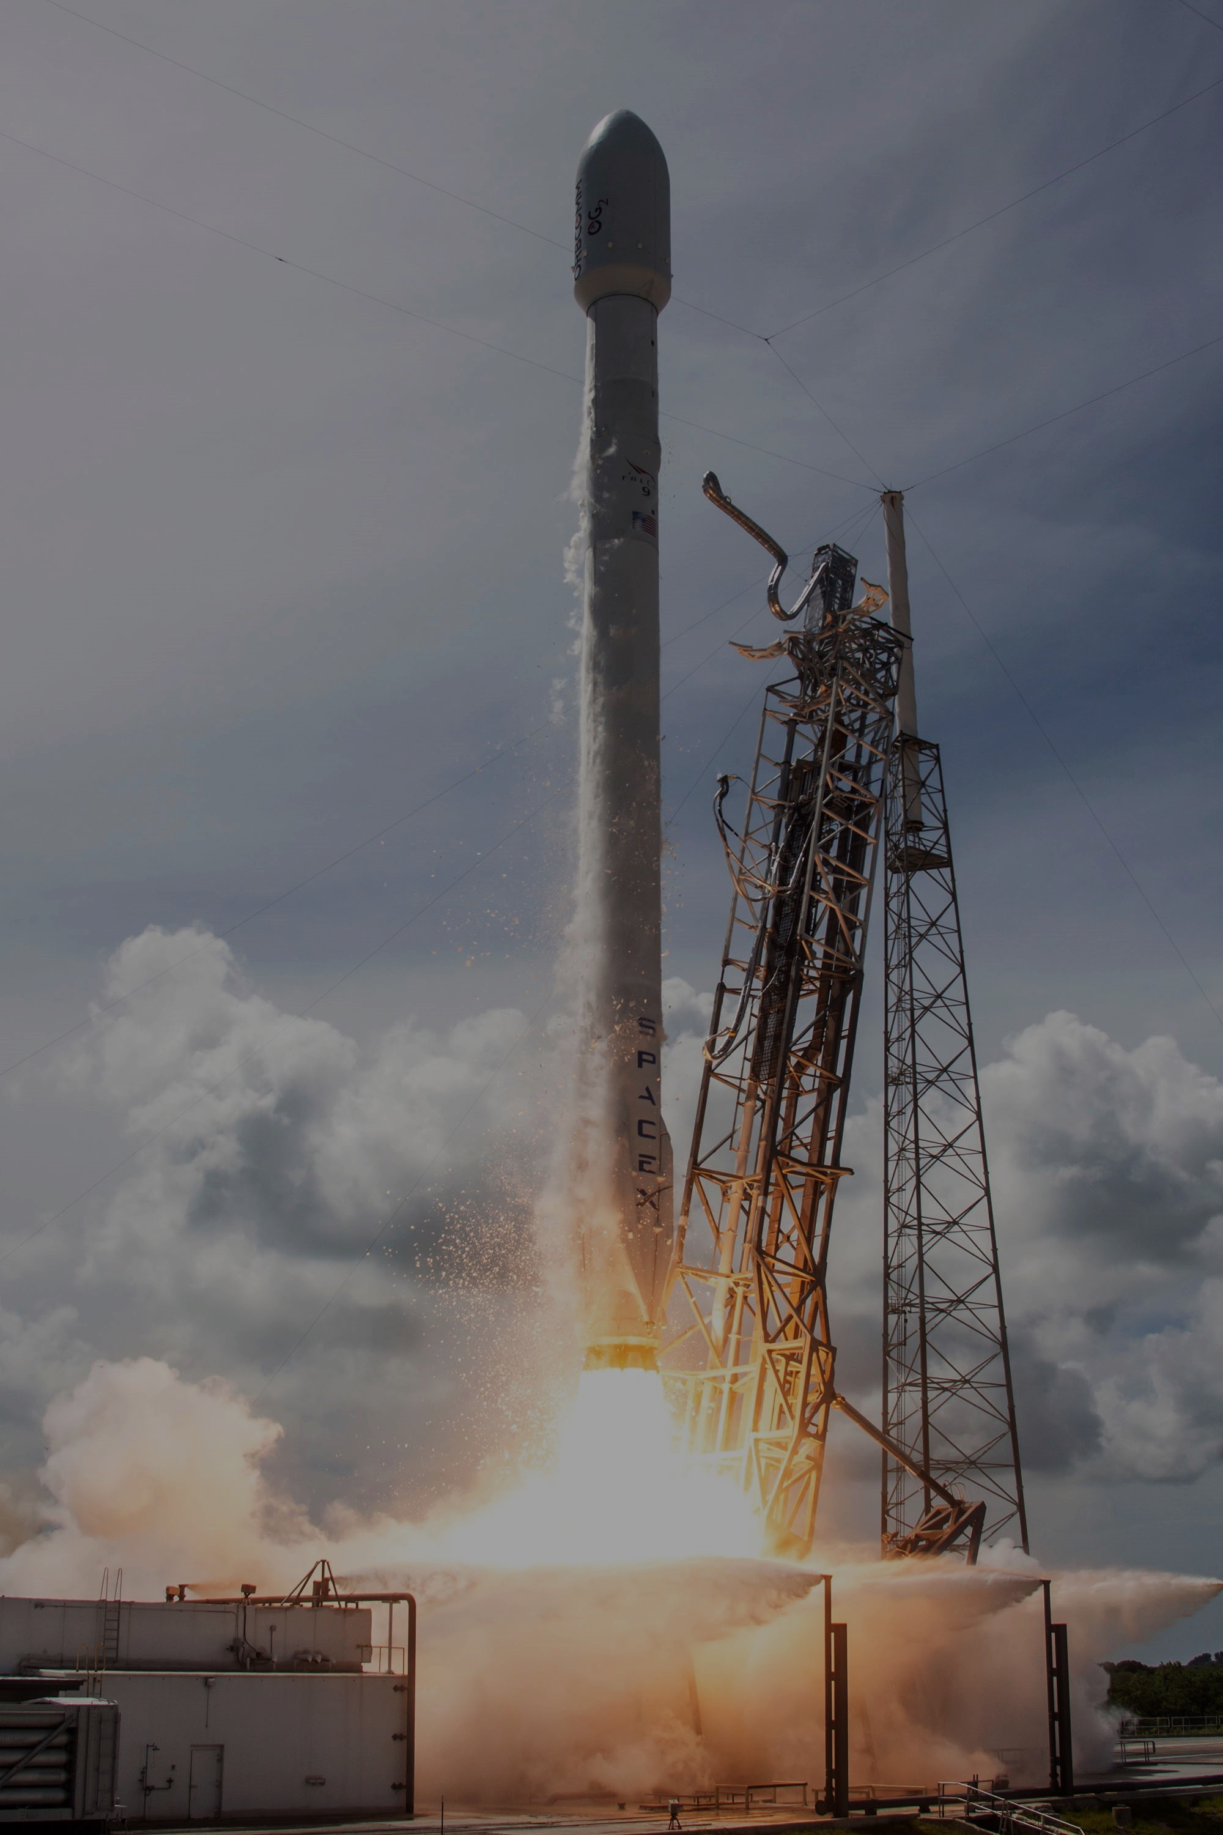
SpaceJMP: Programming with Multiple Virtual Address Spaces
Serialization is not necessary!
Don’t use filesystem!
Izzat El Hajj, Alexander Merritt, Gerd Zellweger,
Dejan Milojicic, Reto Achermann, Paolo Faraboschi,
Wen-mei Hwu, Timothy Roscoe, Karsten Schwan
Not enough virtual address bits!
Let applications manage address spaces!

Slide 3

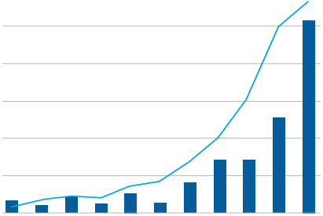
Enormous Demand for Data
$5
600
Invested Captial ($Billion)
$4
500
No. of Deals
$3
300
In-memory real-time analytics
$2
200
$1
100
2004
2005
2006
2007
2008
2009
2010
2011
2012
2013
2014
“How much data is generated every minute?” ¹
Venture Investments in Big Data Analytics Companies²
¹Source: DOMO, Data Never Sleeps 3.0, 2015
²Source: SVB, Big Data Next: Capturing the Promise of Big Data, 2015

Slide 4
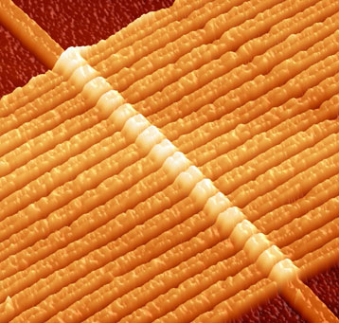
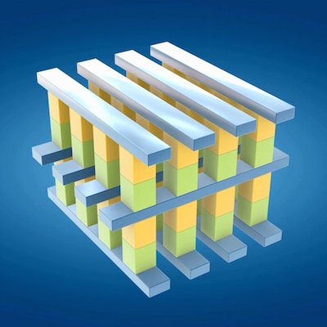
Memory-Centric Computing
Server
High Radix Switches
NVM
Blade
DRAM
CPU
CPU
DRAM
DRAM
SoC
Memristor
DRAM
CPU
CPU
DRAM
DRAM
SoC
...
...
load + store
Network
...
3D XPoint
DRAM
CPU
CPU
DRAM
DRAM
SoC
Shared nothing
Private DRAM
Network-only communication
Data marshaling
Shared something¹
Private DRAM
Global NVM pool
Byte-addressable
Near-uniform latency
¹Faraboschi, et al. Beyond Processor-Centric Operating Systems. HotOS’15

Slide 5
Sharing Pointer-Based Data
Symbol Table
Pointer Data Structure
0x8000
list|0x8D40
tree|null
Serialization via file system
Marshaling costs
Secondary representation
Region-based programming
Fixed base addresses region conflicts!
Special pointers map+swizzling or use offsets!
Contiguous Virtual Region
No control over the address space!
0x8000
Virtual Address Space
Memory Region
L
Virtual Address Space
0x4000
base
offset
0x8D40
0x4000
+
0x0D40
=
0x4D40
region pointer
(absolute)
region pointer
(relative)

Slide 6
What About Large Memories?
2⁵⁶ = 64 PiB (or more)
Physical Memory
Memory mapped region?
No: not enough VA bits
What to do?
Remapping
Many processes
Challenges
Data partitioning
Coordination
region 1
VAS
region 1
Awkward and inefficient designs
2⁴⁸ = 256 TiB*
region 2
region 2
remap
Single Process
region 1
region 2
region 3
Multiple Processes
*Intel x86-64 Processors.

Slide 7
Legacy Designs are Limiting
fragmentation (holes)
Virtual Address Space
Process Abstraction
glob
code
heap
libraries
stack
kernel
VAS*
PC
registers
256 GiB Range
Latency
map 11 sec.
region
0x8000
100
unmap 2.44 sec.
sec.
2-socket HSW Intel Xeon
512GB DRAM, GNU/Linux
10
void* mmap(...) int munmap(...)
1
region
100
Limited control
Randomization due to ASLR
Aliasing not prevented¹
Limited granularity – files, ACL
Costly construction
msec.
construct page table
Why not let applications manage address spaces?
10
destroy page table
1
region
100
µ-sec.
10
1
(not incl. page zeroing or hard faults)
32 KiB
1 MiB
32 MiB
1 GiB
32 GiB
Memory Range Size
¹Linux kernel. FreeBSD has MAP_EXCL to detect aliased regions.
(4-KiB page)

Slide 8
SpaceJMP: VAS as First-Class Citizen
Process A
[private] Virtual Address Space
PC
VAS*
glob
code
heap
lib
stack
registers
translations copied
glob
code
Q
S
lib
stack
B’
switch VAS B’
switch VAS (return)
attach VAS B (create new local VAS B’)
translations copied
Explicit, arbitrary page table “jumping” per thread
Q
S
B
create VAS (global)
add segment to VAS B
create segment
Q
S

Slide 9
SpaceJMP: Shared Address Spaces
Process A
[private] Virtual Address Space
PC
VAS*
glob
code
heap
lib
stack
registers
glob
code
Q
S
lib
stack
B’
Q
S
B
Process B
glob
code
Q
S
lib
stack
B’’
registers
PC
VAS*
glob
code
heap
lib
stack
[private] Virtual Address Space

Slide 10


SpaceJMP: Lockable Segments
Process A
[private] Virtual Address Space
PC
VAS*
glob
code
heap
lib
stack
registers
glob
code
Q
S
lib
stack
B’
switch VAS B’ → acquire lock
Segment S is lockable
Kernel forces processes to abide by locking protocol
Q
S
B
switch VAS B’’ → block! (inside kernel)
Process B
glob
code
Q
S
lib
stack
B’’
registers
PC
VAS*
glob
code
heap
lib
stack
[private] Virtual Address Space

Slide 11
Unobtrusive Implementation
BSD struct vmspace
DragonFly BSD v4.0.6
Small derivative of FreeBSD memory system based on Mach µkernel
Supports only AMD64 arch.
Segment – wrapper around VM Object
VAS – instance of vmspace
Process modifications
Primary and attached VAS set
VAS Switch (as system call)
Lookup vmspace, overwrite CR3
Virtual Address Space
vm_map
vm_map_entry
start; end;
offset; protection;
vm_object*
vm_object
OBJT_PHYS
Resident Pages
SpaceJMP Segment

Slide 12
Unobtrusive Implementation
Capability
retype!
physical address
RAM
Barrelfish OS
SpaceJMP user-level implementation
No dynamic memory allocation in kernel
all memory is typed – frame, vnode, cnode safe via kernel-enforced capabilities
Flexible to experiment with optimizations
Linux port in development at HP Labs.
x86 PML4
Frame
x86 PTDP
Raw Memory
x86 PTD
Segment
x86 PTE
Page Table
SpaceJMP VAS
user space
App
App
Application
OS node
OS node
OS node
kernel
state replica
state replica
state replica
x86
...
Xeon Phi
ARM
interconnect

Slide 13
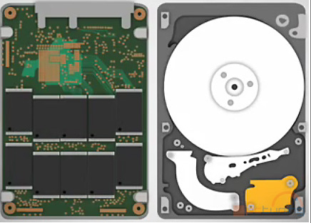
Sharing Pointer-Rich Data
SAMTools Genomics Utilities
2-socket 24-core Westmere
92 GiB DRAM, DF BSD
Normalized Runtime
stage 1
stage 2
stage 3
1.0
0.8
un-marshal
un-marshal
0.6
marshal
marshal
0.4
stage 1
stage 2
stage 3
0.2
Flagstat
Qname Sort
Coordinate Sort
Index
switch
switch
switch
SAMTools Alignment Operations
VAS
1.0
0.8
No data marshaling
Use of absolute pointers no swizzling, or address conflicts
0.6
0.4
0.2
Flagstat
Qname Sort
Coordinate Sort
Index

Slide 14
Single-System Client-Server
GET per second
C
S
Redis – UNIX Sockets
Serialized data into sockets
Buffer copying
Scheduling coordination
user space
marshal + unmarshal
Redis 6x
kernel
Redis
buffers
2-socket 24-core Westmere
92 GiB DRAM, DF BSD

Slide 15
Single-System Client-Server
GET per second
S
Client VAS
C0
RedisJMP
Server VAS
C1
C0
C1
C2
Redis 6x
Client VAS
C0
get!
get!
get!
get!
Client VAS
C2
Redis
Redis with SpaceJMP
2-socket 24-core Westmere
92 GiB DRAM, DF BSD

Slide 16
Single-System Client-Server
Requests per second
C0
Server VAS
Client VAS
C1
C0
C1
set!
C1
writer
Client VAS
get!
get!
user
C2
Client VAS
kernel
block!
C0
C2
Varying read-write loads
Scalability – lock granularity
scalable locks, e.g., MCS
hardware transactional memory
Typical read/write ratio for KVS ca. 10%
Write Ratio %
2-socket 24-core Westmere
92 GiB DRAM, DF BSD

Slide 17
SpaceJMP
P
P
Physical Memory
attached
VAS 1
VAS 2
P
P
VAS
P
P
attached
Future Work
Persistence – fast reboots
Security – sandboxing
Semantics – transactions
Versioning – fast checkpointing

