Slide 1

Predicting the Performance-Cost Trade-off of Applications Across Multiple Systems
Amir Nassereldine (AUB), Safaa Diab (AUB), Mohammed Baydoun (AUB), Kenneth Leach (HPE), Maxim Alt (HPE), Dejan Milojicic (HPE), Izzat El Hajj (AUB)
The 23rd IEEE/ACM International Symposium on Cluster, Cloud, and Internet Computing
May 4, 2023

Slide 2
Motivation
350.md
376.kdtree
streamcluster

Slide 3
Prior Approaches
(App A, Conf 1)
(App A, Conf 2)
(App A, Conf 3)
Application-specific Approach
training
cost
Predictor
App A
execution time
max
Typically only need to collect execution time
Good for short-running recurring applications
Configurations
(App A, Conf 1)
(App A, Conf 2)
(App A, Conf 3)
(App B, Conf 1)
(App B, Conf 2)
(App B, Conf 3)
(App C, Conf 1)
(App C, Conf 2)
(App C, Conf 3)
training
cost
General Approach
Predictor
App D
execution time
Need other information (e.g., profiling) about application
Good for new and long-running applications
max
Configurations

Slide 4

Approach Overview
Fingerprint
Profiling metrics
Profile on fingerprint configuration 1
Performance
System A
Profile on fingerprint configuration 2
Regression Model
System B
Application
System C
…
…
Configurations
Profile on fingerprint configuration N

Slide 5
Distinguishing Aspects
Similar approach commonly used in the literature
Distinguishing aspects of our work:
Employing a classifier to distinguish applications that scale well from those that scale poorly
Providing different scopes of prediction with varying accuracy and online profiling requirements
Performing online profiling using partial runs thereby make predictions for applications without running them to completion
Automating the selection of the fingerprint configurations used for online profiling
Predicting the applications’ sensitivity to interference from other users

Slide 6
Distinguishing Aspects
Similar approach commonly used in the literature
Distinguishing aspects of our work:
Employing a classifier to distinguish applications that scale well from those that scale poorly
Providing different scopes of prediction with varying accuracy and online profiling requirements
Performing online profiling using partial runs thereby make predictions for applications without running them to completion
Automating the selection of the fingerprint configurations used for online profiling
Predicting the applications’ sensitivity to interference from other users

Slide 7
Using a Classifier to Distinguish Applications
Fingerprint
Profiling metrics
Profile on fingerprint configuration 1
Performance
System A
Profile on fingerprint configuration 2
Regression Model
System B
Application
System C
…
…
Configurations
Profile on fingerprint configuration N

Slide 8
Using a Classifier to Distinguish Applications
Fingerprint
Profiling metrics
Performance
System A
Regression Model
System B
Profile on fingerprint configuration 1
System C
Profile on fingerprint configuration 2
Configurations
Application
…
…
Profile on fingerprint configuration N

Slide 9
Using a Classifier to Distinguish Applications
Fingerprint
Profiling metrics
Performance
System A
Regression Model
System B
Profile on fingerprint configuration 1
System C
Scales well
Configurations
Profile on fingerprint configuration 2
Classifier
Application
Scales poorly
Performance
…
…
B
Regression Model
A
C
Profile on fingerprint configuration N
Systems

Slide 10
Distinguishing Aspects
Similar approach commonly used in the literature
Distinguishing aspects of our work:
Employing a classifier to distinguish applications that scale well from those that scale poorly
Providing different scopes of prediction with varying accuracy and online profiling requirements
Performing online profiling using partial runs thereby make predictions for applications without running them to completion
Automating the selection of the fingerprint configurations used for online profiling
Predicting the applications’ sensitivity to interference from other users

Slide 11
Different Scopes of Prediction: Global (Multi-system)
Fingerprint
Profiling metrics
Performance
System A
Regression Model
System B
Profile on fingerprint configuration 1
System C
Scales well
Configurations
Profile on fingerprint configuration 2
Classifier
Application
Scales poorly
Performance
…
…
B
Regression Model
A
C
Profile on fingerprint configuration N
Systems

Slide 12
Different Scopes of Prediction: Single-system
Fingerprint
Profiling metrics
Performance
Regression Model
System i
Profile on fingerprint configuration 1
Scales well
Configurations
Profile on fingerprint configuration 2
Classifier
Application
Scales poorly
…
…
Use least resources
Profile on fingerprint configuration N

Slide 13
Different Scopes of Prediction: Local
Fingerprint
Profiling metrics
Performance
System i
Profile on fingerprint configuration (i, j)
Regression Model
Application
j-1
j
j+1
Configurations

Slide 14
Distinguishing Aspects
Similar approach commonly used in the literature
Distinguishing aspects of our work:
Employing a classifier to distinguish applications that scale well from those that scale poorly
Providing different scopes of prediction with varying accuracy and online profiling requirements
Performing online profiling using partial runs thereby make predictions for applications without running them to completion
Automating the selection of the fingerprint configurations used for online profiling
Predicting the applications’ sensitivity to interference from other users

Slide 15
Online Profiling Using Partial Runs
Fingerprint
Profiling metrics
Performance
System A
Regression Model
System B
Profile on fingerprint configuration 1
System C
Scales well
Configurations
Profile on fingerprint configuration 2
Classifier
Application
Scales poorly
Performance
…
…
B
Regression Model
A
C
Profile on fingerprint configuration N
Systems
Step 1: Fingerprint Generation
Step 2: Classification
Step 3: Performance Prediction
Partially run application for 30s (duration can be modified to trade-off accuracy for profiling overhead)

Slide 16
Distinguishing Aspects
Similar approach commonly used in the literature
Distinguishing aspects of our work:
Employing a classifier to distinguish applications that scale well from those that scale poorly
Providing different scopes of prediction with varying accuracy and online profiling requirements
Performing online profiling using partial runs thereby make predictions for applications without running them to completion
Automating the selection of the fingerprint configurations used for online profiling
Predicting the applications’ sensitivity to interference from other users

Slide 17
Automating Selection of Fingerprint Configurations
Fingerprint
Profiling metrics
Performance
System A
Regression Model
System B
Profile on fingerprint configuration 1
System C
Scales well
Configurations
Profile on fingerprint configuration 2
Classifier
Application
Scales poorly
Performance
…
…
B
Regression Model
A
C
Profile on fingerprint configuration N
Systems
Step 1: Fingerprint Generation
Step 2: Classification
Step 3: Performance Prediction
Prior work hand-selected the configurations

Slide 18
Automating Selection of Fingerprint Configurations
For N configurations, there are 2^{N} possibilities
Expensive to try exhaustively
We use a greedy approach to automate the selection
For 1st configuration, select the one that has the lowest error alone
For 2nd configuration, select the one with lowest error when combined with the 1st
Repeat until the error stops improving

Slide 19
Distinguishing Aspects
Similar approach commonly used in the literature
Distinguishing aspects of our work:
Employing a classifier to distinguish applications that scale well from those that scale poorly
Providing different scopes of prediction with varying accuracy and online profiling requirements
Performing online profiling using partial runs thereby make predictions for applications without running them to completion
Automating the selection of the fingerprint configurations used for online profiling
Predicting the applications’ sensitivity to interference from other users

Slide 20
Predicting Sensitivity to Interference
Performance
System A
System B
System C
Configurations

Slide 21
Predicting Sensitivity to Interference
Performance
System A
System A with interference
System B
System B with interference
System C
System C with interference
Modeling three interference extremes:
Compute-intensive
Memory-intensive
Cache-intensive
Configurations

Slide 22
Methodology
Three systems:
System 1: Dual socket AMD EPYC 7532 CPU system with 64 cores (64 threads) and 512GB of main memory
System 2: Dual socket Intel Xeon Gold 6242 CPU system with 32 cores (64 threads) and 192GB of main memory
System 3: Dual socket Intel Xeon Gold 5120 CPU system with 28 cores (56 threads) and 64GB of main memory
Configurations: 1 vCPU and multiples of 8 vCPUs with proportional memory (26 in total)
We use docker containers to configure resources, but prediction workflow is not unique to docker
Benchmarks: 69 total from 7 suites/libraries:
NAS, PARSEC, SPEC OMP, SPEC ACCEL, Parboil, Rodinia, MLlib
Profiling: 60 profiling metrics per configuration, reduced after feature selection
We use perf to collect metrics, but prediction workflow is not unique to perf metrics
Models: random forest for classifier, XGBoost for regressor

Slide 23
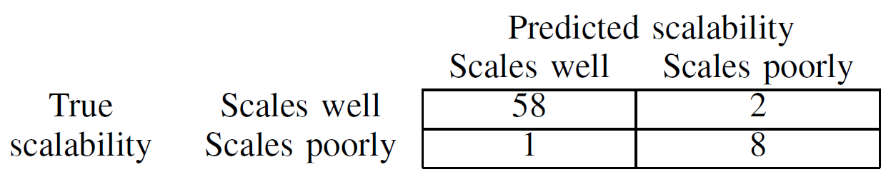
Classifier Accuracy
Key Observation: Our classifier is very accurate and distinguishing applications based on how they scale

Slide 24
Regressor Accuracy: Global and Single-system
Key Observation #1: Best accuracy achieved with 3 fingerprint configurations (24.2%, after feature selection: 22.5%)
Key Observation #2: Selection process automatically diversifies the set of fingerprint configurations

Slide 25
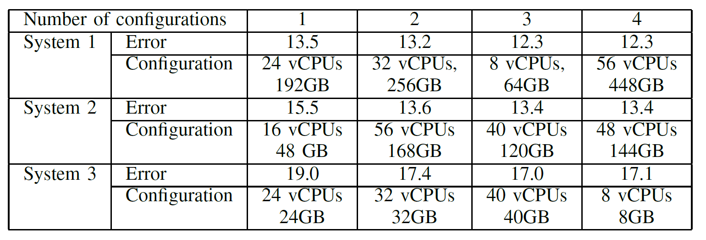
Regressor Accuracy: Global and Single-system
Key Observation: Single-system predictors achieve higher accuracy with less profiling overhead

Slide 26
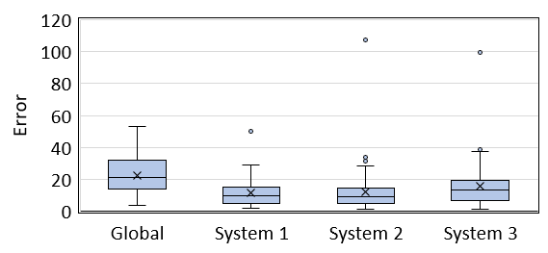
Regressor Accuracy: Global and Single-system
Key Observation: Prediction error is low for most benchmarks, but some benchmarks still have high error (future work: improve classification to screen them out)

Slide 27
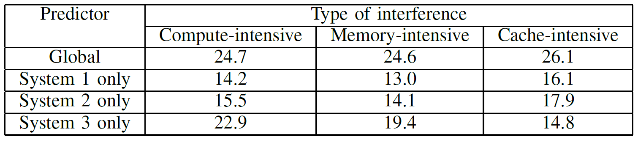
Regressor Accuracy: Global and Single-system
Key Observation: Sensitivity to interference can also be predicted with reasonable accuracy

Slide 28
Regressor Accuracy: Local
# vCPUs =
Key Observation: Local predictor is highly accurate (below 10% for most configurations)

Slide 29
Case Study: GROMACS
Key Observation: Predicted curve is close to real curve (prediction error = 17.3%)

Slide 30
Impact of Using a Classifier
Key Observation: Using a classifier reduces prediction error by 6.67% on average

Slide 31
Impact of Using Partial Runs
Key Observation: Fingerprinting with complete runs would improve prediction error by 8.44%

Slide 32
Training with Partial Data Coverage
(App A, Conf 1)
(App A, Conf 2)
(App A, Conf 3)
(App B, Conf 1)
(App B, Conf 2)
(App B, Conf 3)
(App C, Conf 1)
(App C, Conf 2)
(App C, Conf 3)
training
cost
Predictor
App D
execution time
max
Configurations

Slide 33
Training with Partial Data Coverage
(App A, Conf 1)
(App A, Conf 3)
(App B, Conf 2)
(App C, Conf 2)
(App C, Conf 3)
training
cost
Predictor
App D
execution time
max
Configurations
Key Observation: Training with partial data coverage is feasible, but increases error

Slide 34
Summary
We propose a tool for predicting the performance-cost trade-off across multiple systems
Distinguishing aspects of our tool:
Classify applications before making predictions
Different scopes of prediction
Using partial runs to make predictions
Automating the selection of configurations used for fingerprinting
Predicting sensitivity to interference
Our tool achieves reasonable prediction error, including on production applications

Slide 35
Predicting the Performance-Cost Trade-off of Applications Across Multiple Systems
Amir Nassereldine (AUB), Safaa Diab (AUB), Mohammed Baydoun (AUB), Kenneth Leach (HPE), Maxim Alt (HPE), Dejan Milojicic (HPE), Izzat El Hajj (AUB)
The 23rd IEEE/ACM International Symposium on Cluster, Cloud, and Internet Computing
May 4, 2023

