Slide 1


Parallel K-clique Counting on GPUs
Mohammad Almasri*, Izzat El Hajj§, Rakesh Nagi*, Jinjun Xiong†, Wen-mei Hwu*‡
*C3SR, University of Illinois Urbana-Champaign, Urbana, IL, USA
§ American University of Beirut, Beirut, Lebanon
†University at Buffalo, Buffalo, NY, USA
‡Nvidia Corporation, Santa Clara, CA, USA

Slide 2
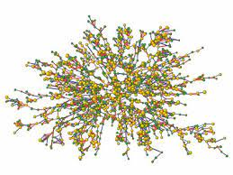
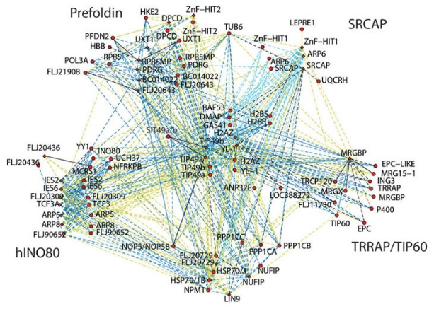
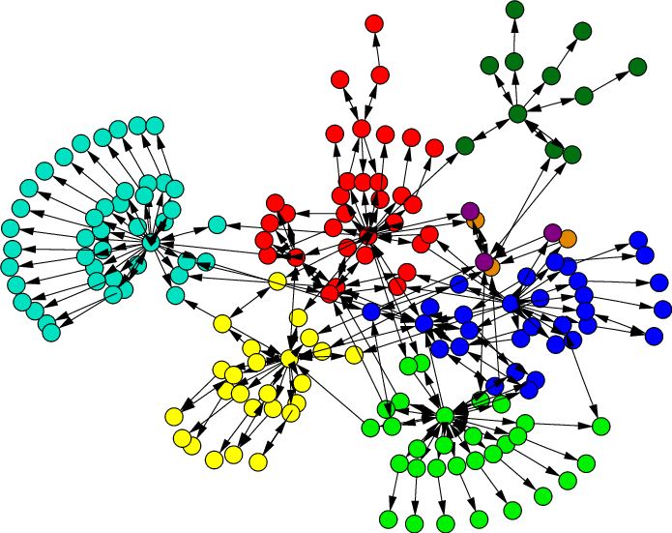
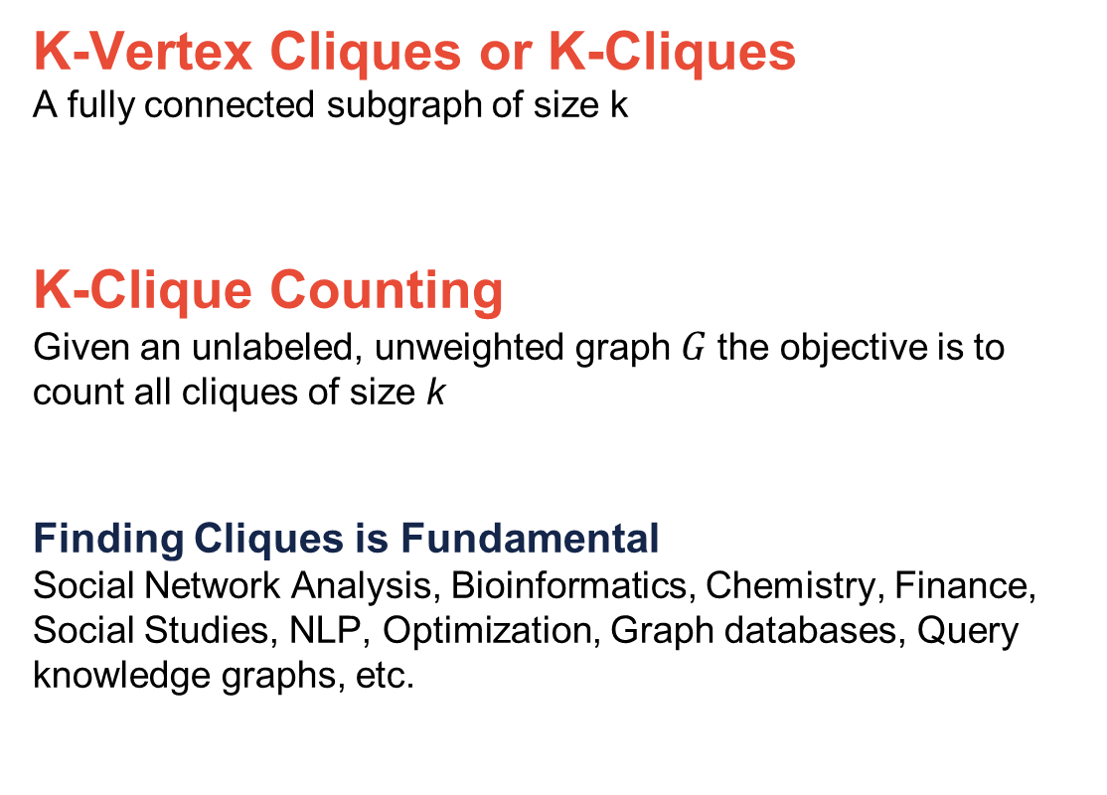
K-Clique Counting
K-Vertex Cliques or K-Cliques
A fully connected subgraph of size k
K-Clique Counting
Given an unlabeled, unweighted graph $G$the objective is to count all cliques of size k
Finding Cliques is Fundamental
Social Network Analysis, Bioinformatics, Chemistry, Finance, Social Studies, NLP, Optimization, Graph databases, Query knowledge graphs, etc.
3-Clique
4-Clique
5-Clique
Find 4-clique in graph G
A
B
E
F
ABCD
EFGH
C
D
H
G
G
Web graph
Social Network
Protein-Protein
Interaction Network

Slide 3
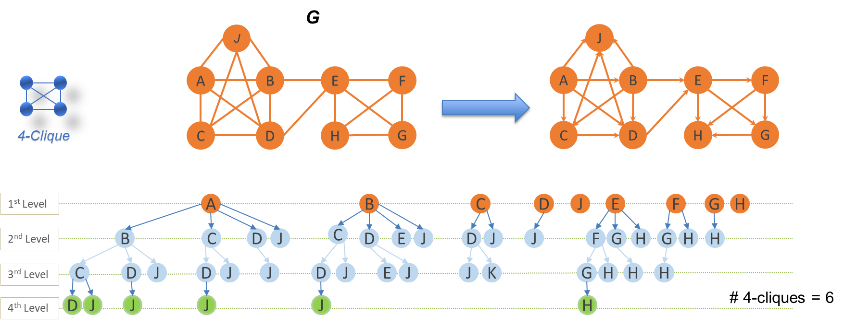
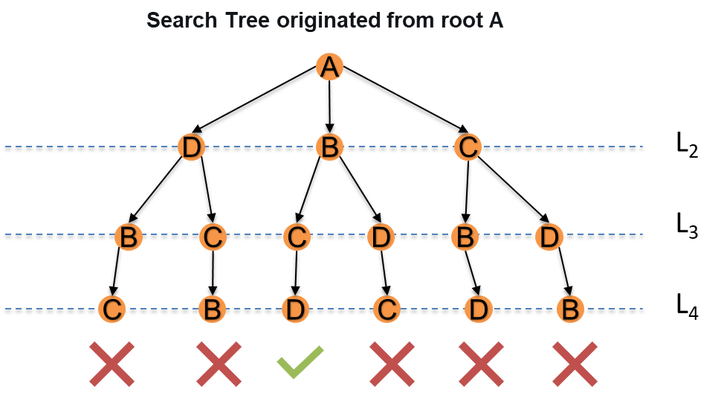
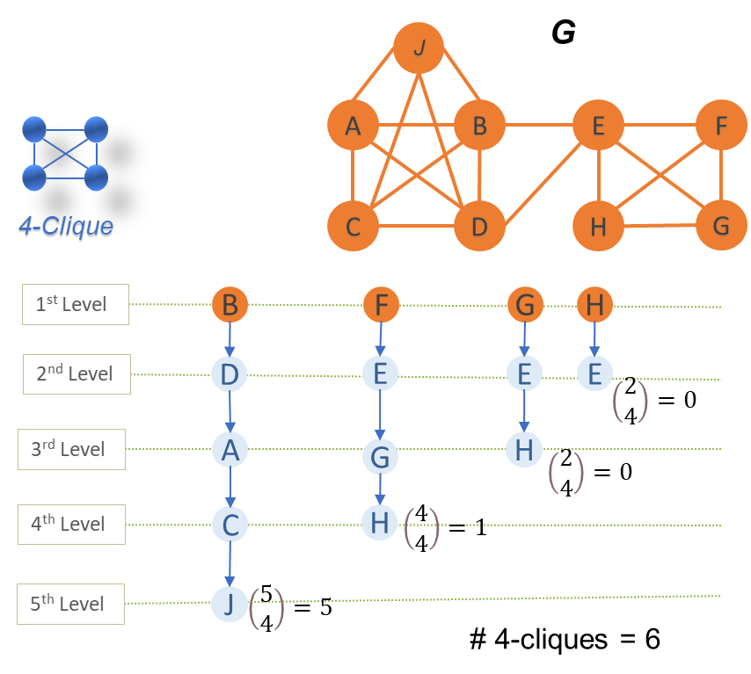

Search Tree Construction
Redundancy Elimination in Clique Problems
G
(A) Graph Orientation
A
B
E
F
4-Clique
C
D
H
G
(B) Pivoting
Redundant
Clique vertices are symmetric

Slide 4
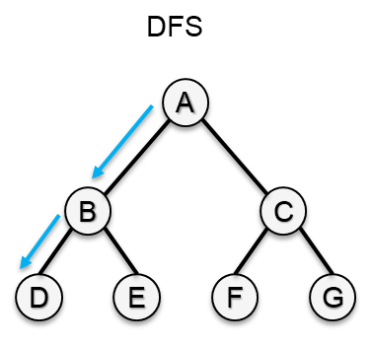
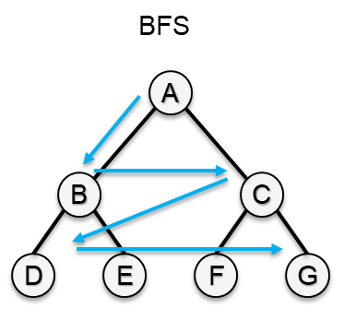
Motivation: High Tree Traversal Complexity
State-of-the-art Parallel CPU Solutions
Exponential Growth
Example from a real-world graph: # of k-cliques as k increases:
High memory requirement
High computational complexity
Scaling to large cliques is challenging
- For both graph orientation and pivoting
- Vertex- and Edge-centric
No performant solutions specialized on GPUs
High execution times
Cannot scale with larger cliques and graphs
Memory not known before starting traversal
GPU solutions for similar problems such as subgraph matching use BFS
Need scalable solutions!

Slide 5
Our Techniques to Accelerate Tree Traversal on GPUs
Techniques
Challenges
Techniques
Induced Sub-Graph on GPUs
Set Intersection
Binary-Encoding
Exploit Fine-Grain Parallelism Available
Two Parallelization Strategies
Vertex-Centric and Edge-Centric
Sub-Warp Partitioning
Load Imbalance
Hierarchical Parallelism
Induced Sub-Graph Sharing
Inefficient Recursion Support
Iterative Tree Traversal with Explicit Management of the Stack
Memory Pre-Allocation and Reuse
Limited Memory Capacity
Single Kernel Design
Total Memory is pre-allocated before kernel launch

Slide 6
Comparison with State-of-the-Art CPU Implementations for k-Clique Counting
k =
Our best GPU implementation consistently outperforms the best state-of-the-art CPU implementation across all values of k → Geometric mean speedup of 12.39x, 6.21x, and 18.99x for k = 4, 7, and 10, respectively
Graph Orientation vs. Pivoting
The transition from graph orientation being fastest to pivoting being fastest happens at around k= 7

Slide 7
Impact of Parallelization Schemes and Speedup of Optimizations
VC → Vertex-Centric
EC → Edge-Centric
+BE → with binary encoding
+P → best thread partition size
Clique Size
For initial k values → Vertex-centric
As k gets larger → Edge-centric
Binary Encoding
→ Geometric mean speedup is 2.17x
Sub-warp Partitioning
→ Geometric mean speedup is 1.98x

Slide 8
Conclusion
Before this work
CPUs are deemed to be better for k-clique counting
No performant GPU solutions found
A paradigm shift from the conventional BFS traversal to a new hybrid traversal approach
Outcomes of this work
Significantly outperform existing parallel CPU solutions
Generalizable to any problem that involves explosive tree traversal
Open-source all techniques and primitives (https://github.com/ssmoha7/mewcp-gpu, will be available soon)

Slide 9
Thanks …
Parallel K-clique Counting on GPUs
Mohammad Almasri*, Izzat El Hajj§, Rakesh Nagi*, Jinjun Xiong†, Wen-mei Hwu*‡
*C3SR, University of Illinois Urbana-Champaign, Urbana, IL, USA
§ American University of Beirut, Beirut, Lebanon
†University at Buffalo, Buffalo, NY, USA
‡Nvidia Corporation, Santa Clara, CA, USA

