Slide 1
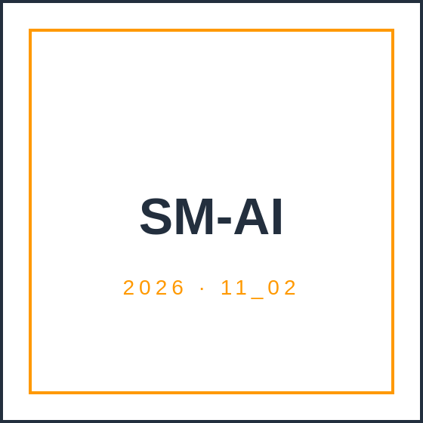
CCBDA · MIRI · UPC BARCELONA
AWS SageMaker AI
A practical tutorial on managed ML
TEAM 11_02
Arthur Bohin · Dalibor Švonavec · Ilias El Mariky · Francesco Barillari · Ralph Khairallah
PRESENTED
May 21, 2026 · 08:30
Notes:
Hi everyone, we're Team 11_02 — Arthur, Dalibor, Ilyas, Francesco, and I'm Ralph. In the next 15 minutes we'll show you what SageMaker is, walk you through training a real model on it end-to-end, and tell you honestly where it works and where it doesn't. We've used it ourselves on the project — including a painful pivot away from AWS Forecast — so this is a tutorial, not a marketing pitch.

Slide 2
02 · CONTEXT
SPEAKER · FRANCESCO
Of organizations now use AI in at least one business function.
72%
Enterprises with at least one AI workload in production
88%
65%
Increased AI budgets in 2026 (median +22% YoY)
88%
Tech & software lead — financial services 79%, healthcare 62%
McKinsey Global AI Survey, 2026 — up from 78% in 2025, 55% in 2024.
“The era of AI as a competitive differentiator is ending; AI is becoming the baseline.”
— McKinsey Global AI Survey 2026
TEAM 11_02 · AWS SAGEMAKER AI · CCBDA-MIRI 2026
02 / 17
Notes:
ML adoption almost doubled in two years. McKinsey's 2026 survey puts 88% of organizations using AI in at least one function, up from 78% the year before. 72% have something in production, two thirds increased their AI budgets this year. The framing matters: AI is no longer a competitive differentiator, it's the baseline. The question for any team in 2026 isn't whether to use ML — it's how to ship it without spending six months building infrastructure. That's the gap managed services like SageMaker fill.

Slide 3
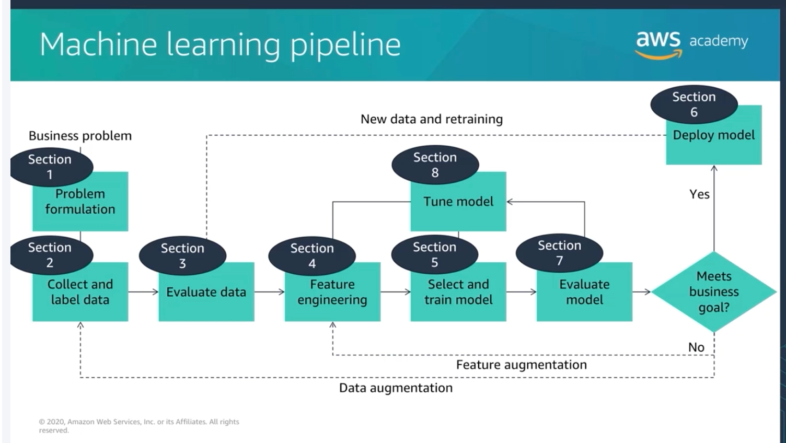
03 · THE ML PIPELINE
SPEAKER · FRANCESCO
Seven stages. One platform.
SageMaker covers all 7 stages — from problem framing to monitored production. One service, one billing line, one set of APIs.
1. Problem formulation
5. Model training
2. Data collection
6. Evaluation
3. Cleaning
7. Deployment + monitoring
4. Feature engineering
↳ all in SageMaker
TEAM 11_02 · AWS SAGEMAKER AI · CCBDA-MIRI 2026
03 / 17
Notes:
This is the canonical ML pipeline — seven stages from problem formulation through data collection, cleaning, feature engineering, training, evaluation, and finally deployment with monitoring. Data scientists used to need different tools for each stage: pandas for cleaning, sklearn for training, Flask for serving, Prometheus for monitoring. SageMaker collapses all of these into one platform with consistent APIs and a single billing line. That's the value proposition in one diagram.

Slide 4
04 · DEFINITION
SPEAKER · FRANCESCO
WHAT IS SAGEMAKER?
AWS’s fully managed end-to-end ML platform — build, train, deploy, monitor , all from one place.
01 / LIFECYCLE
02 / BILLING
03 / INTEGRATION
Covers the entire ML lifecycle — data prep, training, deployment, monitoring.
Pay-per-use. No GPU servers, no clusters, no infra to manage.
Wired into S3, Lambda, IAM, CloudWatch — plays with the rest of AWS.
TEAM 11_02 · AWS SAGEMAKER AI · CCBDA-MIRI 2026
04 / 17
Notes:
Plain definition: SageMaker is AWS's fully managed end-to-end ML platform. Build, train, deploy, monitor — all from one place. Three things matter. One, it covers the entire ML lifecycle. Two, you pay per use; there's no infrastructure to babysit. Three, it's deeply integrated with the rest of AWS — S3 for data, Lambda for triggers, IAM for access, CloudWatch for monitoring. Before SageMaker, building an ML system meant standing up GPU servers, configuring distributed training, building a model server. SageMaker turns each of those into an API call.

Slide 5
05 · SURFACES
SPEAKER · DALIBOR
One service, many ways to use it.
SHAPE
WHAT IT IS
BEST FOR
INTERFACE
Canvas
Visual ML builder, drag & drop
Business analysts, demos, quick prototypes
Web UI
no-code
Studio Notebooks
Cloud Jupyter, pre-loaded with ML libs
Data scientists exploring data
Jupyter
explore
SDK / boto3
Python API to train, deploy, predict
Production engineers, automation, Lambdas
Python code
production
JumpStart
Library of pre-trained models, 1-click deploy
Skipping training when a model already exists
Web UI + API
pre-trained
Pipelines
Workflow orchestrator for ML steps
Production-grade reproducible ML
SDK + UI
orchestrate
Autopilot
Auto algorithm selection, training, tuning
Teams that want best-model search without manual HPO
API + Canvas
autoML
Same compute, same models, same endpoints — pick your interface based on your skill level.
TEAM 11_02 · AWS SAGEMAKER AI · CCBDA-MIRI 2026
05 / 17
Notes:
SageMaker is really many products under one roof. Some are - Canvas is no-code, drag and drop — for analysts and quick demos. Autopilot is the AutoML engine underneath — it automatically selects algorithms, tunes hyperparameters, and ensembles the best models. Canvas runs on it, but you can also call it directly from the API. Studio Notebooks is cloud Jupyter pre-loaded with every ML library you'd want — for exploration. The SDK and boto3 are what you use in production from Python or a Lambda. JumpStart is a library of pre-trained models you can deploy in one click. Pipelines orchestrates the whole workflow as code. Same compute, same models, same endpoints underneath — pick the interface that matches your skill level. We'll show Canvas and the SDK in this talk.

Slide 6
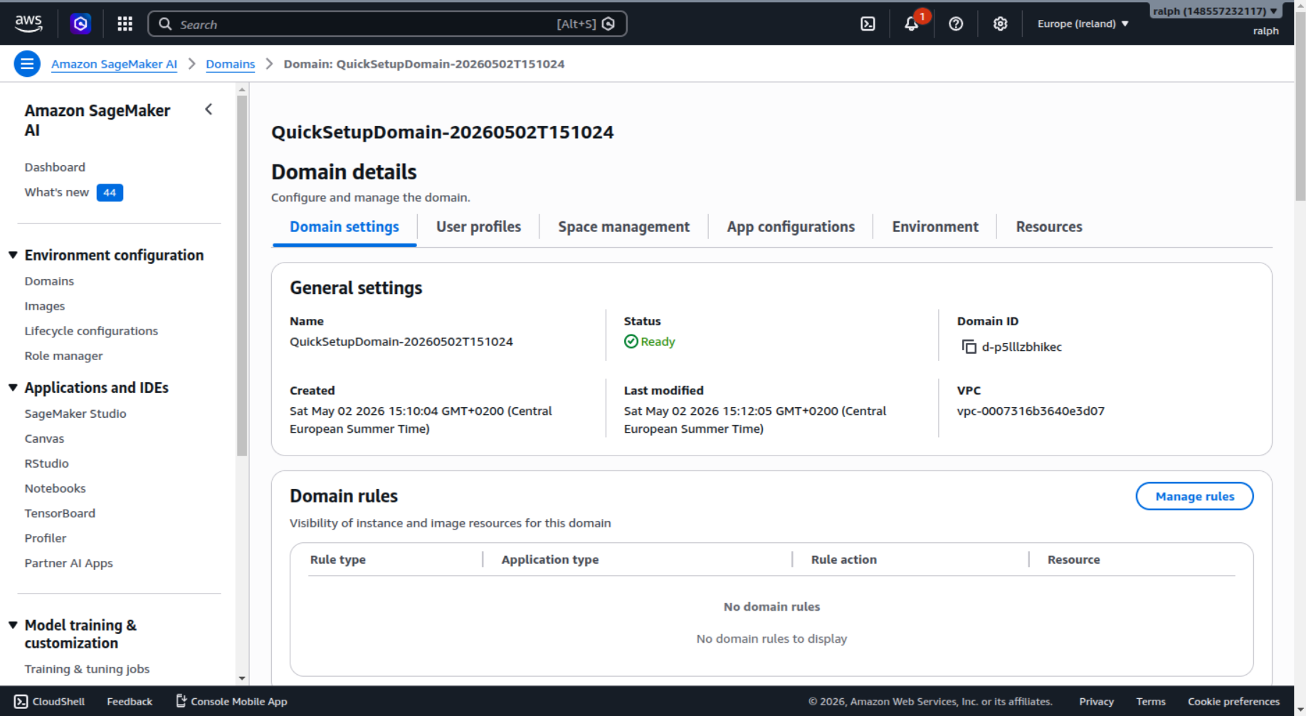
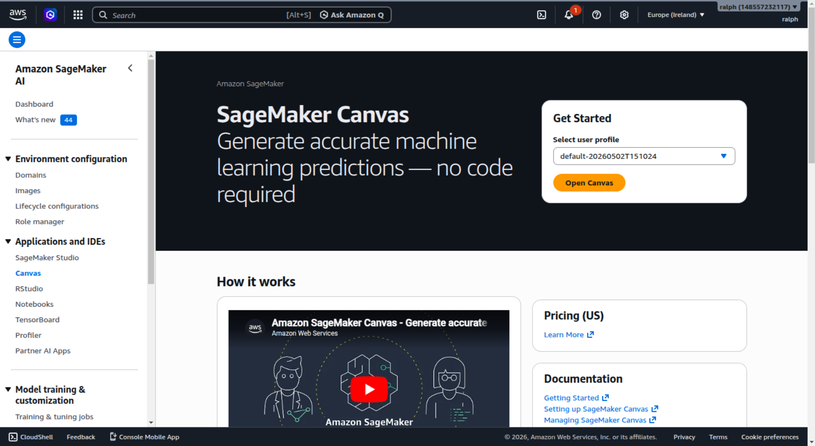
06 · TUTORIAL · STEP 1
SPEAKER · RALPH
Tutorial — from zero to a trained model.
STEP 1 · STEP 2 · STEP 3 · STEP 4
Studio domain — your shared ML workspace, ready in ~5 minutes.
Canvas — the no-code entry point, one click away.
TEAM 11_02 · AWS SAGEMAKER AI · CCBDA-MIRI 2026
06 / 17
Notes:
Here's the workflow. You start by creating a SageMaker Studio domain — that's your shared ML workspace, ready in about five minutes the first time. From there you launch Canvas with one click. Notice the left sidebar in Studio: Studio, Canvas, Notebooks, RStudio — those are the shapes Francesco just described, all under one roof. The screenshots are the actual UI from May 2026 — this is what you'll see if you log in tomorrow.

Slide 7
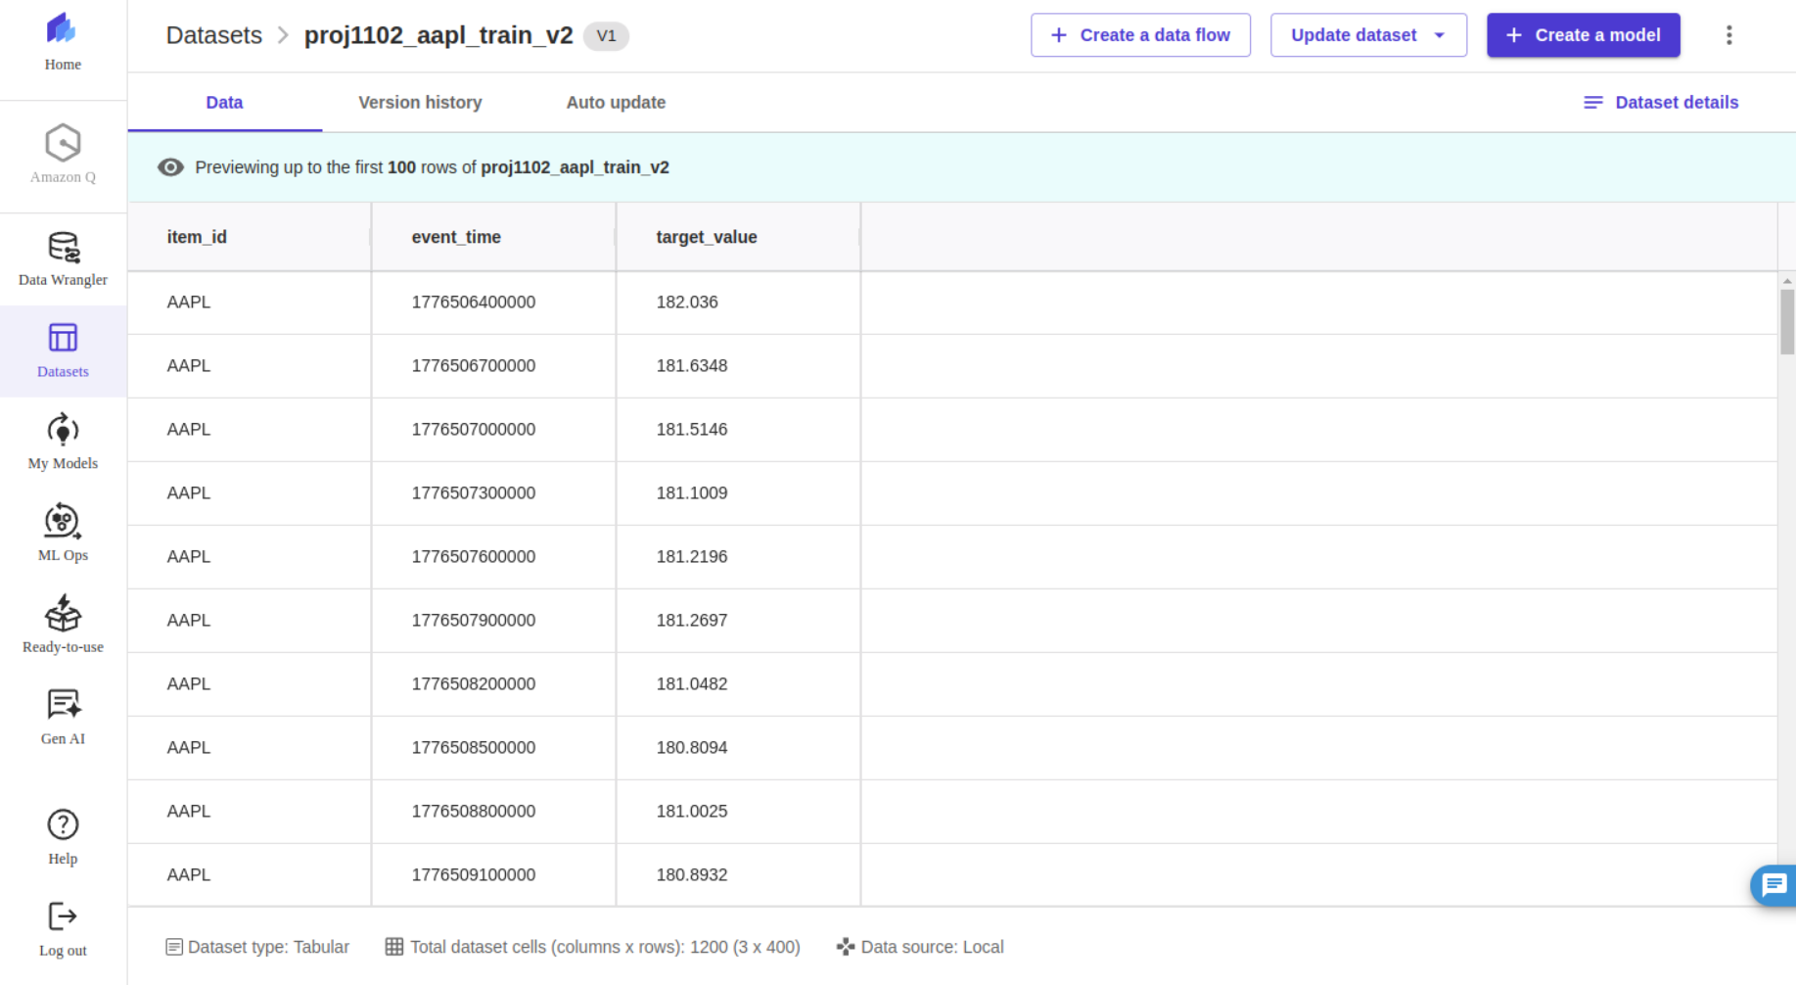
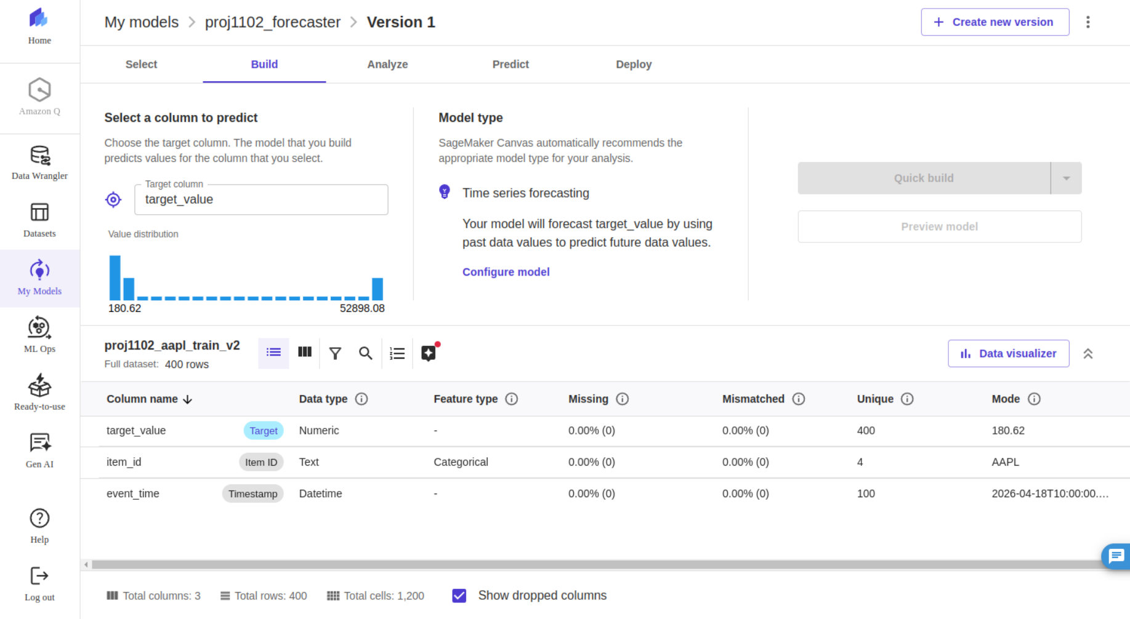
07 · TUTORIAL · STEP 2
SPEAKER · RALPH
Upload data. Canvas does the rest.
STEP 1 · STEP 2 · STEP 3 · STEP 4
AUTO-DETECTED
item_id
categorical
timestamp
datetime
target_value
numeric · target
Dataset preview — Canvas auto-detects column names & types.
Canvas inferred time-series forecasting from a CSV alone — no schema, no code.
No schema definitions. No type hints. Just a CSV.
Build tab — pick your target column. Done.
TEAM 11_02 · AWS SAGEMAKER AI · CCBDA-MIRI 2026
07 / 17
Notes:
Step two: data. You upload a CSV — that's it. Canvas reads the schema, detects column types, and proposes a problem type. In our case it figured out we wanted time-series forecasting because we had a timestamp column and a numeric target. No code, no schema definition. It auto-detected three columns: Item ID, Timestamp, Target. The yellow Build button on the right is one click away from a trained model.

Slide 8
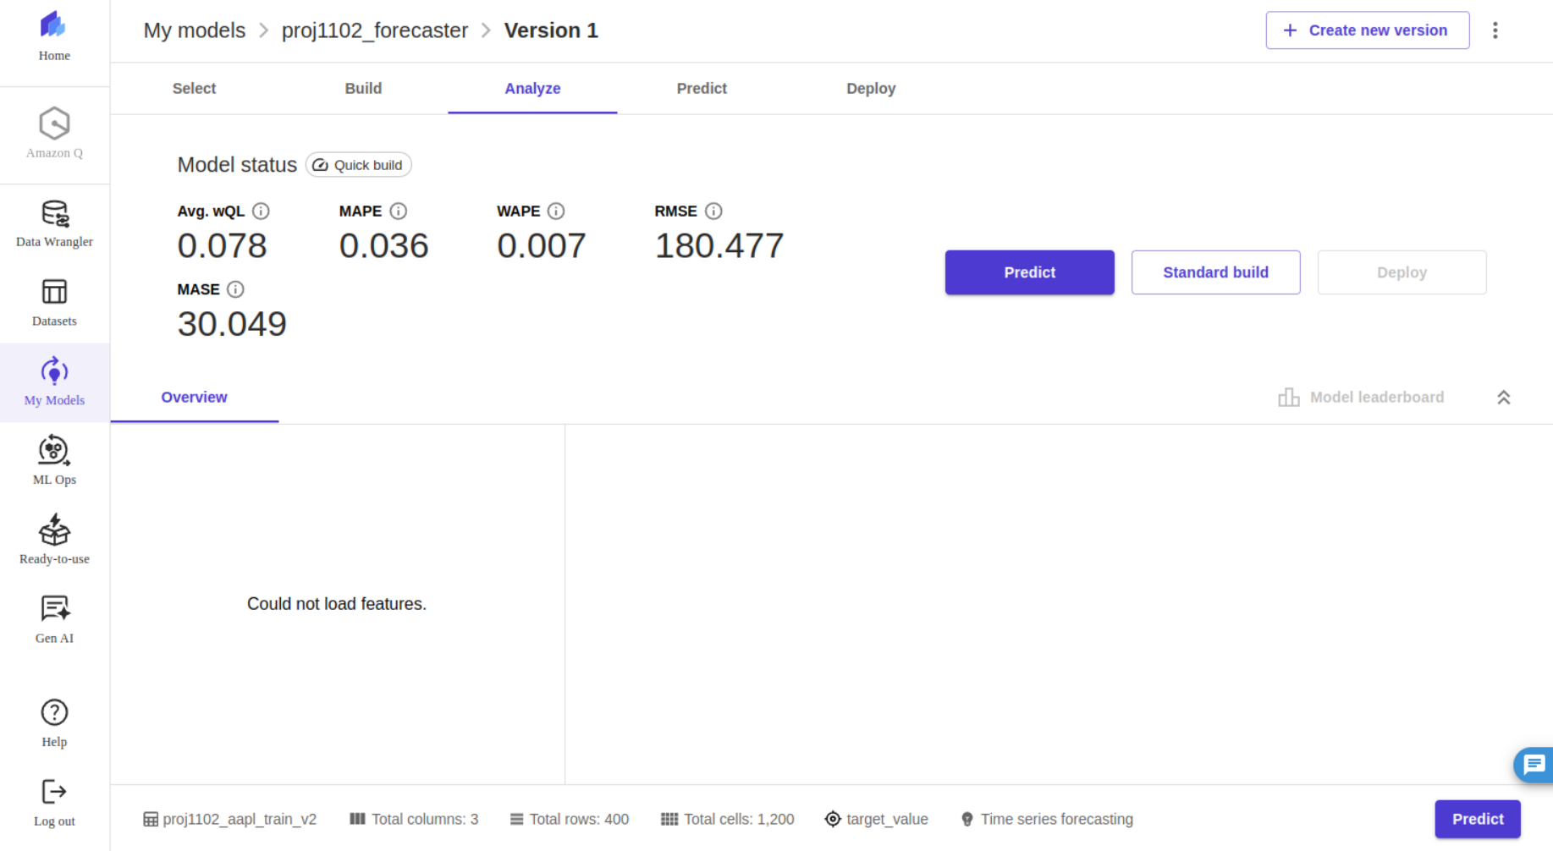
08 · TUTORIAL · STEP 3
SPEAKER · RALPH
One click. 14 minutes. A trained model.
AVG. WQL
MAPE
0.078
0.036
tight quantiles
~3.6% off
WAPE
RMSE
0.007
180.5
weighted
root sq. error
UNDER THE HOOD
DeepAR · ml.c5.xlarge · trained, validated and benchmarked — without provisioning a single server.
TEAM 11_02 · AWS SAGEMAKER AI · CCBDA-MIRI 2026
08 / 17
Real cloud training. Real metrics. No GPU we own. No Kubernetes we manage.
Notes:
This is the moment that sells SageMaker. I clicked Quick build on the previous screen. Fourteen minutes later, this is what I got — a trained DeepAR model with full quality metrics. wQL of 0.078 means very tight forecast quantiles. MAPE of 3.6% means the predictions are within about four percent of the truth on average. WAPE 0.007, RMSE 180. All of this without writing a single line of ML code, without provisioning a server, without touching a GPU. That's the headline.

Slide 9
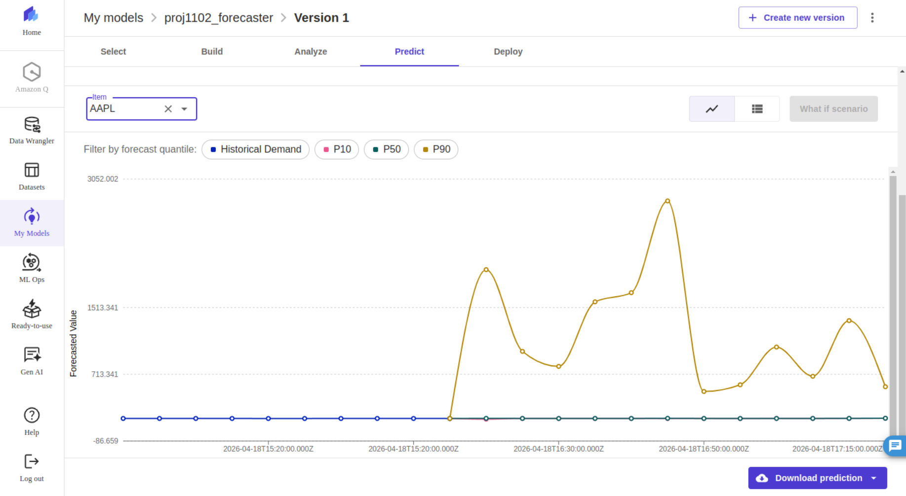
09 · TUTORIAL · STEP 4
SPEAKER · RALPH
Forecasts with built-in confidence bands.
STEP 1 · STEP 2 · STEP 3 · STEP 4
WHAT YOU SEE
P50 hugs AAPL’s range correctly. P90 spikes — we trained one model on dummy data mixing AAPL ($180) with BTC ($55,000) in one column.
Lesson. Canvas does not validate your data prep. Garbage in, garbage out — even on AWS.
Fix: normalize per item, or train one model per ticker. The platform is only as smart as the data you feed it.
TEAM 11_02 · AWS SAGEMAKER AI · CCBDA-MIRI 2026
09 / 17
Notes:
Now the honest part. We're showing this on purpose. Our training set mixed all four of our project's tickers — AAPL at 180, BTC at 55,000 — in the same target column. The model learned a wide distribution. P50, the median forecast, correctly hugs AAPL's actual range. But P90 reflects the spread across all items, giving us this misleading upper bound spiking to 2,400. Two takeaways: Canvas does not catch data prep mistakes for you. And for multi-item series with very different scales, you normalize per item or train separate models. The platform is only as smart as the data you give it.

Slide 10
10 · PRODUCTION PATH
SPEAKER · DALIBOR
Skip the UI. Drive SageMaker from boto3.
BOTO3 · PYTHON SDK
import sagemaker from sagemaker.image_uris import retrieve session = sagemaker.Session() role = sagemaker.get_execution_role() image = retrieve(framework="forecasting-deepar", region="eu-west-1") # Train job — AWS-managed DeepAR container est = sagemaker.estimator.Estimator( image_uri=image, role=role, instance_count=1, instance_type="ml.c5.xlarge", output_path="s3://my-bucket/deepar/output" , ) est.set_hyperparameters( time_freq="5min", context_length=100, prediction_length=12, epochs=50, num_cells=40, num_layers=2 , ) est.fit ({"train": "s3://my-bucket/deepar/train.jsonl"}) # Deploy to a real-time endpoint a Lambda can call predictor = est.deploy(instance_type="ml.t2.medium", initial_instance_count=1) predictor.predict ({"instances": [{"start": "…", "target": […]}]})
SAME WORKFLOW
Same DeepAR model. Same training. Same metrics — the UI just disappears.
↳ Re-run from a Lambda on a schedule
↳ Version it in git, plug into CI
↳ Swap algorithms with a one-line change
↳ Tune hyperparameters via SageMaker HPO
TEAM 11_02 · AWS SAGEMAKER AI · CCBDA-MIRI 2026
10 / 17
Notes:
Once you've validated an approach in Canvas, you graduate to the SDK. This is roughly twenty lines of Python that does the same thing you just saw — uploads data to S3, trains a DeepAR model, deploys an endpoint, calls it. Now you can re-run from a Lambda, schedule it, version it in git, plug it into CI. Same SageMaker under the hood — same DeepAR algorithm, same training, same metrics. The UI just disappears.

Slide 11
11 · ALGORITHMS
SPEAKER · DALIBOR
20+ built-in algorithms. Here are the ones you'll see most.
CATEGORY
ALGORITHMS
USE CASE
General purpose
XGBoost, Linear Learner, AutoGluon-Tabular, CatBoost
Classification & regression on tabular data
Time series
DeepAR
Forecasting (next slide)
Unsupervised
K-Means, PCA, Random Cut Forest
Clustering, dimensionality reduction, anomaly detection
Text / NLP
BlazingText, Seq2Seq, LDA
Word embeddings, translation, topic modeling
Vision
Image Classification, Object Detection, Semantic Segmentation
Image labeling, object detection, pixel-level tagging
NOT BUILT-IN — DIFFERENT SERVICES
LLMs / generative AI → Bedrock
Pre-trained models (Hugging Face, Stable Diffusion, etc.) → JumpStart
TEAM 11_02 · AWS SAGEMAKER AI · CCBDA-MIRI 2026
11 / 17
Notes:
SageMaker ships over twenty built-in algorithms across five categories. For tabular data, XGBoost is the most popular by far — it's what Autopilot defaults to in HPO mode. For unsupervised problems, Random Cut Forest is the go-to for anomaly detection. For NLP, BlazingText gives you word2vec and text classification. For images, you get ResNet-based classification and SSD-based object detection out of the box. Two things that are not built-in algorithms: LLMs live in Bedrock, and pre-trained open-source models live in JumpStart. Don't confuse them. For time series — that's our project — let's zoom in.

Slide 12
12 · TIME SERIES
SPEAKER · DALIBOR
One built-in algorithm. One AutoML ensemble. Pick your level of control.
APPROACH
WHAT IT IS
BEST FOR
DeepAR
RNN-based deep learning forecaster
Full control, many related series jointly (e.g. all 4 tickers + sentiment)
our pick
Autopilot ensemble
Trains 6 models, stacks the best (ARIMA, Prophet, NPTS, ETS, CNN-QR, DeepAR+ )
Best model with minimal effort
minimal effort
↳ ARIMA
Classical statistical model
Simple datasets, < 100 series
baseline
↳ Prophet
Additive model, trend + seasonality
Single series, interpretable
interpretable
DECISION QUICK-RULE
Multiple series, full control → DeepAR
One series, simple → Prophet / ARIMA via Autopilot
TEAM 11_02 · AWS SAGEMAKER AI · CCBDA-MIRI 2026
12 / 17
Notes:
For time series, SageMaker gives you two paths. Path one: DeepAR directly via the SDK — that's what we showed in slide ten. You control the hyperparameters, you train one model across multiple related series. That's what we did with our four tickers. Path two: Autopilot's time-series ensemble, which is what Canvas was running in slide eight. It trains six algorithms — CNN-QR, DeepAR+, Prophet, ARIMA, NPTS, and ETS — and stacks them into one optimal model. Important: you cannot call Prophet or ARIMA individually from the SDK. They only run inside Autopilot. So if you want a specific classical model, you go through Autopilot and let it handle the orchestration. Our recommendation: start with Autopilot to benchmark, then graduate to DeepAR via SDK when you need production control.

Slide 13
13 · PRICING REALITY
SPEAKER · ARTHUR
What it actually costs.
FREE TIER · FIRST 2 MONTHS
AFTER FREE TIER · EU-WEST-1 · MAY 2026
Studio Notebooks ml.t3.medium
250 h/mo
Studio Notebook small
$0.05 /h
Training jobs ml.m5.xlarge
50 h/mo
Canvas session
$1.13 /h
Real-time inference ml.m5.xlarge
125 h/mo
Training (CPU / GPU)
$0.27 → $4.20 /h
Data Wrangler ml.m5.4xlarge
25 h/mo
Real-time endpoint
$0.06 – $0.27 /h
Covers most learning use cases — our team has spent < $5 so far.
A small idle endpoint on 24/7 ≈ $200/mo even if no one calls it.
⚠ PROBLEM — ZOMBIE RESOURCES
Deleted endpoints can leave attached EBS volumes, elastic inference accelerators, or notebook resources billing forever.
✓ SOLUTION — CLOUDWATCH BILLING ALARMS
Set a CloudWatch billing alarm before you start — cost monitoring is not automatic on SageMaker.
TEAM 11_02 · AWS SAGEMAKER AI · CCBDA-MIRI 2026
13 / 17
Notes:
The free tier covers most learning use cases for two months — that's how our team is running, total spend under five dollars. After that, the real cost driver is leaving an inference endpoint always-on. A small idle endpoint runs about two hundred dollars a month even if no one calls it. Big tip we learned the hard way: the most common SageMaker complaint online is zombie resources — you delete the endpoint but forget the attached EBS volumes, which bill indefinitely. Set a CloudWatch billing alarm before you start.

Slide 14
14 · ALTERNATIVES
SPEAKER · ARTHUR
SageMaker is one of many options.
TOOL
CLOUD
BEST FOR
DECISION RULES
AWS SageMaker
AWS
Full ML lifecycle on AWS
LLM / chatbot → Bedrock
Google Vertex AI
GCP
Same idea on GCP
Time series, beginner → Canvas
Azure ML
Azure
Same idea on Azure
Time series, production → SDK + DeepAR
MLflow on K8s
Cloud-agnostic
Avoiding lock-in
Tabular ML → SDK + XGBoost
WHEN SAGEMAKER ISN'T THE FIT
WHEN SAGEMAKER ISN'T THE FIT
COMPLEMENTARY AWS SERVICES
COMPLEMENTARY AWS SERVICES
Avoiding lock-in → MLflow on K8s
AWS Bedrock
AWS
LLMs / generative AI
AWS Forecast
AWS
Deprecated for new accounts (2024)
TEAM 11_02 · AWS SAGEMAKER AI · CCBDA-MIRI 2026
14 / 17
Notes:
SageMaker isn't always the answer. If you need an LLM or a chatbot, Bedrock. If you're avoiding AWS lock-in, MLflow on Kubernetes is the open path — more setup, no vendor leash. Vertex AI and Azure ML are equivalent on their own clouds. And as a cautionary tale: AWS Forecast, the older managed forecasting service, is deprecated for new accounts since 2024. We hit that wall ourselves on day one of week two. Pick the right tool, and check it's still alive for new accounts before you build on it.

Slide 15
15 · COMMUNITY & ADOPTION
SPEAKER · ILIAS
Who actually uses it?
88% of organizations now use AI in at least one business function — McKinsey 2026
10,900+
7,000+
MLflow
Stars · GitHub
Forks · GitHub
Native integration
Figma
Perplexity
NFL
LG AI Research
Toyota
Salesforce
Itaú · banking
Cerner · healthcare
Intuit
Sophos
LOVED
COMPLAINED ABOUT
✓ One-touch deployment
✗ Opaque pricing → "month-end shock"
✓ Fully managed, scales easily
✗ Steep learning curve for non-AWS natives
✓ Wide framework support — TF / PyTorch / MXNet
✗ "Zombie resources" keep billing after deletion
✓ Strong technical support
✗ Vendor lock-in — SageMaker-specific artifacts
FLAGSHIP USE CASE
NFL Next Gen Stats scores every play of every game in real time using SageMaker — including live Completion Probability during broadcasts.
TEAM 11_02 · AWS SAGEMAKER AI · CCBDA-MIRI 2026
15 / 17

Slide 16
16 · GOTCHAS
SPEAKER · ILIAS & ARTHUR
Lessons we learned the hard way.
01
Service quotas
Quotas hit zero by default for new accounts — especially GPU instances.
→ File a quota request — plan for 24–48h delay
02
Region matching
SageMaker, S3, QuickSight, DynamoDB — all in one region. Silent failures otherwise.
→ Everything in eu-west-1, never mix
03
Cross-account S3
IAM permissions on your side alone aren't enough. Add explicit bucket policy on S3 side.
→ Add bucket policy on S3 side
04
Idle billing ~$200/month if endpoint left on 24/7
Canvas keeps billing while idle — always log out. Closing the tab does NOT stop the session.
→ Set a CloudWatch billing alarm before you start
05
Reserved keyword: timestamp
Reserved in Athena AND Canvas — both reject it silently. We lost 30 min on this.
→ Rename to event_time
06
AlgorithmError opaque
When a training job fails, the error message is useless.
→ Always check CloudWatch container logs — enable debug from the start
TEAM 11_02 · AWS SAGEMAKER AI · CCBDA-MIRI 2026
16 / 17

Slide 17
17 · PERSPECTIVE & RESOURCES
SPEAKER · ILIAS
Our pivot. Where to dig deeper.
OUR PIVOT
AWS Forecast → SageMaker. Forecast was deprecated for new accounts — we hit the wall on day one of week two.
DeepAR is the spiritual successor to Forecast — same algorithm, lower level of abstraction.
PERSPECTIVE
RESOURCES · WHERE TO DIG DEEPER
SageMaker = comfort.
Open source = freedom.
The real question: are you ready
to bet on AWS for the next 10 years?
Official docs
aws.amazon.com/sagemaker/ai/
Examples · 10.9K stars
→ Unified Studio GA — March 2025: analytics + ML + GenAI unified
github.com/aws/amazon-sagemaker-examples
→ Challenger: MLflow on K8s, TrueFoundry — cloud-agnostic, zero lock-in
Free Studio Lab — no AWS account
studiolab.sagemaker.aws
→ SageMaker Pipeline → full rewrite if migrating to another cloud
DeepAR paper
arxiv.org/abs/1704.04110
SageMaker Unified Studio · GA March 2025
TEAM 11_02 · AWS SAGEMAKER AI · CCBDA-MIRI 2026
17 / 17

