Slide 1
CS 4063 – Natural Language Processing
Lecture Notes – week 1+2
Muhammad Usman Joyia

Slide 2
Course Announcements and LMS
Google classroom: bnrszm5
WhatsApp Community: will be shared later in google classroom
Email: hannan.farooq@nu.edu.pk

Slide 3
Course Objectives and LOs
Utilize and explain the function of software tools such as corpus readers, stemmers, taggers and parsers
Critically appraise existing Natural Language Processing (NLP) applications such as chatbots and translation systems
Describe some applications of statistical techniques to natural language analysis, such as classification and probabilistic parsing.

Slide 4
Essential Readings
Books
Bird, Klein, and Loper (2009): Natural Language Processing with Python. The full text including diagrams is freely available online at http://nltk.org/book
Perkins (2010): Python Text Processing with NLTK 2.0 Cookbook.
Russell and Norvig (2010) Artificial Intelligence: a modern approach, third edition.
Corpus Analysis
The Bank of English forms part of the Collins Corpus, developed by Collins Dictionaries and the University of Birmingham
BNCWeb is a web-based interface to the British National Corpus hosted at Lancaster University
Journals and conferences
Computational Linguistics is the leading journal in this field and is freely available at http://www.mitpressjournals.org/loi/coli
Conference Proceedings are often freely downloadable and many of these are hosted by the ACL Anthology at http://aclweb.org/anthology-new/

Slide 5
Software Requirements
Python with Jupyter IDE
Google Colab for resource intensive tasks
Github for rapid development and version controlling
Important libraries: numpy, pandas, nltk, nltk-data, matplotlib, gensim, sklearn.

Slide 6
NLP
Natural Language Processing is the study of computational methods for working with voice and text data.
Goal: for computers to process or “understand” natural language in order to perform tasks that are useful

Slide 7

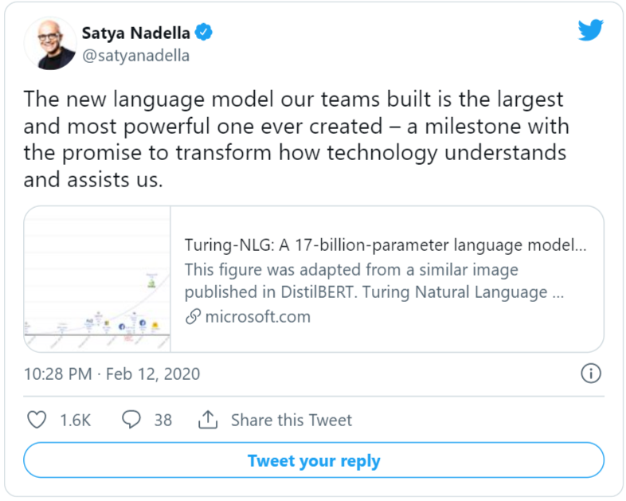
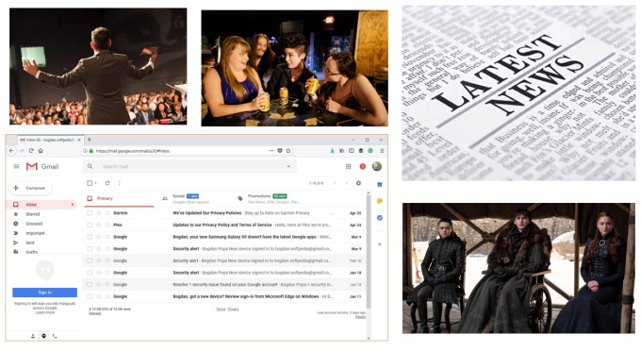
Motivation

Slide 8
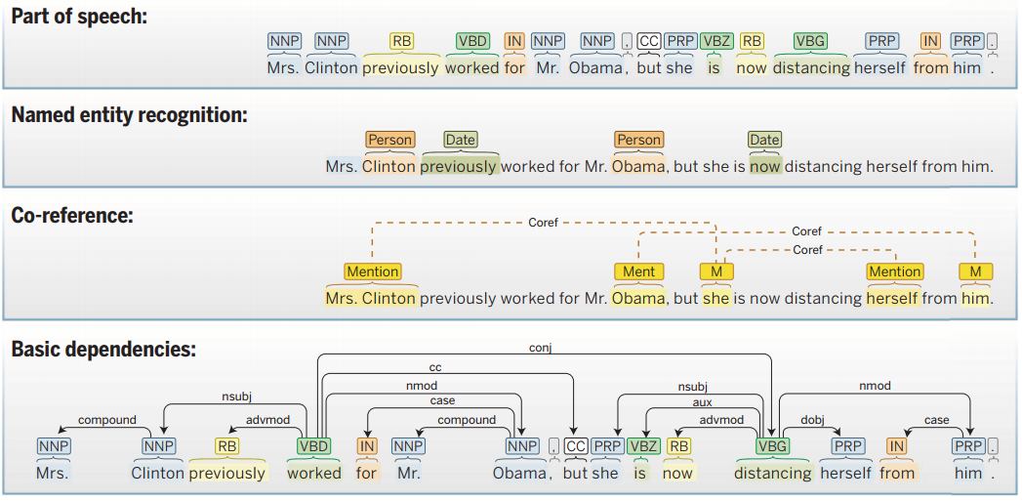

If text is so important, the follow-up question is:
why has technology failed to keep up with the scope at which natural language is used?
https://techcrunch.com/sponsor/nvidia/how-the-revolution-of-natural-language-processing-is-changing-the-way-companies-understand-text/

Slide 9
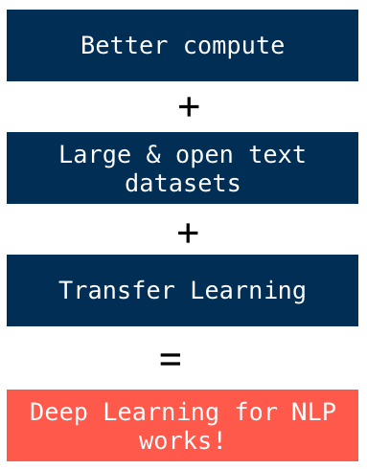
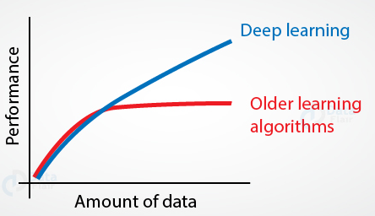
NLP has made more progress in the past three years than any other field in machine learning.

Slide 10
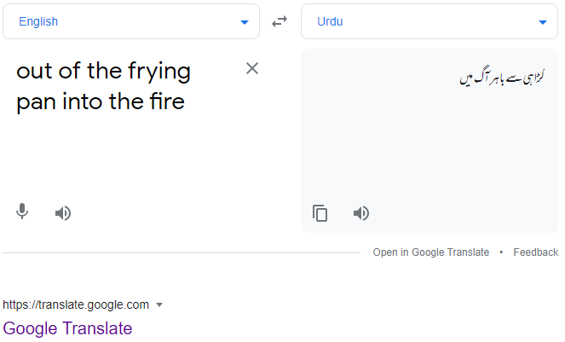
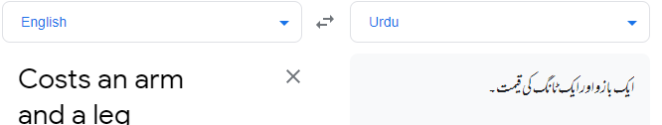
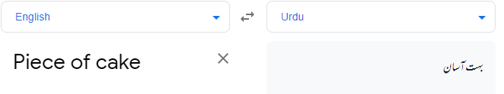
Challenges
Tone
Sarcasm, figurative languages, idioms,
Context, commonsense, etc.

Slide 11

Challenges
Evolving use of language:
Google, photoshop, internet,..
Language morphology:
Stem, stemming, stemmer, ..

Slide 12
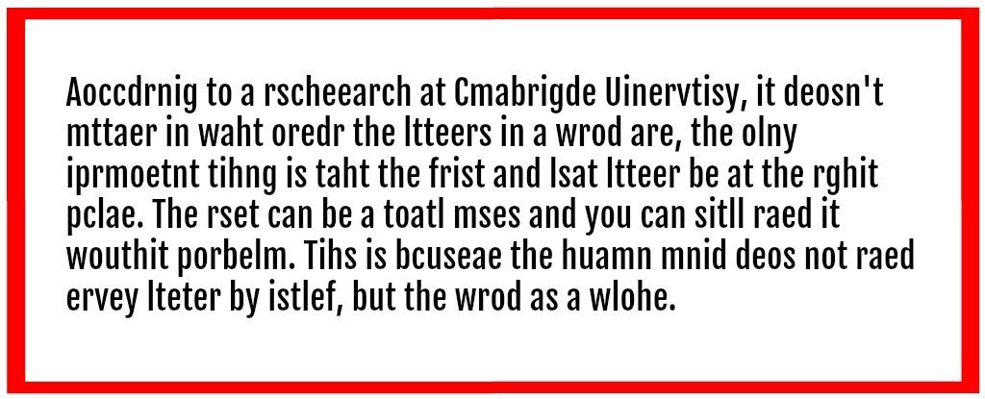
Challenges
Precision
Human speech not precise, unambiguous, complex variables, regional dialects, social context, etc.

Slide 13
Language Processing
What can we achieve by combining simple programming techniques with large quantities of text?
Word Count & Frequency Analysis
Sentiment Analysis
Removing Noise
Tokenization
Search and Keyword Matching
Text Summarization
Text Classification
Topic Modeling
AND MANY MORE…

Slide 14
Language Processing
How can we automatically extract key words and phrases that sum up the style and content of a text?
Term Frequency-Inverse Document Frequency (TF-IDF)
Named Entity Recognition (NER)
Part-of-Speech (POS) Tagging + Noun Phrase Extraction
RAKE (Rapid Automatic Keyword Extraction)
Latent Semantic Analysis (LSA)
TextRank (Graph-Based Keyword Extraction)
BERT for Keyword Extraction (Advanced NLP)
N-Gram Analysis
Clustering Techniques (K-Means or DBSCAN)
AND MANY MORE…

Slide 15
Language Processing
What tools and techniques does the Python programming language provide for such work?
Natural Language Toolkit (NLTK)
spaCy
TextBlob
Gensim
RAKE-NLTK

Slide 16
Language Processing
What are some of the interesting challenges of natural language processing?
Ambiguity in Language
Contextual Understanding
Handling Noisy Text
Word Sense Disambiguation (WSD)
Lack of Data in Low-Resource Languages
Domain-Specific Language
Sentiment Analysis
Long-Range Dependencies
Data Sparsity and Rare Words
Ethical and Fairness Challenges

Slide 17
Text
What is a text? At one level, it is a sequence of symbols on a page such as this one. At another level, it is a sequence of chapters, made up of a sequence of sections
However, we will think of a text as nothing more than a sequence of words and punctuation.
“Dr. Watson, Mr. Sherlock Holmes”, said Stamford, introducing us.

Slide 18
Some Linguistic Terminologies
Morphology: the structure of words. For instance, unusually can be thought of as composed of a prefix un-, a stem usual, and an affix-ly
Syntax: the way words are used to form phrases. e.g., it is part of English syntax that a determiner such as ‘the’ will come before a noun, and the determiners are obligatory with certain singular nouns.
Semantics. Compositional semantics is the construction of meaning (generally expressed as logic) based on syntax.
Pragmatics: meaning in context.

Slide 19
Overview of NLP Applications
Spelling and grammar checking
Optical character recognition (OCR)
Screen readers for blind and partially sighted users
Augmentative and alternative communication)
Machine aided translation
Information retrieval
Document classification (filtering, routing)
Information extraction
Question answering
Summarization
Text segmentation
Exam marking
Report generation (possibly multilingual)
Machine translation
Natural language interfaces to databases
Email understanding
Dialogue systems
Spelling and grammar checking

Slide 20
Overview of NLP Applications
translation,
summarization,
extracting information,
question answering,
natural interfaces to databases,
conversational agents,
and many many more….

Slide 21
Need to understand…1/2
Even ‘simple’ NLP applications, such as spelling checkers, need complex knowledge sources for some problems.
Applications cannot be 100% perfect, because full real-world knowledge is not possible, but these can be useful.
Applications that aid humans are much easier to construct than applications which replace humans.

Slide 22
Need to understand… 2/2
NLP interfaces are nearly always competing with a non-language based approach.
Currently nearly all applications either do relatively shallow processing on arbitrary input or deep processing on narrow domains.
The development of NLP has mainly been driven by hardware and software advances, and societal and infrastructure changes, not by great new ideas.
Improvements in NLP techniques are generally incremental rather than revolutionary

Slide 23
Tokenized Text
breaking up a stream of characters into words, punctuation marks, numbers and other discrete items.
At this level, words have not been classified into grammatical categories and have very little indication of syntactic structure.
“Dr. Watson, Mr. Sherlock Holmes”, said Stamford, introducing us.
‘"’ ‘Dr.’ ‘Watson’ ‘,’ ‘Mr.’ ‘Sherlock’ ‘Holmes’ ‘"’ ‘,’ ‘said’ ‘Stamford’ ‘,’ ‘introducing’ ‘us’ ‘.’

Slide 24
Parts of Speech 1/2
A further stage in analyzing text is to associate every token with a grammatical category or part of speech (POS).
Noun fish, book, house, pen, procrastination, language
Proper noun John, France, Barack, Goldsmiths, Python
Verb loves, hates, studies, sleeps, thinks, is, has
Adjective grumpy, sleepy, happy, bashful
Adverb slowly, quickly, now, here, there
Pronoun I, you, he, she, we, us, it, they
Preposition in, on, at, by, around, with, without
Conjunction and, but, or, unless
Determiner the, a, an, some, many, few, 100

Slide 25
Parts of Speech 2/2
There are many words that can take different parts of speech depending on what they do in a sentence
Rome fell swiftly.
The fall of Rome was swift.
The enemy completely destroyed the city.
The enemy’s destruction of the city was complete.
John likes to fish on the riverbank.
John caught a fish.

Slide 26
Activity
Identify parts of speech in these examples:
The cat sat on the mat.
John sat on the chair.
The dog saw the rabbit.
Jack and Jill went up the hill.
The owl and the pussycat went to sea.
The train travelled slowly.

Slide 27
Corpora
A corpus (corpora is the plural) is simply a body of text that has been collected for some purpose.
Corpora may also be collected for a specific task. For instance, when implementing an email answering application, it is essential to collect samples of representative emails.
Corpora are needed in NLP for two reasons. Firstly, we must evaluate algorithms on real language: corpora are required for this purpose for any style of NLP.
Secondly, corpora provide the data source for many machine-learning approaches.

