Slide 1
Sales & Price Analysis Case Study
Customer Shopping Retail Analysis
Prepare By: Ibrahim Shakhatreh

Slide 2
Introduction about dataset
The data set that I used taking about the sales across 10 malls in istanbul and this data set provide useful information such as invoice number, invoice date, customer id, price, category,shopping mall and another useful information

Slide 3
Overview about analysis operation
The dataset contains a total of 99,457 invoices. The data is clean and reliable, with no duplicated records and no missing values, which ensures the validity of the analysis.
The initial exploratory analysis focused on assessing whether prices are stable across different shopping malls. As a first step, scatter plots were used to visualize price distribution across product categories, helping to identify price stability within each category.
Based on this, an additional scatter plot was created to examine the relationship between price and shopping mall. The results show a high level of price overlap across malls, indicating that prices are generally consistent across different locations for the same product categories.
However, the analysis also reveals price gaps between categories, where certain categories consistently exhibit higher price levels compared to others, suggesting category-driven pricing differences rather than mall-specific pricing.

Slide 4
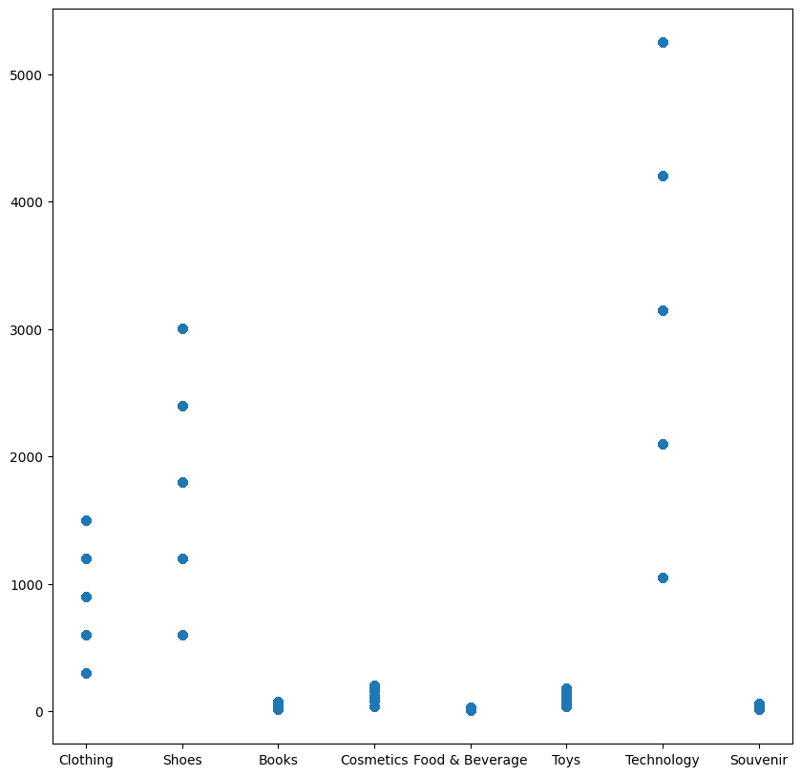
Based on the following chart the category has highest price is Technology because there is an distribution on prices on this category cross malls and reach the price over 5000, also maybe there is distribution between cheap and expense categories , also show the 4 categories has lower than 500
Toys,Books,Clothing,Shoes in general there is an gap between especially in shoes and clothes because may be the mall introduce highest and expense brand

Slide 5
The following analysis is based on the standard deviation and variance and mean:
For example if select a simple sample to compare between Cevahir AVM mall
And Emaar Square Mall in book category, after calculate the mean and the
Variance found the variance in Cevahir AVM mall
For book category is 4.543511e+02 and for the same category 5.019698e+02
Based on this results show that in the second mall the price is higher than in
First mall because the first variance is less than the second variance to show if there is an different in the price for the same category in different malls.

Slide 6
After that I start analysis based on the Age group in this phase I analyse the most age group spent by calculate the mean of the age and calculate the total revenue for all ages less than or equal to mean, and greater than mean, I found the group less than or equal to mean spent most.
But after that also i classify the group into three categories teenagers,
Young Adults, Seniors I found the Seniors has been spent most.
I didn't stop there, I divided the ages into four categories:
13-19 2) 20-39 4) 40-65 4) >65
I found the most two groups that have been spent 40-65 and >65
And the following the chart shows the results

Slide 7
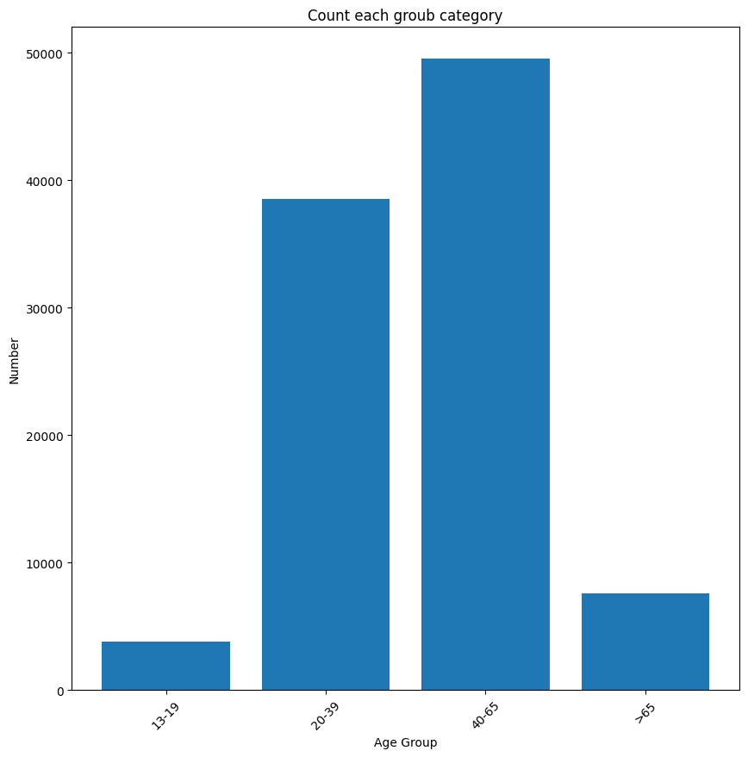

Slide 8
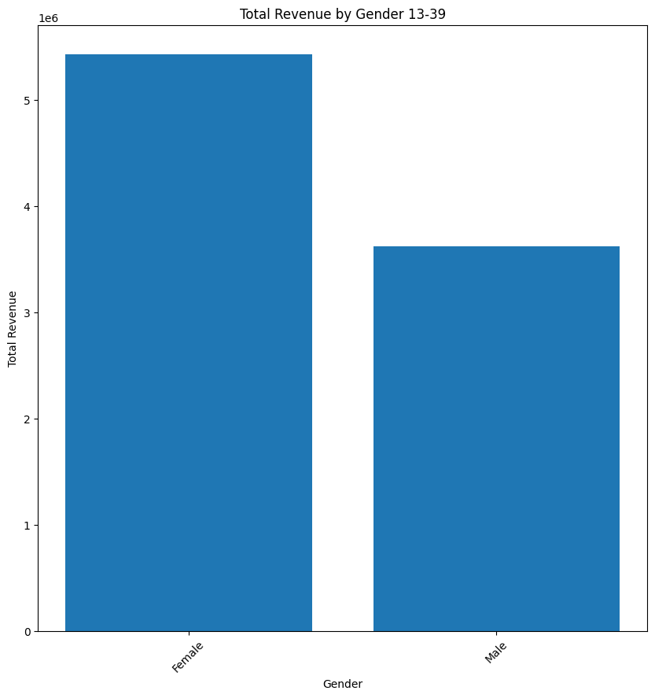
I show in each category which gender is most spent after classify the age groups and get the the information for each group and make grouping for each gender type with total sum of revenue shows that the female has most spent and the following chart shows that
The following chart shows spent for each gender type in age group 13-19

Slide 9
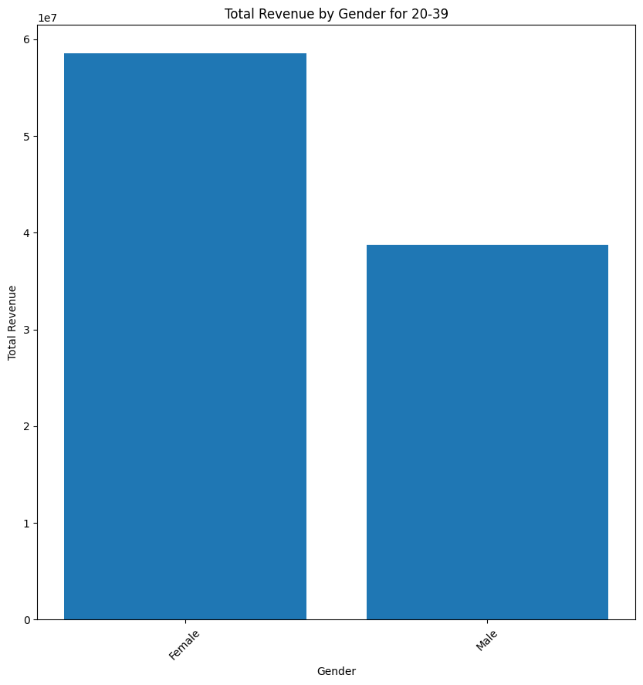
The following chart shows the spent for each male and female in group 20-39

Slide 10
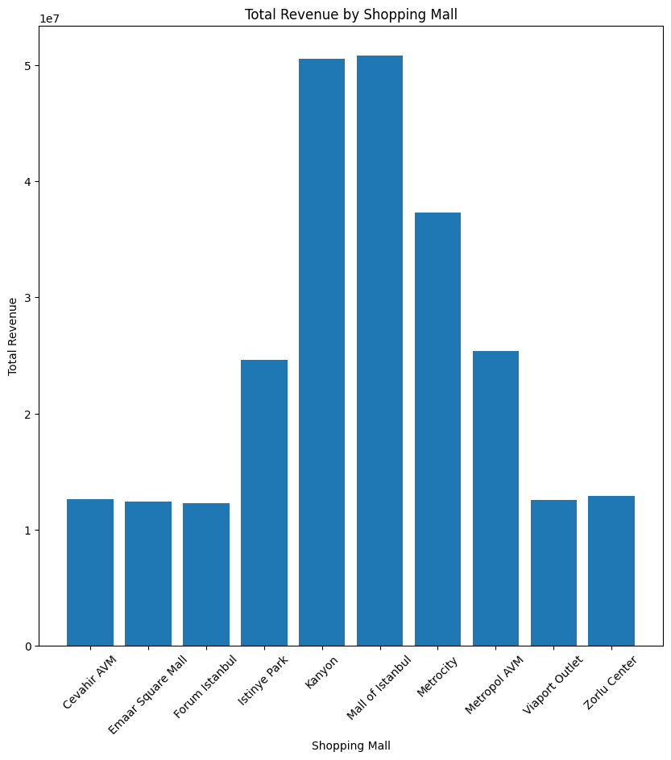
Also I noticed that female and male are favourite payment method cash.
The following bar chart shows the total revenue for each mall in the period 2021-203
The bar chart shows that the most two malls that have highest revenue are Mall of Istanbul and
Kanyon.

Slide 11
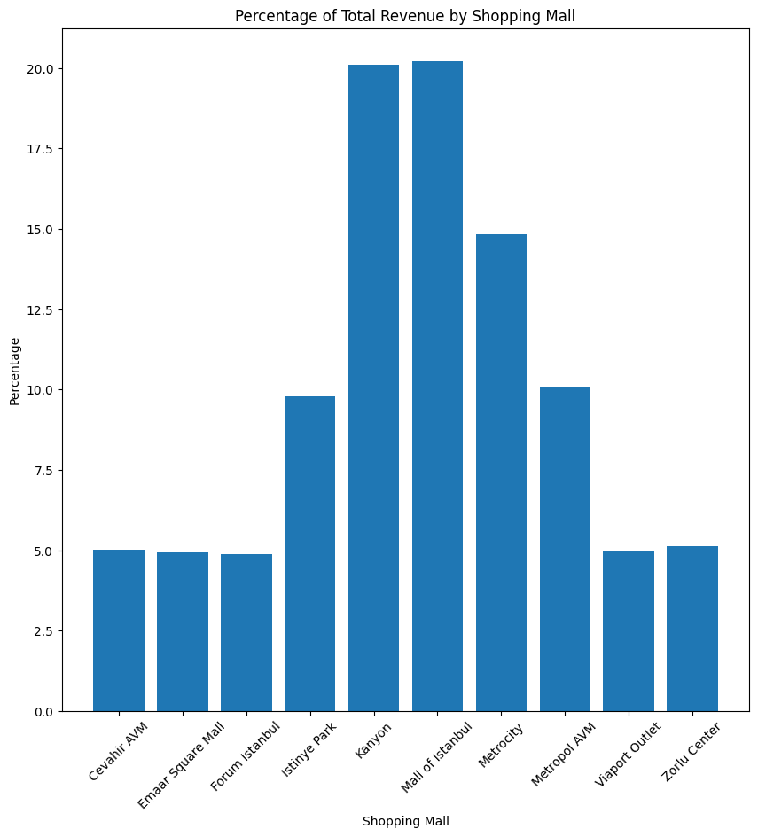
Also I calculate the percentage of revenue of each mall from total revenue over the period 2021-2023 shows that also Mall of Istanbul and
Kanyon have highest percentage of revenue.
The following bar chart shows the percentage revenue of each mall over period 2021-2023 ans shows that the Mall of Istanbul has highest percentage revenque of total revenue

