Slide 1


RESEARCH TOPIC:
DA-NN: A ResNet-Based Architecture with Domain Adaptation for Automatic EEG Artifact Identification
EV
Emmanuel de Jesús
Velásquez-Martínez
MP
Miguel Ángel
Porta-García
INFOTEC
Centro de Investigación e Innovación en Tecnologías de la Información y Comunicación

Slide 2
Agenda
BIOSIGNALS 2026
Introduction
Related Works
Materials and Methods
Sinkhorn-Based Domain Alignment Process Applied to Deep Learning Models
Experimentation
Conclusions

Slide 3
Agenda
BIOSIGNALS 2026
Introduction
Related Works
Materials and Methods
Sinkhorn-Based Domain Alignment Process Applied to Deep Learning Models
Experimentation
Conclusions

Slide 4
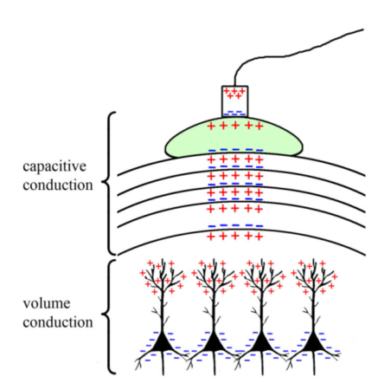
Background
EEG Essentials
BIOSIGNALS 2026
Electroencephalography (EEG) captures cortical electrical activity through non-invasive scalp electrodes (Ahmed, 2022).
  Clinical & Research Utility: Essential for neurology (epilepsy), sleep medicine, cognitive neuroscience, Brain-Computer Interfaces (BCI), and ICU monitoring (Saba-Sadiya et al., 2021).
  Critical Challenge: Diagnostic accuracy heavily relies on clean signals. Artifacts can mimic pathology, making robust identification crucial. (Chuang et al., 2022).
  Data Characteristics: High temporal resolution but low spatial resolution; signals are microvolt-scale (µV) and highly susceptible to noise (Huang et al., 2024).
Figure 1. Propagation of the neuronal signal. Source: (Jackson & Bolger, 2014).

Slide 5
PROBLEM DEFINITION
Artifacts in EEG: Types and Impact
BIOSIGNALS 2026
Artifact Categories
Consequences
Clinical Impact
Obscures Neural Patterns: Critical waveforms (e.g., spikes, sleep spindles) are masked.
Diagnostic Errors: Increases false positives (mimicking epilepsy) and false negatives.
Analysis Reliability: Severely degrades performance of automated analysis algorithms.
Physiological
Non-Physiological
Ocular: Blinks and eye movements (EOG) create high-amplitude deflections.
Muscle (EMG): High-frequency noise from jaw clenching or facial tension.
Shivering: Tremors causing rhythmic interference.
Chewing: Rhythmic, broad-spectrum artifacts.
Electrode Pop: Abrupt impedance changes causing spike-like artifacts.
Line Noise: 50/60Hz power line interference.
Environmental: Electromagnetic interference from nearby equipment.
Motion: Cable movement or electrode displacement.
Source: (Quintero-Rincon et al., 2021)

Slide 6
Agenda
BIOSIGNALS 2026
Introduction
Related Works
Materials and Methods
Sinkhorn-Based Domain Alignment Process Applied to Deep Learning Models
Experimentation
Conclusions

Slide 7



PREVIOUS RESEARCH
Related Works
BIOSIGNALS 2026
Maiwald et al. (2023), Image-based CNNs (Xception, EfficientNetB0),
F1-score: > 89%
TUH-EEG
Saba-Sadiya et al. (2020), Unsupervised Encoder-Decoder,
Cohen’s kappa: ≈ 0.49
Bahador et al. (2020), CNN (2D RGB EEG representation), Accuracy: 92.30%, AUC: 0.96
2020
2023
2019
2022
Kim & Keene (2019), CNN-LSTM,
Accuracy: 67.59%
TUH-EEG
Peh et al. (2022), CNN-Transformer, Balanced Accuracy: 0.804
TUH-EEG

Slide 8
Agenda
BIOSIGNALS 2026
Introduction
Related Works
Materials and Methods
Sinkhorn-Based Domain Alignment Process Applied to Deep Learning Models
Experimentation
Conclusions

Slide 9
RESEARCH MOTIVATION
Motivation and Objectives
BIOSIGNALS 2026
Primary Objectives
Strategic Approach
Domain Adaptation
Semi-Supervised Learning: Utilize labeled source data (real) and unlabeled target data (synthetic).
Latent Alignment: Project disparate signals into a shared, domain-invariant latent space.
Feature Transfer: Learn universal features applicable to both domains.
Bridge Domain Gap
Robust Identification
Overcome Distribution Shift: Address the statistical mismatch between real and synthetic EEG data.
Synthetic Training: Enable models trained on synthetic noise to generalize to real clinical artifacts.
Reduce Labeling: Eliminate the need for extensive manual labeling of target datasets.
Scalable Solution: Develop a system that works across different recording devices and settings.
High Specificity: Accurately distinguish true neural activity from artifacts.
Consistency: Maintain high performance metrics regardless of the input data source.
Source: (Choi, 2025)

Slide 10
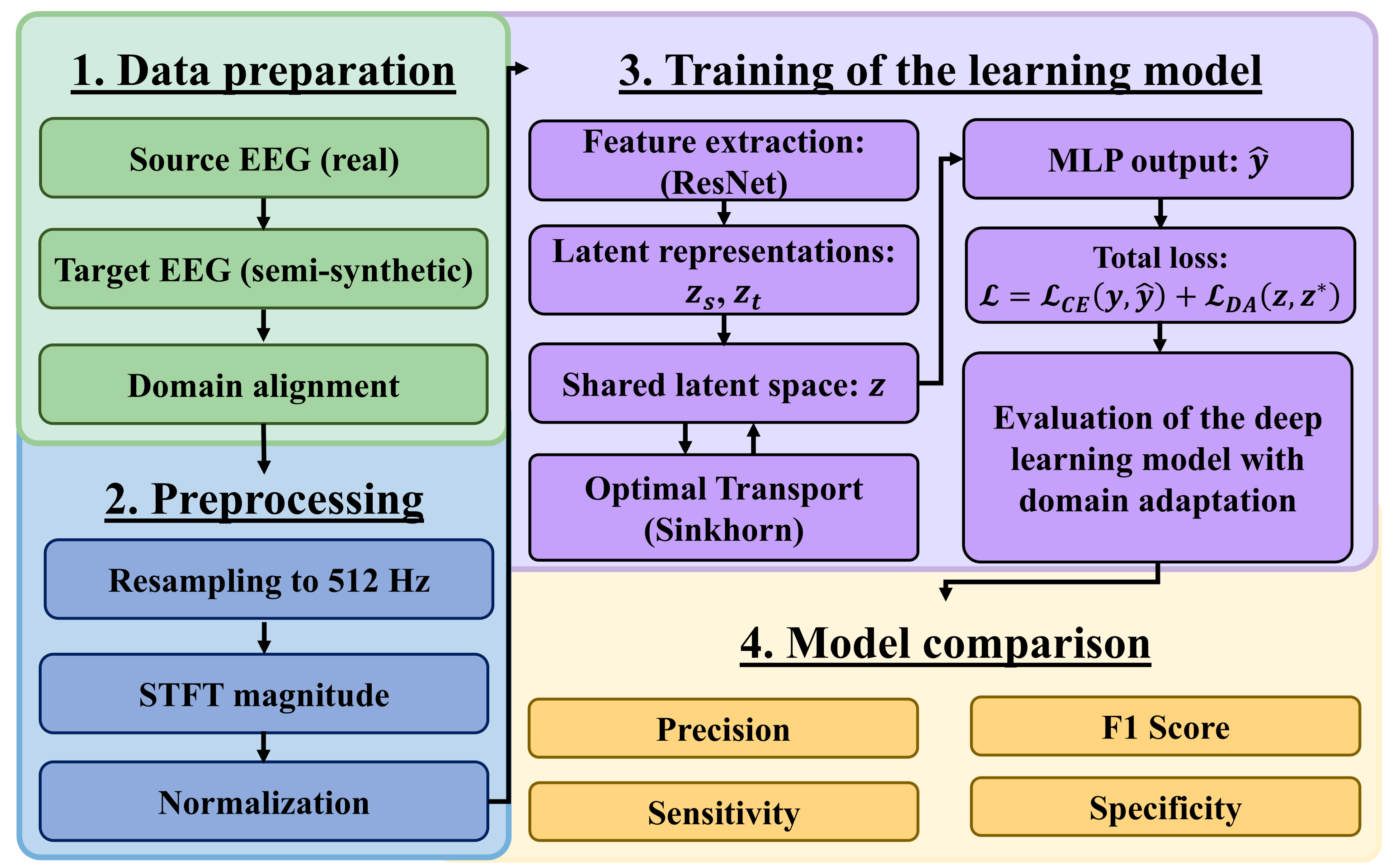
METHODOLOGY
From data preparation to model evaluation
BIOSIGNALS 2026
Figure 2. Proposed methodology for EEG artifact identification.

Slide 11
Agenda
BIOSIGNALS 2026
Introduction
Related Works
Materials and Methods
Sinkhorn-Based Domain Alignment Process Applied to Deep Learning Models
Experimentation
Conclusions

Slide 12
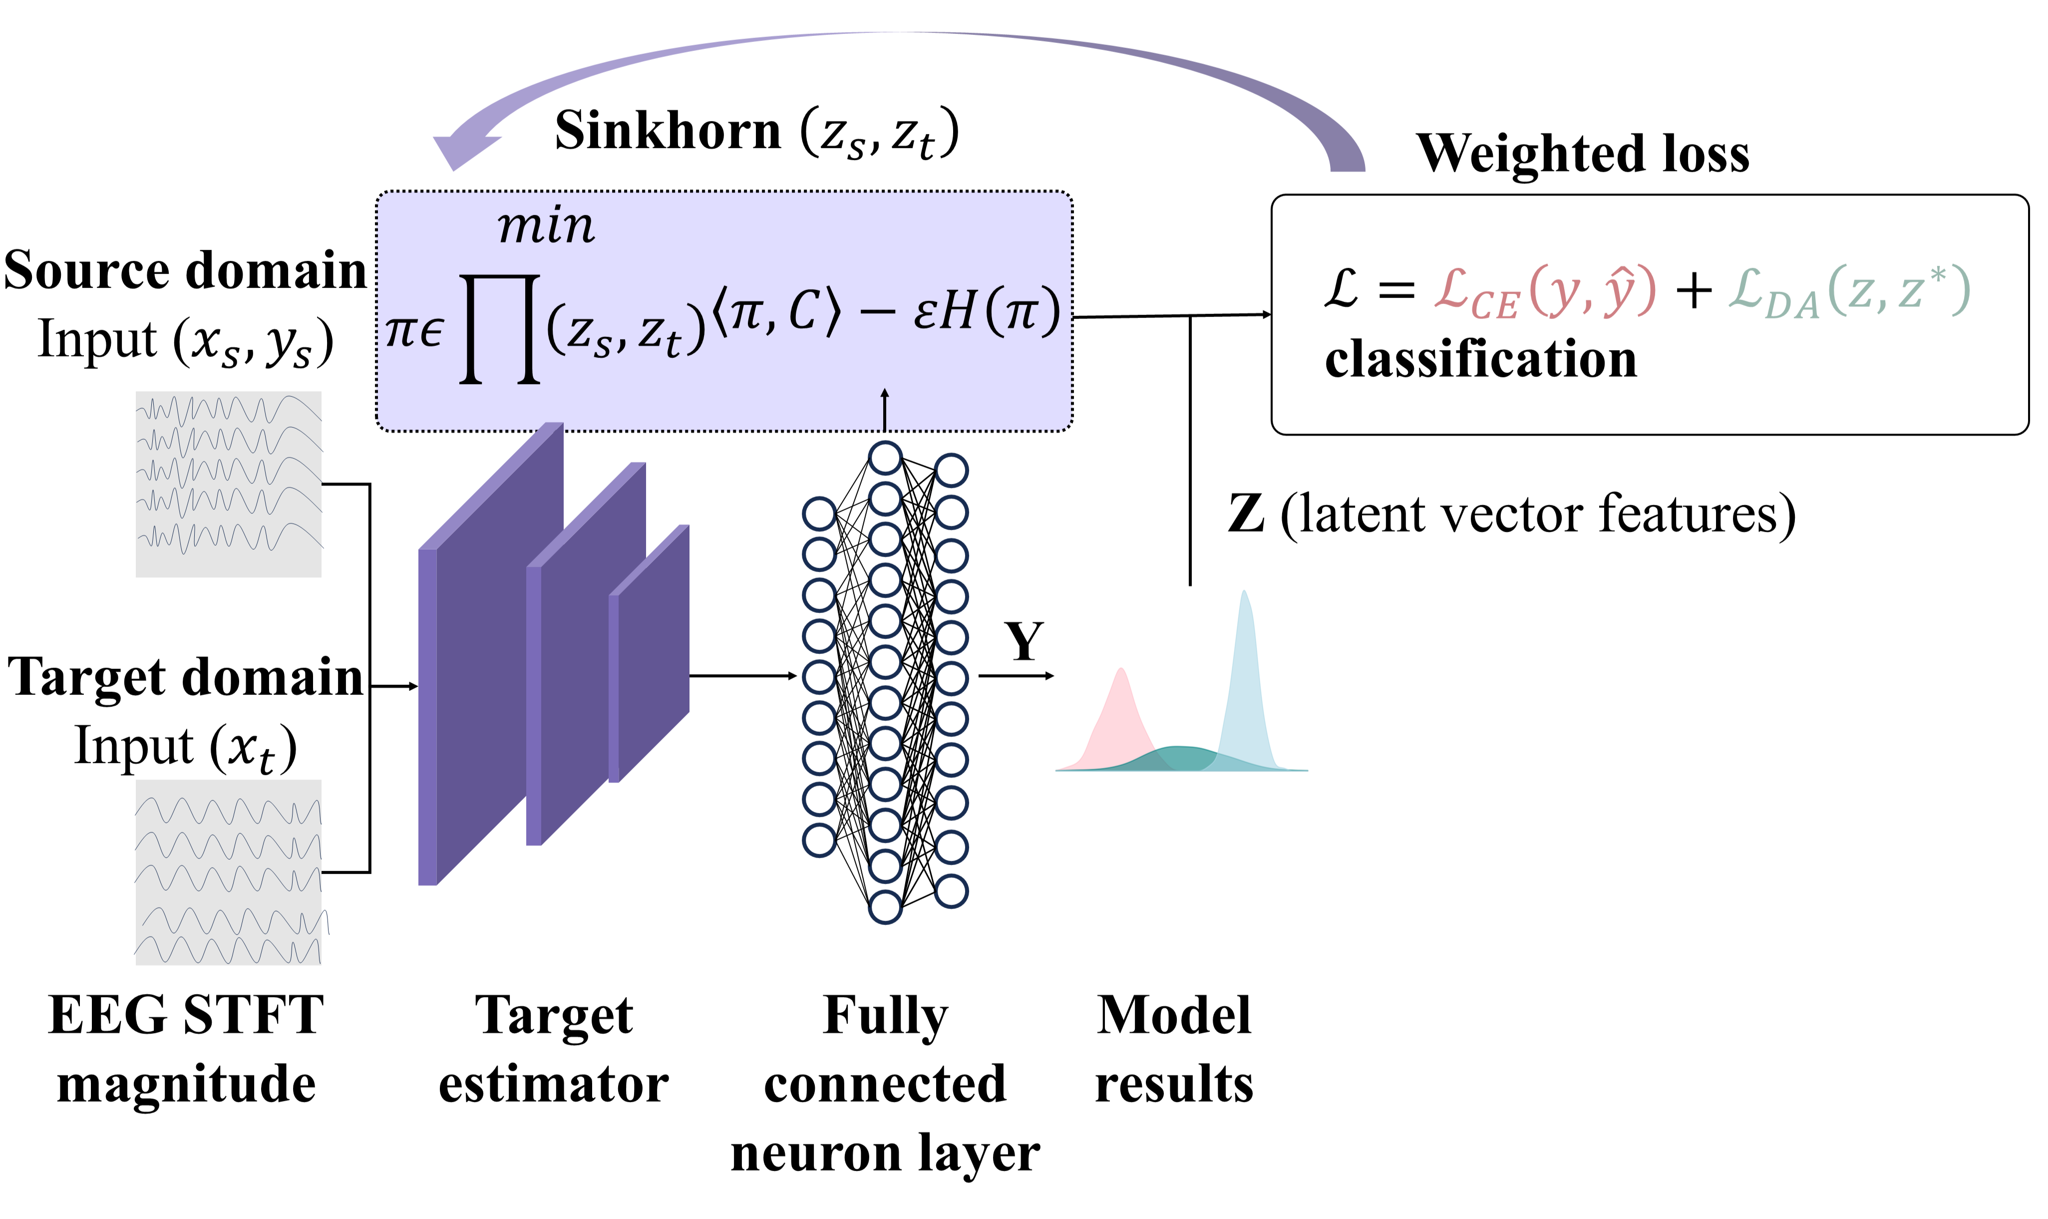
BIOSIGNALS 2026
ALGORITHM
Based Domain Alignment Process Applied to Deep Learning Models
Figure 3. Neural network architecture with domain adaptation (DA-NN).

Slide 13
Agenda
BIOSIGNALS 2026
Introduction
Related Works
Materials and Methods
Sinkhorn-Based Domain Alignment Process Applied to Deep Learning Models
Experimentation
Conclusions

Slide 14
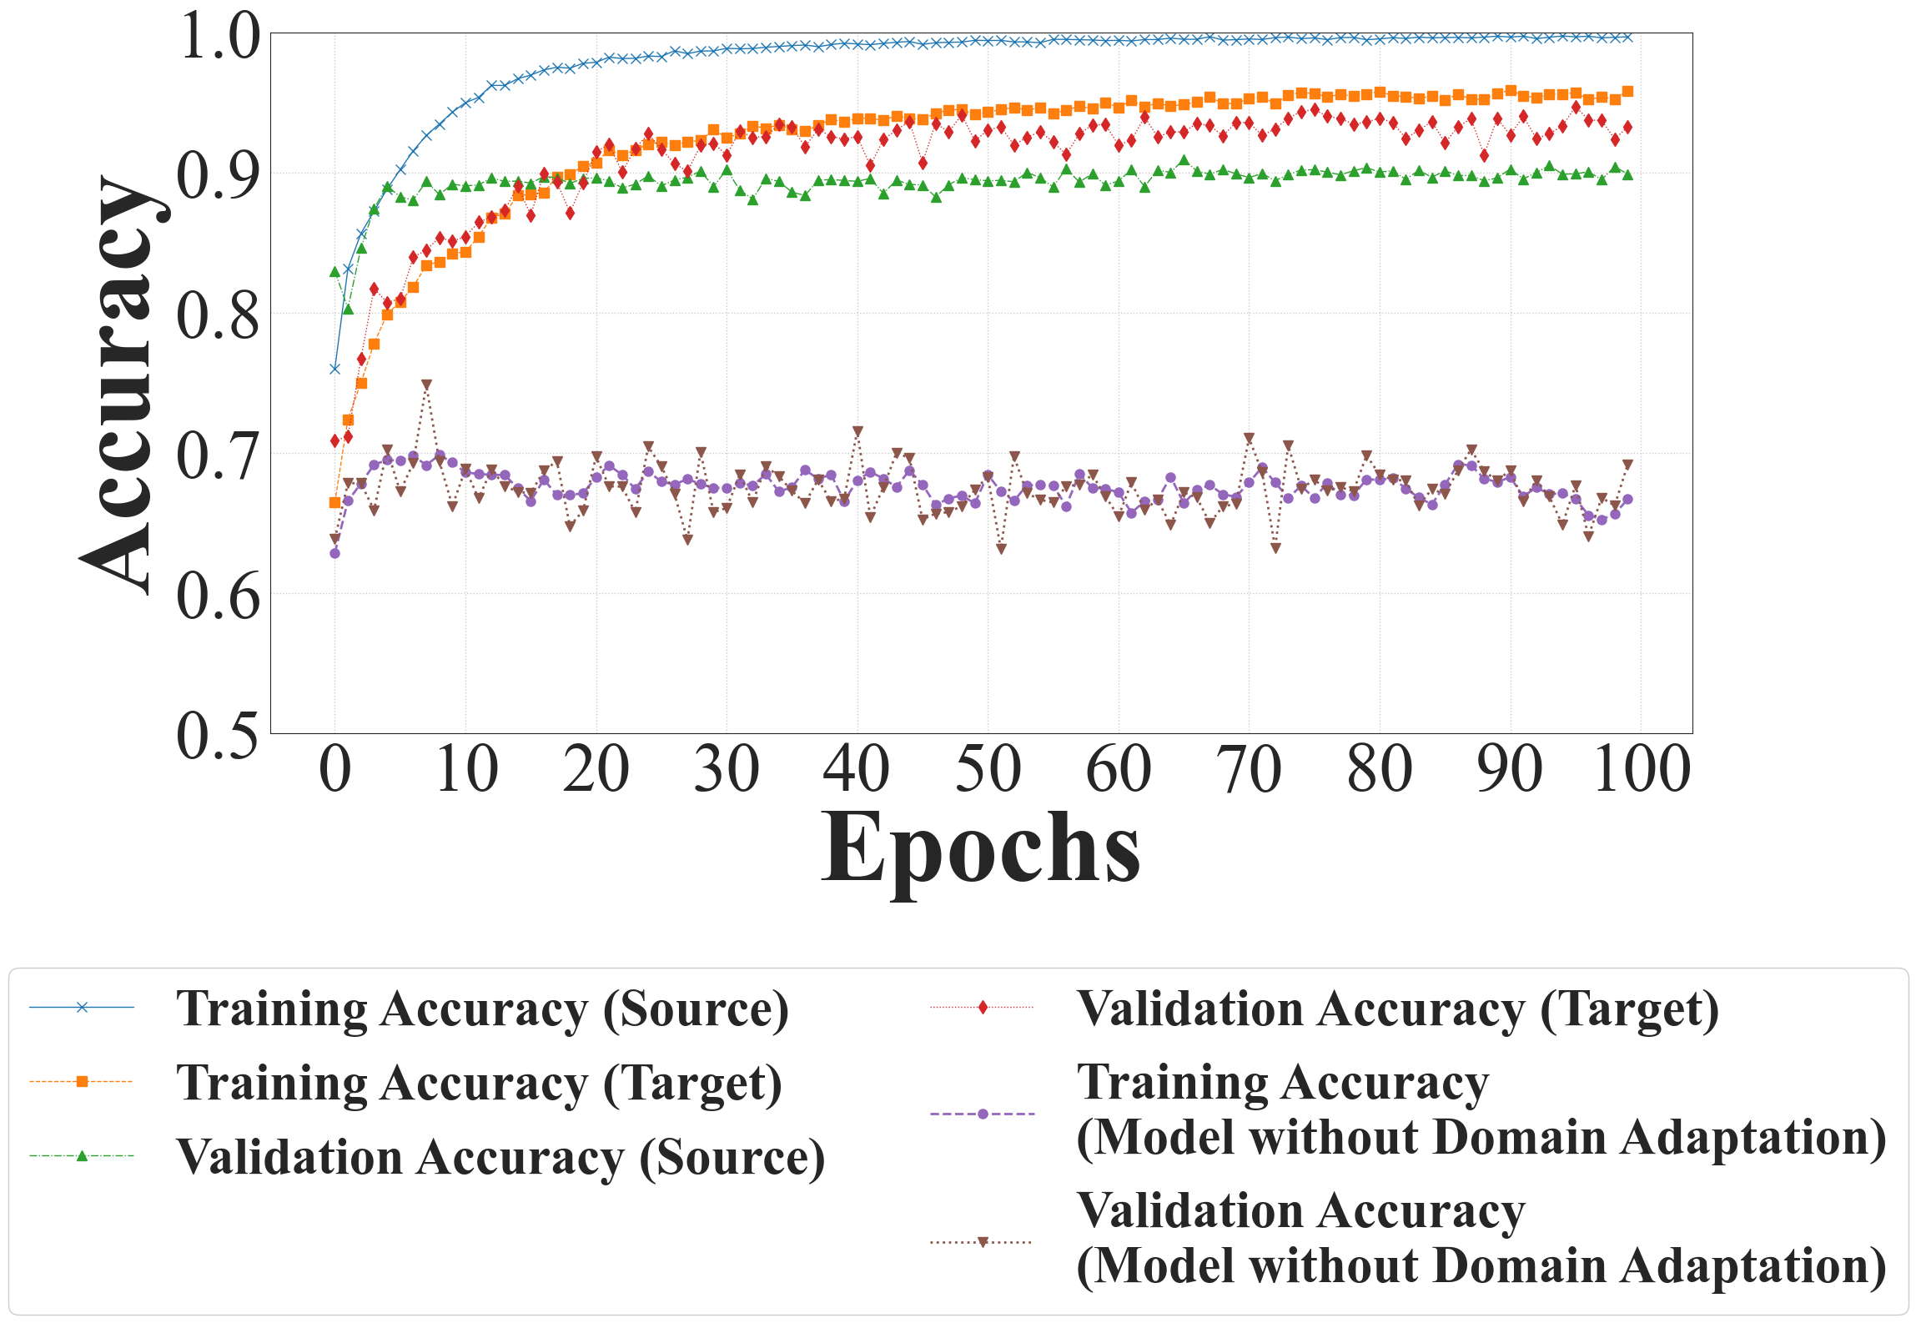
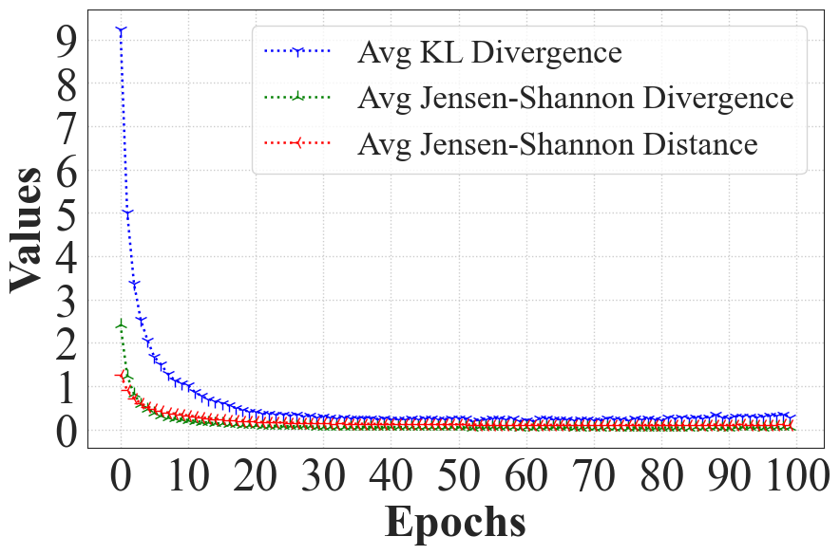
BIOSIGNALS 2026
METRICS
Learning Behavior of the Neural Network over the Epochs
Figure 4. Training and validation accuracy over epochs
Figure 5. Domain adaptation distance and divergence metrics over epochs

Slide 15
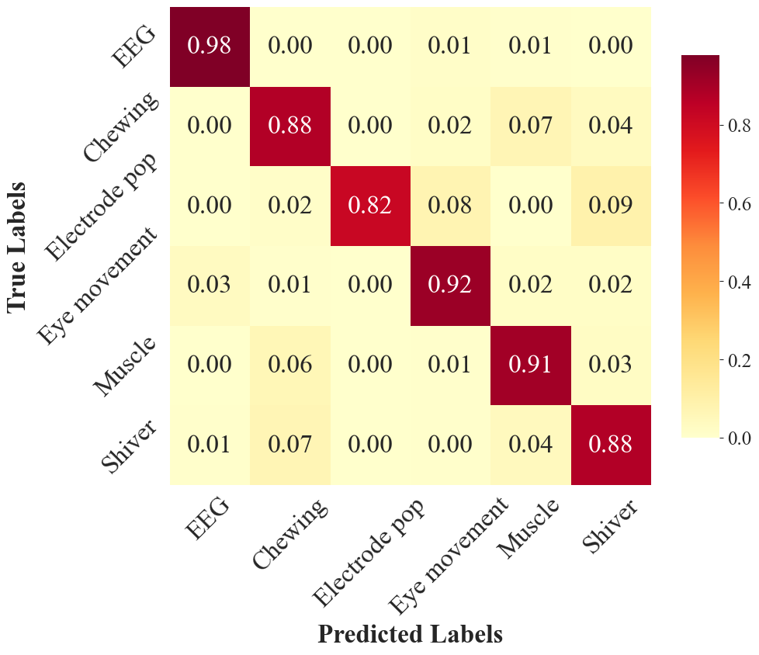
BIOSIGNALS 2026
ARTIFACT DETECTION
Confusion Matrix of the Neural Network Classification
Figure 6. Confusion matrix — Source and Target domains

Slide 16
BIOSIGNALS 2026
METRICS
Comparative Analysis of Metrics Between Source and Target Domains
Table I. Comparison of classification performance metrics per class between TUH-EEG and EEGdenoiseNet Custom
Class | TUH-EEG |  |  |  | EEGdenoiseNet Custom
 | Precision | Sensitivity | F1-score | Specificity | Precision | Sensitivity | F1-score | Specificity
EEG | 0.9896 | 0.9566 | 0.9728 | 0.9972 | 0.9325 | 1.0000 | 0.9651 | 0.9795
Chewing | 0.8878 | 0.8440 | 0.8654 | 0.9709 | 0.8999 | 0.9071 | 0.9035 | 0.9724
Electrode pop | 1.0000 | 0.8485 | 0.9180 | 1.0000 | 0.7879 | 0.7879 | 0.7879 | 0.9983
Eye movement | 0.9449 | 0.9255 | 0.9351 | 0.9841 | 0.9727 | 0.9222 | 0.9468 | 0.9923
Muscle | 0.8116 | 0.8814 | 0.8450 | 0.9451 | 0.9769 | 0.9349 | 0.9554 | 0.9941
Shiver | 0.8350 | 0.8755 | 0.8548 | 0.9772 | 0.8563 | 0.8797 | 0.8678 | 0.9805

Slide 17
BIOSIGNALS 2026
METRICS
Comparative Metric Analysis Across State-of-the-Art Studies
Table II. Comparison of Artifact Classification Models with the State of the Art
Method | Feature Type | Accuracy
(Kim and Keene, 2019) | Baseline EEG | 67.59%
(Peh et al., 2022) | Baseline EEG statistics | 79.22%
(Maiwald et al., 2023) | Spectrogram | 88.30%
DA-NN model | STFT magnitude | 91.59%

Slide 18
Agenda
BIOSIGNALS 2026
Introduction
Related Works
Materials and Methods
Sinkhorn-Based Domain Alignment Process Applied to Deep Learning Models
Experimentation
Conclusions

Slide 19
Summary & Outlook
Conclusions and Future Work
BIOSIGNALS 2026
Key Conclusions
Future directions
Bridged the Domain Gap: The DA-NN effectively aligns real and synthetic EEG distributions using Sinkhorn Optimal Transport, reducing domain discrepancy by 24%.
Superior Performance: Achieved 91.59% accuracy, outperforming methods like CNN-LSTM and Transformers while maintaining high clinical specificity.
Practical Robustness: Eliminated the need for extensive labeled target data, offering a scalable solution for varying recording environments.
Fully Unsupervised Learning: Extend the architecture to leverage completely unlabeled real-world recordings, removing dependencies on synthetic priors.
Multi-Channel Integration: Expand from single-channel processing to spatial-temporal modeling across full electrode montages for better artifact localization.
Real-Time Clinical Deployment: Optimize the ResNet backbone for edge devices to enable live artifact removal during Real-Time Clinical Deployment monitoring and BCI applications.

Slide 20
THANK YOU FOR YOUR ATTENTION
DA-NN: A ResNet-Based Architecture with Domain Adaptation for Automatic EEG Artifact Identification
EV
Emmanuel de Jesús
Velásquez-Martínez
MP
Miguel Ángel
Porta-García
INFOTEC
Centro de Investigación e Innovación en Tecnologías de la Información y Comunicación
iemmanuelvm@gmail.com
miguel.porta@infotec.mx

Slide 21
References
BIOSIGNALS 2026
Ahmed, A. (2022). A quick survey of eeg signal noise removal methods. Global Journal of Engineering and Technology Advances, 11:098–104.
Azhar, M., Shafique, T., and Amjad, A. (2024). A convolutional neural network for the removal of simultaneous ocular and myogenic artifacts from eeg signals. Electronics, 13(22).
Bahador, N., Erikson, K., Laurila, J., Koskenkari,J., Ala-Kokko, T., and Kortelainen, J. (2020a).Automatic detection of artifacts in eeg by combining deep learning and histogram contour processing. In2020 42nd Annual International Conference of the IEEE Engineering in Medicine & Biology Society(EMBC), pages 138–141.
Bahador, N., Erikson, K., Laurila, J., Koskenkari,J., Ala-Kokko, T., and Kortelainen, J. (2020b).A correlation-driven mapping for deep learning application in detecting artifacts within the eeg. Journal of Neural Engineering, 17(5):056018.
Bao, C., Hao, Z., and Dou, W. (2022). Automatic removal of scalp eeg artifacts using an interpretable hybrid deep learning method. In 2022 IEEE International Conference on Bioinformatics and Biomedicine (BIBM), pages 1451–1456.
Brophy, E., Redmond, P., Fleury, A., De Vos, M., Boylan,G., and Ward, T. (2022). Denoising eeg signals for real-world bci applications using gans. Frontiers in Neuroergonomics, Volume 2 - 2021.
Cai, Y., Meng, Z., and Huang, D. (2025). Dhct-gan:Improving eeg signal quality with a dual-branch hybrid cnn–transformer network. Sensors, 25(1).
Choi, B. J. (2025). Removing neural signal artifacts with autoencoder-targeted adversarial transformers (at-at).
Chuang, C.-H., Chang, K.-Y., Huang, C.-S., and Jung, T.-P. (2022). Ic-u-net: A u-net-based denoising autoencoder using mixtures of independent components for automatic eeg artifact removal. NeuroImage, 263:119586. Epub ahead of print,August 27, 2022.
Courty, N., Flamary, R., Habrard, A., and Rakotomamonjy,A. (2017a). Joint distribution optimal transportation for domain adaptation. In Proceedings of the31st International Conference on Neural Information Processing Systems, NIPS’17, page 3733–3742, RedHook, NY, USA. Curran Associates Inc.
Courty, N., Flamary, R., Tuia, D., and Rakotomamonjy, A.(2017b). Optimal transport for domain adaptation. IEEE Transactions on Pattern Analysis and Machine Intelligence, 39(9):1853–1865.
Farahani, A., Voghoei, S., Rasheed, K., and Arabnia,H. R. (2021). A brief review of domain adaptation. In Stahlbock, R., Weiss, G. M.,Abou-Nasr, M., Yang, C.-Y., Arabnia, H. R., and Deligiannidis, L., editors, Advances in Data Science and Information Engineering, pages 877–894, Cham.Springer International Publishing.
Feydy, J., Sejourne, T., Vialard, F.-X., Amari, S.-i.,Trouve, A., and Peyre, G. (2019). Interpolating between optimal transport and mmd using sinkhorn divergences. In The 22nd International Conference on Artificial Intelligence and Statistics, pages2681–2690.
Fuglede, B. and Topsoe, F. (2004). Jensen-Shannon divergence and hilbert space embedding. In International Symposium on Information Theory,2004. ISIT 2004. Proceedings
Gabardi, M., Saibene, A., Gasparini, F., Rizzo, D., and Stella, F. A. (2023). A multi-artifact eeg denoising by frequency-based deep learning.
Geron, A. (2019). Hands-On Machine Learning with Scikit-Learn, Keras, and TensorFlow: Concepts, Tools, and Techniques to Build Intelligent Systems.O’Reilly Media, 2nd edition.

Slide 22
References
BIOSIGNALS 2026
Geuter, J., Kornhardt, G., Tomasson, I., and Laschos,V. (2025). Universal neural optimal transport. In Singh, A., Fazel, M., Hsu, D., Lacoste-Julien, S.,Berkenkamp, F., Maharaj, T., Wagstaff, K., and Zhu,J., editors, Proceedings of the 42nd International Conference on Machine Learning, volume 267 of Proceedings of Machine Learning Research, pages19196–19232. PMLR.
Goyal, D. and Pabla, B. (2015). Condition based maintenance of machine tools—a review. CIRP Journal of Manufacturing Science and Technology,10:24–35.
Grandini, M., Bagli, E., and Visani, G. (2020). Metrics for multi-class classification: an overview. ArXiv,abs/2008.05756.
Hamid, A., Gagliano, K., Rahman, S., Tulin, N., Tchiong,V., Obeid, I., and Picone, J. (2020). The temple university artifact corpus: An annotated corpus of eeg artifacts. In 2020 IEEE Signal Processing in Medicineand Biology Symposium (SPMB), pages 1–4.
Huang, X., Li, C., Liu, A., Qian, R., and Chen, X.(2024). Eegdfus: A conditional diffusion model for fine-grained eeg denoising. IEEE Journal of Biomedical and Health Informatics, pages 1–13.
Jackson, A. F. and Bolger, D. J. (2014). The neurophysiological bases of eeg and eeg measurement: a review for the rest of us. Psychophysiology, 51(11):1061–1071. Epub 2014 Jul17.
Kim, D. and Keene, S. (2019). Fast automatic artifact annotator for eeg signals using deep learning. In 2019IEEE Signal Processing in Medicine and Biology Symposium (SPMB), pages 1–5.
Lin, H.-Y., Tseng, H.-H., Lu, X., and Tsao, Y. (2021).Unsupervised noise adaptive speech enhancement by discriminator-constrained optimal transport.
Maiwald, A., Ackermann, L., Kalcher, M., and Wu,D. J. (2023). Image-based data representations of time series: A comparative analysis in eeg artifact detection.
Mashhadi, N., Khuzani, A. Z., Heidari, M., and Khaledyan,D. (2020). Deep learning denoising for eog artifacts removal from eeg signals. 2020 IEEE Global Humanitarian Technology Conference (GHTC), pages1–6.
Pandya, S., Patel, P., Nord, B. D., Walmsley, and Ciprijanovic, A. (2025). Sidda: Sinkhorn dynamic domain adaptation for image classification with equivariant neural networks.
Peh, W. Y., Yao, Y., and Dauwels, J. (2022). Transformerconvolutional neural networks for automated artifactdetection in scalp eeg. 2022 44th Annual InternationalConference of the IEEE Engineering in Medicine &Biology Society (EMBC), pages 3599–3602.
Quintero-Rinc´on, A., Giano, C. D., and Batatia, H. (2021).Chapter 11. artefacts detection in eeg signals. InArtefacts Detection in EEG Signals.
Saba-Sadiya, S., Chantland, E., Alhanai, T., Liu, T., andGhassemi, M. M. (2021). Unsupervised eeg artifactdetection and correction. Frontiers in Digital Health,2.

Slide 23
References
BIOSIGNALS 2026
Shlens, J. (2014). Notes on kullback-leibler divergence andlikelihood. ArXiv, abs/1404.2000.
Tohka, J. and van Gils, M. (2021). Evaluation of machine learning algorithms for health and wellness applications: A tutorial. Computers in Biology and Medicine, 132:104324.
Xiong, W., Ma, L., and Li, H. (2024). A general dual-pathway network for eeg denoising. Frontiers inNeuroscience, 17.
Zhang, H., Zhao, M., Wei, C., Mantini, D., Li, Z., and Liu,Q. (2021). Eegdenoisenet: a benchmark dataset fordeep learning solutions of eeg denoising. Journal ofNeural Engineering, 18(5):056057.
Zunino, L., Olivares, F., Ribeiro, H. V., and Rosso,O. A. (2022). Permutation jensen-shannon distance:A versatile and fast symbolic tool for complextime-series analysis. Phys. Rev. E, 105:045310.

