Slide 1
Parallel Algorithms for the N-Queens problem
第27組
0756166 楊牧樺
0856009 王靖
0856056 曾鈺文

Slide 2
Outline
Introduction
Proposed Solution
Evaluation
Related Work
Contribution
Conclusion

Slide 3
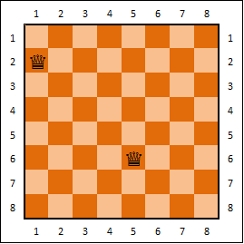
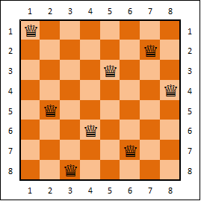
Introduction
To place N queens on an N*N chessboard such that no two queens can attack each other.

Slide 4
Introduction
Some algorithms to solve N-queens problem
Backtracking
Hill climbing
Genetic algorithm
Simulated annealing

Slide 5
Backtracking
Viewed as a search tree
Place queens one by one
Go down: find partial solution
Go up: conflict occured, return partial solution

Slide 6
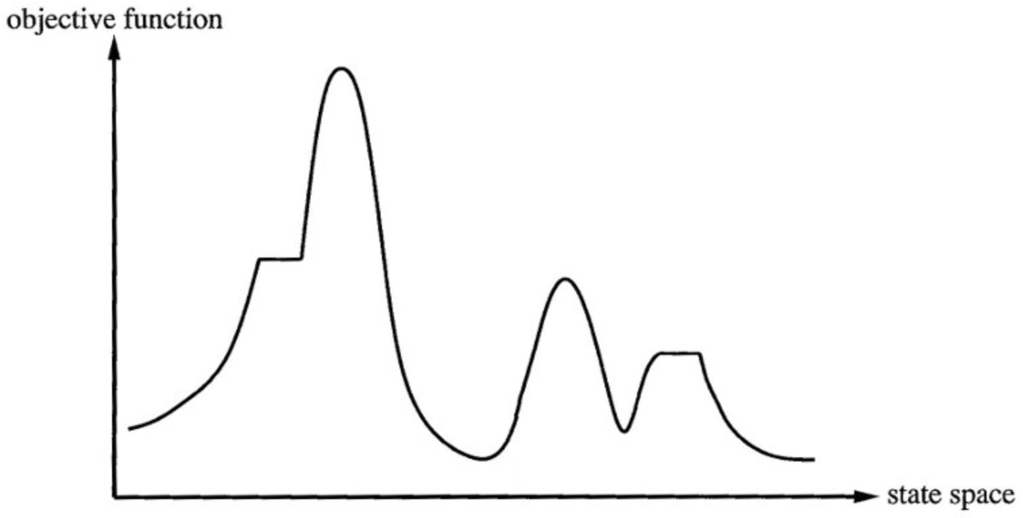
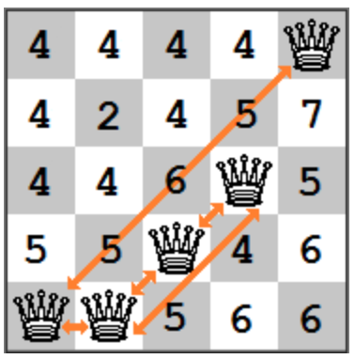
Hill Climbing
Heuristic search algorithm
Move continuously in the direction of decreasing cost
Local maximum problem

Slide 7
Genetic Algorithm
Heuristic search algorithm
To find optimized solution
selection
crossover
mutation
0 | 2 | 1 | 3
3 | 2 | 1 | 0
0 | 3 | 1 | 2
2 | 0 | 1 | 2
3 | 0 | 1 | 2
2 | 0 | 1 | 3
0 | 3 | 1 | 3
0 | 2 | 1 | 3

Slide 8
Simulated Annealing
Heuristic search algorithm
To find optimized solution
Let s = s₀
For k = 0 through k_{max} (exclusive):
T ← temperature( k_{max}/(k+1) )
Pick a random neighbour, s_{new} ← neighbour(s)
If P(E(s), E(s_{new}), T) ≥ random(0, 1):
s ← s_{new}
Output: the final state s

Slide 9
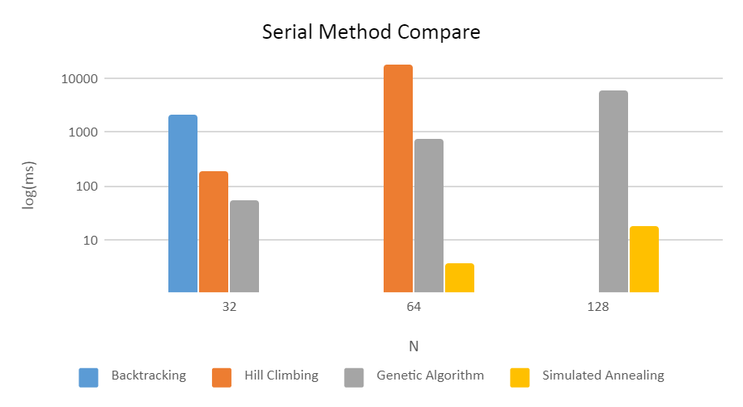
Compare

Slide 10
Proposed solution
Parallel simulated annealing
Pthread
OpenMP
Parallel backtracking
Assembling methods
MPI
Pthread
CUDA

Slide 11
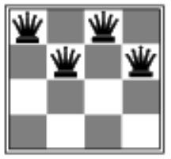
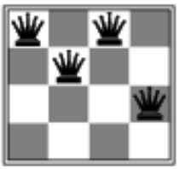
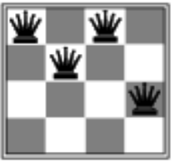
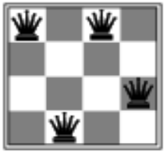
Parallelized simulated annealing
Different heuristic start points
Terminate all children if one child found solution
. . .

Slide 12
Parallelized simulated annealing evaluation
Performance
 | 512 | 1024 | 2048
Serial | 4.8291 | 24.3117 | 128.2092
Pthread | 3.6469 | 19.4029 | 102.3802
OpenMP | 3.814 | 20.3228 | 99.9756
(digit: second)

Slide 13
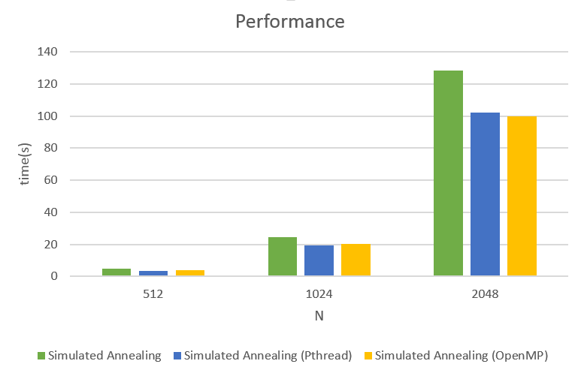
Parallelized simulated annealing evaluation

Slide 14
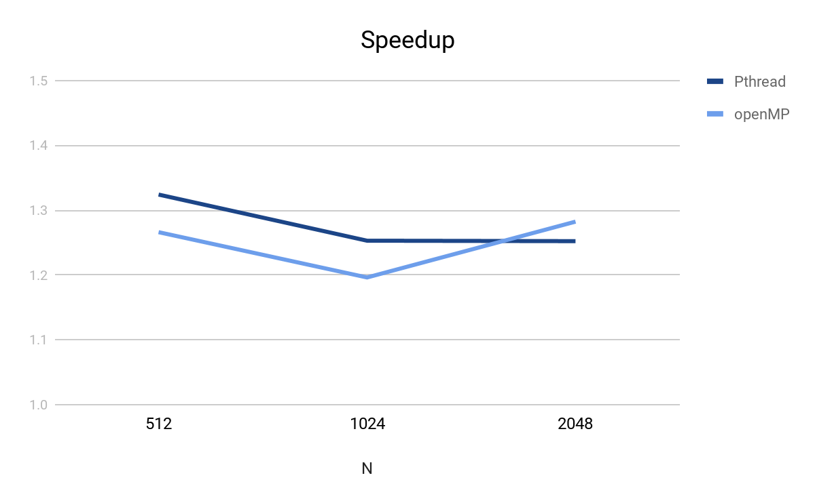
Parallelized simulated annealing evaluation
Speedup
 | 512 | 1024 | 2048
Pthread | 1.3241 | 1.252 | 1.2522
OpenMP | 1.2661 | 1.1962 | 1.2824

Slide 15
Parallelized backtracking
Using MPI on 1st ROW.
Let N = number of nodes Let i = index of the node Let q = number of queens Each i will deal with COL[ q / N * i ] → COL[ q / N * (i + 1) ]
. . .

Slide 16
Parallelized backtracking
Using MPI on 1st ROW.
Using Pthread on 2nd ROW.
Let N = number of threads Let i = rank of the thread Let q = number of queens Each i will deal with COL[ q / N * i ] → COL[ q / N * (i + 1) ]
. . .
. . .

Slide 17
Parallelized backtracking
Using MPI on 1st ROW.
Using Pthread on 2nd ROW.
Using Cuda on 3rd and 4thROW.
Let q = number of queens Let B_{i} = index of the block (For i from 0 to q)
Let T_{i} = index of the thread(For i from 0 to q) Each pair (B_{i}, T_{i}) will calcularte the result in COL[ B_{i} ] on 3rd ROW and COL[ T_{i} ] on 4th ROW
. . .
. . .
. . .

Slide 18
Parallelized backtracking evaluation
Performance
 | 16 | 24 | 32
Serial | 0.0032 | 0.1178 | 29.1556
MPI | 0.0611 | 0.0864 | 8.8559
MPI + Pthread | 0.0591 | 0.0739 | 0.6997
MPI + Pthread + CUDA | 0.5194 | 0.565 | 0.688
(digit: second)

Slide 19
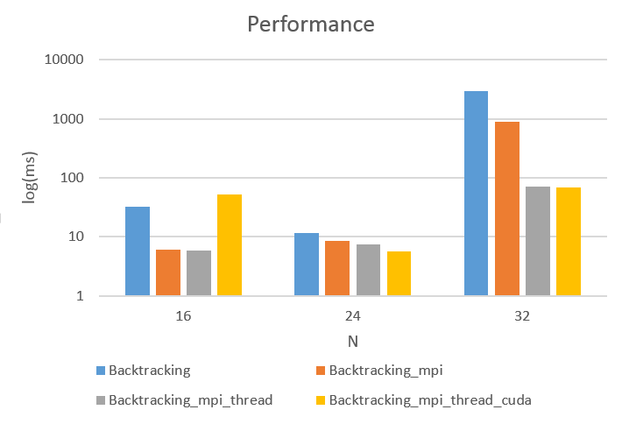
Parallelized backtracking evaluation

Slide 20
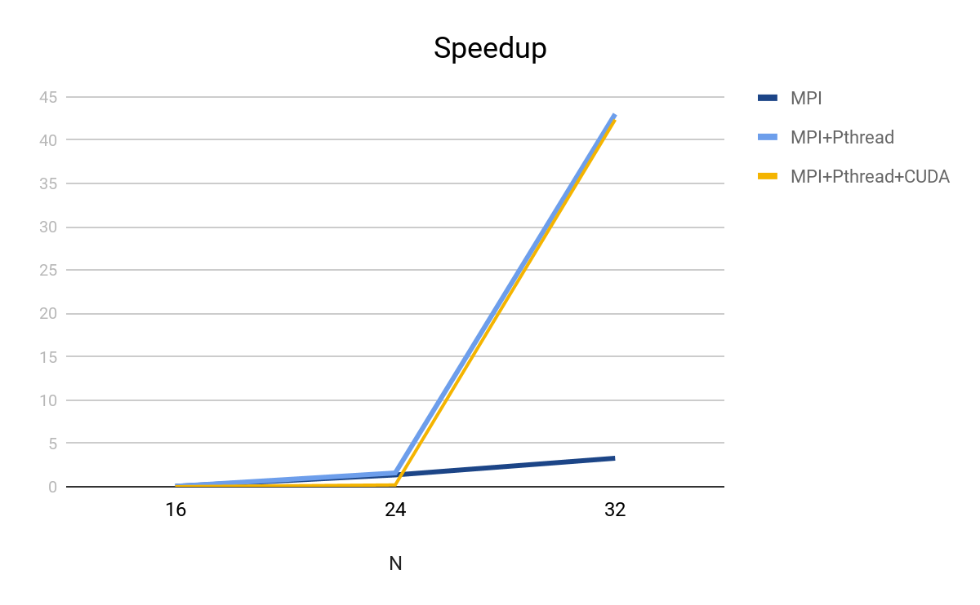
Parallelized backtracking evaluation
Speedup
 | 16 | 24 | 32
MPI | 0.052 | 1.363 | 3.292
MPI + Pthread | 0.054 | 1.59 | 43.021
MPI + Pthread + CUDA | 0.006 | 0.208 | 42.373

Slide 21
Parallelized backtracking evaluation
MPI
MPI + Pthread
 | thread = 4 | thread = 8 | Efficiency
16 | 0.0611 | 0.0497 | 0.6
24 | 0.0864 | 0.0517 | 0.6
32 | 8.8559 | 3.7631 | 1.15
 | thread = 4 | thread = 8 | Efficiency
16 | 0.0591 | 0.0492 | 0.6
24 | 0.0739 | 0.0614 | 0.6
32 | 0.6997 | 1.2601 | 0.3

Slide 22
Related work
Bozikovic, Marko, Marin Golub, and Leo Budin. "Solving n-Queen problem using global parallel genetic algorithm." The IEEE Region 8 EUROCON 2003. Computer as a Tool.. Vol. 2. IEEE, 2003.
master-slaves
Salaman, L., and D. Bollman. "A parallel algorithm for the n-queens problem." Proc Computing Research Conference. 2001.

Slide 23
Contribution
楊牧樺
Parallelized simulated annealing using OpenMP
Algorithms compare
王靖
Parallelized backtracking using assembling methods
曾鈺文
Parallelized simulated annealing using Pthread
Algorithms compare

Slide 24
Conclusion
Attempt to parallelize simulated annealing to solve n-queens problem using Pthread and OpenMP.
Experiment parallization on backtracking method using assembling approach with MPI, Pthread and CUDA.
The performance of heuristic search algorithm is hardly to touch by backtracking method.

Slide 25

Thanks!

