Slide 1
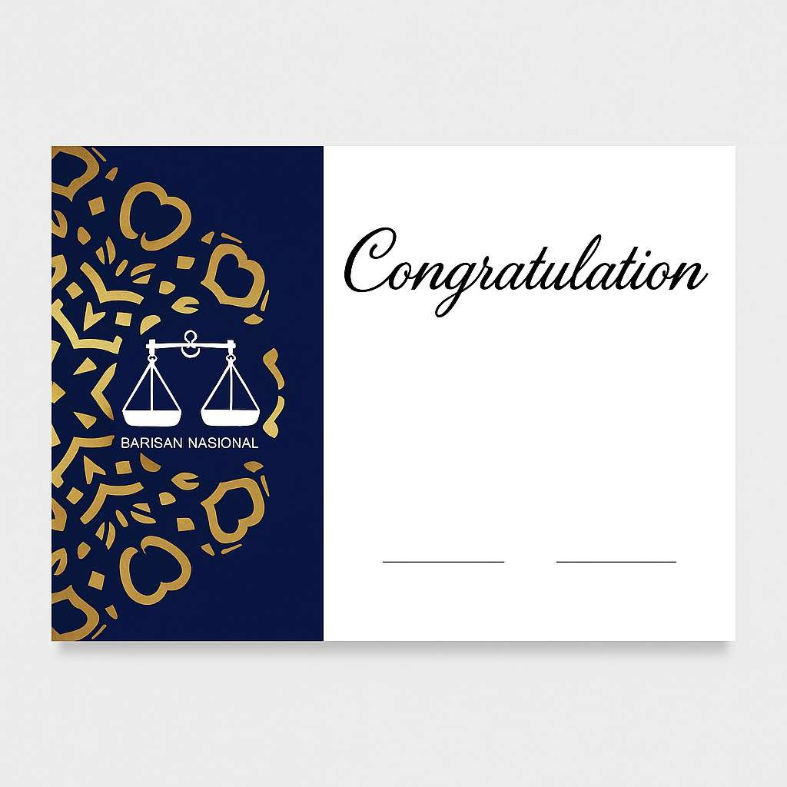
MOZILA BIN GOZILLA IC: 89***412***4 WhatsApp: 6281420550984 Email: redmie2gaboga@gmail.com No Pendaftaran: 6

