Slide 1
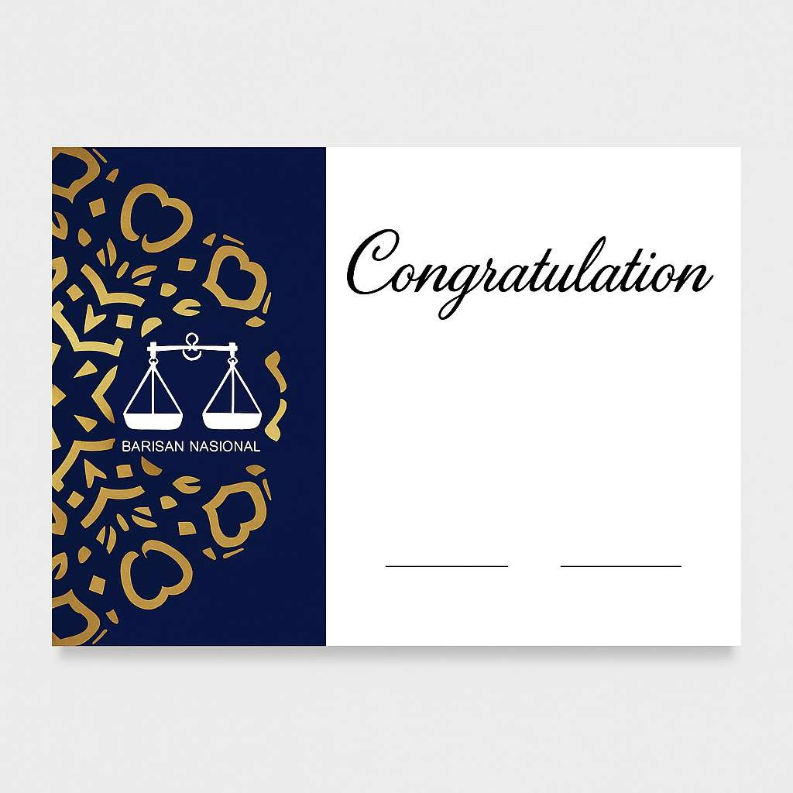
SARIZAN BIN MULUK IC: 95***812***6 WhatsApp: 6281420550984 Email: redmie2gaboga@gmail.com No Pendaftaran: 9

