Slide 1
Canine localization and classification

Slide 2
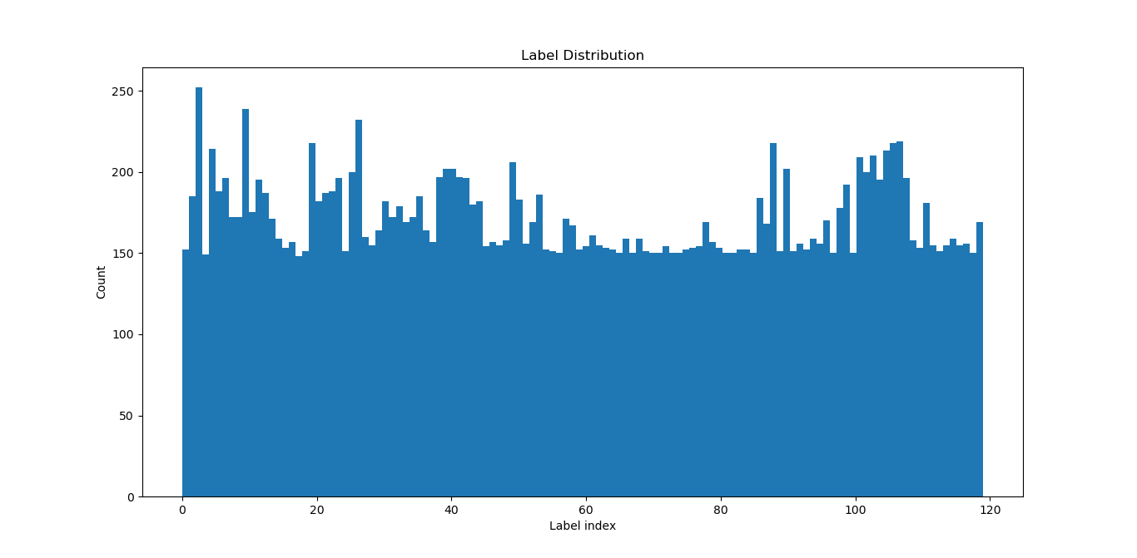
Dataset
https://www.kaggle.com/jessicali9530/stanford-dogs-dataset
20.580 images of 120 species
0.8/0.2 split for training / validation
Preprocessing :
-> classification: crop images using provided annotations to isolate area of interest
-> localization: resize images to required size

Slide 3
Classification – Related work
https://www.kaggle.com/msripooja/dog-images-classification-using-keras-alexnet#6.-Predict-values-using-the-trained-model : AlexNet, subset of data (20 classes), 0.31 accuracy, 5.286 loss
https://www.kaggle.com/twhitehurst3/stanford-dogs-keras-vgg16 : transfer learning vgg16, 10 classes, 0.66 acc, 1.001 loss
https://www.kaggle.com/hengzheng/dog-breeds-classifier : transfer learning densenet121, all classes, 0.7 acc, 0.96 loss
https://www.kaggle.com/devang/transfer-learning-with-keras-and-mobilenet-v2 : transfer learning, all classes, 0.8 accuracy, 0.77 loss

Slide 4
Classification - comparsion
 | Accuracy | Precision | Recall | F1-score
NASNetLarge | 0.91 | 0.92 | 0.91 | 0.90
InceptionResNetv2 | 0.86 | 0.87 | 0.86 | 0.86
DenseNet201 | 0.79 | 0.82 | 0.79 | 0.79
VGG16 | 0.72 | 0.74 | 0.72 | 0.72
MobileNetv2 | 0.68 | 0.73 | 0.68 | 0.68
MobileNet | 0.69 | 0.75 | 0.69 | 0.69
Simple CNN | 0.15

Slide 5
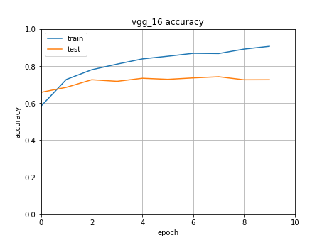
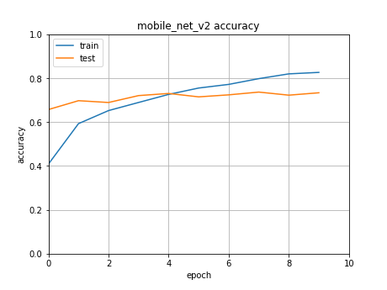

Slide 6
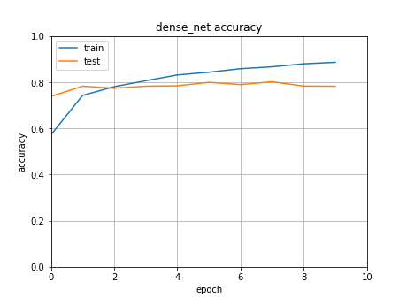
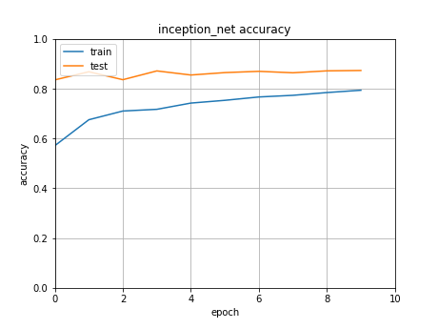

Slide 7
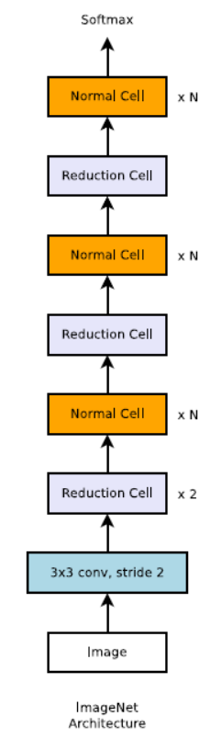
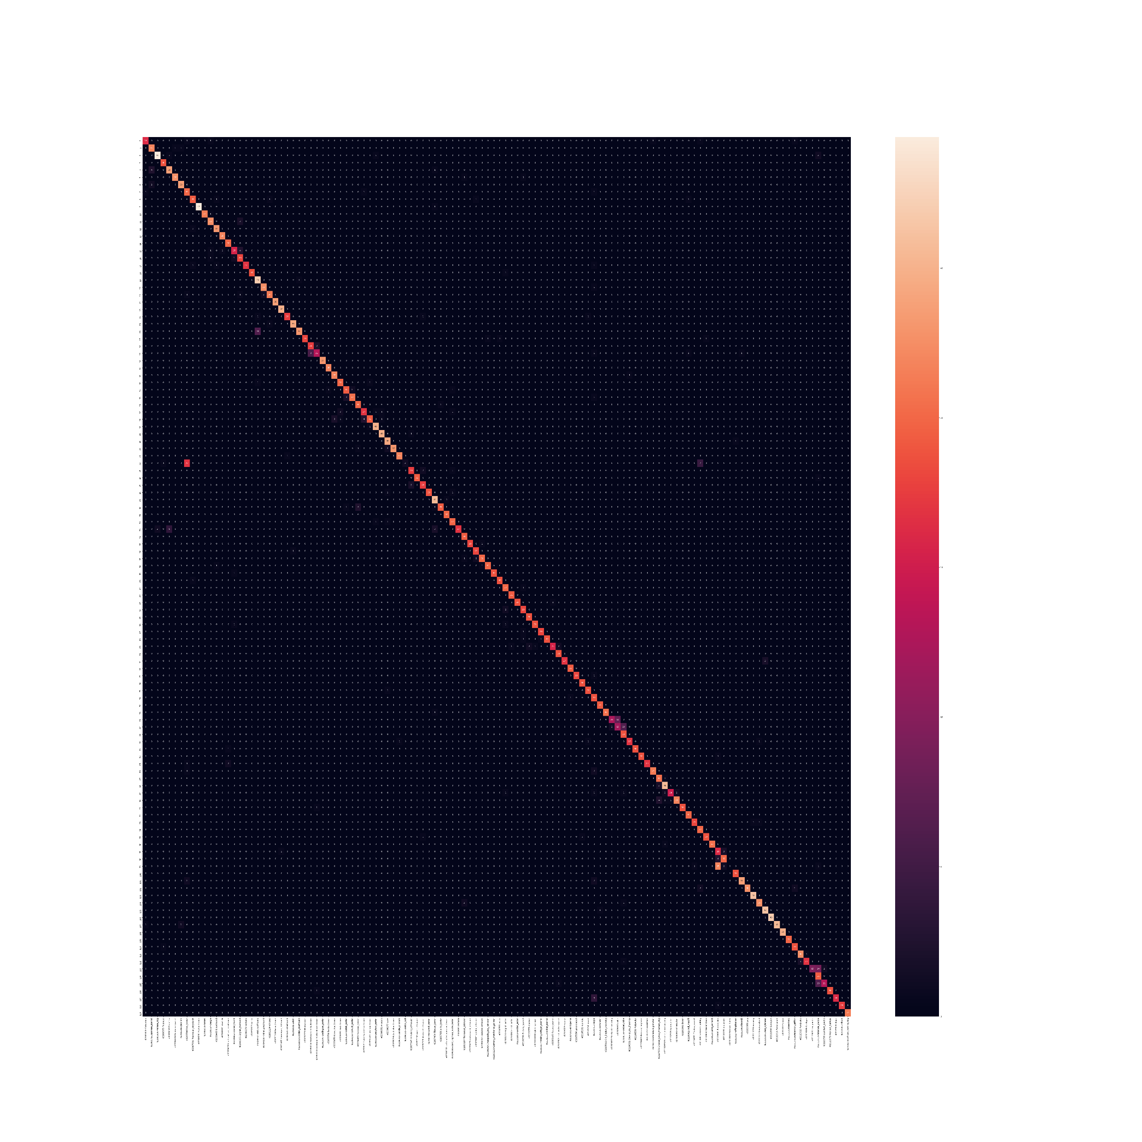
Selected model – NASNetLarge
Confusion matrix for our dataset
Stands for Neural Architecture Search Network – the architecture of the network was created through machine learning
NASNetLarge – trained by Google through reinforced learning
82.7% performance on ImageNet (best non-ensembled predictor)
Trained one epoch on Google Colab – 32293s
0.9094 acc, 0.3378 loss

Slide 8
Localization
pretrained Resnet50 convolutional layers
7 dense layers:
Batch normalization
Dropout
Linear
ReLU
Batch normalization
Dropout
Linear

