Slide 1

TDT4290-Customer Driven Project
PRIVACY ADVISOR
GROUP 4
Ulf Nore, Nicholas Gerstle, Henrik Knutsen, Dimitry Kongevold,
Einar Aouni, Neshahvan Karunakaran, Amanpreet Kaur

Slide 2
Overview
Background/Motivation
Goals
Objectives & Requirements
Method & Approach – (pre-study, development model, tools and technology)
Architecture (simple diagram detailing your implementation is good enough here)
Implementation
Testing
Results
Conclusion
Future work

Slide 3
Background/Motivation
State the problems with previous privacy control (e.g.)
Problem 1
Problem 2
Problem 3
Problem…n

Slide 4
Goals
The aim of project is to implement the key functionality of privacy agent that advises users in making “ Internet Privacy Decision”.
The main focus of this project is on developing a framework that allows for testing the CBR privacy agent framework.
Implementing a browser plugin is given a low priority

Slide 5
Objectives
Implementing testing framework of CBR based privacy agent.
Implementing community system
Extend the system to other standards

Slide 6
Requirements (may be merged with objectives)
High level Requirements for this project are: (e.g.)
A framework for implementing/testing future privacy agent algorithms
A CLI for testing….
A GUI for…..

Slide 7
Preliminary Study
P3P
Case-Based Reasoning (CBR)
Project Scope
Development Model

Slide 8
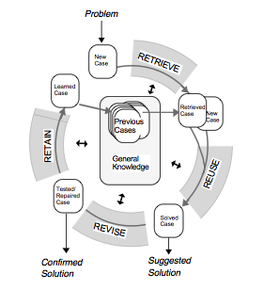
CBR Cycle
1. RETRIEVE the most similar case or cases
2. REUSE the information and knowledge in that case
^{to solve the problem}
3. REVISE the proposed solution
4. RETAIN the parts of this experience likely to be
useful for future problem solving

Slide 9
Tools and Technologies
Document and source code repository
Programming Language
Databases
Third party libraries

Slide 10
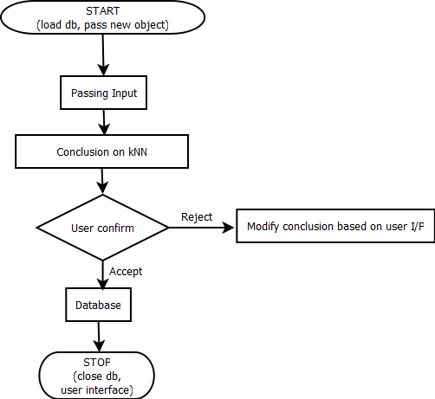
Architecture?? This is flow diagram. You need a good diagram detailing your implementation

Slide 11
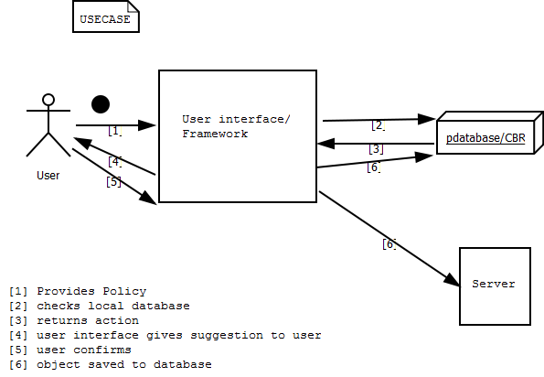
System Overview

Slide 12
Implementation
Algorithms
Data Storage
User Interface

Slide 13
Algorithms
CBR
Conclusion Algorithm
Reduction Algorithm
Learn Algorithm

Slide 14
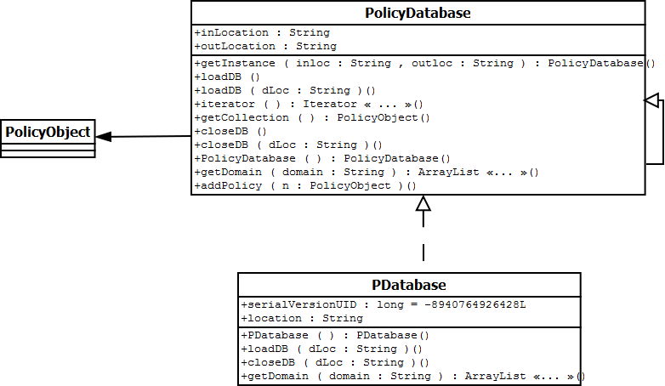
Data Storage

Slide 15
Testing
Unit Testing
Interface Testing

Slide 16
Results

Slide 17
Future Work
Implements the system as browser plugin

