Slide 1

TDT4290-Customer Driven Project
PRIVACY ADVISOR
GROUP 4
Ulf Nore, Nicholas Gerstle, Henrik Knutsen, Dimitry Kongevold,
Einar Aouni, Neshahvan Karunakaran, Amanpreet Kaur

Slide 2
Overview
Introduction - AIM and Objectives
Approach - What tools are used
Architecture
Implementation
Testing
Results
Conclusion
Future work

Slide 3
Introduction
The aim of project is to implement the key functionality of privacy agent that advises users in making “ Internet Privacy Decision”.
The main focus of this project is on developing a framework that allows for testing the CBR privacy agent framework.
Implementing a browser plugin is given a low priority

Slide 4
Objectives
Implementing testing framework of CBR based privacy agent.
Implementing community system
Extend the system to other standards
Implements the system as browser plugin

Slide 5
Preliminary Study
P3P
CBR
Project Scope
Development Model

Slide 6
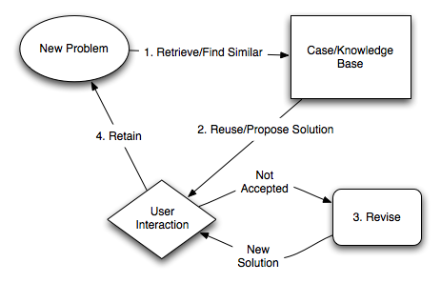
CBR Cycle

Slide 7
Tools and Technologies
Document and source code repository
Programming Language
Databases
Third party libraries

Slide 8
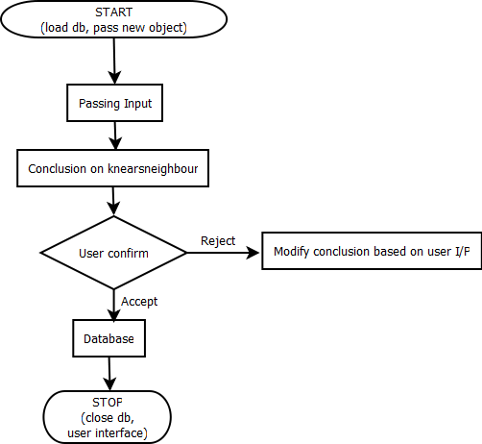
Architecture

Slide 9
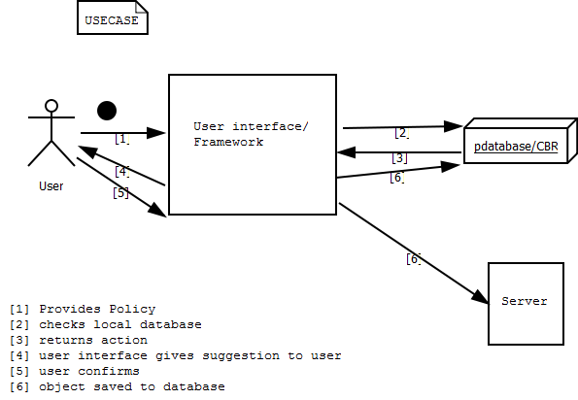
System Overview

Slide 10
Implementation
Algorithms
Data Storage
User Interface

Slide 11
Results

Slide 12
Future Work

