Slide 1

TDT4290-Customer Driven Project
PRIVACY ADVISOR
GROUP 4
Ulf Nore, Nicholas Gerstle, Henrik Knutsen, Dimitry Kongevold,
Einar Aouni, Neshahvan Karunakaran, Amanpreet Kaur

Slide 2
Overview
Introduction - AIM and Objectives
Approach - What tools are used
Architecture
Implementation
Testing
Results
Conclusion
Future work

Slide 3
Introduction
The aim of project is to implement the key functionality of privacy agent that advises users in making “ Internet Privacy Decision”.
The main focus of this project is on developing a framework that allows for testing the CBR privacy agent framework.
Implementing a browser plugin is given a low priority

Slide 4
Objectives
Implementing testing framework of CBR based privacy agent.
Implementing community system
Extend the system to other standards

Slide 5
Preliminary Study
P3P
CBR
Project Scope
Development Model

Slide 6
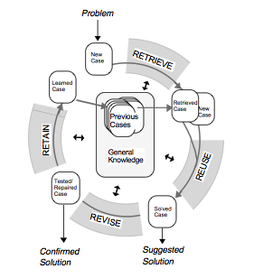
CBR Cycle

Slide 7
Tools and Technologies
Document and source code repository
Programming Language
Databases
Third party libraries

Slide 8
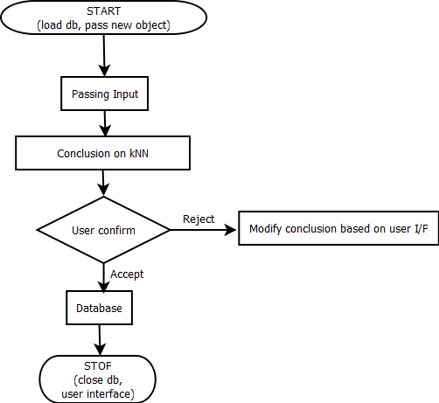
Architecture

Slide 9
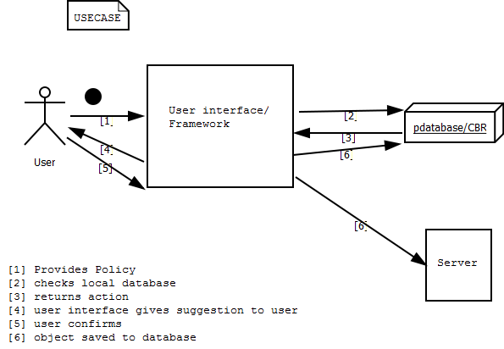
System Overview

Slide 10
Implementation
Algorithms
Data Storage
User Interface

Slide 11
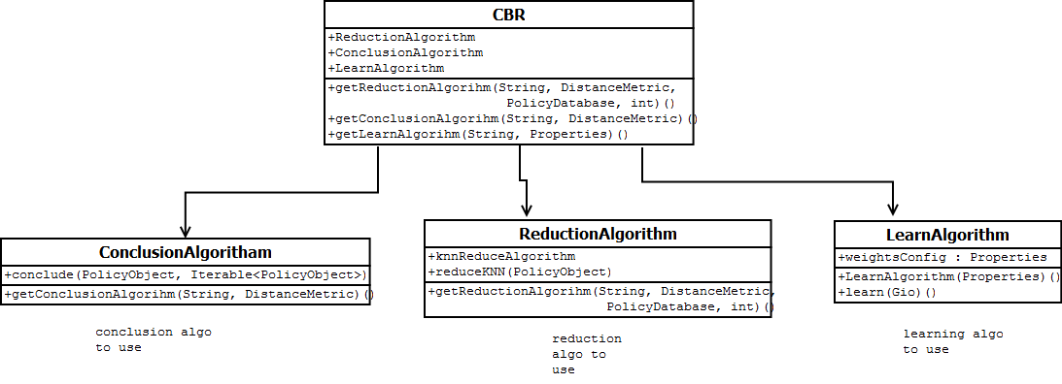
Algorithms

Slide 12
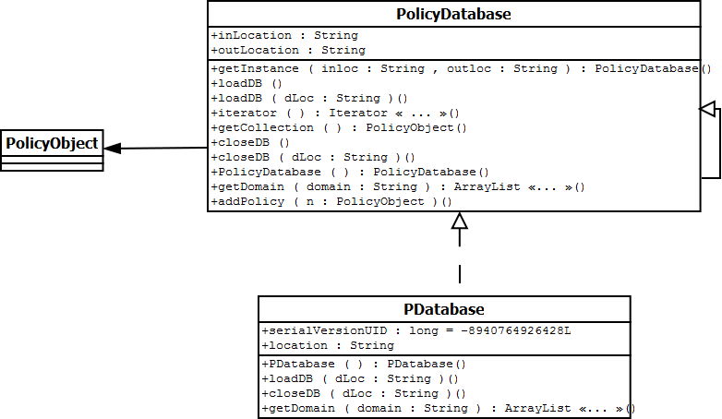
Data Storage

Slide 13
Testing
Unit Testing
Interface Testing

Slide 14
Results

Slide 15
Future Work
Implements the system as browser plugin

