Slide 1

Texts are Knowledge
Christopher Manning
AKBC 2013 Workshop
Gabor Angeli, Jonathan Berant, Bill MacCartney Mihai Surdeanu, Arun Chaganty, Angel Chang, Kevin Aju Scaria, Mengqiu Wang, Peter Clark, Justin Lewis, Brittany Harding, Reschke, Julie Tibshirani, Jean Wu, Osbert Bastani, Keith Siilats
Notes:
Trinity College Library, Dublin. The long room.
45 minutes for Chris = 35 minute talk and some questions
So one possibility would be for something like 5 minutes of intro on Jeremy and Wittgenstein and are we making an error?
Should we reason straight from texts? Natural Logic!
But we are extracting information. Miners of ore! KBP
But not much is happening with the ore so far. Can we do more? Bio.
Conclude

Slide 2
Jeremy Zawodny [ex-Yahoo!/Craigslist] sez …
Back in the late 90s when I was building things that passed for knowledge management tools at Marathon Oil, there was all this talk about knowledge workers. These were people who’d have vast quantities of knowledge at their fingertips. All they needed was ways to organize, classify, search, and collaborate.
I think we’ve made it. But the information isn’t organized like I had envisioned a few years ago. It’s just this big ugly mess known as The Web. Lots of pockets of information from mailing lists, weblogs, communities, and company web sites are loosely tied together by hyperlinks. There’s no grand schema or centralized database. There’s little structure or quality control. No global vocabulary.
But even with all that going against it, it’s all indexed and easily searchable thanks largely to Google and the companies that preceded it (Altavista, Yahoo, etc.). Most of the time it actually works. Amazing!
Notes:
20 year olds in 2012 were born in 1992. Can’t remember life before the web!

Slide 3
From language to knowledge bases – Still the goal?
For humans, going from the largely unstructured language on the web to information is effortlessly easy
But for computers, it’s rather difficult!
This has suggested to many that if we’re going to produce the next generation of intelligent agents, which can make decisions on our behalf
Answering our routine email
Booking our next trip to Fiji
then we still first need to construct knowledge bases
To go from languages to information

Slide 4
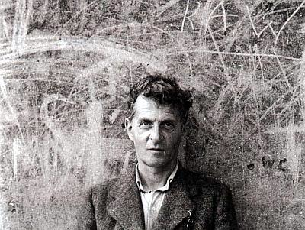
Notes:
Ludwig Wittgenstein

Slide 5
“You say: the point isn’t the word, but its meaning, and you think of the meaning as a thing of the same kind as the word, though also different from the word. Here the word, there the meaning. The money, and the cow that you can buy with it. (But contrast: money, and its use.)”

Slide 6
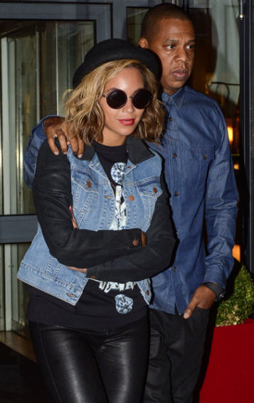
1. Inference directly in text: Natural Logic (van Benthem 2008, MacCartney & Manning 2009)
Q Beyoncé Knowles’s husband is X.
A Beyoncé’s marriage to rapper Jay-Z and portrayal of Etta James in Cadillac Records (2008) influenced her third album I Am... Sasha Fierce (2008).
Notes:
But first -- to illustrate the operation of the system, I’m going to use a running example, shown here.
The example is quite contrived, but it compactly exhibits the three phenomena I’m trying to model: containment, exclusion, and implicativity.
So the premise is, “Jimmy Dean refused to move without blue jeans”
and the hypothesis is, “James Dean didn’t dance without pants”
and this is a valid inference. [>]

Slide 7
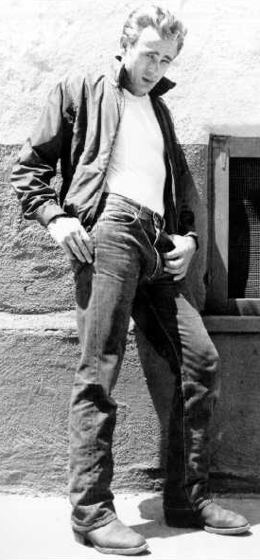
Inference directly in text: Natural Logic (van Benthem 2008, MacCartney & Manning 2009)
P James Dean refused to move without blue jeans.
H James Byron Dean didn’t dance without pants
The example is contrived, but it compactly exhibits containment, exclusion, and implicativity
Notes:
Say what P and H are
But first -- to illustrate the operation of the system, I’m going to use a running example, shown here.
The example is quite contrived, but it compactly exhibits the three phenomena I’m trying to model: containment, exclusion, and implicativity.
So the premise is, “Jimmy Dean refused to move without blue jeans”
and the hypothesis is, “James Dean didn’t dance without pants”
and this is a valid inference. [>]

Slide 8
Step 1: Alignment
P | James Dean | refused to |  |  | move | without | blue | jeans
H | James Byron Dean |  | did | n’t | dance | without |  | pants
edit index | 1 | 2 | 3 | 4 | 5 | 6 | 7 | 8
edit type | SUB | DEL | INS | INS | SUB | MAT | DEL | SUB
Alignment as sequence of atomic phrase edits
Ordering of edits defines path through intermediate forms
Need not correspond to sentence order
Decomposes problem into atomic inference problems
Notes:
In the second stage, we establish an alignment between the premise and hypothesis, represented by a sequence of atomic edits over spans of word tokens.
I’ve shown an alignment for our running example here.
We use four types of edit: deletion, insertion, substitution, and match.
The edits are ordered, and this ordering defines a path from premise to hypothesis through intermediate forms -- but the ordering need not correspond to sentence order, as it does in this example.
Thus, the alignment effectively decomposes the inference problem into a sequence of atomic inference problems, one for each atomic edit.
Alignment hasn’t been a major focus of this work so far, but it’s next on the to-do list. [>]

Slide 9
Step 2: Lexical entailment classification
Goal: predict entailment relation for each edit, based solely on lexical features, independent of context
Done using lexical resources & machine learning
Feature representation:
WordNet features: synonymy (=), hyponymy (⊏/⊐), antonymy (|)
Other relatedness features: Jiang-Conrath (WN-based), NomBank
Fallback: string similarity (based on Levenshtein edit distance)
Also lexical category, quantifier category, implication signature
Decision tree classifier
Notes:
The next stage is the heart of the system: lexical entailment classification.
Here we try to predict an entailment relation for each atomic edit, based solely on the features of the lexical items involved, independent of the surrounding context, such as falling under a downward-monotone operator.
We do this by exploiting available resources on lexical semantics, and applying machine learning.
Our feature representation includes: semantic relatedness information based on WordNet, NomBank, and other lexical resources; string and lemma similarity scores; and information about lexical categories, including special-purpose categories for quantifiers and implicatives.
We use a decision tree classifier, trained on about 2,500 hand-annotated lexical entailment problems, like the examples shown here. [>]
The classifier achieves very high accuracy when tested on the training data, which simply indicates that our feature representation is sufficient to capture relevant distinctions. [>]

Slide 10
Step 2: Lexical entailment classification
P | James Dean | refused to |  |  | move | without | blue | jeans
H | James Byron Dean |  | did | n’t | dance | without |  | pants
edit index | 1 | 2 | 3 | 4 | 5 | 6 | 7 | 8
edit type | SUB | DEL | INS | INS | SUB | MAT | DEL | SUB
lex feats | strsim= 0.67 | implic: –/o | cat:aux | cat:neg | hypo |  |  | hyper
lex entrel | = | | | = | ^ | ⊐ | = | ⊏ | ⊏
Notes:
So, back to the running example.
I’ve added rows which show features generated for each edit, and the lexical entailment relation predicted from these features.
The 1st edit is a substitution; string similarity is high, so we predict equivalence.
In the 2nd edit, we delete an implicative, “refuse”; the model knows that deleting implicatives in this category generates the alternation relation.
The 3rd edit inserts an auxiliary verb; since auxiliaries are more or less semantically vacuous, the model predicts equivalence.
The 4th edit inserts a negation; this generates the negation relation.
The 5th edit is a substitution; WordNet tells us that these are hyponyms, so we predict reverse entailment.
The 6th edit is a match: equivalence.
The 7th edit is the deletion of a generic modifier; by default, this generates forward entailment.
Finally, the 8th edit is a hypernym substitution: forward entailment. [>]

Slide 11
Step 3: Sentence semantic analysis
Identify items w/ special projectivity & determine scope
S
category: –/o implicatives
examples: refuse, forbid, prohibit, …
scope: S complement
pattern: __ > (/VB.*/ > VP $. S=arg)
projectivity: {=:=, ⊏:⊐, ⊐:⊏, ^:|, |:#, _:#, #:#}
VP
refuse↓
S
VP
Jimmy Dean
without↓
VP
PP
move
blue
NP NP
jeans
NNP NNP VBD TO VB IN JJ NNS
James Dean refused to move without blue jeans
+
+
+
–
–
–
+
+
Specify scope in trees
Notes:
In the first stage, we do linguistic pre-processing. We begin by tokenizing and parsing the input sentences, using the Stanford parser, a broad-coverage statistical parser trained on the Penn Treebank. But the most important task at this stage is to identify any semantic functions with non-default projectivity, and to compute their scope, in order to determine the effective projectivity at the locus of each edit. What makes this tricky is that the phrase structure trees produced by the parser may not correspond exactly to the semantic structure of the sentence.
If we had idealized semantic composition trees [!], then determining effective projectivity would be easy. Since we don’t, we use a somewhat awkward workaround. [!] We define categories of items with special projectivity, and for each category we specify its default scope in phrase structure trees using a tree-pattern language called Tregex, which is similar to Tgrep. This enables us to identify the constituents over which the projective properties should be applied, and thereby to compute the final effective projectivity at each token. [>]

Slide 12
Step 4: Entailment projection
P | James Dean | refused to |  |  | move | without | blue | jeans
H | James Byron Dean |  | did | n’t | dance | without |  | pants
edit index | 1 | 2 | 3 | 4 | 5 | 6 | 7 | 8
edit type | SUB | DEL | INS | INS | SUB | MAT | DEL | SUB
lex feats | strsim= 0.67 | implic: –/o | cat:aux | cat:neg | hypo |  |  | hyper
lex entrel | = | | | = | ^ | ⊐ | = | ⊏ | ⊏
projec-tivity | ↑ | ↑ | ↑ | ↑ | ↓ | ↓ | ↑ | ↑
atomic entrel | = | | | = | ^ | ⊏ | = | ⊏ | ⊏
inversion
Notes:
The fourth stage is entailment projection. I covered this earlier: it means projecting lexical entailment relations upward by taking account of the projective properties of the surrounding context. I’m going to simplify things a bit here by only considering upward and downward monotonicity.
I’ve added two new rows.
The first row shows the effective monotonicity at the locus of each edit.
Everything is upward monotone until we insert the negation, after which the next two edits occur in a downward-monotone context.
But “without” creates another inversion, so the last two edits occur in an upward-monotone context.
The last row shows [!] how the lexical entailment relations are projected into atomic entailment relations; that is, entailment relations across each atomic edit.
The only interesting case is [!] HERE, where a reverse entailment is changed into a forward entailment by a downward-monotone context. [>]

Slide 13
Step 5: Entailment composition
P | James Dean | refused to |  |  | move | without | blue | jeans
H | James Byron Dean |  | did | n’t | dance | without |  | pants
edit index | 1 | 2 | 3 | 4 | 5 | 6 | 7 | 8
edit type | SUB | DEL | INS | INS | SUB | MAT | DEL | SUB
lex feats | strsim= 0.67 | implic: –/o | cat:aux | cat:neg | hypo |  |  | hyper
lex entrel | = | | | = | ^ | ⊐ | = | ⊏ | ⊏
projec-tivity | ↑ | ↑ | ↑ | ↑ | ↓ | ↓ | ↑ | ↑
atomic entrel | = | | | = | ^ | ⊏ | = | ⊏ | ⊏
compo-sition | = | | | | | ⊏ | ⊏ | ⊏ | ⊏ | ⊏
For example:
human ^ nonhuman
fish | human
fish ⊏ nonhuman
final answer
Notes:
The final stage is entailment composition, in which we progressively compose atomic entailment relations to obtain our final answer.
[!] We start at the left with equivalence, and the first couple of compositions are quite intuitive:
[!] equivalence composed with alternation yields alternation, and
[!] alternation composed with equivalence yields alternation again.
[!] The next one is more interesting: alternation composed with negation yields forward entailment. That may not be immediately obvious, but it makes sense if you think about it for a bit.
[!] For example, “fish” alternates with “human”, and “human” negates “nonhuman”, so “fish” forward-entails “nonhuman”.
[!] After that, we’re just composing forward entailment with itself [!] or with equivalence, so forward entailment is preserved [!] [!] all the way through,
[!] and that’s our final answer -- and it’s the CORRECT answer for this problem. [>]

Slide 14
The problem
Much of what we could and couldn’t do depended on knowledge of word and multi-word relationships …
which we mainly got from knowledge-bases (WordNet, Freebase, …)
Notes:
Well, I’m just joking on the ™® . You’re free to work with Natural Logics too!

Slide 15
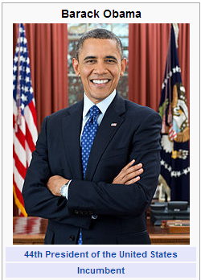

2. Knowledge Base Population (NIST TAC task) [Angeli et al. 2013]
“Obama was born on August 4, 1961, at Kapi’olani Maternity & Gynecological Hospital (now Kapi’olani Medical Center for Women and Children) in Honolulu, Hawaii.”
Relations (“slots”:
per:date_of_birth
per:city_of_birth
…
Slot Values

Slide 16
The opportunity
There is now a lot of content in various forms that naturally aligns with human language material
In the old days, we were either doing unsupervised clustering or doing supervised machine learning over painstakingly hand-annotated natural language examples
Now, we can hope to learn based on found, naturally generated content

Slide 17
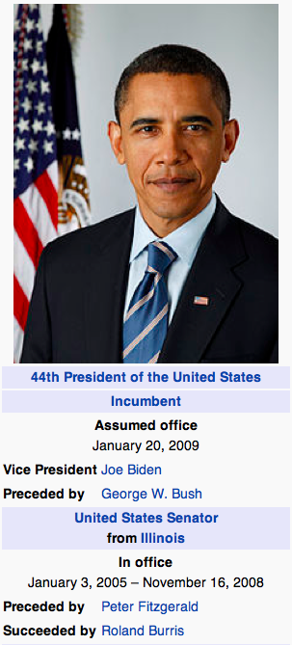
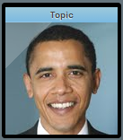
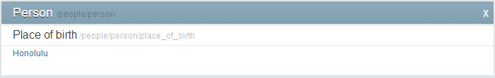
Distantly Supervised Learning
Lots of text »
Barack Obama is the 44th and current President of the United States.
Millions of infoboxes in Wikipedia
Over 22 million entities in Freebase, each with multiple relations
»
Notes:
This looks easy: Train a relation extraction system to get the facts listed in freebase out of text mentioning the facts

Slide 18
Traditional Supervised Learning
example 1
label 1
example 2
label 2
example 3
label 3
example 4
label 4
…
example n
label n

Slide 19
Not so fast! Only distant supervision
?
Barack Obama is the 44th and current President of the United States.
United States President Barack Obama meets with Chinese Vice President Xi Jinping today.
Obama was born in the United States just as he has always said.
Obama ran for the United States Senate in 2004.
EmployedBy
EmployedBy
BornIn
--
Same Query
EmployedBy(Barack Obama, United States)
BornIn (Barack Obama, United States)
…

Slide 20
Multi-instance Multi-label (MIML) Learning
instance 11
object 1
label 11
instance 12
label 12
instance 13
…
instance n1
object n
label n1
instance n2
label nk
instance nm
(Surdeanu et. al 2012)

Slide 21
MIML for Relation Extraction
Barack Obama is the 44th and current President of the United States.
United States President Barack Obama meets with Chinese Vice President Xi Jinping today.
(Barack Obama,
United States)
EmployedBy
BornIn
Obama was born in the United States just as he
has always said.
Obama ran for the United States Senate in 2004.

Slide 22
Model Intuition
Z
Y
instance 1
latent label 1
object
label 1
instance 2
latent label 2
label k
instance m
latent label m
Jointly trained using discriminative EM:
E-step: assign latent labels using current θ_{z} and θ_{y}.
M-step: estimate θ_{z} and θ_{y} using the current latent labels.

Slide 23
Plate Diagram
binary relation-level classifiers
output: relation label
(per:state_of_birth)
latent label for each mention
multi-class mention-level classifier
input: a mention
(“Obama from HI”)
# mentions in tuple
# tuples in the DB

Slide 24
Post-hoc evaluation on TAC KBP 2011

Slide 25

Error Analysis
* Actual output from Stanford’s 2013 submission

Slide 26
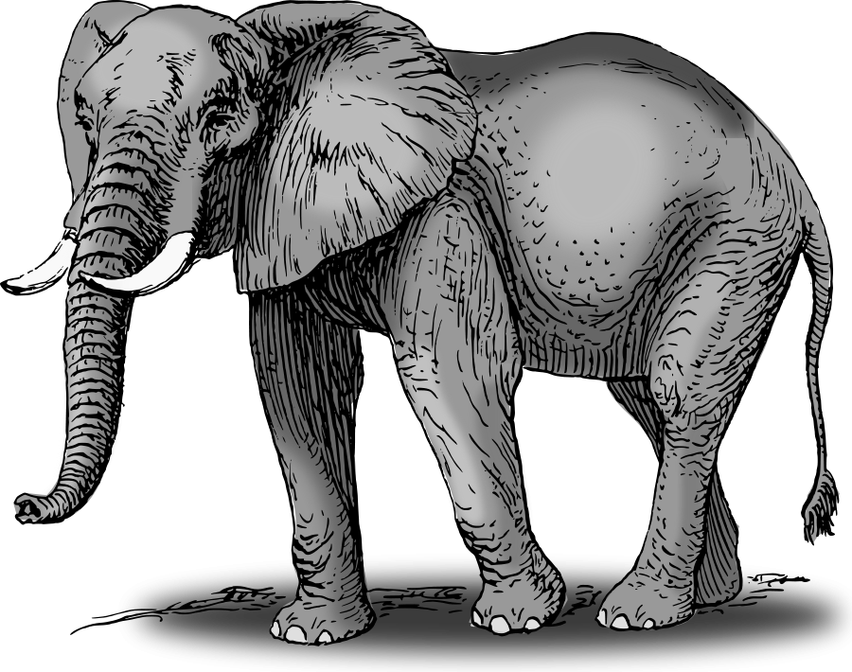
Consistency: Relation Extractor’s View
Ear!
Inconsistent
Ear!
Eye!
Ear!
Foot!
Lion!
Invalid

Slide 27
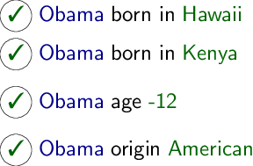
Consistency as a CSP
Nodes: Slot fills proposed by relation extractor

Slide 28
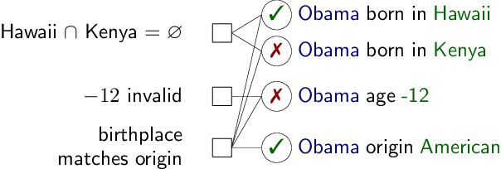
Consistency as a CSP
End Result: More robust to classification noise

Slide 29
Error Analysis: Quantitative
Our IR + MIML-RE: our KBP system as run in the evaluation -
Gold IR + Perfect Relation Extraction: get correct documents; classifier “memorizes” test set
Gold IR + MIML-RE: get correct documents; use our relation extractor
Gold Responses: return any correct response given by any system.
Duplicate slots not detected correctly
Relevant sentence not found in document
Incorrect Relation

Slide 30
3. What our goal should be: Not just knowledge bases but inference
Populating knowledge-bases is a method
If it has a use, it’s to enable easier inferences!

Slide 31
Test-case: modeling processes (Berant et al. 2013)
Processes are all around us.
Example of a biological process:
Also, slippage can occur during DNA replication, such that the template shifts with respect to the new complementary strand, and a part of the template strand is either skipped by the replication machinery or used twice as a template. As a result, a segment of DNA is deleted or duplicated.
Notes:
This is an example of a biological process.

Slide 32
Answering non-factoid questions
Also, slippage can occur during DNA replication, such that the template shifts with respect to the new complementary strand, and a part of the template strand is either skipped by the replication machinery or used twice as a template. As a result, a segment of DNA is deleted or duplicated.
In DNA replication, what causes a segment of DNA to be deleted?
A part of the template strand being skipped by the replication machinery.
A part of the template strand being used twice as a template.
Notes:
*******
Automatically extracting the structure of processes from text is crucial for applications that require reasoning, such as non-factoid question answering. Given this paragraph, say we are asked “In DNA replication, what causes a segment of DNA to be deleted?” And, we have 2 choices to pick from..

Slide 33
Answering non-factoid questions
Also, slippage can occur during DNA replication, such that the template shifts with respect to the new complementary strand, and a part of the template strand is either skipped by the replication machinery or used twice as a template. As a result, a segment of DNA is deleted or duplicated.
In DNA replication, what causes a segment of DNA to be deleted?
A part of the template strand being skipped by the replication machinery.
A part of the template strand being used twice as a template.
Entities
Events
Notes:
The question asks about the entity and event highlighted in green and blue..

Slide 34
Answering non-factoid questions
Also, slippage can occur during DNA replication, such that the template shifts with respect to the new complementary strand, and a part of the template strand is either skipped by the replication machinery or used twice as a template. As a result, a segment of DNA is deleted or duplicated.
In DNA replication, what causes a segment of DNA to be deleted?
A part of the template strand being skipped by the replication machinery.
A part of the template strand being used twice as a template.
Entities
Events
Notes:
The first question mentions the event and entity highlighted here

Slide 35
Answering non-factoid questions
Also, slippage can occur during DNA replication, such that the template shifts with respect to the new complementary strand, and a part of the template strand is either skipped by the replication machinery or used twice as a template. As a result, a segment of DNA is deleted or duplicated.
In DNA replication, what causes a segment of DNA to be deleted?
A part of the template strand being skipped by the replication machinery.
A part of the template strand being used twice as a template.
Entities
Events
Notes:
And the second answer mentions the ones highlighted here.. As we can see, both the answers are present in the paragraph. This makes it difficult for systems that model lexical overlap to answer questions like these correctly..

Slide 36
Process structures
Also, slippage can occur during DNA replication, such that the template shifts with respect to the new complementary strand, and a part of the template strand is either skipped by the replication machinery or used twice as a template. As a result, a segment of DNA is deleted or duplicated.
CAUSES
CAUSES
skipped
deleted
shifts
CAUSES
used twice
duplicated
CAUSES
Notes:
Triggers that signify the occurrence of an event.

Slide 37
Example: Biology AP Exam
In the development of a seedling, which of the following will be the last to occur?
Initiation of the breakdown of the food reserve
Initiation of cell division in the root meristem
Emergence of the root
Emergence and greening of the first true foliage leaves
Imbibition of water by the seed
Actual order: E A C B D
Notes:
*********
If you look at actual Biology AP exams (which is for college students), there are questions related to processes. This question asks which is the last event in the process which requires information on the ordering of the events.. The actual order is E A C B D.

Slide 38
Setup
Event extraction (entities and relations)
Process Model
Local Model
Global constraints
Process structure
Notes:
Our model has two parts.
First local model which predicts relation between pairs of events.
Later, we predcit the structure of process as a whole using global constraints.

Slide 39
Local event relation classifier
Input: a pair of events i and j
Output: a relation
11 relations including
Temporal ordering
Causal relations – cause/enable
Coreference
Features:
Some adapted from previous work
A few new ones – to combat sparseness
Especially exploiting function words that suggest relations (e.g., hence)
Notes:
******************************
I’m going to talk briefly about local classifier. It takes a pair of events as input and predicts a relation between them.. There are 11 relations.. We have the details on the relation types in the paper..
We train a maxent based classifier that makes the predictions.
Most of the features are adapted from previous work. We also have some new features and I will briefly talk about them..

Slide 40
Global constraints
Ensure consistency using hard constraints.
Favor structures using soft constraints.
Mainly in three flavors
Connectivity constraint
The graph of events must be connected
Chain constraints
90% of events have degree <= 2
Event triple constraints
E.g.: Event co-reference is transitive
Enforced by formulating the problem as an ILP.

Slide 41
Connectivity constraint
ILP formulation based on graph flow for dependency parsing by Martins et. al. (2009).
skipped
CAUSES
deleted
CAUSES
CAUSES
shifts
CAUSES
CAUSES
CAUSES
CAUSES
used
duplicated
CAUSES
Gold standard
Local model
Global model
Notes:
**************8
Our graphs are not trees, but since , it is easy to adapt it to our problem

Slide 42
Dataset
148 paragraphs describing processes.
From the textbook “Biology” (Campbell and Reece, 2005).
Annotated by trained biologists
70-30% train-test split.
Baselines
All-Prev: For every pair of adjacent triggers in text, predict PREV relation.
Local_{base}: MaxEnt classifier with features from previous work.
Chain: Join adjacent events with highest probability relation
Notes:
Parameter tuning includes feature selection and finding coefficients for ilp (penalties for soft constraints)

Slide 43
Event-event relation results
 | P | R | F1
All-Prev | 34.1 | 32.0 | 33.0
Local_{base} | 52.1 | 43.9 | 47.6
Local | 54.7 | 48.3† | 51.3
Chain | 56.1 | 52.6†‡ | 54.3†
Global | 56.2 | 54.0†‡ | 55.0†‡
NOTE:
† and ‡ denote statistical significance against Local_{base} and Local baselines.
Notes:
**********************
INTERESTING
Micro averaged precision, recall and F1.. Statistical significance..
Box to compare when I talk
Full evaluation is based on our full set of 11 relations.. For the temporal evaluation, we consider only the temporal aspect of the relations essentially collapsing the causal aspect.. So, PREV, CAUSES and ENABLES becomes one single category..
Local substantially outperforms local_base indicating our novel features were very useful..
Chain baseline performs only slightly worse than the global model.. This shows the strong tendency of processes to proceed linearly from one event to another.. But, chain is highly inflexible and does not allow for extensions or incorporation of other structural constraints or domain knowledge.. Hence, it can be used only as a simple and efficient approximation, but is not a good candidate for a real system.
Connectivity most important.. Chain constraint is added third, because the local model in itself is pretty good in identifying chain structures..

Slide 44
Towards understanding processes
We built a system that can recover process descriptions in text
We see this as an important step towards applications that require deeper reasoning, such as building biological process models from text or answering non-factoid questions about biology
Our current performance is still limited by the small amounts of data over which the model was built
But we want to go on to show that these process descriptions can be used for answering questions through reasoning

Slide 46
“When I talk about language (words, sentences, etc.) I must speak the language of every day. Is this language somehow too coarse and material for what we want to say? Then how is another one to be constructed?—And how strange that we should be able to do anything at all with the one we have!”

Slide 47
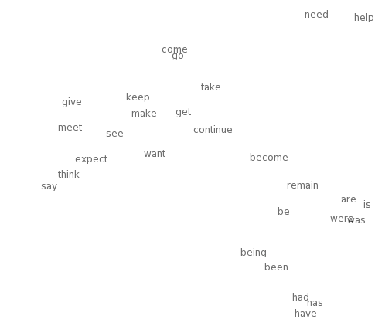
Word distributions can be used to build vector space models
0.286
0.792
−0.177
−0.107
0.109
−0.542
0.349
0.271
0.487
linguistics =
Notes:
Vector space semantics has just been mega-useful.
Up to now, better lexical semantics has clearly given us more operational value than trying to model first order logic in NLP.
Meaning representations are at the other end of the spectrum from signal processing, but they share with signals that human beings have at best fairly weak ideas about how to represent the useful information in them.

Slide 48
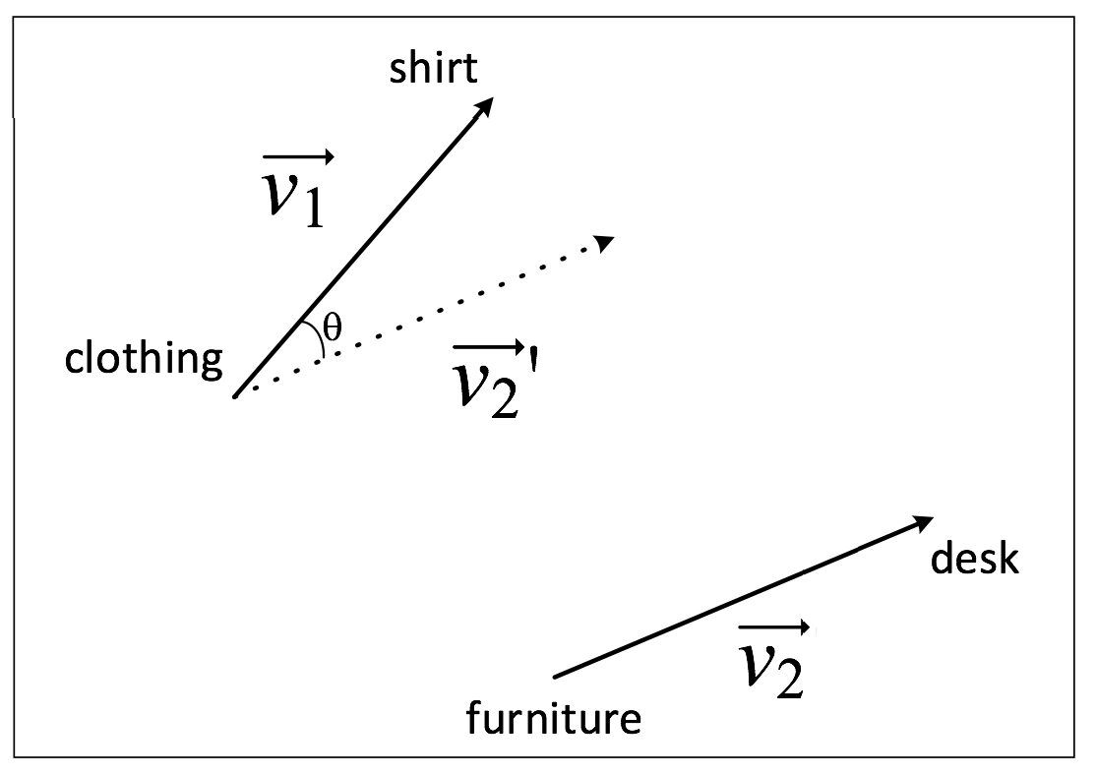
Neural/deep learning models: Mikolov, Yih & Zweig (NAACL 2013)
Notes:
At NAACL 2013, Mikolov et al. show quite stunning results about how well a vector space is representing various semantic and syntactic relationships.
Class inclusion: singular – collective noun.

Slide 49
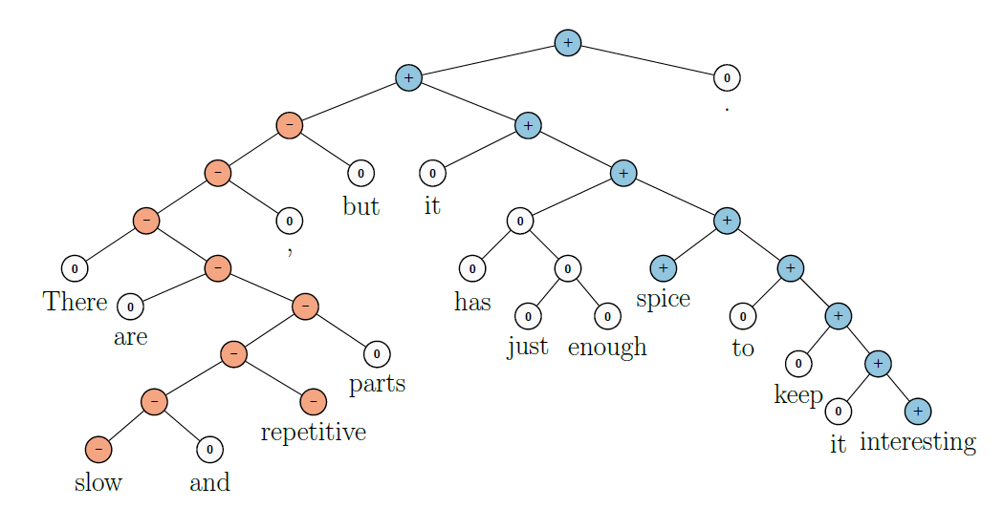
Socher et al. (2013) Recursive Neural Tensor Networks
Notes:
Our work on detailed sentiment analysis can do sentiment composition.

Slide 50
Texts are Knowledge
Notes:
Trinity College Library, Dublin. The long room.
High-level point: Texts are Knowledge. We already have knowledge-bases … which are very successful for people.
Maybe they can be successful for computers as well. Maybe Wittgenstein is right and we should not try to set up meaning apart from language.
But, on the other hand, more explicit characterizations of knowledge do still seem to have their uses.
But you’ve got to understand where those uses are. They can’t really be for individual facts. The use has to more come from aggregation and the ability to reason.

