Slide 1
Scalable Joint Inference and Reasoning in Automatic KB Construction
William W. Cohen
Machine Learning Dept
and Language Technology Dept
joint work with:
William Wang, Kathryn Rivard Mazaitis,
Bhavana Dalvi, Lise Getoor, Jay Pujara, Hui Miao, …

Slide 2
Outline
Background: NELL
Semi-supervised learning for an ontology
  GLOFIN (Dalvi et al)
  …
Jointly learning to reason and extract relations
  ProPPR + …

Slide 3
Never Ending Language Learning (NELL)
NELL is a broad-coverage IE system
  Simultaneously learning 500-600 concepts and relations (person, celebrity, emotion, acquiredBy, locatedIn, capitalCityOf, ..)
  Starting point: containment/disjointness relations between concepts, types for relations, and O(10) examples per concept/relation
  Uses 500M web page corpus + live queries
  Has learned > 80M beliefs over four years

Slide 4
Never Ending Language Learning (NELL)
To simplify, NELL is …
  Simultaneously learning 500-600 concepts and relations (e.g., person, celebrity, emotion, acquiredBy, locatedIn, capitalCityOf, ..)
  By classifying noun phrases (e.g., Elmore James, Kim Kardashian, regret, …) and pairs of noun phrases (e.g., YouTube:Google, McGill University~Montreal, …) into a large ontology using semi-supervised learning

Slide 5
Conjecture: SSL Is Harder for One Concept Than For Many Related Concepts Together
Question 1: What algorithm should you use for this task?
teamPlaysSport(t,s)
playsForTeam(a,t)
person
sport
playsSport(a,s)
team
coach(NP)
athlete
coach
coachesTeam(c,t)
NP
NP1
NP2
Krzyzewski coaches the Blue Devils.
Krzyzewski coaches the Blue Devils.
hard (underconstrained)
semi-supervised learning problem
much easier (more constrained)
semi-supervised learning problem

Slide 6
Conjecture: SSL Is Harder for One Concept Than For Many Related Concepts Together
Question: What algorithm should you use for this task?
Only concepts – no relations!
Semi-supervised classification into an ontology (Dalvi, Callan, Cohen, AKBC 2013; Dalvi, Talukdar, Minkov and Cohen WSDM 2015)
Answer: NELL, which interleaves
suggesting candidate “beliefs” (using multiple strategies),
“promoting” a set of beliefs consistent with the ontology and each other, and
distantly-training the candidate generators from the “promoted” beliefs
Promotion as joint inference using PSL (Pujara, Miao, Getoor, Cohen, ISWC 2013; AKBC-2013; AI Magazine 2014)
Can keep all the multiple candidate belief suggestion strategies intact…

Slide 7
Only concepts – no relations!
Semi-supervised classification into an ontology (Dalvi, Callan, Cohen, AKBC 2013; Dalvi, Talukdar, Minkov and Cohen WSDM 2015)
teamPlaysSport(t,s)
teamPlaysSport(t,s)
playsForTeam(a,t)
playsForTeam(a,t)
person
person
playsSport(a,s)
sport
playsSport(a,s)
sport
team
team
athlete
coach
athlete
coach
coachesTeam(c,t)
coachesTeam(c,t)
NP1
NP2
NP1
NP2
Krzyzewski coaches the Blue Devils.
Krzyzewski coaches the Blue Devils.

Slide 8
Seeded K-means
Learn initial model from labeled data
Repeat until convergence:
For each unlabeled point x
  Find similarity of x to each class, based on the current model
  Assign x to the closest class.
Relearn the model from the seeds and current assignments
Only concepts – no relations!
Semi-supervised classification into an ontology (Dalvi, Callan, Cohen, AKBC 2013; Dalvi, Talukdar, Minkov and Cohen WSDM 2015)
teamPlaysSport(t,s)
playsForTeam(a,t)
person
sport
playsSport(a,s)
team
athlete
coach
coachesTeam(c,t)
NP1
NP2
Krzyzewski coaches the Blue Devils.

Slide 9
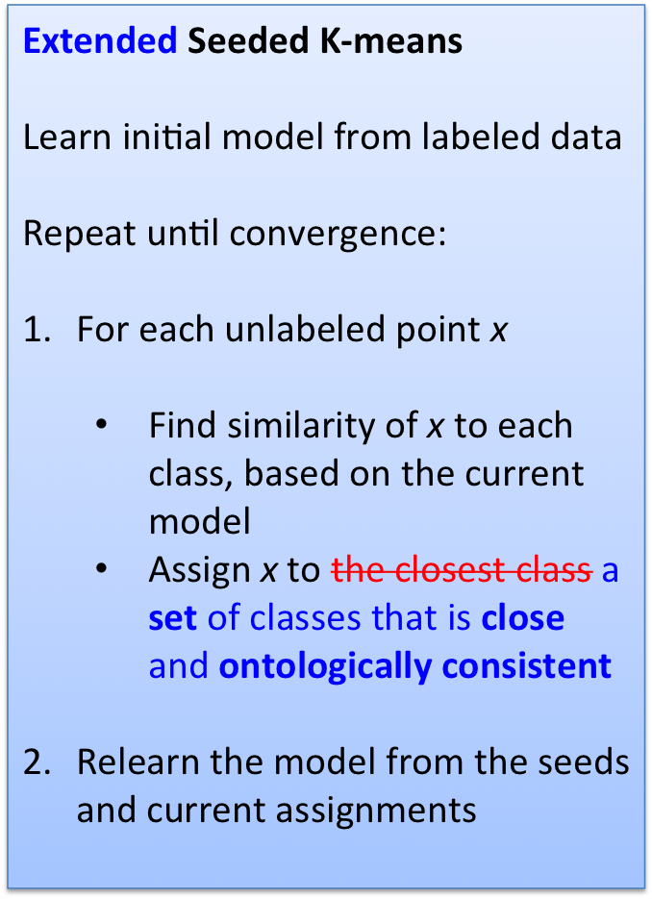
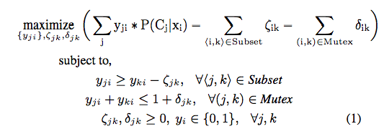
Mixed integer programming
Only concepts – no relations!
Semi-supervised classification into an ontology (Dalvi, Callan, Cohen, AKBC 2013; Dalvi, Talukdar, Minkov and Cohen WSDM 2015)
Hard joint inference problem
Solved independently for each example
Size grows with size of ontology, not size of dataset
teamPlaysSport(t,s)
playsForTeam(a,t)
person
sport
playsSport(a,s)
team
athlete
coach
coachesTeam(c,t)
NP1
NP2
Krzyzewski coaches the Blue Devils.

Slide 10
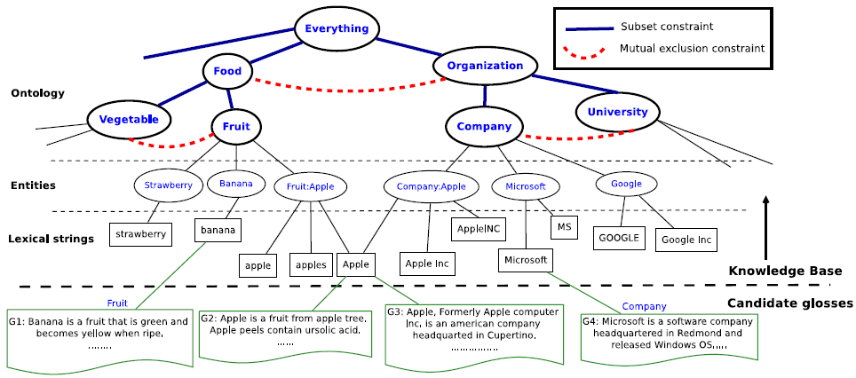
Task: classifying definitional sentences (candidate glosses) into KB categories
Test: Ambiguous glosses
Train: Unambiguous glosses

Slide 11
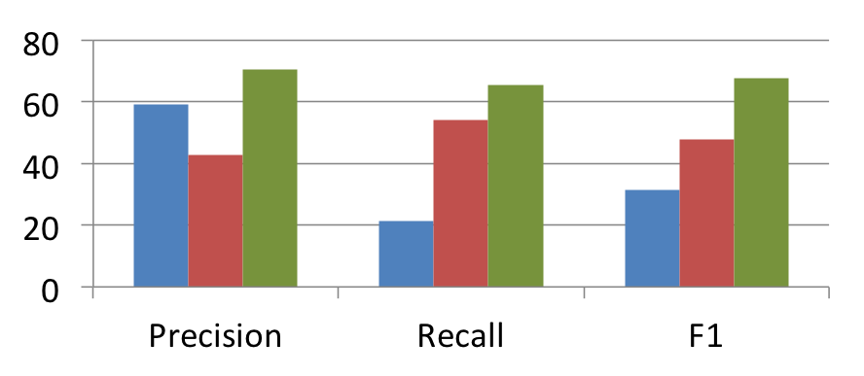
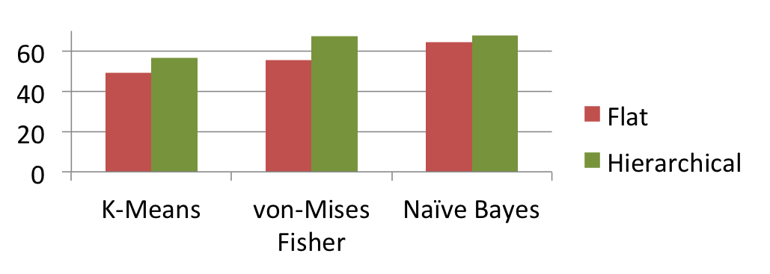
Task: classifying definitional sentences (candidate glosses) into KB categories
NELL: Ambiguous glosses only
SVM
Label Prop
GLOFIN
GLOFIN: With and without hierarchy
F1

Slide 12
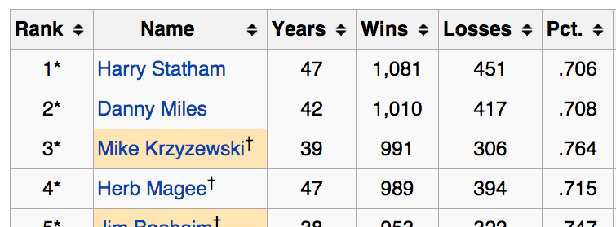
NELL Also Exploits Multi-View Learning
___ , head coach of
pushed ___ ‘s income
__ made almost $
___ was born in
best __ quotes at
__ built a dynasty
__ (pronounced Sha-Shef
teamPlaysSport(t,s)
playsForTeam(a,t)
person
sport
playsSport(a,s)
team
athlete
coach
coachesTeam(c,t)
NP1
NP2
shape = Xx+
endsWith = -ski
startsWith = Krz
vowelFraction = 0.2
…
Krzyzewski coaches the Blue Devils.

Slide 13
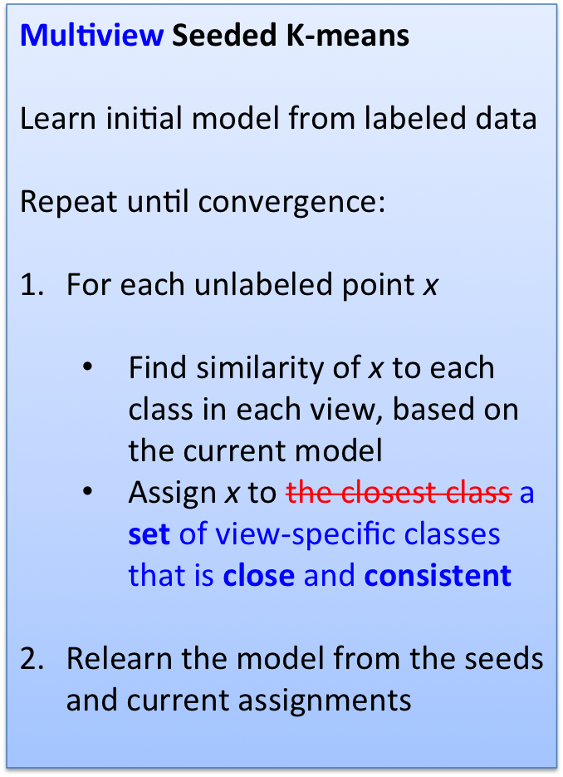
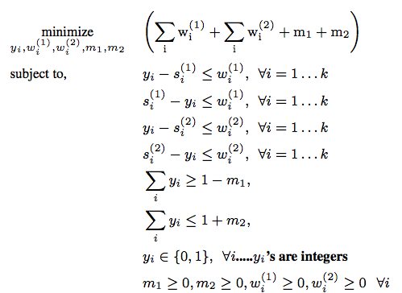
Mixed integer programming
Ongoing work…along with:
Can you extend an ontology as you classify into it? (structural EM)
Can you combine multiview, heirarchical, …?

Slide 14
Outline
Background: NELL
Semi-supervised learning for an ontology
  GLOFIN (Dalvi et al)
  …
Jointly learning to reason and extract relations
  ProPPR (Programming with Personalized PageRank) + …

Slide 15
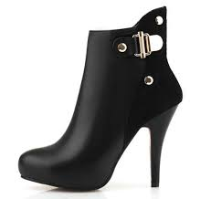
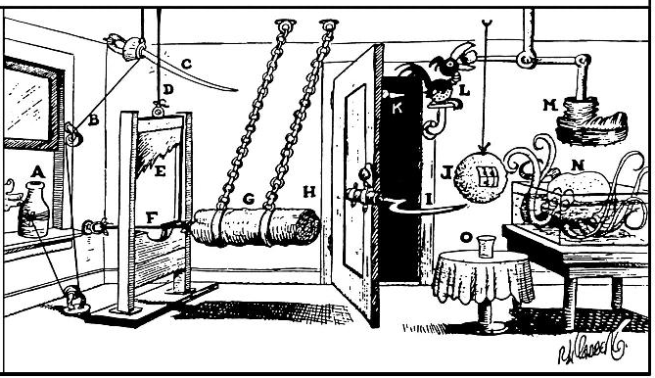

How can we make ML systems better?
Only concepts – no relations!
Semi-supervised classification into an ontology (Dalvi, Callan, Cohen, AKBC 2013; Dalvi, Talukdar, Minkov and Cohen WSDM 2015)
Relation learning and inference
Large ML-based software system

Slide 16
Relational Learning Systems
Task
2. First order program
3. “Compiled” representation
Inference | Learning
formalization
+DB
“compilation”

Slide 17
Relational Learning Systems
MLNs
Task |  | Task
2. First order program |  | Clausal 1st-order logic
3. “Compiled” representation |  | Undirected graphical model
Inference | Learning | approx | approx
formalization
easy
+DB
very expressive
“compilation”
expensive
grows with DB size
intractible

Slide 18
Relational Learning Systems
MLNs
ProPPR
Task |  | Task |  | Task
2. First order program |  | Clausal 1st-order logic |  | Function-free Prolog (Datalog)
3. “Compiled” representation |  | Undirected graphical model |  | Graph with feature-vector labeled edges
Inference | Learning | approx | approx | PPR (RWR) | pSGD
formalization
easy
harder?
+DB
“compilation”
sublinear in DB size
expensive
fast
can parallelize
linear
fast, but
not convex

Slide 19
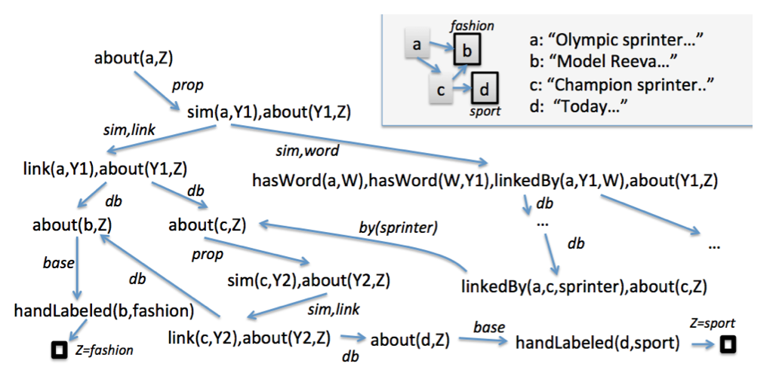
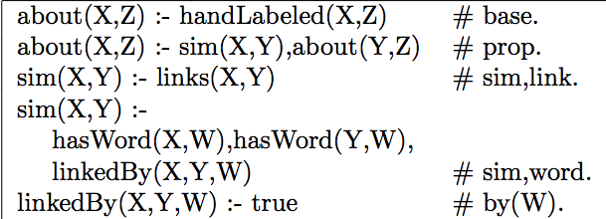
Query: about (a,Z)
DB
Program + DB + Query define a proof graph, where nodes are conjunctions of goals and edges are labeled with sets of features.
Program (label propagation)
LHS ➔ features

Slide 20
Every node has an implicit reset link
Low probability
High probability
Short, direct paths from root
Longer, indirect paths from root
Transition probabilities, Pr(child|parent), plus Personalized PageRank (aka Random-Walk-With-Reset) define a distribution over nodes.
Very fast approximate methods for PPR
Transition probabilities, Pr(child|parent), are defined by weighted sum of edge features, followed by normalization.
Learning via pSGD

Slide 21
Results – parameter learning for large mutually recursive theories
Theories/programs learned by PRA (Lao et al) over six subsets of NELL
#rules | 100k facts | AUC | sec | 1M facts | AUC | sec
PRA 1 | ~ 430-540 | 88.4 – 95.2 | 5-10s with 16 threads | ~ 550 | 95.5 | 15-18s with 16 threads
PRA 2 | ~ 620-770 | 91.6 – 95.4 |  | ~ 800 | 96.0
PRA 3 | ~800-1000 | 95.2 – 95.9 |  | ~1000 | 96.4
Alchemy MLNs: 960 – 8600s for a DB with 1k facts

Slide 22
Query: about (a,Z)
DB
Where does the program come from?
So far – humans or external learner (PRA)
Program (label propagation)
LHS ➔ features

Slide 23
Features generated from using the interpreter correspond to specific rules in the sublanguage
Logic program is an interpreter for a program containing all possible rules from a sublanguage
interpreter
#f(…)
Where does the program come from?
Use parameter learning to suggest structure
Program (label propagation)
LHS ➔ features

Slide 24
Logic program is an interpreter for a program containing all possible rules from a sublanguage
Query₀: sibling(malia,Z)
DB₀: sister(malia,sasha), mother(malia,michelle), …
Query: interp(sibling,malia,Z)
DB: rel(sister,malia,sasha), rel(mother,malia,michelle), …
Interpreter for all clauses of the form P(X,Y) :- Q(X,Y):
interp(P,X,Y) :- rel(P,X,Y).
interp(P,X,Y) :- interp(Q,X,Y), assumeRule(P,Q).
assumeRule(P,Q) :- true # f(P,Q). // P(X,Y):-Q(X,Y)
interp(sibling,malia,Z)
rel(Q,malia,Z), assumeRule(sibling,Q),…
Features correspond to specific rules
assumeRule(sibling,sister),…
assumeRule(sibling,mother),…
f(sibling,sister)
f(sibling,mother)
…
…
Z=sasha
Z=michelle

Slide 25
Logic program is an interpreter for a program containing all possible rules from a sublanguage
Features ~ rules. For example:
f(sibling,sister) ~ sibling(X,Y):-sister(X,Y).
Gradient of parameters (feature weights) informs you about what rules could be added to the theory…
Query: interp(sibling,malia,Z)
DB: rel(sister,malia,sasha), rel(mother,malia,michelle), …
Interpreter for all clauses of the form P(X,Y) :- Q(X,Y):
interp(P,X,Y) :- rel(P,X,Y).
interp(P,X,Y) :- interp(Q,X,Y), assumeRule(P,Q).
assumeRule(P,Q) :- true # f(P,Q). // P(X,Y):-Q(X,Y)
interp(sibling,malia,Z)
rel(Q,malia,Z), assumeRule(sibling,Q),…
Added rule:
Interp(sibling,X,Y) :- interp(sister,X,Y).
assumeRule(sibling,sister),…
assumeRule(sibling,mother),…
f(sibling,sister)
f(sibling,mother)
…
…
Z=sasha
Z=michelle

Slide 26
Structure Learning in ProPPR
Iterative Structural Gradient (ISG):
  Construct interpretive theory for sublanguage
  Until structure doesn’t change:
    Compute gradient of parameters wrt data
    For each parameter with a useful gradient:
      Add the corresponding rule to the theory
  Train the parameters of the learned theory

Slide 27
Structure Learning in ProPPR
Experiment
  2000+ Wikipedia pages on “European royal families”
  15 Infobox relations: birthPlace, child, spouse, commander, …
  Randomly delete some relation instances, run ISG to find a theory that models the rest, and compute MAP of predictions.
 | 10% deleted | 50% deleted
MLNs/Alchemy | 60.8 | 38.8
ProPPR/ISG | 79.5 | 61.9
  Similar results on two other similar datasets

Slide 28
IE in ProPPR
In March 1849 her father-in-law <a href=“Charles_Albert_of_Sardinia”> Charres Albert</a> abdicated …
Experiment
  Same data and protocol
  Add facts: nearHyperlink(Word,Src,Dst) for Src,Dst in data
  Add rules like:
  interp(Rel,Src,Dst) :-
  nearHyperlink(Word,Src,Dst), assumeRelated(Word,Rel).
  assumeRelated(Word,Rel) :- true #f(Word,Rel)
~= 67.5k links
 | 10% deleted | 50% deleted
ProPPR/ISG | 79.5 | 61.9
ProPPR/IE | 81.1 | 70.6
  Similar results on two other similar datasets

Slide 29
Joint Relation Learning IE in ProPPR
Experiment
  Combine IE rules using nearHyperlink and interpretive rules
 | 10% deleted | 50% deleted
MLNs/Alchemy | 60.8 | 38.8
ProPPR/ISG | 79.5 | 61.9
ProPPR/IE | 81.1 | 70.6
ProPPR/Joint IE,ISG | 82.8 | 78.6
  Similar results on two other similar datasets

Slide 30
Summary
Semi-supervised learning for an ontology
  Jointly performs SSL for all concepts in an ontology
  Ontology need not be a tree
  O(10⁵⁻10⁶) entities and O(1,000) concepts
  Joint inference is expensive but limited in scope
  Readily extensible to multiple views, …
Jointly learning to reason and extract relations
  ProPPR is scalable first-order learning system
  O(10⁵⁻10⁶) facts and O(1,000) training queries
  Very flexible but still understanding what it can/can’t do

