Slide 1
Reading Documents with Memory Networks
Antoine Bordes
Facebook AI Research
AKBC Workshop – NAACL – San Diego
June 17, 2016

Slide 2
Horizon
Machines that can understand language:
Able to manipulate symbolic systems
Able to query knowledge sources (KBs, text, etc.)
Able to operate various memory systems
Facebook AI Research:
Develop algorithms
Create and release benchmarks and test-beds
This talk:
End-to-end learning of Q&A systems reading answers directly from text

Slide 3
Memory Networks at FAIR
Team work
Jason Weston
Sumit Chopra
Arthur Szlam
Alex Miller
Adam Fisch
Felix Hill
Sainbayar Sukhbaatar
Jesse Dodge
Xiang Zhang
Andrea Gane
Bart van Merrienboer
Sasha Rush
Amir-Hossein Karimi
Rob Fergus
Tomas Mikolov
Armand Joulin
Apr. 2014: Q&A with Embedding Models
Oct. 2014: Memory Networks
Feb. 2015: bAbI Tasks
May 2015: End-to-end Memory Networks
June 2015: Large-scale Q&A with Memory Networks
Nov. 2015: Story understanding (Children’s books)
Nov. 2105: Testing pre-requisite qualities of end-to-end dialog systems
May 2016: bAbI Tasks for dialog
June 2016: Key-Value Memory Networks for Q&A from Wikipedia

Slide 4
bAbI Tasks (Weston et al., ICLR16)
Set of 20 tasks testing basic reasoning capabilities for QA from stories
Short stories are generated from a simulation
Easy to interpret results / test a broad range of properties
Useful to foster innovation: cited 60+ times
John dropped the milk.
John took the milk there.
Sandra went to the bathroom.
John moved to the hallway.
Mary went to the bedroom.
Where is the milk ? Hallway
The suitcase is bigger than the chest.
The box is bigger than the chocolate.
The chest is bigger than the chocolate.
The chest fits inside the container.
The chest fits inside the box.
Does the suitcase fit in the chocolate? no
Task 3: Two supporting facts
Task 18: Size reasoning

Slide 5
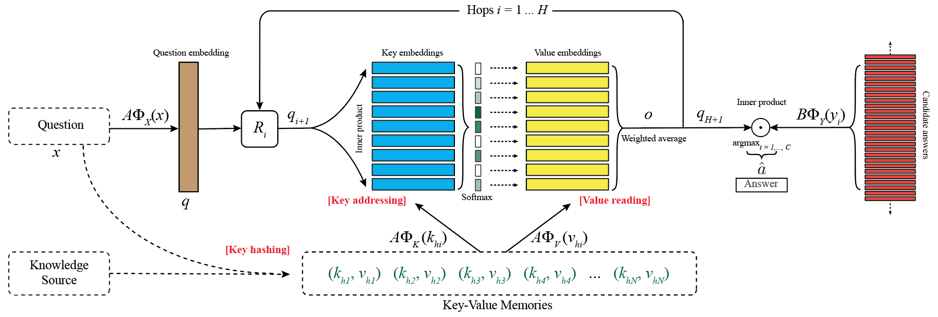
Memory Networks (Weston et al., ICLR15; Sukhbaatar et al., NIPS15)
Where is the milk?
hallway
John
(m₁, m₂, m₃, m₄, …)
milk
(m₁, m₂, m₃, m₄, …)
John
Memories
John dropped the milk.
John took the milk there.
Sandra went to the bathroom.
John moved to the hallway.
Mary went back to the bedroom.
Memories
hallway
m1: John dropped the milk.
m2: John took the milk there.
m4: John moved to the hallway.
m5: Mary went back to the bedroom.
m3: Sandra went to the bathroom.
office
…

Slide 6
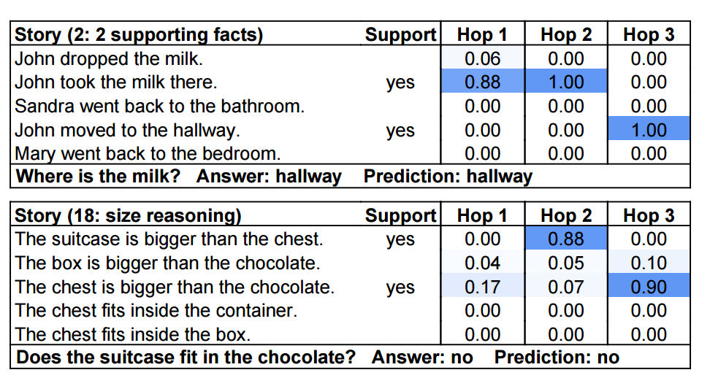
Memory Networks for bAbI Tasks
An attention model

Slide 7
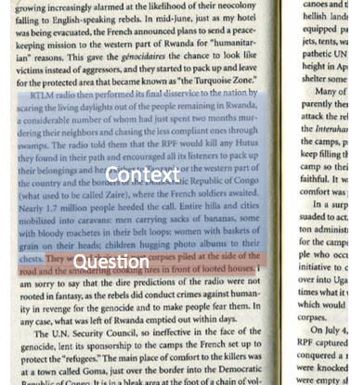
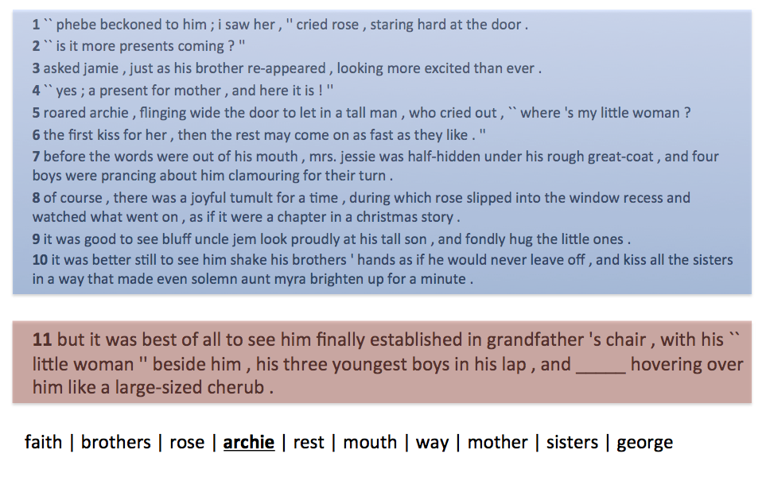
Children’s Books Test (CBT) (Hill et al., ICLR16)
Story understanding dataset based on 118 children books from project Gutenberg
Related but different from QACNN (Herman et al, NIPS15)

Slide 8
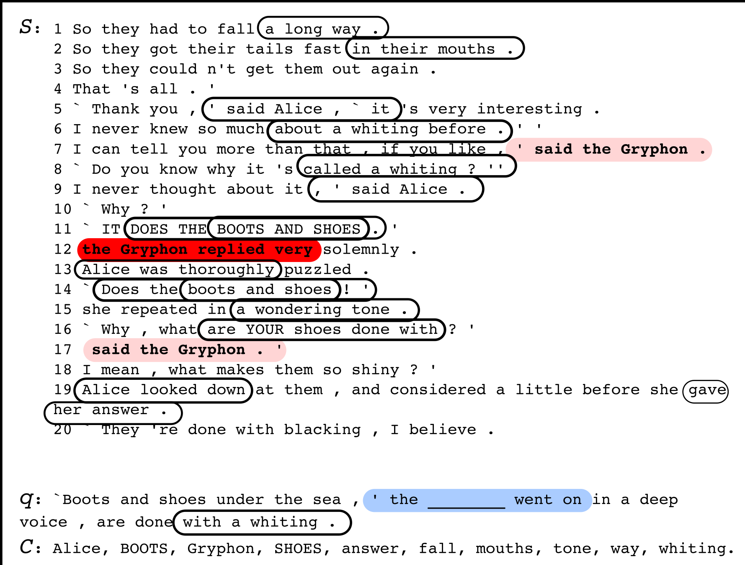
MemNNs on CBT
Memories format?
Sentential: whole sentences (as in the bAbI tasks)
Lexical: 1 word at a time (language modeling style)
Windows: store windows made through the story (convolution style)

Slide 9
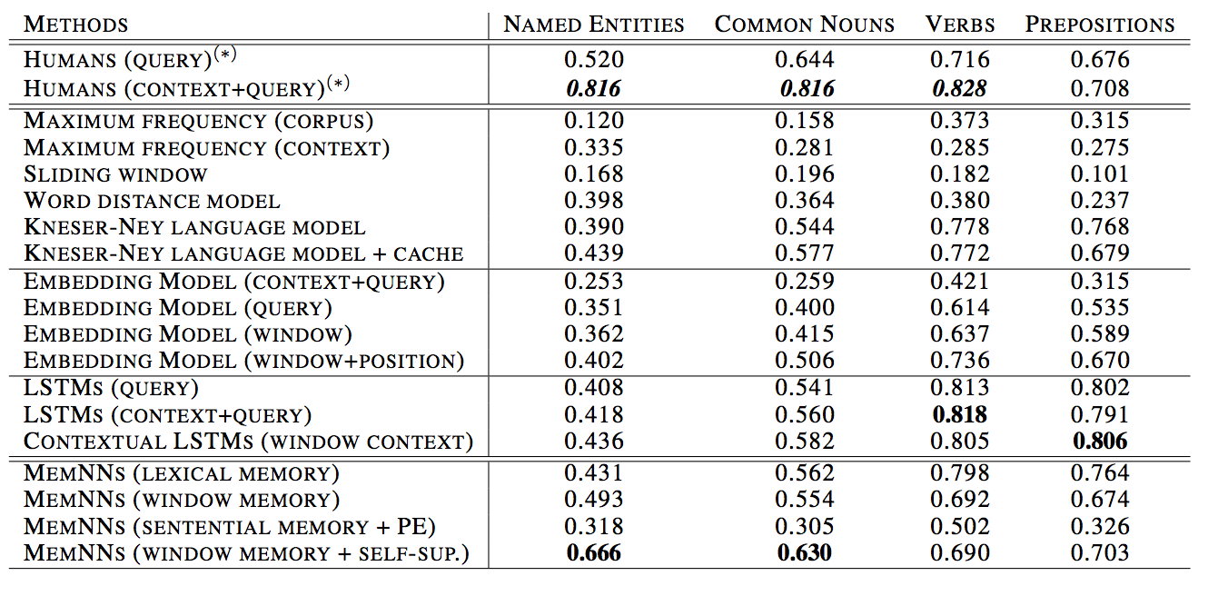
Different Word Types / Different Models
Gated-Attention Readers (Dhingra et al., June 16) 0.719 0.694 <= Current State of the Art

Slide 10
Open-domain Question Answering
Answer questions on any topic
Knowledge Base (KB)
KBs can suffer from missing information and fixed schemas
[Blade Runner, directed_by, Ridley Scott] [Blade Runner, written_by, Philip K. Dick, Hampton Fancher] [Blade Runner, starred_actors, Harrison Ford, Sean Young, …]
[Blade Runner, release_year, 1982] [Blade Runner, has_tags, dystopian, noir, police, androids, …]
[…]
???????????????????
What year was the movie Blade Runner released?
Can you describe Blade Runner in a few words?
In Blade Runner, who built the Replicants?
1982
A dystopian and noir movie
???

Slide 11
Question Answering + Information Extraction
Or even completely automatic KB: OpenIE, NELL, …
Wikipedia Entry: Blade Runner
Blade Runner is a 1982 American neo-noir dystopian science fiction film directed by Ridley Scott and starring Harrison Ford, Rutger Hauer, Sean Young, and Edward James Olmos. The screenplay, written by Hampton Fancher and David Peoples, is a modified film adaptation of the 1968 novel “Do Androids Dream of Electric Sheep?” by Philip K. Dick. The film depicts a dystopian Los Angeles in November 2019 in which genetically engineered replicants, which are visually indistinguishable from adult humans, are manufactured by the powerful Tyrell Corporation as well as by other “mega-corporations” around the world…
[Blade Runner, directed_by, Ridley Scott] [Blade Runner, written_by, Philip K. Dick, Hampton Fancher] [Blade Runner, starred_actors, Harrison Ford, Sean Young, …]
[Blade Runner, release_year, 1982] [Blade Runner, has_tags, dystopian, noir, police, androids, …]
Knowledge Base (KB)
[Replicants, manufactured_by, Tyrell Coporation ]
IE is not an easy problem!
What year was the movie Blade Runner released?
Can you describe Blade Runner in a few words?
In Blade Runner, who built the Replicants?
1982
A dystopian and noir movie
Tyrell Corporation
???

Slide 12
Question Answering Directly from Text
Wikipedia Entry: Blade Runner
Blade Runner is a 1982 American neo-noir dystopian science fiction film directed by Ridley Scott and starring Harrison Ford, Rutger Hauer, Sean Young, and Edward James Olmos. The screenplay, written by Hampton Fancher and David Peoples, is a modified film adaptation of the 1968 novel “Do Androids Dream of Electric Sheep?” by Philip K. Dick. The film depicts a dystopian Los Angeles in November 2019 in which genetically engineered replicants, which are visually indistinguishable from adult humans, are manufactured by the powerful Tyrell Corporation as well as by other “mega-corporations” around the world…
Much more information than in KB
QA is harder but no need for IE
What year was the movie Blade Runner released?
Can you describe Blade Runner in a few words?
In Blade Runner, who built the Replicants?
1982
A dystopian and noir movie
Tyrell Corporation

Slide 13
MovieQA (Miller et al., arxiv16)
Hypothesis: Systems answering from text directly must be on par with systems using KBs for questions whose answers are in KBs.
MovieQA: a new analysis tool for QA
A set of 100k question -- answer pairs (based on SimpleQuestions)
3 knowledge sources:
A KB based on OMDb
Raw text extracted from Wikipedia
An imperfect KB made by an IE system ran on the Wikipedia articles
Answers to all questions are in the KB and in the Wikipedia text.

Slide 14
Memory Networks for QA from KB (Bordes et al., arxiv15)
What year was the movie Blade Runner released?
1982
Tron
(m₁, m₂, m₃, m₄, …)
1982
[…] […] […]
KB
Memories
police
[Blade Runner, directed_by, Ridley Scott] [Blade Runner, written_by, Philip K. Dick, Hampton Fancher] [Steven Spielberg, directed, Jurassic Park, …]
[Blade Runner, release_year, 1982] [Blade Runner, has_tags, dystopian, noir, police, androids, …]
[…]
[Blade Runner, release_year, 1982]
[Blade Runner, written_by, Philip K. Dick]
[Blade Runner, directed_by, Ridley Scott]
Tom Cruise
…

Slide 15
Memory Networks for QA from Text (Hill et al., ICLR16)
What year was the movie Blade Runner released?
1982
Tron
(m₁, m₂, m₃, m₄, …)
1982
[…] […] […]
Wikipedia Entry: Blade Runner
Blade Runner is a 1982 American neo-noir dystopian science fiction film directed by Ridley Scott and starring Harrison Ford, Rutger Hauer, Sean Young, and Edward James Olmos. The screenplay, written by Hampton Fancher and David Peoples, is a modified film adaptation of the 1968 novel “Do Androids Dream of Electric Sheep?” by Philip K. Dick. The film depicts a dystopian Los Angeles in November 2019 in which genetically engineered replicants, which are visually indistinguishable from adult humans, are manufactured by the powerful Tyrell Corporation as well as by other “mega-corporations” around the world…
Memories
police
is a 1982 American neo-noir
directed by Ridley Scott and starring
written by H. Fancher and David Peoples
Tom Cruise
…

Slide 16
Memory Networks on MovieQA
Memory Networks
Standard QA
System on KB
93.5%
24%
No Knowledge
(embeddings)
54.4%
Response accuracy (%)

Slide 17
Structuring Memories
Structure in the symbolic memories
Parts of the memories match questions where others encode response
Prior knowledge on the task
Which Wikipedia page do the windows come from?
Which knowledge source do memories have been extracted from?
[Blade Runner, directed_by, Ridley Scott]
directed by Ridley Scott and starring
[Blade Runner, release_year, 1982]
is a 1982 American neo-noir

Slide 18
Key-Value Memory Networks (Miller et al., arxiv16)
(m₁, m₂, m₃, m₄, …)
Memories

Slide 19
Key-Value Memory Networks on KB
What year was the movie Blade Runner released?
1982
Tron
1982
[…] […] […]
KB
police
[Blade Runner, directed_by, Ridley Scott] [Blade Runner, written_by, Philip K. Dick, Hampton Fancher] [Steven Spielberg, directed, Jurassic Park, …]
[Blade Runner, release_year, 1982] [Blade Runner, has_tags, dystopian, noir, police, androids, …]
[…]
[Blade Runner, release_year] / 1982
[Blade Runner, written_by] / Philip K. Dick
[Blade Runner, directed_by] / Ridley Scott
Tom Cruise
…

Slide 20
Key-Value Memory Networks onText
What year was the movie Blade Runner released?
1982
Tron
[…] […] […]
1982
Wikipedia Entry: Blade Runner
Blade Runner is a 1982 American neo-noir dystopian science fiction film directed by Ridley Scott and starring Harrison Ford, Rutger Hauer, Sean Young, and Edward James Olmos. The screenplay, written by Hampton Fancher and David Peoples, is a modified film adaptation of the 1968 novel “Do Androids Dream of Electric Sheep?” by Philip K. Dick. The film depicts a dystopian Los Angeles in November 2019 in which genetically engineered replicants, which are visually indistinguishable from adult humans, are manufactured by the powerful Tyrell Corporation as well as by other “mega-corporations” around the world…
is a 1982 American neo-noir / 1982
police
directed by R. Scott and starring / R. Scott
is a 1982 American neo-noir / Blade Runner
written by H. Fancher and D. P. / H. Fancher
directed by R. Scott and starring / Blade Runner
written by H. Fancher and D. P. / Blade Runner
Tom Cruise
…

Slide 21
Comparison on MovieQA
Memory Networks
Key-Value Memory Networks
Standard QA
System on KB
93.5%
17%
No Knowledge
(embeddings)
54.4%
Response accuracy (%)

Slide 22
Synthetic Documents
DIFFICULTY
KB: [Flags of Our Fathers, directed_by, Clint Eastwood]
One Template: Clint Eastwood directed Flags of Our Fathers
All Templates: Flags of Our Fathers was directed by Clint Eastwood.
One Template + coref.: Flags of Our Fathers came out in 2006. Clint Eastwood directed it.
One Template + conjunctions: Flags of Our Fathers is in English and Clint Eastwood directed Flags of Our Fathers.
All Templates + coref. + conj.: Flags of Our Fathers is a famous film. Ryan Phillippe, Jesse Bradford, Adam Beach, and John Benjamin Hickey are the actors in it and Clint Eastwood is the person who directed it.
Wikipedia: The film adaptation Flags of Our Fathers, which opened in the U.S. on October 20, 2006, was directed by Clint Eastwood and produced by Steven Spielberg, with a screenplay written by William Broyles, Jr. and Paul Haggis.

Slide 23
Synthetic Documents Analysis
Key-Value Memory Networks
Response accuracy (%)

Slide 24
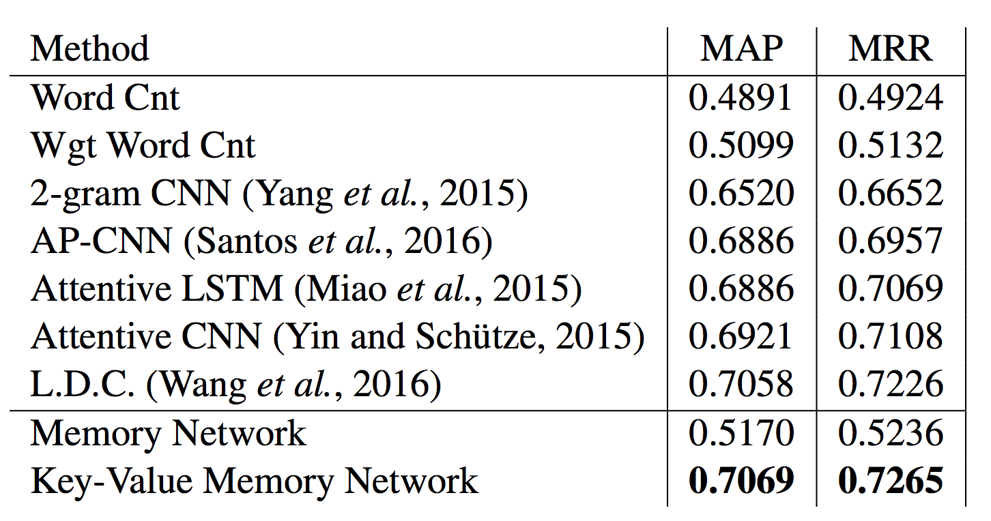
WikiQA (Yang et al., EMNLP15)
QA Benchmark in the answer selection setting
Key-Value Memories -> (window, sentence)
Q: How are glacier caves formed ?
A: A glacier cave is a cave formed within the ice of a glacier
Training size is very small (~1k examples):
Word embeddings pre-trained on Wikipedia and fixed
Dropout regularization

Slide 25
Conclusion
Key-Value Memory Networks: promising model for jointly using symbolic and continuous systems
Can be trained end-to-end through backpropagation + SGD
Provide a great flexibility on how to design memories
bAbI, CBT and MovieQA: new tools for developing learning algorithms
Training and evaluation sets of reasonable sizes
Designed to ease interpretation

Slide 26
Open Research
Papers:
Key-Value Memory Networks: http://arxiv.org/abs/1606.03126
Memory Networks: http://arxiv.org/abs/1410.3916
End-to-end Memory Networks: http://arxiv.org/abs/1503.08895
bAbI tasks: http://arxiv.org/abs/1502.05698
Children’s Books Test: http://arxiv.org/abs/1511.023701
Large-scale QA with Memory Networks: http://arxiv.org/abs/1506.02075
Evaluating pre-requisite qualities of dialog systems: http://arxiv.org/abs/1511.06931
Dialog bAbI tasks: http://arxiv.org/abs/1605.07683
Dialog-based language learning: http://arxiv.org/abs/1604.06045
Data: fb.ai/babi (7 datasets including bAbI tasks, CBT and MovieQA)
Code:
Memory Networks: https://github.com/facebook/MemNN
bAbI tasks generator: https://github.com/facebook/bAbI-tasks
MemNN
Q&A
Dialog

Slide 27
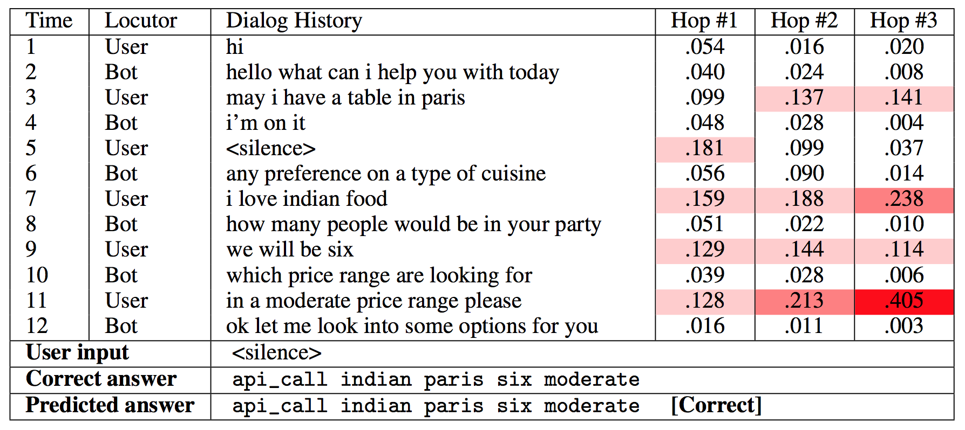
Dialog (Dodge et al. ICLR16) (Bordes et al., arxiv16)
bAbI tasks for goal-oriented dialog
6 tasks around restaurant booking
Involve manipulate language and KB symbols
MemNNs for Goal-oriented Dialog

