Slide 1


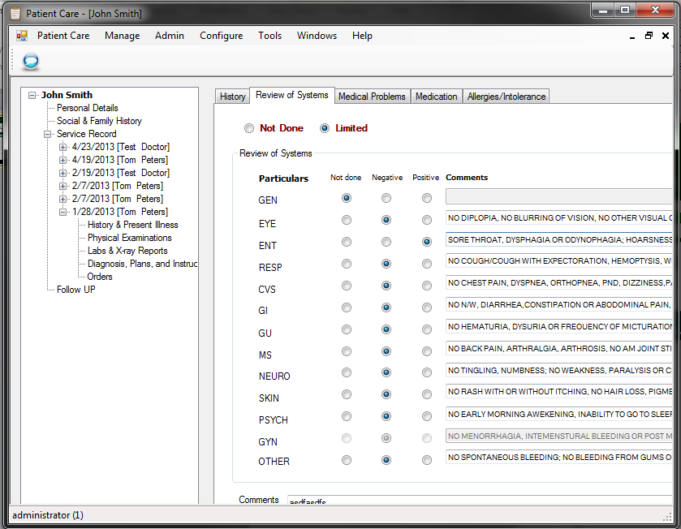
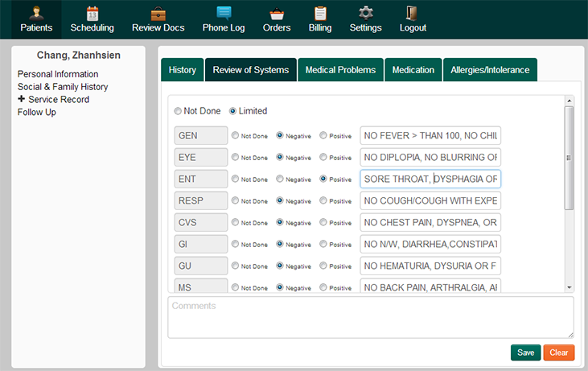
Medical Practice Management System
Zhansien Chang, Imran Esmail, Sean Malone
Goal: Create a cloud based application for medical practice management using modern Web technologies.
Patient Records
Scheduling
Billing
Orders
Phone Logs
Insurance Verification
Document Uploads

