Slide 1
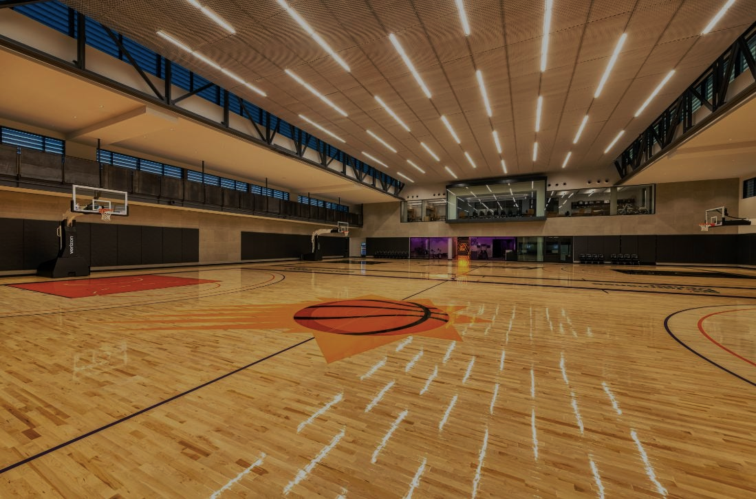

Slide 2
HOBBY: PLAYING BASKETBAL
ALL ABOUT ME:
NAME: IESSEN REMORIN
FROM: LIMAY BATAAN
AGE: 19

