Slide 1
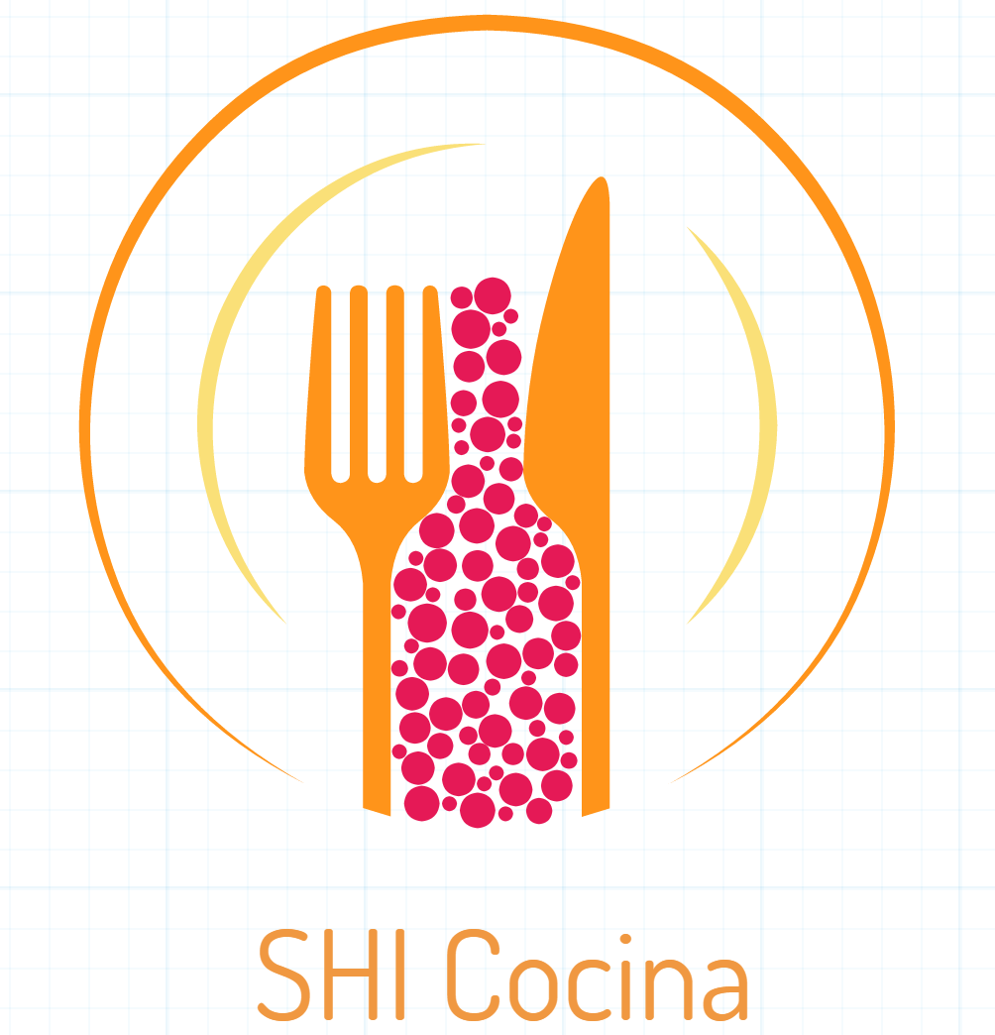
By: Sofia Cosio, Isabel Esteve and Helena Hernandez

Slide 2
Shi Cocina
We are have decided to base our project on an imaginary Mexican restaurant chain named SHI Cocina. The chain has multiple locations in US and is headquartered in Babson Park, MA. The menu consists of various typical Mexican food and drink offerings, as well as Mexican candies/snacks for sale. We are a low cost restaurants with a smaller variety of products. We keep track of customers, orders, and employees in order to reward our loyal customers and best employees.
SHI Cocina was founded on March 8th, 2017 by Sofia Cosio, Isabel Esteve, and Helena Hernandez.

Slide 3
