Slide 1
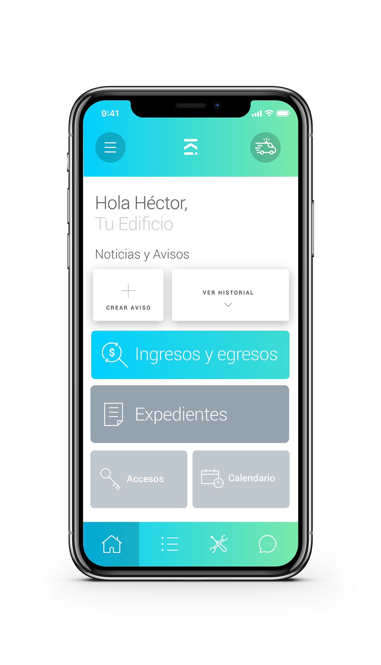
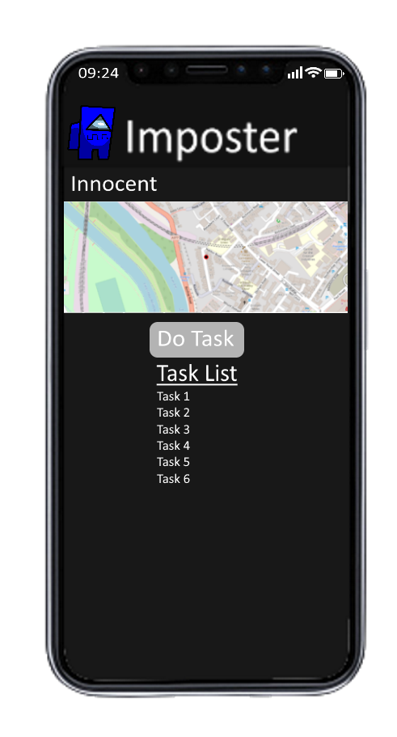
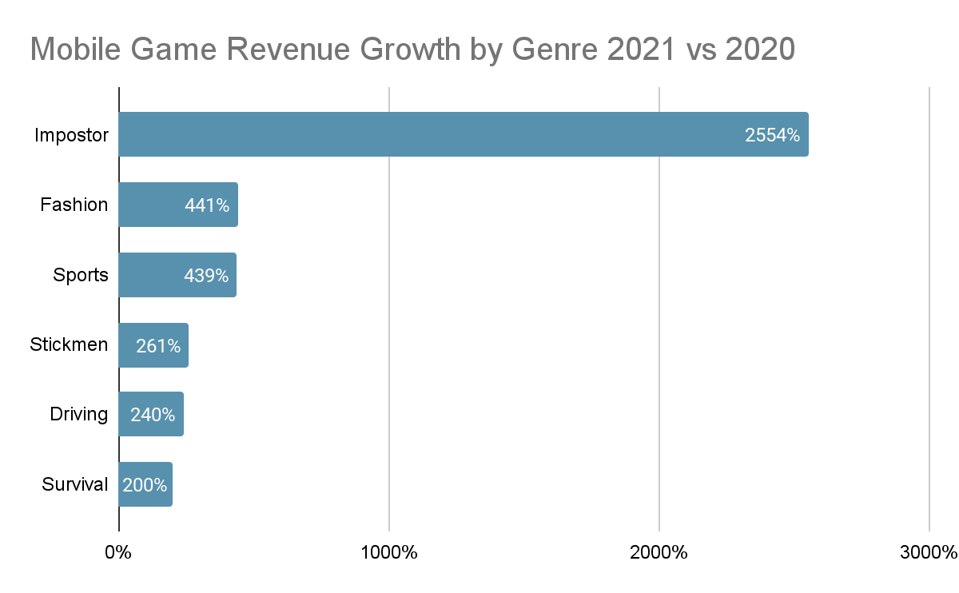
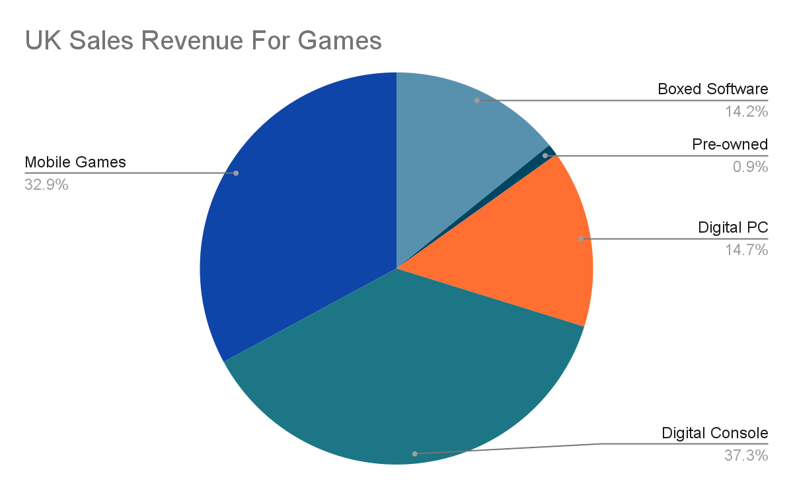
Group 24 - Impostors
Afnan, Iestynlee, Jack and Jakub
Explore the campus but in a fun and interactive manner
Many students will not have fully explored the campus but with this app you can explore you have never been to in an exciting way
Meet new people outside your friend group
Most people will end up making friends from their course or from friends of friend
Talk to other players in realtime
Unlike other webapps, our app allows our users to interact with each other in real time
Complete tasks to win
Travel to different areas of the campus to complete tasks in order to win
Find the impostors
There are 10 of you but which of them are really trying to help you win
Notes:
Screen shot(s) of the main interface(s) and annotated feature
Market research that supports the app design
Website and QR code if hosted publicly
- QR code can be generated here https://www.qr-code-generator.com/

