Slide 1
IETF 127 BPM (2)
18 November 2026
This session is being recorded
Internet Engineering Task Force
© 2026 IETF Trust
Production by Meetecho

Slide 2
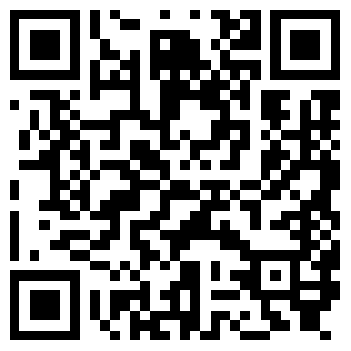
Note Well
By participating in the IETF you agree to follow IETF processes and policies. This Note Well is a reminder
of some of those policies. For a linked version of this text, please visit www.ietf.org/note-well or use the QR code below.
IETF participants are expected to behave in a professional manner and extend respect and courtesy to their colleagues at all times (see RFC 7154: IETF Guidelines for Conduct and IETF Anti-Harassment Policy). If you have any concerns about behavior, please contact the Ombudsteam who have a duty of confidentiality and extensive powers to act, as set out in RFC 7776: IETF Anti-Harassment Procedures.
If you are aware that any IETF contribution (as defined in RFC 5378: Rights Contributors Provide to the IETF Trust) is covered by patents or patent applications that are owned or controlled by you, your employer or your sponsor, you must disclose that fact, or not participate in the discussion
(see RFC 8179: Intellectual Property Rights in IETF Technology).
For detailed process information consult RFC 2026: Internet Standards Process and
RFC 2418: IETF Working Group Guidelines and Procedures and updates to those.
The IETF routinely makes public written, audio, video, and photographic records
of IETF activities, including your personal information as set out in the IETF Privacy Statement.
For advice, please talk to Working Group chairs or Area Directors.
Notes:
The IETF Note Well should be shown at the start of every IETF working session. The guidance below is adapted from IETF legal counsel presentation during IETF 120
DO
Do make sure people have enough time to read through the slide before you move on,
Do give a high-level summary of what’s covered in the Note Well: “IETF policies on conduct, privacy and IPR.”,
Do encourage people to read through all the linked policies & documents in detail before participating or contributing,
Do explain where people can direct questions or concerns (IETF Executive Director or Ombudsteam).
DON'T
Don’t dismiss the importance or relevance of any of the information on the Note Well.
Don’t interpret the meaning or get into the substance of any of the topics or content of the policies.
Don’t communicate that the Note Well conveys all the information participants need to know.
Don’t address questions or concerns in the meeting itself.

Slide 3
Note Really Well
IETF meetings, virtual meetings, and mailing lists are intended for professional collaboration and networking, as defined in the IETF Guidelines for Conduct (RFC 7154), the IETF Anti-Harassment Policy, and the IETF Anti-Harassment Procedures (RFC 7776). If you have any concerns about observed behavior, please talk to the Ombudsteam, who are available if you need confidentiality to raise concerns confident about harassment or other conduct in the IETF.
The IETF strives to create and maintain an environment in which people of many different backgrounds and identities are treated with dignity, decency, and respect. Those who participate in the IETF are expected to behave according to professional standards and demonstrate appropriate workplace behavior.
IETF participants must not engage in harassment while at IETF meetings, virtual meetings, social events, or on mailing lists. Harassment is unwelcome hostile or intimidating behavior—in particular, speech or behavior that is aggressive or intimidates.
If you believe you have been harassed, notice that someone else is being harassed,
or have any other concerns, you are encouraged to raise your concern in confidence
with one of the Ombudspersons.

Slide 4
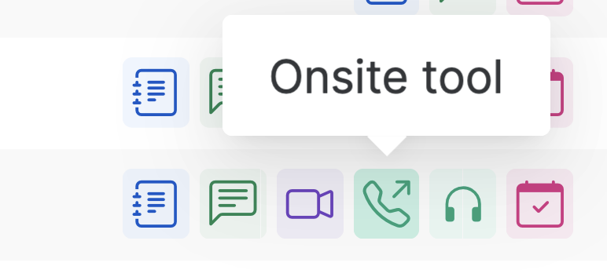
IETF 127 Meeting Tips
This session is being recorded
In-person participants
Make sure to sign into the session via Datatracker or the QR Code in this session.
Use Meetecho (usually the “Meetecho lite”) client to:
  join the mic queue
  participate in shows of hands
Keep audio and video off if not using the onsite version.
Remote participants
Make sure your audio and video are off unless you are chairing or presenting during a session.
Use of a headset is strongly recommended.

Slide 5
Notetaker
We need a volunteer for notetaking.
https://notes.ietf.org/notes-ietf-127-bpm

Slide 6
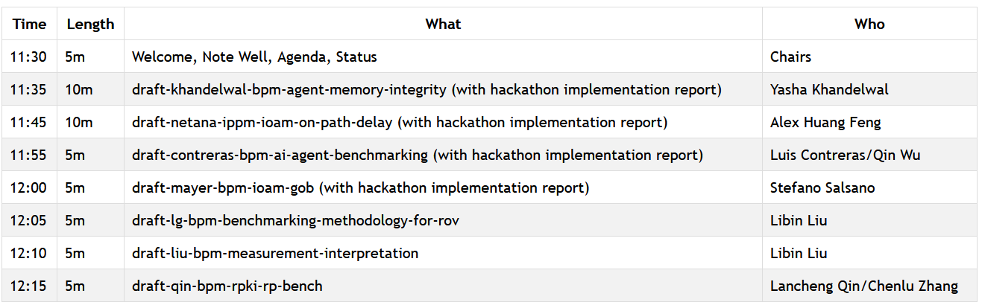
Agenda – Proposed Work

Slide 7
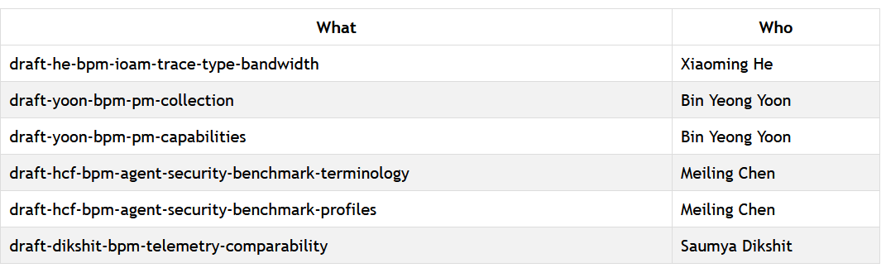
Agenda – Lightning Talks (if time permits)

Slide 8
Resources for IETF 127 San Francisco
Agenda
https://datatracker.ietf.org/meeting/agenda
Meetecho and other information:
https://www.ietf.org/how/meetings/preparation
If you need technical assistance, see the Reporting Issues page:
http://www.ietf.org/how/meetings/issues/

