Slide 1
A YANG Data Model for WDM Tunnels
draft-ietf-ccamp-wdm-tunnel-yang-06
Co-authors:
Aihua Guo (Futurewei)
Sergio Belotti (Nokia)
G. Galimberti (Individual)
J.E.L.d.V. Mendez (Naudit HPCN)
D.P. Burrero (Universidad Autonoma de Madrid)
Contributors:
Daniel King (Olddog Consulting)
Haomian Zheng (Huawei)
Italo Busi (Huawei)
Victor Lopez (Nokia)
Contributors:
Dieter Beller (Nokia)
Ricard Vilalta (CTTC)
Young Lee (Samsung)
Bin Yeong Yoon (ETRI)
Daniel Michaud Vallinoto (Universidad Autonoma de Madrid)
Zafar Ali (Cisco)
Esther Le Rouzic (Orange)
Julien Meuric (Orange)
Gert Grammel (Juniper)
Roberto Manzotti (Cisco)
IETF 124, Montreal

Slide 2
Summary of Updates in -05
YANG model updates
  Aligned with the latest WG LC changes for rfc9093-bis
  Updated model for regenerators reflecting the resolution of L0/L1 boundary scenarios
    Support back-to-back and uni-directional regenerators
    Support single or multiple-transponder pairs as regenerator(s), single or multi-carrier
    Defined base identity for regeneration layer, digital layer mapping/termination (with order) and inverse multiplexing
    Matching digital mapping between source/destination/regenerator
Text updates
  Added text for 3R regenerators
    3R regenerator scenarios (also referencing the definition from rfc9093-bis)
    Added definition of some terminologies to facilitate modelling, e.g., incoming and outgoing transponders

Slide 3
Open Issues & Ongoing discussion
Address Rtgdir and YANG Doctor review comments (#74, #76)
Improve the text on the WDM tunnel provisioning steps
Need a diagram to illustrate the relationship between this model, the optical impairment , RFC 9093 bis, optical path computation.(#25)
Provide the identity definitions for regeneration layer, digital layer mapping/termination (with order) and inverse multiplexing
Consider defining optical layer-specific operations (RPCs), for example automatic power equalization, that are application to a WDM tunnel
Related work in CCAMP may require additional changes to this draft
  WDM path computation
  Ongoing work on pluggable management & control, including the gap analysis and use cases documents, may require additional changes to the model

Slide 4
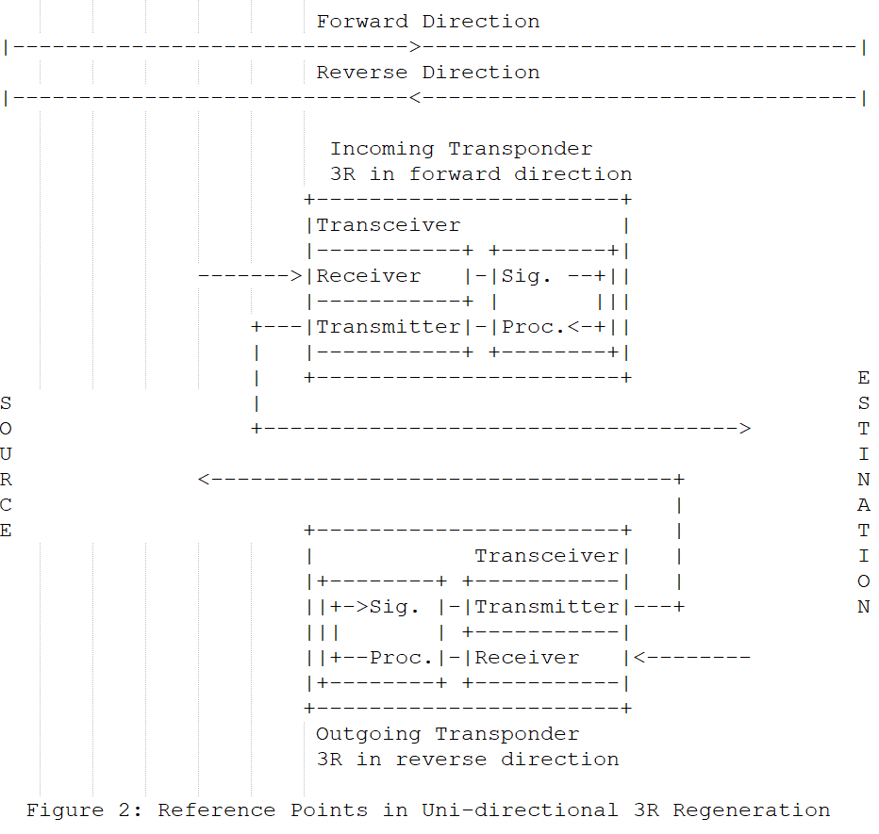
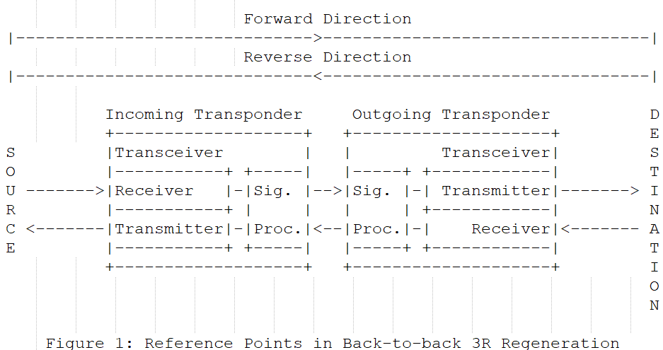
Defining “Incoming” and “Outgoing” Transponder in Regenerator Scenarios

Slide 5
Consistent Transponder Configurations at Source, Destination and Regenerator
+--rw (node-position)?
+--:(source) or (destination)
| +--rw source-transponder (or destination-transponder)
| +--rw transponder-id? uint32
| +--rw digital-terminations
| | +--rw digital-termination* [index]
| | +--rw index uint8
| | +--rw termination-type? identityref
| | +--rw mapping-type? identityref
| +--rw transceiver
| +--rw transceiver-id? uint32
| +--rw otsi-carrier-id? uint16
| +--rw otsi-carrier-frequency?
| | l0-types:frequency-thz
| +--rw tx-channel-power?
| | l0-types:power-dbm
| +--rw operational-mode? string
| +--rw line-coding-bitrate? identityref
| +--rw preferred-rx-channel-power?
| | l0-types:power-dbm
| +--rw gsnr-extra-margin? snr
| +--rw inverse-multiplexing!
| +--rw inverse-mux-type? identityref
| +--rw otsi-lane-termination-type? identityref
| +--rw additional-transceivers
| +--rw index? uint8
| +--rw transceiver-id? uint32
| +--rw otsi-carrier-id? uint16
| +--rw otsi-carrier-frequency?
| | l0-types:frequency-thz
| +--rw tx-channel-power?
| l0-types:power-dbm
|
+--:(regenerator)
| +--rw regenerator
| +--rw regen-group-id? uint32
| +--rw regeneration-layer? identityref
| +--rw incoming-transponder
| | +--rw transponder-id? uint32
| | +--rw digital-terminations
| | | +--rw digital-termination* [index]
| | | +--rw index uint8
| | | +--rw termination-type? identityref
| | | +--rw mapping-type? identityref
| | +--rw transceiver
| | +--rw transceiver-id? uint32
| | +--rw otsi-carrier-id? uint16
| | +--rw otsi-carrier-frequency?
| | | l0-types:frequency-thz
| | +--rw tx-channel-power?
| | | l0-types:power-dbm
| | +--rw operational-mode? string
| | +--rw line-coding-bitrate? identityref
| | +--rw preferred-rx-channel-power?
| | | l0-types:power-dbm
| | +--rw gsnr-extra-margin? snr
| | +--rw inverse-multiplexing!
| | +--rw inverse-mux-type? identityref
| | +--rw otsi-lane-termination-type? identityref
| | +--rw additional-transceivers
| | +--rw index? uint8
| | +--rw transceiver-id? uint32
| | +--rw otsi-carrier-id? uint16
| | +--rw otsi-carrier-frequency?
| | | l0-types:frequency-thz
| | +--rw tx-channel-power?
| | l0-types:power-dbm
| +--rw outgoing-transponder
(same structure as incoming-transponder)
|
+--:(regenerators)
+--rw regenerators
+--rw common-incoming
| +--rw operational-mode? string
| +--rw line-coding-bitrate? identityref
| +--rw preferred-rx-channel-power?
| | l0-types:power-dbm
| +--rw gsnr-extra-margin? snr
+--rw common-outgoing
| +--rw operational-mode? string
| +--rw line-coding-bitrate? identityref
| +--rw preferred-rx-channel-power?
| | l0-types:power-dbm
| +--rw gsnr-extra-margin? snr
+--rw regenerator* [index]
+--rw index uint8
+--rw regen-group-id? uint32
+--rw regeneration-layer? identityref
+--rw incoming-transponder
| +--rw transponder-id? uint32
| +--rw transceiver
| +--rw transceiver-id? uint32
| +--rw otsi-carrier-id? uint16
| +--rw otsi-carrier-frequency?
| | l0-types:frequency-thz
| +--rw tx-channel-power?
| l0-types:power-dbm
+--rw outgoing-transponder
+--rw transponder-id? uint32
+--rw transceiver
+--rw transceiver-id? uint32
+--rw otsi-carrier-id? uint16
+--rw otsi-carrier-frequency?
| l0-types:frequency-thz
+--rw tx-channel-power?
l0-types:power-dbm

Slide 6
Next Steps
Consolidate the basic reference scenarios out of our complete package
Address the open issues & WG comments
  Weekly team meeting:
    Thursday, 14:00 (CET)
    CCAMP WebEx Details
      https://ietf.webex.com/ietf/j.php?MTID=ma1ca3bcec716fe1ff93e0a28b3558294
      Join by meeting number
        Meeting number (access code): 2422 698 1495
        Meeting password: 6UbM2tEJJd6

Slide 7
Thank you!

Slide 8
Backup

Slide 9
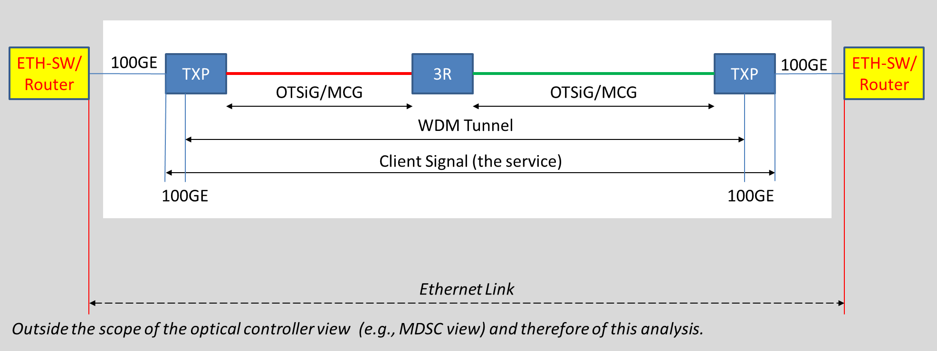
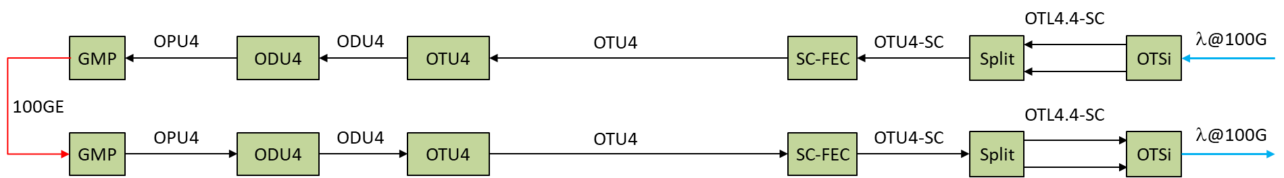
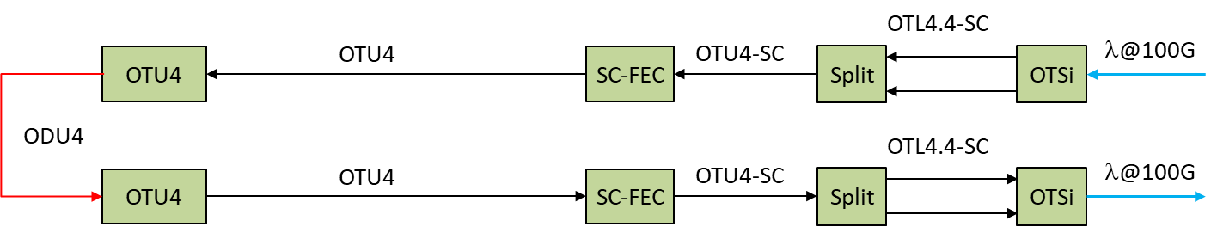
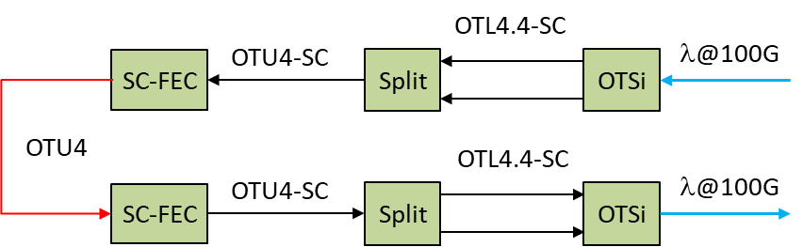
Reference Scenario (1) - 100GE Service with 3R
Source Transponder
Destination Transponder (in reverse signal direction)
Regen layer: 100GE
Regen layer: ODU4
Regen layer: OTU4

Slide 10
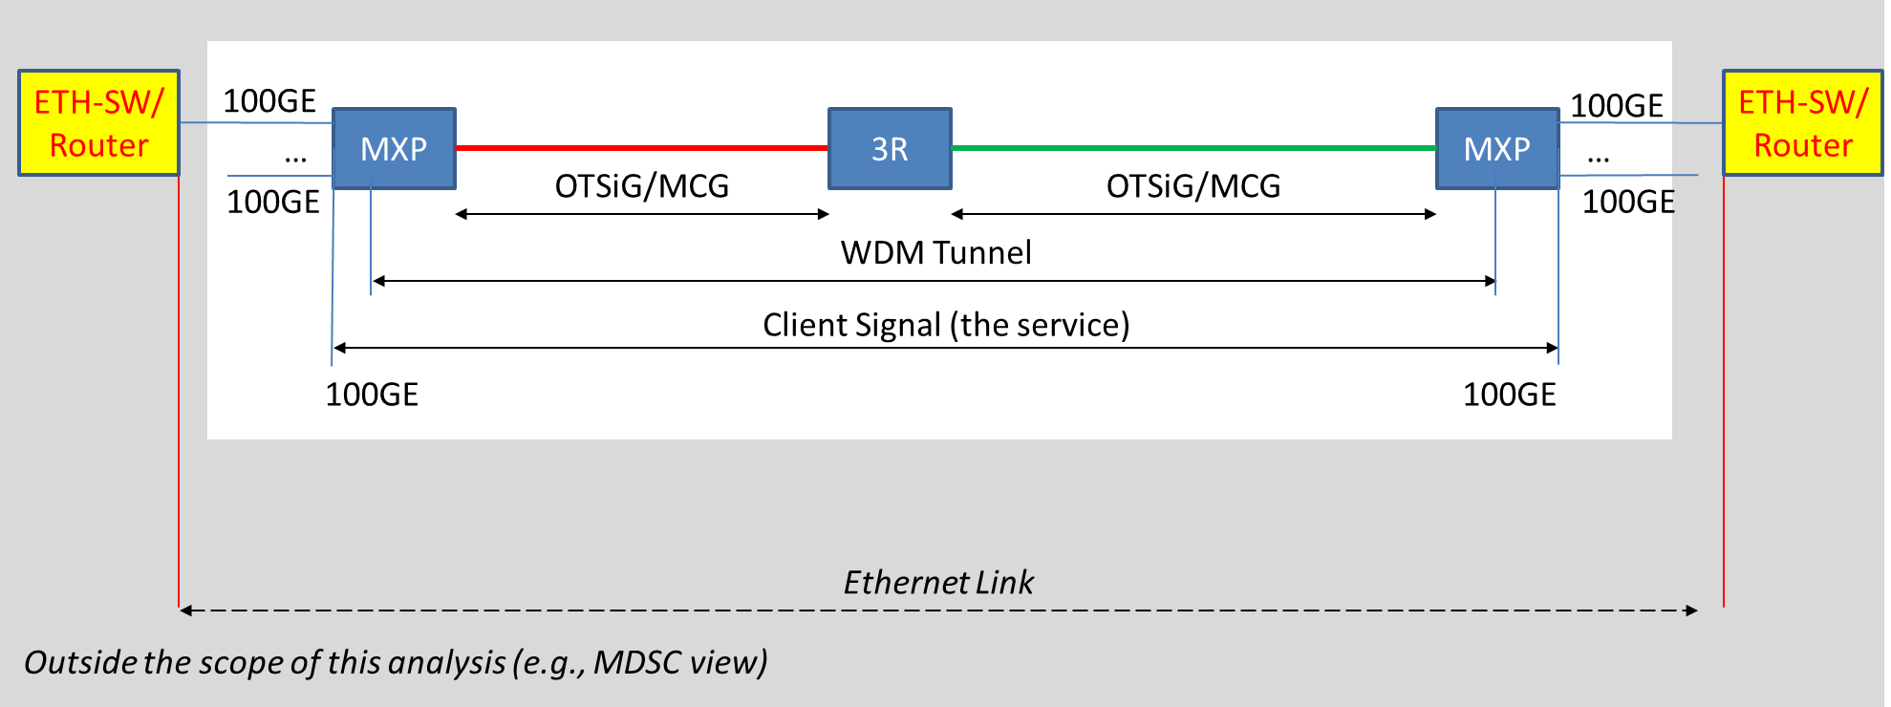
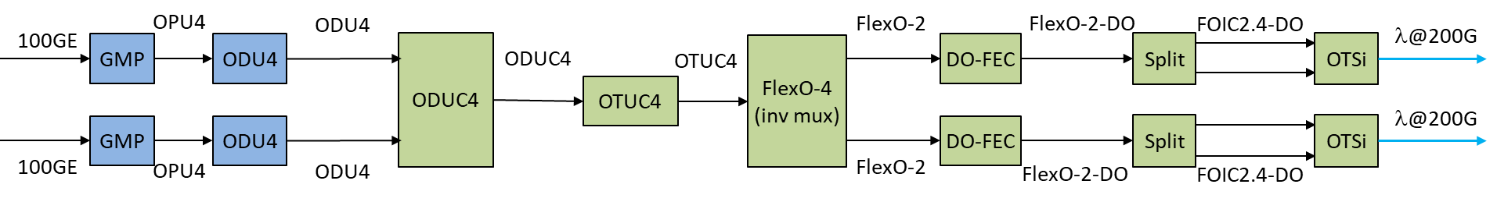
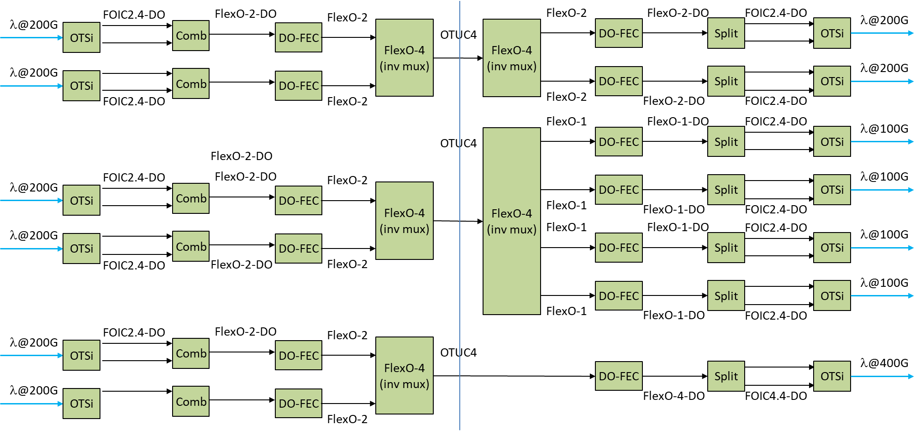
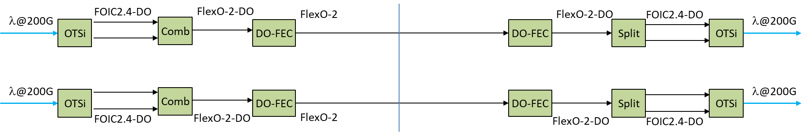
Reference Scenario (2) – 4 x 100GE Service with 3R
Source Muxponder
Destination Muxponder (in reverse signal direction, can have different digital mapping than the source muxponder)
Regen layer: OTUC4
Regen layer: FlexOnM/FlexOxR

Slide 11
YANG modules impacts (1)
To align and merge with previous
draft-ietf-ccamp-client-signal-yang (client information) | draft-ietf-ccamp-wdm-tunnel-yang (configuration) | Optical Impairment topology (capabilities)
Client Payload | Multiplexing schema type (e.g. LO-ODU,VLAN etc.)) | Inverse Multiplexing types
Digital Mapping (inferred ?) GMP, GFP-F | Digital-termination-type (ordered list) | 3R regeneration layer supported
Multiplexing label value(s) (e.g. tsg/tpn in case of OTN)) | 3R regeneration layer (list in the tunnel, single value for an hop in the ERO) (1) | List of multiplexing schema types supported
 | Inverse Multiplexing types (single value) | Digital-termination-types supported
Client Signal YANG
WDM Tunnel YANG model + OI topology
LEGENDA
Multiplexing schema type: identifies the type of multiplexing technology used (e.g ODUj,K)
Digital Mapping: identifies the mapping technology used to map the client ETH signal (e.g. OTN, VLAN) (GMP, GFP-F)
Client Payload: identifies the client signal that will be carried by WDM tunnel (e.g. 100GE, 400GE, etc.)
Multiplexing label value(s): identifies which multiplexing slot(s) are used by the client (if OTN tributary slot/tributary port number)
Digital termination type: identifies the type of the multiplexing container (e.g. ODUC4)
(1) 3R reg list as constraints for tunnel, single value for transceiver configuration in the ERO

