Slide 1
CCAMP: Transport NBI Design Team
Nigel Davis
Italo Busi
Julien Meuric
Dieter Beller
Haomian Zheng
Sergio Belotti
Gabriele Galimberti
Aihua Guo
Luis M, Contreras
Scott Mansfield
Peter Landon
Prasenjit Manna
Reza Rokui
Daniel King

Slide 2
Scope of the Transport NBI Design Team
A CCAMP Working Group Design Team was created to discuss the use cases and applicability of CCAMP, and related YANG models for the Northbound Interface used to communicate with Transport Network resources
The Design Team will provide guidelines regarding how all the relevant models can solve agreed and well-identified transport network use cases
It was agreed that the Design Team members and interested participants should use a non-WG mailing list
https://mailarchive.ietf.org/arch/browse/transport-nbi-dt/
The Design Team will publish via the CCAMP GitHub and Wiki
https://github.com/ietf-ccamp-wg/transport-nbi
List is open access; anyone may join and attend
JSON Examples will be agnostic to deployment architectures

Slide 3
What is the Transport NBI?
An additional, an early, goal of the TNBI discussion is to clarify the term “Transport NBI”
Early text being discussed:
“The optical transport domain is designed to support various connectivity services, such as Wave Division Multiplexing (WDM) and the Optical Transport Network (OTN). A primary objective for network operators is to automate the establishment of these services in single-layer and complex hierarchical, multi-domain optical transport networks. Exposing capability and infrastructure assets are crucial to providing access to network resources and offering advanced control and manageability features. Optical transport Application Programming Interface (API) becomes essential to achieve this.
The "Transport Northbound Interface" (T-NBI) API are well-defined, open interfaces vital for network operators. They provide the capability to view optical transport resources and effectively operate multi-vendor and multi-domain networks. Furthermore, the T-NBI API is instrumental in facilitating the coordination and automation of service provisioning, thereby enhancing efficiency and operational flexibility when managing optical network resources.”
Not final, updates are encouraged and expected
https://github.com/ietf-ccamp-wg/transport-nbi/issues/115
It should be noted that "well-defined”, also includes procedure and usage, and we will need to include that YANG is used to model capability.
We are also synching IETF industry terms (ACTN, OTS, OMS, OTSI, OTU, service models, et al.) ideally providing a mapping between other SDOs and initiatives (such as ONF TAPI, and OIF work)

Slide 4
Transport NBI Design Team Early Meetings
The DT will help people utilise CCAMP models and IETF protocols.
Publish best practice and examples via Wiki, GitHub, or a combination.
DT Discussions are based on Use Cases and Scenarios
Use Case: A use case is a broader concept that describes a set of components, actions/steps, and may define the interactions between functional components to achieve requested objective(s).
Scenario: A scenario may refer to a specific narrative, technology and set of steps or events.
Started meeting formally after IETF 118, a key discussion was which "use case(s)" should we focus on first?
We agreed to work on, initially
1. Inventory Management
2. Multi-layer Topology Management
We also agreed that we can potentially reuse the existing work, scenarios and examples from our earlier work:
https://datatracker.ietf.org/doc/html/draft-ietf-ccamp-transport-nbi-app-statement-17#name-json-code

Slide 5
Defining Inventory and Use Case for the TNBI
(Italo)

Slide 6
Inventory 1- Examples of NE configurations
Site
Site
equipment-room
Wuhan-C-A1-NO.101
equipment-room
Wuhan-C-A1-NO.101
network-element
Ne(115-50)
network-element
Ne(115-50)
rack
rack 1-2
rack
rack 1-1
rack
rack 1-2
rack
rack 1-3
shelf
chassis-1
shelf
chassis-2
shelf
chassis-3
shelf
chassis-1
shelf
chassis-2
shelf
chassis-1
shelf
chassis-1
Rack belongs to NE
We don’t consider that rack belongs to NE. Because there could be a scenario that multiple NEs are installed on one rack.
We have not fully understood the definition of site. We think site is not mandatory，so is equipment room.

Slide 7
Inventory 2 - Examples of NE configurations
network-element
Ne(115-50)
network-element
Ne(115-50)
Site
Site
Site
equipment-room
Wuhan-C-A1-NO.101
equipment-room
Wuhan-C-A1-NO.102
equipment-room
Wuhan-C-A1-NO.101
equipment-room
Wuhan-C-A1-NO.102
rack
rack 1-2
rack
rack 1-1
rack
rack 1-2
rack
rack 1-1
rack
rack 1-2
rack
rack 1-1
rack
rack 1-2
shelf
chassis-1
shelf
chassis-2
shelf
chassis-1
shelf
chassis-1
shelf
chassis-1
shelf
chassis-1
shelf
chassis-1
shelf
chassis-1
A NE can be split into two equipment rooms in the same site
A NE could be split into two different sites…
For the model we propose, we think it can describe this relationship mostly. The location of NE should be modified to a list to represent this one NE split into two or more equipment rooms scenario.

Slide 8
2- Examples of NE configurations - Reviewed
Site
Wuhan-C-A1
Site
Wuhan-C-A1
equipment-room
Wuhan-C-A1-NO.101
equipment-room
Wuhan-C-A1-NO.101
rack
rack 1-1
rack
rack 1-2
rack
rack 1-3
rack
rack 1-4
shelf
chassis-1
r=1, sh=3
shelf
chassis-2
r=1, sh=1
shelf
chassis-3
r=1, sh=2
shelf
chassis-1
sh=1
shelf
chassis-2
sh=2
shelf
chassis-4
sh=3
shelf
chassis-1
sh=4
network-element
Ne(115-50)
network-element
Ne(115-51)
NE occupies a full rack
NEs can share the same rack

Slide 9
Defining Network Layering and Use Case for the TNBI
(Nigel)

Slide 10
Transceiver1
RFC8345 Key
Transceiver2
Link
Layer names to be aligned with other IETF docs
YANG fragments to be identified
JSON samples to be generated
TP
Node
OTN (ODU)
Figure using symbol set from ONF TAPI (see https://github.com/OpenNetworkingFoundation/TAPI/releases/tag/v2.5.0)
Figure adapted from Figure in TAPI TR-547
ODU
OTN (OTU)
OTU
ROADM1
ROADM3
OTSiMC
OTSiMC
OTSiMC
OTSiMC
MC
Not modelled in the topology
OMS
OMS
OMS
OTS
OTS
OTS
OTS
OTS

Slide 11
Next Steps for TNBI Meetings
See our GitHub for activity
https://github.com/ietf-ccamp-wg/transport-nbi/issues
Agree inventory models (with JSON examples)
Agree layering model (with terminology)
Need to synchronise TAPI terms with IETF, including topology and service models.
RFC8345 (Network Topology)
https://datatracker.ietf.org/doc/draft-ietf-ccamp-l1csm-yang/
https://datatracker.ietf.org/doc/draft-ietf-ccamp-layer1-types/
https://datatracker.ietf.org/doc/draft-ietf-ccamp-optical-impairment-topology-yang/
Map between TAPI/OIF Terminology like: OTS, OMS, OTSI, OTU, to IETF terminology
Agree tooling is still an ongoing discussion of how we can reuse code easily and generate JSON automatically
Start to publish the IETF models used, process and provide JSON examples

Slide 12
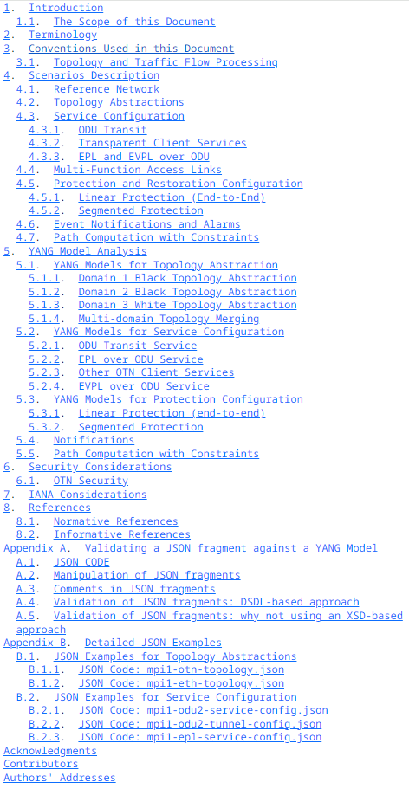
But Wait, There is More…
What happened to the T-NBI 1.0 Output?
“Transport Northbound Interface Applicability Statement”
https://datatracker.ietf.org/doc/draft-ietf-ccamp-transport-nbi-app-statement/
The document is highly technology specific and provides several JSON code examples
The document has been stuck trying to reduce the size and complexity, after numerous revisions and reviews it is now “Waiting for WG Chair Go-Ahead”
Current size of the document is 95 pages
Given the concerns raised by reviewers, especially non-subject matter experts, we could look to break the document into smaller pieces and publish the work in the CCAMP TNBI Wiki (instead of an RFC)
Reusing some of the topology and use cases for TNBI 2.0 activity
WG and Chair thoughts?

