Slide 1
IETF 123 BMWG & IPPM
21 July 2025
This session is being recorded
Internet Engineering Task Force
© 2025 IETF Trust
Production by Meetecho

Slide 2
Note Well
This is a reminder of IETF policies in effect on various topics such as patents or code of conduct. It is only meant to point you in the right direction. Exceptions may apply. The IETF's patent policy and the definition of an IETF "contribution" and "participation" are set forth in BCP 79; please read it carefully.
As a reminder:
By participating in the IETF, you agree to follow IETF processes and policies.
If you are aware that any IETF contribution is covered by patents or patent applications that are owned or controlled by you or your sponsor, you must disclose that fact, or not participate in the discussion.
As a participant in or attendee to any IETF activity you acknowledge that written, audio, video, and photographic records of meetings may be made public.
Personal information that you provide to IETF will be handled in accordance with the IETF Privacy Statement.
As a participant or attendee, you agree to work respectfully with other participants; please contact the ombudsteam (https://www.ietf.org/contact/ombudsteam/) if you have questions or concerns about this.
Definitive information is in the documents listed below and other IETF BCPs. For advice, please talk to WG chairs or ADs:
BCP 9 (Internet Standards Process)
BCP 25 (Working Group processes)
BCP 25 (Anti-Harassment Procedures)
BCP 54 (Code of Conduct)
BCP 78 (Copyright)
BCP 79 (Patents, Participation)
https://www.ietf.org/privacy-policy/(Privacy Policy)
Notes:
The IETF Note Well should be shown at the start of every IETF working session. The guidance below is adapted from IETF legal counsel presentation during IETF 120
DO
Do make sure people have enough time to read through the slide before you move on,
Do give a high-level summary of what’s covered in the Note Well: “IETF policies on conduct, privacy and IPR.”,
Do encourage people to read through all the linked policies & documents in detail before participating or contributing,
Do explain where people can direct questions or concerns (IETF Executive Director or Ombudsteam).
DON'T
Don’t dismiss the importance or relevance of any of the information on the Note Well.
Don’t interpret the meaning or get into the substance of any of the topics or content of the policies.
Don’t communicate that the Note Well conveys all the information participants need to know.
Don’t address questions or concerns in the meeting itself.

Slide 3
Note Really Well
IETF meetings, virtual meetings, and mailing lists are intended for professional collaboration and networking, as defined in the IETF Guidelines for Conduct (RFC 7154), the IETF Anti-Harassment Policy, and the IETF Anti-Harassment Procedures (RFC 7776). If you have any concerns about observed behavior, please talk to the Ombudsteam, who are available if you need confidentiality to raise concerns confident about harassment or other conduct in the IETF.
The IETF strives to create and maintain an environment in which people of many different backgrounds and identities are treated with dignity, decency, and respect. Those who participate in the IETF are expected to behave according to professional standards and demonstrate appropriate workplace behavior.
IETF participants must not engage in harassment while at IETF meetings, virtual meetings, social events, or on mailing lists. Harassment is unwelcome hostile or intimidating behavior—in particular, speech or behavior that is aggressive or intimidates.
If you believe you have been harassed, notice that someone else is being harassed, or have any other concerns, you are encouraged to raise your concern in confidence with one of the Ombudspersons.

Slide 4
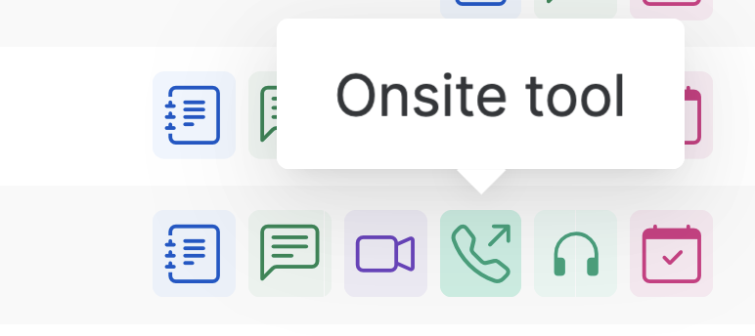
IETF 123 Meeting Tips
This session is being recorded
In-person participants
Make sure to sign into the session via Datatracker or the QR Code in this session.
Use Meetecho (usually the “Meetecho lite”) client to:
join the mic queue
participate in shows of hands
Keep audio and video off if not using the onsite version.
Remote participants
Make sure your audio and video are off unless you are chairing or presenting during a session.
Use of a headset is strongly recommended.

Slide 5
Joint BMWG and IPPM Meeting
Due to the similar topics we wanted to facilitate the exchange and discussions between both working group by having a joint session at IETF 123.
Seeking feedback from both working groups.
Did help to familiarize which topics and documents are being discussed in each others working group?
Would you like to see more such activities?

Slide 6
BMWG charter
The Benchmarking Methodology Working Group (BMWG) will continue to produce a series of recommendations concerning the key performance characteristics of internetworking technologies, or benchmarks for network devices, systems, and services. Taking a view of networking divided into planes, the scope of work includes benchmarks for the management, control, and forwarding planes.
The set of relevant benchmarks will be developed with input from the community of users (network operators and testing organizations) and from those affected by the benchmarks when they are published (networking and test equipment manufacturers).
The scope of the BMWG is limited to the characterization of implementations of various internetworking technologies using controlled stimuli in a laboratory environment. Said differently, the BMWG does not attempt to produce benchmarks for live, operational networks.
Full Charter: https://datatracker.ietf.org/group/bmwg/about/

Slide 7
IPPM charter
The IP Performance Measurement (IPPM) Working Group develops and maintains standard metrics that can be applied to the quality, performance, and reliability of Internet data delivery services and applications running over transport layer protocols (e.g. TCP, UDP) over IP. It also develops and maintains methodologies and protocols for the measurement of these metrics. These metrics, protocols, and methodologies are designed such that they can be used by network operators, end users, or independent testing groups. Metrics developed by the IPPM WG are intended to provide unbiased quantitative performance measurements.
The IPPM WG works to foster commonality and comparability of metrics and measurements across IETF protocols at different layers. Its work is limited to metrics and methodologies which are applicable over transport-layer protocols over IP, and does not specify encapsulations required for measurements over non-IP layers.
Full Charter: https://datatracker.ietf.org/group/ippm/about/

Slide 8
Notetaker
We need a volunteer for notetaking.
https://notes.ietf.org/notes-ietf-123-bmwg-ippm

Slide 9
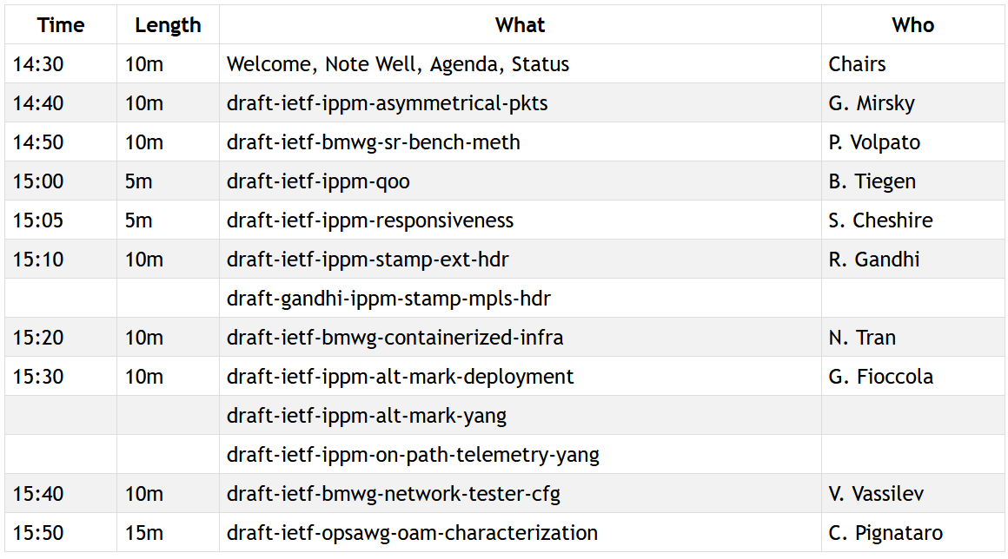
Agenda – Working Group Documents

Slide 10
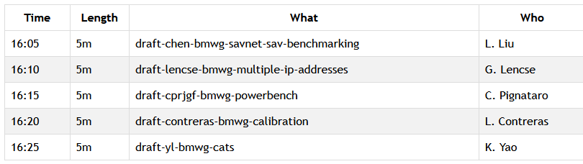
Agenda – Proposed Work

Slide 11
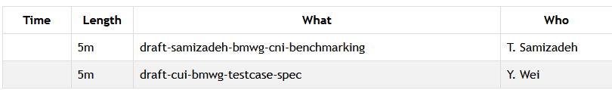
Agenda – If Time Permits

Slide 12
BMWG Document Updates Since IETF 122
draft-ietf-bmwg-mlrsearch to be submitted to IESG for publication
AD Review addressed in the latest version
draft-ietf-bmwg-sr-bench-meth and draft-ietf-bmwg-network-tester-cfg preparing for the WGLC
Milestones to be revised accordingly
draft-cprjgf-bmwg-powerbench, draft-chen-bmwg-savnet-sav-benchmarking and draft-lencse-bmwg-multiple-ip-addresses candidate for adoption
Recent discussion on the mailing list
Proposals keep coming (see https://datatracker.ietf.org/wg/bmwg/documents/)
Some discussion for revisiting BMWG RFCs in order to update RFC 2544

Slide 13
BMWG MLRsearch Update after WGLC
draft-ietf-bmwg-mlrsearch-11 posted on 2025-07-07.
Changes from -10:
Addressed comments and suggestions from IETF AD review.
Big Thanks to Mohamed Boucadair for a very thorough AD review - PDF version with 118 comments and improvement suggestions.
Version -11 with notes and comments per each AD point available in github - kramdown md version.
Most other edits are minor improvements for clarity and general readability inspired by AD review.
Two brand new sections:
1.2. Positioning within BMWG Methodologies – in the Introduction section.
4.1. Scope – in the MLRsearch Specification section.
Resulted from AD review and associated email thread re mlrsearch "positioning” with respect to the existing BMWG specs.
"Revisiting BMWG RFCs” email thread that forked from mlrsearch AD review one:
Larger discussion about potential shortcomings and gaps identified in a selection of BMWG RFCs.
Including requirements language and security considerations boilerplate sections (see AD review comments to mlrsearch).
BMWG next steps
Based on AD decision, move it to IETF LC.
Publish.

Slide 14
IPPM Document Updates Since IETF 122
draft-ietf-ippm-capacity-protocol at IESG
Received reviews from PERFMETRDIR, GENART and OPSDIR
draft-ietf-ippm-asymmetrical-pkts working group last call concluded
Shepherd write-up pending
draft-ietf-ippm-on-path-telemetry-yang working group adopted
Received and addressed a YANGDOCTORS review
draft-ietf-ippm-qoo working group last call in progress
Received and addressed good feedback. Looking forward for more.

Slide 15
Resources for IETF 123 Madrid
Agenda https://datatracker.ietf.org/meeting/agenda
Meetecho and other information: https://www.ietf.org/how/meetings/preparation
If you need technical assistance, see the Reporting Issues page: http://www.ietf.org/how/meetings/issues/

