Slide 1
IETF 125 BMWG & IPPM
19 March 2026
This session is being recorded
Internet Engineering Task Force
© 2026 IETF Trust
Production by Meetecho

Slide 2
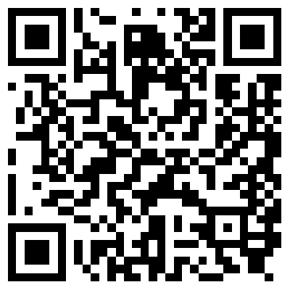
Note Well
By participating in the IETF you agree to follow IETF processes and policies. This Note Well is a reminder of some of those policies. For a linked version of this text, please visit www.ietf.org/note-well or use the QR code below.
IETF participants are expected to behave in a professional manner and extend respect and courtesy to their colleagues at all times (see RFC 7154: IETF Guidelines for Conduct and IETF Anti-Harassment Policy). If you have any concerns about behavior, please contact the Ombudsteam who have a duty of confidentiality and extensive powers to act, as set out in RFC 7776: IETF Anti-Harassment Procedures.
If you are aware that any IETF contribution (as defined in RFC 5378: Rights Contributors Provide to the IETF Trust) is covered by patents or patent applications that are owned or controlled by you, your employer or your sponsor, you must disclose that fact, or not participate in the discussion (see RFC 8179: Intellectual Property Rights in IETF Technology).
For detailed process information consult RFC 2026: Internet Standards Process and RFC 2418: IETF Working Group Guidelines and Procedures and updates to those.
The IETF routinely makes public written, audio, video, and photographic records of IETF activities, including your personal information as set out in the IETF Privacy Statement.
For advice, please talk to Working Group chairs or Area Directors.
Notes:
The IETF Note Well should be shown at the start of every IETF working session. The guidance below is adapted from IETF legal counsel presentation during IETF 120
DO
Do make sure people have enough time to read through the slide before you move on,
Do give a high-level summary of what’s covered in the Note Well: “IETF policies on conduct, privacy and IPR.”,
Do encourage people to read through all the linked policies & documents in detail before participating or contributing,
Do explain where people can direct questions or concerns (IETF Executive Director or Ombudsteam).
DON'T
Don’t dismiss the importance or relevance of any of the information on the Note Well.
Don’t interpret the meaning or get into the substance of any of the topics or content of the policies.
Don’t communicate that the Note Well conveys all the information participants need to know.
Don’t address questions or concerns in the meeting itself.

Slide 3
Note Really Well
IETF meetings, virtual meetings, and mailing lists are intended for professional collaboration and networking, as defined in the IETF Guidelines for Conduct (RFC 7154), the IETF Anti-Harassment Policy, and the IETF Anti-Harassment Procedures (RFC 7776). If you have any concerns about observed behavior, please talk to the Ombudsteam, who are available if you need confidentiality to raise concerns confident about harassment or other conduct in the IETF.
The IETF strives to create and maintain an environment in which people of many different backgrounds and identities are treated with dignity, decency, and respect. Those who participate in the IETF are expected to behave according to professional standards and demonstrate appropriate workplace behavior.
IETF participants must not engage in harassment while at IETF meetings, virtual meetings, social events, or on mailing lists. Harassment is unwelcome hostile or intimidating behavior—in particular, speech or behavior that is aggressive or intimidates.
If you believe you have been harassed, notice that someone else is being harassed, or have any other concerns, you are encouraged to raise your concern in confidence with one of the Ombudspersons.

Slide 4
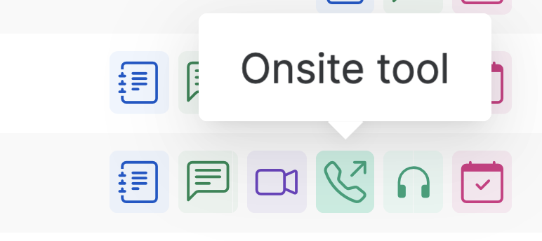
IETF 125 Meeting Tips
This session is being recorded
In-person participants
Make sure to sign into the session via Datatracker or the QR Code in this session.
Use Meetecho (usually the “Meetecho lite”) client to:
join the mic queue
participate in shows of hands
Keep audio and video off if not using the onsite version.
Remote participants
Make sure your audio and video are off unless you are chairing or presenting during a session.
Use of a headset is strongly recommended.

Slide 5
Joint BMWG and IPPM Meeting
Due to similar topics we wanted to facilitate the exchange and discussions between both working groups by having a joint session again and start exploring a joint charter with Qin Wu together.
We reserved 15min time at the end of this session to hear your feedback on cross reviews, having enough time for discussions and newly proposed work and wherever you believe your time was spent well given that this is a joint session.

Slide 6
BMWG charter
The Benchmarking Methodology Working Group (BMWG) will continue to produce a series of recommendations concerning the key performance characteristics of internetworking technologies, or benchmarks for network devices, systems, and services. Taking a view of networking divided into planes, the scope of work includes benchmarks for the management, control, and forwarding planes.
The set of relevant benchmarks will be developed with input from the community of users (network operators and testing organizations) and from those affected by the benchmarks when they are published (networking and test equipment manufacturers).
The scope of the BMWG is limited to the characterization of implementations of various internetworking technologies using controlled stimuli in a laboratory environment. Said differently, the BMWG does not attempt to produce benchmarks for live, operational networks.
Full Charter: https://datatracker.ietf.org/group/bmwg/about/

Slide 7
IPPM charter
The IP Performance Measurement (IPPM) Working Group develops and maintains standard metrics that can be applied to the quality, performance, and reliability of Internet data delivery services and applications running over transport layer protocols (e.g. TCP, UDP) over IP. It also develops and maintains methodologies and protocols for the measurement of these metrics. These metrics, protocols, and methodologies are designed such that they can be used by network operators, end users, or independent testing groups. Metrics developed by the IPPM WG are intended to provide unbiased quantitative performance measurements.
The IPPM WG works to foster commonality and comparability of metrics and measurements across IETF protocols at different layers. Its work is limited to metrics and methodologies which are applicable over transport-layer protocols over IP, and does not specify encapsulations required for measurements over non-IP layers.
Full Charter: https://datatracker.ietf.org/group/ippm/about/

Slide 8
Notetaker
We need a volunteer for notetaking.
https://notes.ietf.org/notes-ietf-125-bmwg-ippm

Slide 9
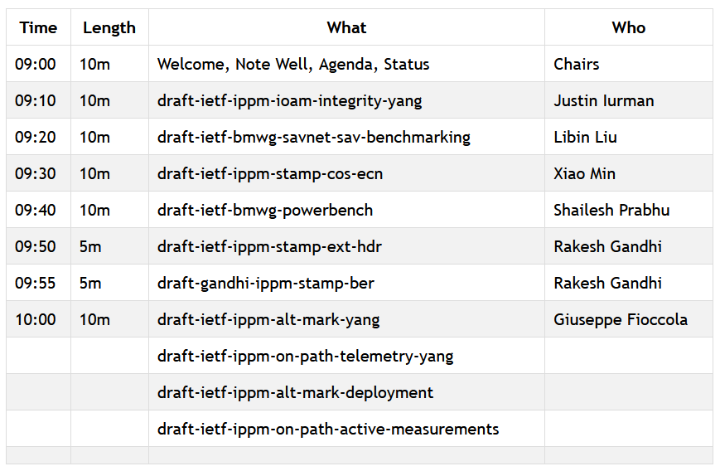
Agenda – Working Group Documents

Slide 10
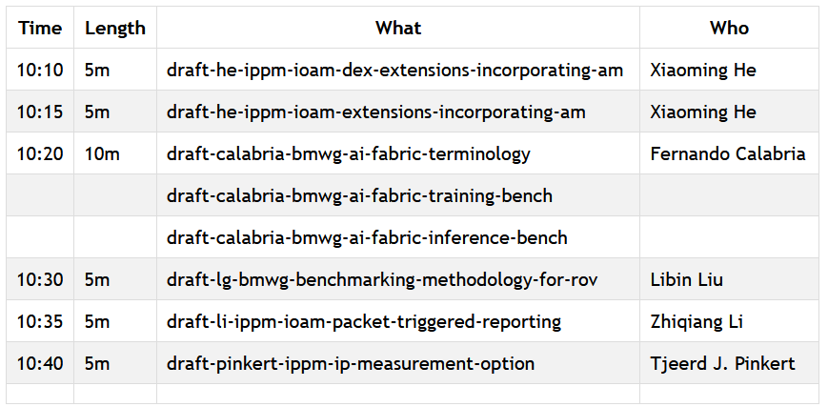
Agenda – Proposed Work

Slide 11
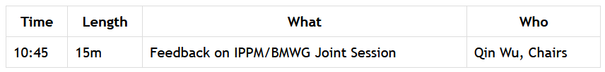
Joint Session Feedback
We will raise the following questions to gather your feedback to help with the session planning and understanding the usefulness of the joint sessions.
Was there enough time for discussions?
For your interested topics, was the time well spent?
Should we allocate more time to proposed work?
Did you cross review one or more documents?

Slide 12
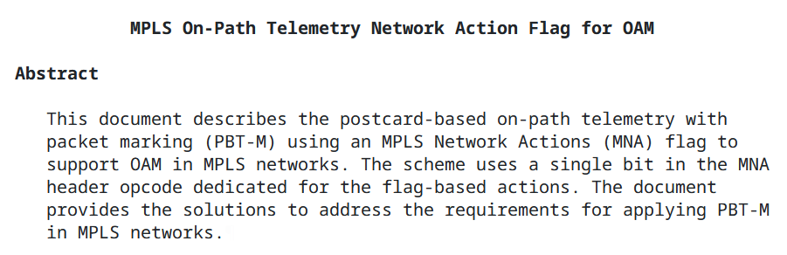
draft-song-mpls-on-path-telemetry-flag MPLS/IPPM/BMWG Joint Adoption Call
We need feedback from the IPPM and BMWG community.
Please review the document and comment on the adoption call:
https://mailarchive.ietf.org/arch/msg/ippm/EhSNZ0ndecsyflNhu31ing8ijzA/

Slide 13
BMWG Document Updates Since IETF 124
draft-ietf-bmwg-mlrsearch in RFC Ed Queue
draft-ietf-bmwg-network-tester-cfg passed WGLC
New revision in preparation to address the Yangdoctors review
draft-ietf-bmwg-sr-bench-meth passed WGLC
draft-ietf-bmwg-savnet-sav-benchmarking and draft-ietf-bmwg-powerbench adopted
To resume the discussion for revisiting BMWG RFCs in order to update RFC 2544
Rechartering to include new work on AI (either for a joint future with IPPM or separately)

Slide 14
draft-ietf-bmwg-sr-bench-meth: Recap
WGLC issued, cross posted to IPPM, SPRING, SRv6OPS.
Overall good support from BMWG.
Comments will be incorporated just after IETF 125:
Section 4.3 (Frame Formats and Sizes): Reword to clarify that “Fragmentation of IPv4 packet” is “out of scope”.
Section 4.4 (Protocol Addresses): add an explicit MUST-report item in Section 5 (Reporting Format) indicating which fields are used as the hashing keys for ECMP and how traffic streams are randomized.
Section 4.5 (Trial Duration): Remove duplicated text around hold-time considerations.
Thanks to all who supported the work!

Slide 15
IPPM Document Updates Since IETF 124
draft-ietf-ippm-asymmetrical-pkts received IESG comments which were addressed in -13.
draft-ietf-ippm-qoo-07 received reviews from TSVART, ARTART, SECDIR and GENART. Authors are currently working on addressing the comments.
draft-ietf-ippm-ioam-integrity-yang-05 working group last call currently running. We need more feedback from both working groups and want to progress draft-ietf-ippm-ioam-data-integrity and draft-ietf-ippm-ioam-integrity-yang at the same time through IESG.
draft-ietf-ippm-encrypted-pdmv2 authors published -13 and intend to reach-out to the TSVART and GENART reviewers to clarify wherever the document update addressed their comments and request feedback from IPPM/BMWG/6MAN.

Slide 16
Resources for IETF 125 Shenzhen
Agenda https://datatracker.ietf.org/meeting/agenda
Meetecho and other information: https://www.ietf.org/how/meetings/preparation
If you need technical assistance, see the Reporting Issues page: http://www.ietf.org/how/meetings/issues/

