Slide 1
IETF 126 BMWG & IPPM (1)
22 July 2026
This session is being recorded
Internet Engineering Task Force
© 2026 IETF Trust
Production by Meetecho

Slide 2
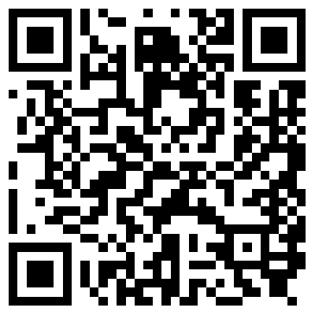
Note Well
By participating in the IETF you agree to follow IETF processes and policies. This Note Well is a reminder of some of those policies. For a linked version of this text, please visit www.ietf.org/note-well or use the QR code below.
IETF participants are expected to behave in a professional manner and extend respect and courtesy to their colleagues at all times (see RFC 7154: IETF Guidelines for Conduct and IETF Anti-Harassment Policy). If you have any concerns about behavior, please contact the Ombudsteam who have a duty of confidentiality and extensive powers to act, as set out in RFC 7776: IETF Anti-Harassment Procedures.
If you are aware that any IETF contribution (as defined in RFC 5378: Rights Contributors Provide to the IETF Trust) is covered by patents or patent applications that are owned or controlled by you, your employer or your sponsor, you must disclose that fact, or not participate in the discussion (see RFC 8179: Intellectual Property Rights in IETF Technology).
For detailed process information consult RFC 2026: Internet Standards Process and RFC 2418: IETF Working Group Guidelines and Procedures and updates to those.
The IETF routinely makes public written, audio, video, and photographic records of IETF activities, including your personal information as set out in the IETF Privacy Statement.
For advice, please talk to Working Group chairs or Area Directors.
Notes:
The IETF Note Well should be shown at the start of every IETF working session. The guidance below is adapted from IETF legal counsel presentation during IETF 120
DO
Do make sure people have enough time to read through the slide before you move on,
Do give a high-level summary of what’s covered in the Note Well: “IETF policies on conduct, privacy and IPR.”,
Do encourage people to read through all the linked policies & documents in detail before participating or contributing,
Do explain where people can direct questions or concerns (IETF Executive Director or Ombudsteam).
DON'T
Don’t dismiss the importance or relevance of any of the information on the Note Well.
Don’t interpret the meaning or get into the substance of any of the topics or content of the policies.
Don’t communicate that the Note Well conveys all the information participants need to know.
Don’t address questions or concerns in the meeting itself.

Slide 3
Note Really Well
IETF meetings, virtual meetings, and mailing lists are intended for professional collaboration and networking, as defined in the IETF Guidelines for Conduct (RFC 7154), the IETF Anti-Harassment Policy, and the IETF Anti-Harassment Procedures (RFC 7776). If you have any concerns about observed behavior, please talk to the Ombudsteam, who are available if you need confidentiality to raise concerns confident about harassment or other conduct in the IETF.
The IETF strives to create and maintain an environment in which people of many different backgrounds and identities are treated with dignity, decency, and respect. Those who participate in the IETF are expected to behave according to professional standards and demonstrate appropriate workplace behavior.
IETF participants must not engage in harassment while at IETF meetings, virtual meetings, social events, or on mailing lists. Harassment is unwelcome hostile or intimidating behavior—in particular, speech or behavior that is aggressive or intimidates.
If you believe you have been harassed, notice that someone else is being harassed, or have any other concerns, you are encouraged to raise your concern in confidence with one of the Ombudspersons.

Slide 4
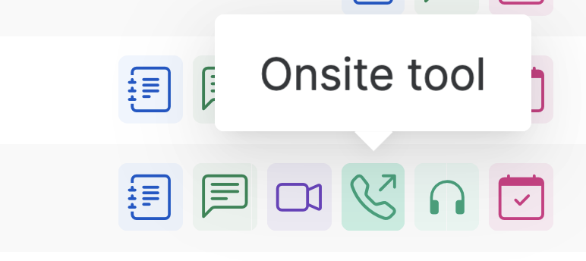
IETF 126 Meeting Tips
This session is being recorded
In-person participants
Make sure to sign into the session via Datatracker or the QR Code in this session.
Use Meetecho (usually the “Meetecho lite”) client to:
join the mic queue
participate in shows of hands
Keep audio and video off if not using the onsite version.
Remote participants
Make sure your audio and video are off unless you are chairing or presenting during a session.
Use of a headset is strongly recommended.

Slide 5
BMWG charter
The Benchmarking Methodology Working Group (BMWG) will continue to produce a series of recommendations concerning the key performance characteristics of internetworking technologies, or benchmarks for network devices, systems, and services. Taking a view of networking divided into planes, the scope of work includes benchmarks for the management, control, and forwarding planes.
The set of relevant benchmarks will be developed with input from the community of users (network operators and testing organizations) and from those affected by the benchmarks when they are published (networking and test equipment manufacturers).
The scope of the BMWG is limited to the characterization of implementations of various internetworking technologies using controlled stimuli in a laboratory environment. Said differently, the BMWG does not attempt to produce benchmarks for live, operational networks.
Full Charter: https://datatracker.ietf.org/group/bmwg/about/

Slide 6
IPPM charter
The IP Performance Measurement (IPPM) Working Group develops and maintains standard metrics that can be applied to the quality, performance, and reliability of Internet data delivery services and applications running over transport layer protocols (e.g. TCP, UDP) over IP. It also develops and maintains methodologies and protocols for the measurement of these metrics. These metrics, protocols, and methodologies are designed such that they can be used by network operators, end users, or independent testing groups. Metrics developed by the IPPM WG are intended to provide unbiased quantitative performance measurements.
The IPPM WG works to foster commonality and comparability of metrics and measurements across IETF protocols at different layers. Its work is limited to metrics and methodologies which are applicable over transport-layer protocols over IP, and does not specify encapsulations required for measurements over non-IP layers.
Full Charter: https://datatracker.ietf.org/group/ippm/about/

Slide 7
Notetaker
We need a volunteer for notetaking.
https://notes.ietf.org/notes-ietf-126-bmwg-ippm

Slide 8
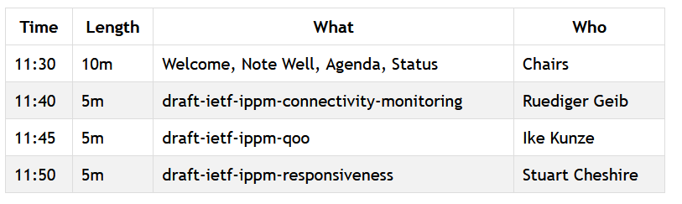
Agenda – Working Group Documents

Slide 9
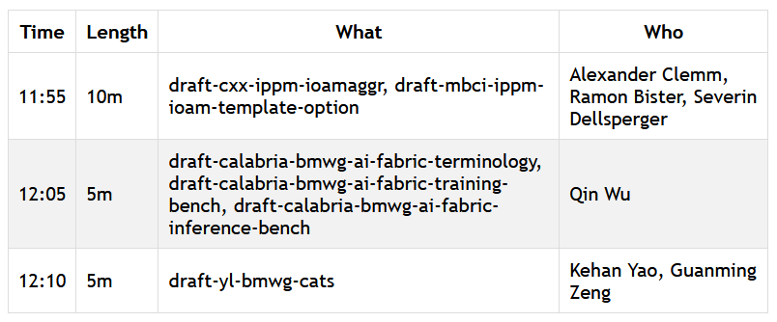
Agenda – Proposed Work

Slide 10
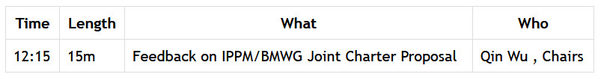
Joint Charter Discussion
We reserved 20min time at the end of this session where we discuss with Qin Wu together your feedback and comments on the proposed joint charter https://github.com/ietf-ippm/wg-charter/blob/main/ippm-bmwg-joint.md and deciding the name of the joint working group.

Slide 11
BMWG Document Updates Since IETF 125
draft-ietf-bmwg-sr-bench-meth Submitted to IESG for Publication. Received AD review. Awaiting reviews from RTGDIR and PERFMETRDIR.
draft-ietf-bmwg-network-tester-cfg RFC Ed Queue
draft-ietf-bmwg-mlrsearch in RFC Ed Queue

Slide 12
IPPM Document Updates Since IETF 125
draft-ietf-ippm-connectivity-monitoring-13, parked document (on agenda today)
draft-ietf-ippm-qoo-11, RFC Ed Queue, (on agenda today)
draft-ietf-ippm-hybrid-two-step-06, AD review received
draft-ietf-ippm-stamp-ext-hdr-11 WGLC concluded, waiting for shepherd writeup
draft-ietf-ippm-alt-mark-deployment-07 and draft-ietf-ippm-alt-mark-yang-04 in WGLC (on agenda tomorrow)
draft-ietf-ippm-asymmetrical-pkts-14, RFC Ed Queue
draft-ietf-ippm-ioam-data-integrity-19, IESG Evaluation
draft-ietf-ippm-ioam-integrity-yang-08, Submitted to IESG for Publication

Slide 13
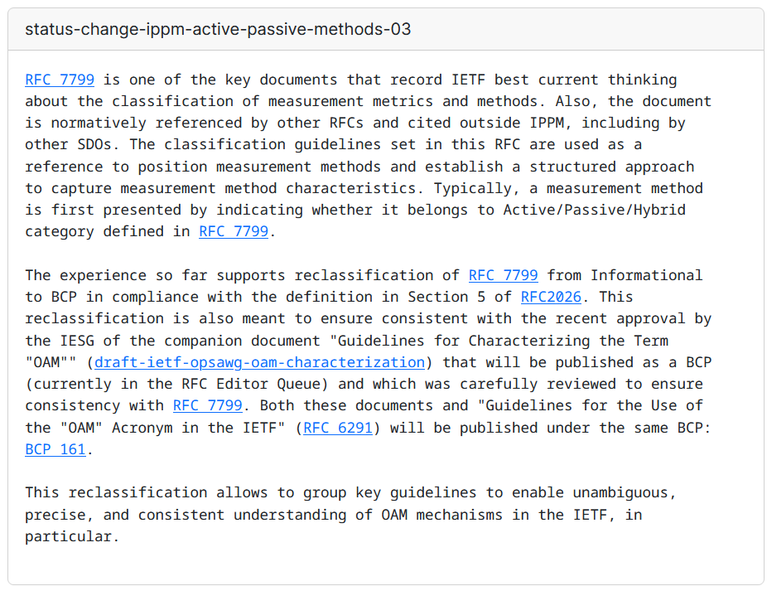
RFC 7799bis
RFC 7799 is well established, widely used, referenced, and has been considered for being BCP 161 (Best Common Practice) together with RFC 6291 and RFC 10014.
At the IESG last call, the proposal received the feedback that since it is already 10years old, a refresh would be appreciated. Giuseppe has taken the initiative and published draft-fioccola-ippm-rfc7799bis (many thanks!).
Please review and comment on the mailing list on the following thread: https://mailarchive.ietf.org/arch/msg/ippm/mLhjuga9b-gGYs91mSmfdqA1VP8/.
We are looking forward to initiate working group adoption call.
https://datatracker.ietf.org/doc/status-change-ippm-active-passive-methods/

Slide 14
Resources for IETF 126 Vienna
Agenda https://datatracker.ietf.org/meeting/agenda
Meetecho and other information: https://www.ietf.org/how/meetings/preparation
If you need technical assistance, see the Reporting Issues page: http://www.ietf.org/how/meetings/issues/

