Slide 1
BMWG & IPPM interim-2025-01
20 November 2025
This session is being recorded
Internet Engineering Task Force
© 2025 IETF Trust
Production by Meetecho

Slide 2
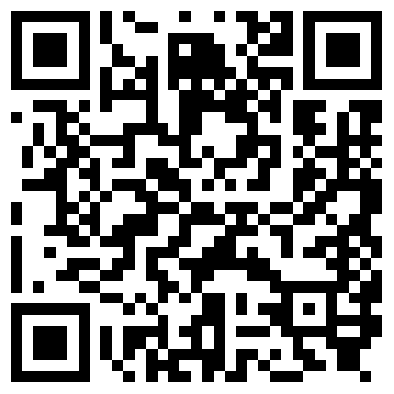
Note Well
By participating in the IETF you agree to follow IETF processes and policies. This Note Well is a reminder
of some of those policies. For a linked version of this text, please visit www.ietf.org/note-well or use the QR code below.
IETF participants are expected to behave in a professional manner and extend respect and courtesy to their colleagues at all times (see RFC 7154: IETF Guidelines for Conduct and IETF Anti-Harassment Policy). If you have any concerns about behavior, please contact the Ombudsteam who have a duty of confidentiality and extensive powers to act, as set out in RFC 7776: IETF Anti-Harassment Procedures.
If you are aware that any IETF contribution (as defined in RFC 5378: Rights Contributors Provide to the IETF Trust) is covered by patents or patent applications that are owned or controlled by you, your employer or your sponsor, you must disclose that fact, or not participate in the discussion
(see RFC 8179: Intellectual Property Rights in IETF Technology).
For detailed process information consult RFC 2026: Internet Standards Process and
RFC 2418: IETF Working Group Guidelines and Procedures and updates to those.
The IETF routinely makes public written, audio, video, and photographic records
of IETF activities, including your personal information as set out in the IETF Privacy Statement.
For advice, please talk to Working Group chairs or Area Directors.
Notes:
The IETF Note Well should be shown at the start of every IETF working session. The guidance below is adapted from IETF legal counsel presentation during IETF 120
DO
Do make sure people have enough time to read through the slide before you move on,
Do give a high-level summary of what’s covered in the Note Well: “IETF policies on conduct, privacy and IPR.”,
Do encourage people to read through all the linked policies & documents in detail before participating or contributing,
Do explain where people can direct questions or concerns (IETF Executive Director or Ombudsteam).
DON'T
Don’t dismiss the importance or relevance of any of the information on the Note Well.
Don’t interpret the meaning or get into the substance of any of the topics or content of the policies.
Don’t communicate that the Note Well conveys all the information participants need to know.
Don’t address questions or concerns in the meeting itself.

Slide 3
IETF interim-2025-01 Meeting Tips
This session is being recorded
Remote participants
Make sure your audio and video are off unless you are chairing or presenting during a session.
Use of a headset is strongly recommended.

Slide 4
Joint BMWG and IPPM Meeting
Due to similar topics we wanted to facilitate the exchange and discussions between both working groups by having a joint session again and start exploring a joint charter with Qin Wu.
Qin presented the rationale for joint chartering at IETF 124. Since then we have collected feedback from participants of both working groups.
At the end of this meeting Qin will present the current status of the ongoing discussions.

Slide 5
BMWG charter
The Benchmarking Methodology Working Group (BMWG) will continue to produce a series of recommendations concerning the key performance characteristics of internetworking technologies, or benchmarks for network devices, systems, and services. Taking a view of networking divided into planes, the scope of work includes benchmarks for the management, control, and forwarding planes.
The set of relevant benchmarks will be developed with input from the community of users (network operators and testing organizations) and from those affected by the benchmarks when they are published (networking and test equipment manufacturers).
The scope of the BMWG is limited to the characterization of implementations of various internetworking technologies using controlled stimuli in a laboratory environment. Said differently, the BMWG does not attempt to produce benchmarks for live, operational networks.
Full Charter: https://datatracker.ietf.org/group/bmwg/about/

Slide 6
IPPM charter
The IP Performance Measurement (IPPM) Working Group develops and maintains standard metrics that can be applied to the quality, performance, and reliability of Internet data delivery services and applications running over transport layer protocols (e.g. TCP, UDP) over IP. It also develops and maintains methodologies and protocols for the measurement of these metrics. These metrics, protocols, and methodologies are designed such that they can be used by network operators, end users, or independent testing groups. Metrics developed by the IPPM WG are intended to provide unbiased quantitative performance measurements.
The IPPM WG works to foster commonality and comparability of metrics and measurements across IETF protocols at different layers. Its work is limited to metrics and methodologies which are applicable over transport-layer protocols over IP, and does not specify encapsulations required for measurements over non-IP layers.
Full Charter: https://datatracker.ietf.org/group/ippm/about/

Slide 7
Notetaker
We need a volunteer for notetaking.
https://notes.ietf.org/notes-ietf-interim-2025-ippm-01-ippm

Slide 8
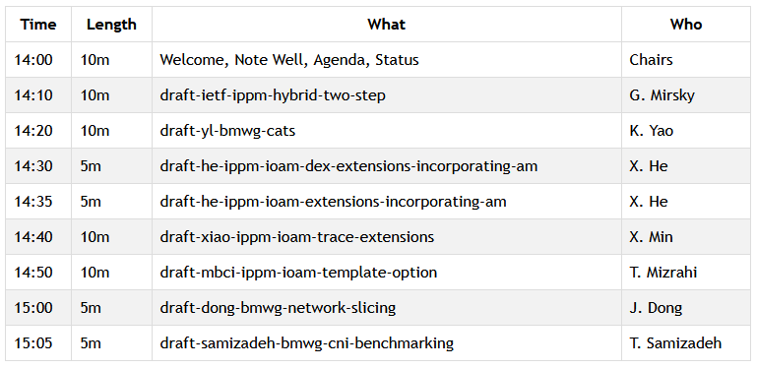
Agenda – Proposed Work

Slide 9

Joint Chartering Discussion

Slide 10
BMWG and IPPM Document Updates
BMWG
draft-ietf-bmwg-mlrsearch submitted to IESG for publication.
draft-ietf-bmwg-network-tester-cfg passed WGLC but a new revision is needed to address the Yangdoctors review.
draft-ietf-bmwg-sr-bench-meth preparing for the WGLC.
draft-ietf-bmwg-powerbench just adopted.
Resumed the discussion for revisiting BMWG RFCs in order to update RFC 2544.
IPPM
draft-ietf-ippm-capacity-protocol approved by IESG.
draft-ietf-ippm-asymmetrical-pkts and draft-ietf-ippm-hybrid-two-step has been passed on to IESG.
draft-ietf-ippm-hybrid-two-step received OPS AD review.
draft-ietf-ippm-qoo publication request.
draft-iuzh-ippm-ioam-integrity-yang adoption call is currently running.

Slide 11
Resources for interim-2025-01
Agenda
https://datatracker.ietf.org/meeting/interim-2025-ippm-01/session/ippm
Meetecho and other information:
https://www.ietf.org/how/meetings/preparation
If you need technical assistance, see the Reporting Issues page:
http://www.ietf.org/how/meetings/issues/

