Slide 1

NASR Interim Meeting Network Attestation for Secured foRwarding
26 February 2025
This Session is Recorded

Slide 2
Agenda
Nancy & Luigi: Meeting opening
Any Comment on last meeting minutes?
Initial Discussion on Slides for IETF 122 (All)
https://drive.google.com/drive/u/1/folders/1IZrVA9WWIdra-pZ9mY3uJW0mADzTUxf4

Slide 3
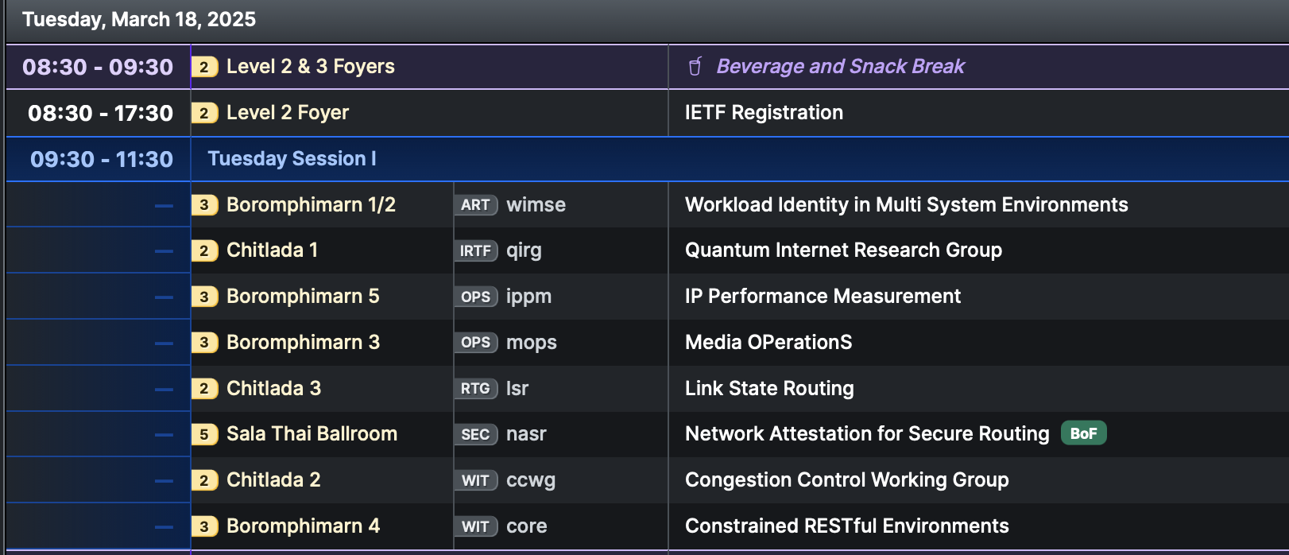

Next Meeting
See you in Bangkok
Minutes and recording to be posted on github!

