Slide 1
RATS Architecture Design Team
Status and Walkthrough
WHO:
Henk Birholz(*)
Thomas Fossati
Andrew Guinn
Thomas Hardjono
Sarah C. Helble
Xinxin Fan IoTeX
Eliot Lear
Peter Loscocco
Laurence Lundblade
Nicolae PALADI
Wei (William) Pan(*-new)
Michael Richardson(*)
Paul Rowe
Ned Smith(*)
Dave Thaler(*)
Akura Tsukamoto
Eric Voit
Monty Wiseman
Ling (Frank) Xia
WHEN: Tuesdays 10am EST. (+ a few Fridays/adhoc)
eight meetings since IETF108
ISSUES: 159 total
2 issues open, 1 wontfix
Pull requests:
104 pull requests closed
(*)-listed author
DONE? DONE? DONE?

Slide 2
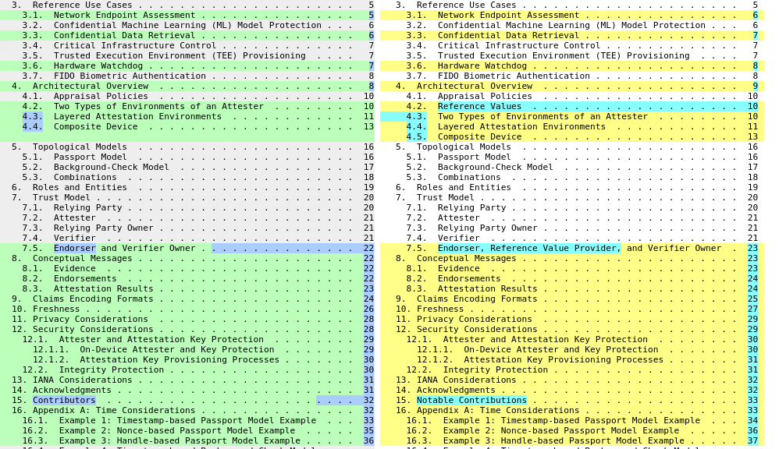
Major changes in -07

Slide 3
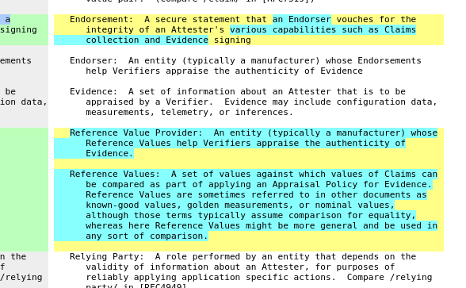
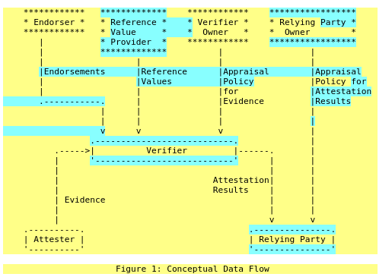
Reference Values

Slide 4
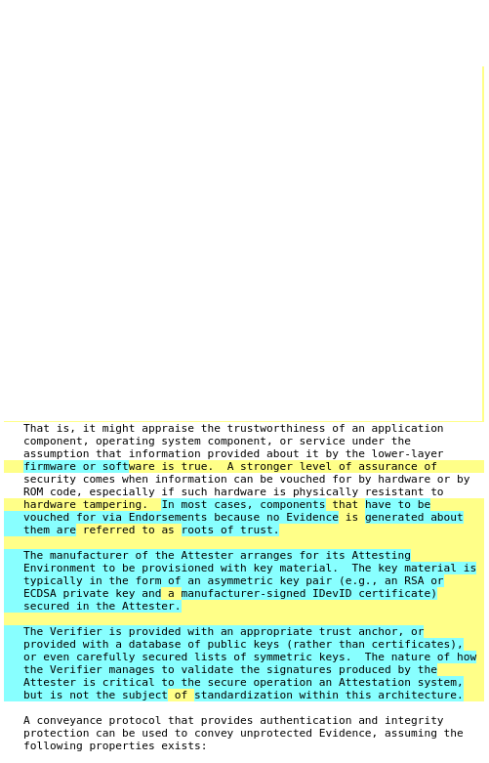
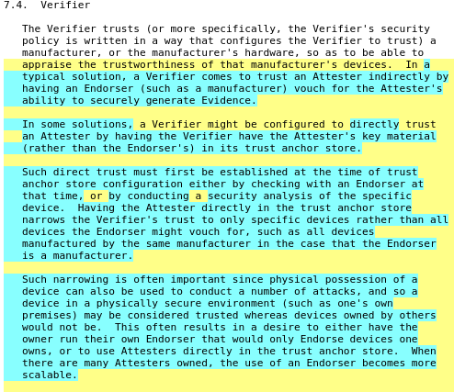
About the Verifier

Slide 5
Freshness and other edits
https://www.ietf.org/rfcdiff?url1=draft-ietf-rats-architecture-06&url2=draft-ietf-rats-architecture-07

Slide 6
Questions
Discussion

