Slide 1
RATS Architecture Design Team
Status and Walkthrough
WHO:
Henk Birholz(*)
Thomas Fossati
Yogesh Deshpande
Andrew Guinn
Thomas Hardjono
Sarah C. Helble
Xinxin Fan IoTeX
Eliot Lear
Peter Loscocco
Laurence Lundblade
Nicolae Paladi
Wei (William) Pan(*)
Michael Richardson(*)
Paul Rowe
Ned Smith(*)
Dave Thaler(*)
Akura Tsukamoto
Eric Voit
Monty Wiseman
Ling (Frank) Xia
Penglin Yang
WHEN: Tuesdays 10am EST.
four meetings since IETF113
ISSUES: 9 total since IETF113
a few issues open
Pull requests:
12 pull requests
processed AD review comments
now on round two of comments
(*)-listed author

Slide 2
Minor changes since IETF113
AD review comments
Beautiful SVG
Adjustments to terminology
Integrity Protection -> Conceptual Message Protection

Slide 3
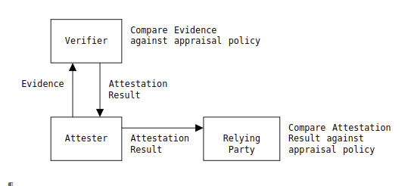
AD comments: produce/consume #1
The Attester does not consume the Attestation Result, but might cache it.
The Attester can then present the Attestation Result (and possibly additional Claims) to a Relying Party, which then compares this information against its own appraisal policy.
The Attester may also present the same Attestation Result to other Relying Parties.
data forwarded,
may be cached,
additional claims possible
Attestation Results and Evidence are signed, and can not modified!

Slide 4
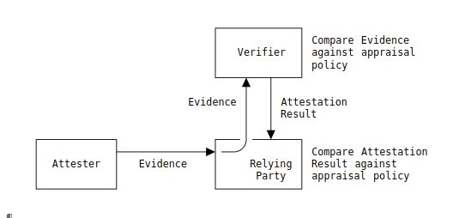
AD comments: consume/produce #2
data passes
through, may be
cached
In this model, an Attester conveys Evidence to a Relying Party, which treats it as opaque and simply forwards it on to a Verifier.
The Verifier compares the Evidence against its appraisal policy, and returns an Attestation Result to the Relying Party.
The Relying Party then compares the Attestation Result against its own appraisal policy.
The resource access protocol between the Attester and Relying Party includes Evidence rather than an Attestation Result, but that Evidence is not processed by the Relying Party.
Attestation Results and Evidence are signed, and can not modified!

Slide 5
Questions
Discussion

