Slide 1
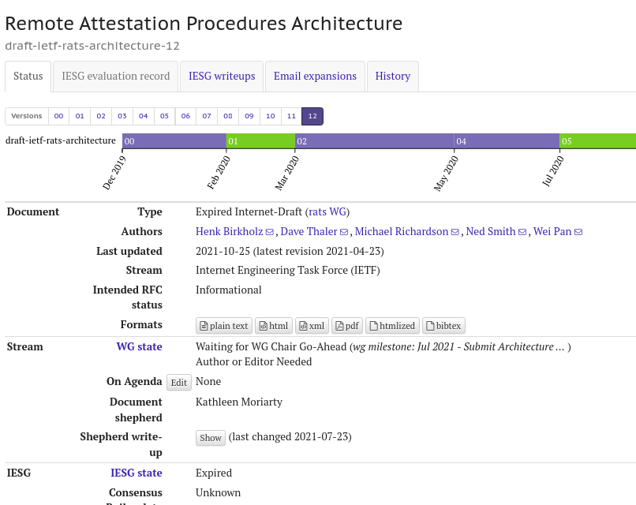
RATS Architecture Status: no change since April

Slide 2
Questions
Discussion

