Slide 1
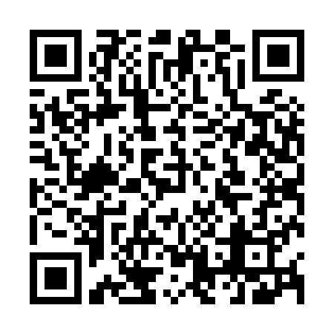
Use cases for RATS WG for IETF104, Prague. March 28, 2019 draft-richardson-rats-usecases-01
Authors:
Michael Richardson (Sandelman)
mcr+ietf@sandelman.ca

Slide 2
History of Document
Initial -00 (minutes before deadline)
-01 posted this week
personal submission
Intended status:
not published as RFC!!!
for WG internal use
Maybe: publish as appendix of some TBD document.
Looking for new additions.
I prefer to talk to you (voice, in person) and paraphrase
rather than read your confidential document.
ALMOST 100% certain I got at least three things completely backwards
Not a member/expert
on any of the industry
groups.
Aiming for no bias,
seeking common
components

Slide 3
The document so far
Trusted Computing Group (TCG)
  Current summary based upon prepublication Work-in-Progress document
  “The proposal is intended to provide an assurance to a network operator that the equipment on their network can be reliably identified”
Android Keystore
  Had difficulty finding any kind of attestion service
    Educate me!
  Clearly offers crypto offload and a TEEP-like service.
  “A great deal of focus from the Android Keystore seems to be on providing fine-grained authorization of what keys can be used by which applications.”
FIDO
  Fast IDentity Online
  Spec has moved to W3C: https://www.w3.org/TR/webauthn-1/
  “This specification is very much focused on authenticating user from devices with
  humans attached to them.”
    No more passwords
Insert Yours Here

Slide 4
Discussion
?

