Slide 1
Use cases for RATS WG for IETF105, Montreal. July 24, 2019 draft-richardson-rats-usecases-03
Authors:
Michael Richardson (Sandelman)
mcr+ietf@sandelman.ca
Carl Wallace (Red Hound Software)
Wei Pan (Huawei Technologies)

Slide 2
The next twenty minutes (or so)
How we got here
Where we are
Where is it going?
Discussion
An end goal vision

Slide 3
History of Document
Initial -00 (minutes before deadline)
-01 posted this week
-03 posted just before virtual interim
-04 posted on Tuesday
personal submission
Intended status:
not published as RFC!!!
for WG internal use
Maybe: publish as appendix of some TBD document.
Looking for new additions.
I prefer to talk to you (voice, in person) and paraphrase
rather than read your confidential document.
ALMOST 100% certain I got at least three things completely backwards

Slide 4
The document so far
~13 use cases
~4 categories
  Device Capabilities/Firmware
  Cryptographic Key
  Geographic
  Connectivity
A survey of identified users
  Trusted Computing Group
  FIDO (Fast IDentity Online)
  Android Keystore
Examples from existing systems
  Android Keystore
  Windows 10 TPM
  Yubikey
Do we want
examples?
Do we want
So many details?

Slide 5
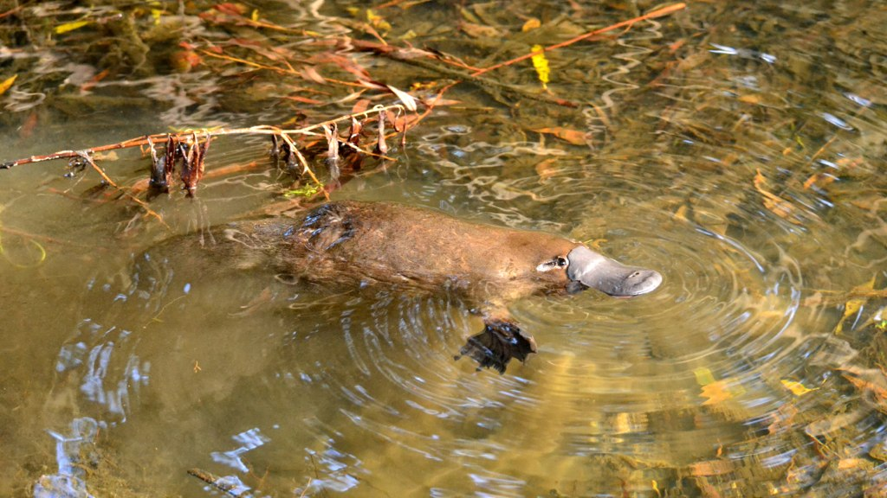
Where is it going?
Add new ideas/claims
  Dr. Ian Oliver has three:
    Supply Chain,
    Dynamic Systems
    Data (Calibration?)
I will be quite liberal in what is accepted. I prefer to
  take text/ideas
  get agreement that it accurately describes situation
  Then.. argue about whether or not it is unique
Sort ideas by different dimensions
  Jessica Fitzgerald-McKay has proposed
    Information that is being attested to
    Geographic
    connectivity
  Other dimensions welcome!
Categories are useful as primary keys for designing solutions, but this is not an ontology.
  Remember the platypus!
description
New section
In document
Arguments
About
uniqueness
Clarifying
questions
By Klaus - Flickr: Wild Platypus 4, CC BY-SA 2.0, https://commons.wikimedia.org/w/index.php?curid=32551315

Slide 6
Discussion
?

Slide 7
Final vision for document
Use case name: Twelve Monkeys
Who will use it: Army of the Twelve Monkeys SDO
Attesting Party: James Cole
Relying Party: Dr. Kathryn Reilly
Description: James Cole must convince Dr. Reilly he is from the future, and not insane.
Claims used:
  OEM Identity
  Age Claim
  Location Claim
  Uptime Claim

