Slide 1
Attestation Results for Secure Interactions
draft-voit-rats-attestation-results
Eric Voit
Cisco
evoit@cisco.com
Henk Birkholz Fraunhofer SIT
henk.birkholz@sit.fraunhofer.de
Thomas Hardjono
MIT
hardjono@mit.edu
Thomas Fossati
Arm Limited
Thomas.Fossati@arm.com
Vincent Scarlata Intel
vincent.r.scarlata@intel.com

Slide 2
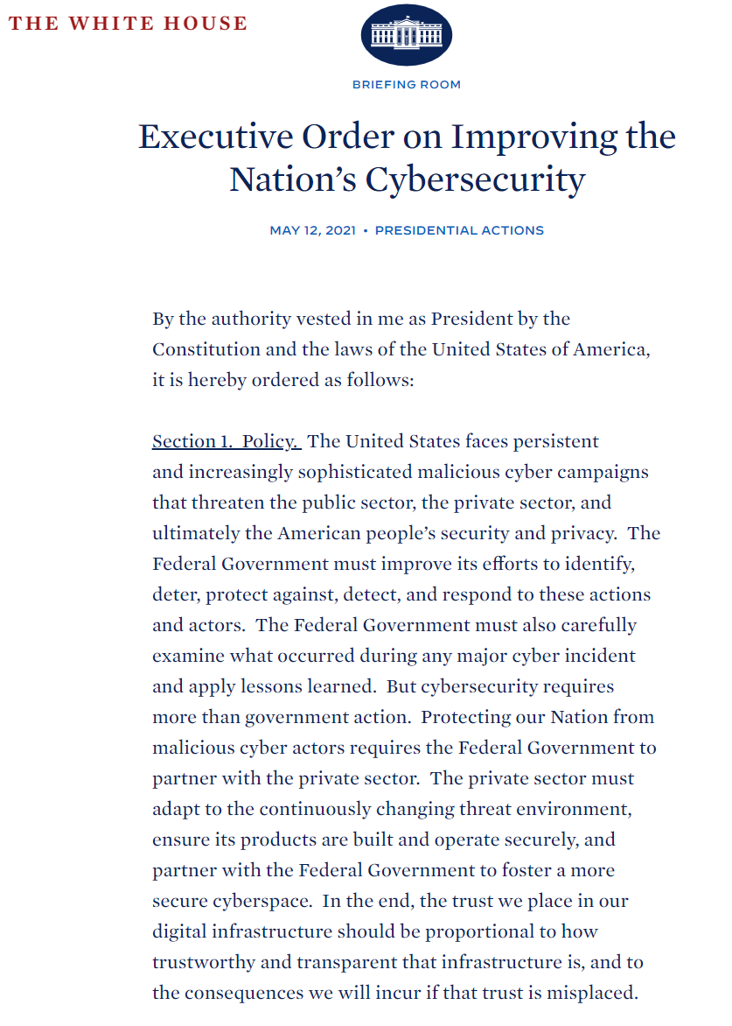
In the end, the trust we place in our digital infrastructure should be proportional to how trustworthy and transparent that infrastructure is.

Slide 3






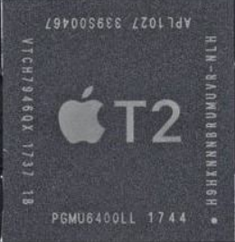


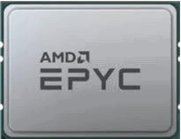






Remote Attestation in a Heterogenous World
Attesting
Environment
Confidential compute in an umbrella term
Confidentiality of Code & Data
Integrity of Code & Data
Identity of Code
Confidentiality of Execution
I trust you
Application
attestation
Support varies by chip type
(and implicitly all of them)
Opaque clusters of networked TEE
Secured meshes will span from Local Host through Cloud
Attest security posture & peer identity
Mesh a mix and match of TEE types across L1 ↔ L7 platforms

Slide 4

Categorizing Confidential Compute
Value proposition
Deny visibility to rogue
Application Data
Homomorphic Encryption
(future?)
CPU
Process can’t expose unencrypted objects
Application developer
Process
Process
Each process runs and saves opaquely
SGX, TrustZone
Guest VM
(or container)
Guest VM Operator or
privileged process
Guest VM
(or container)
VM operates as a Walled Garden
SEV, TDX, ACCA, SEV-SNP
Peer guest VM
VM Manager
VM orchestration
Host root admin or
privileged process
Host OS
Attester
Hardware Security Module (HSM)
can’t lie about security measurements
TPM2

Slide 5
Built upon IETF’s draft-ietf-rats-architecture
+------------+
| | Compare Evidence
| Verifier | against appraisal policy
| |
+------------+
^ |
Evidence | | Attestation
| | Result
| v
+------------+ +-------------+
| |------------->| | Compare Attestation
| Attester | Attestation | Relying | Result against
| | Result | Party | appraisal policy
+------------+ +-------------+
Passport Model

Slide 6
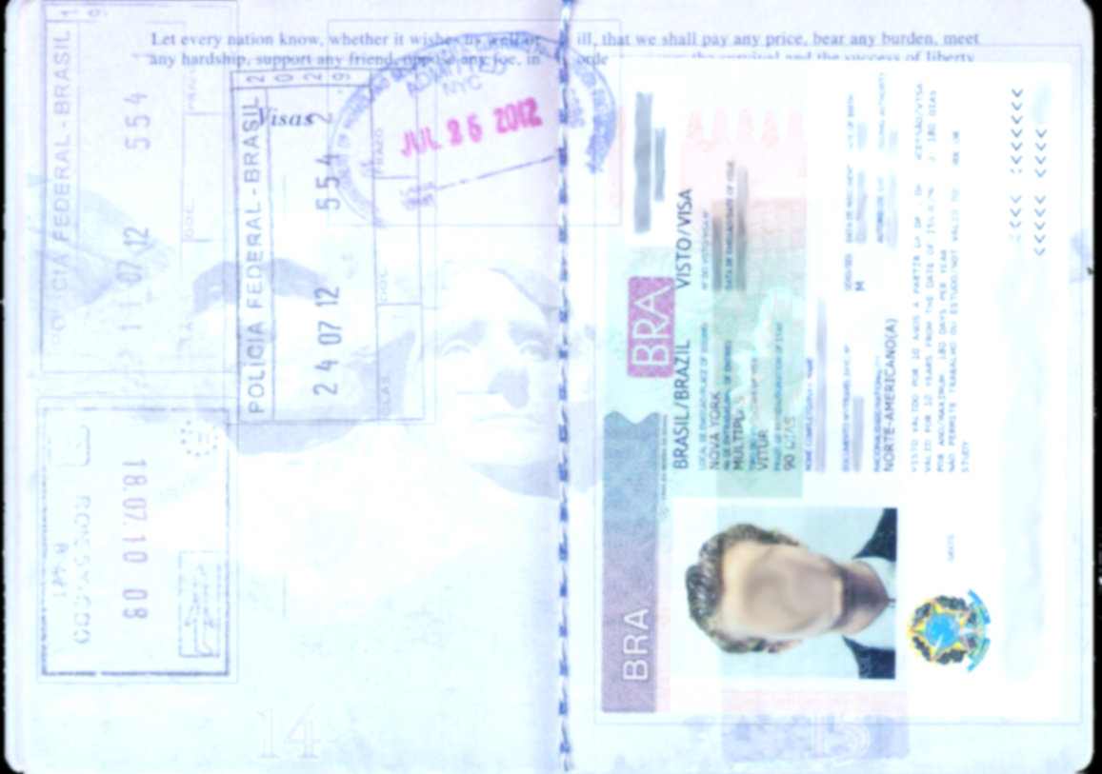
Built upon IETF’s draft-ietf-rats-architecture
Verifier A
Verifier
Signature
target environment
hw-authentic
executables-verified
Attesting
Environment
Signature
secure-storage
runtime-confidential
timestamp
Attestation Result (AR)
target environment
Relying Party (Verifier B)
Evidence
Attester
Identity
is Verifier A known & trusted ?
is Attester on Accept-List ?
Trustworthiness Claims
what did Verifier A conclude ?
Freshness
is this Evidence recent ?
nonce
Attesting Environment
Verifier
Signature
Attesting
Environment
Signature
target environment
hw-authentic
nonce
executables-verified
secure-storage
runtime-confidential
timestamp
AR Augmented Evidence

Slide 7
Attestation Results Augmented Evidence a.k.a.: Things which the Relying Party might Action
Verifier
Signature
Attesting
Environment
Signature
target environment
hw-authentic
nonce
executables-verified
secure-storage
runtime-confidential
timestamp
Verified Identity instance(s)
+
Trustworthiness Claims of the Verifier
+
Verifiable Freshness
Attester | chip vendor
 | chip type
 | target environment
Software Bill of Materials | target developer
 | ae instance
Verifier | verifier id
Identity | Attesting Environment | ae-instance-recognized
 |  | ae-instance-unknown
Integrity | Hardware | hw-authentic
 |  | hw-verification-fail
 | Files | executables-verified
 |  | executables-refuted
 |  | file-system-anomaly
 |  | source-data-integrity
 | Config | config-secure
 |  | config-insecure
Confidentiality | Target Environment | target-isolation
 |  | runtime-confidential
 | Data | secure-storage
Random Number | nonce
Synchronized Clocks | timestamp
 | tuda sync token
Epoch | epoch id

Slide 8
Normalizing Trustworthiness Claims
Trustworthiness Claim | Supportable Protection Technologies
Trustworthiness Claim | Process-based | VM-based | HSM-based
ae-instance-recognized | Optional | Optional | Optional
ae-instance-unknown | Optional | Optional | Optional
hw-authentic | Implicit | Chip dependent | If PCR check ok
hw-verification-fail | Implicit if not ok | Chip dependent | If PCR don't check ok
executables-verified | Optional | Optional | If PCR check ok
executables-refuted | Optional | Optional | If PCR don't check ok
file-system-anomaly | n/a | Optional | Insufficient
source-data-integrity | Optional | Optional | Optional
config-secure | Optional | Optional | Optional
config-insecure | Optional | Optional | Optional
target-isolation | Implicit | Implicit | Optional
runtime-confidential | Implicit | Implicit | Insufficient
secure-storage | Implicit | Chip dependent | Very minimal space

Slide 9
Notes:
Slide background color #0e284d

Slide 10

Trustworthiness Appraisal
One to Many Trustworthiness Claims assigned during an appraisal cycle.
Verifier
hw-authentic
hw-authentic
executables-verified
executables-verified
hw-verification-fail
config-secure
config-secure
file-system-anomaly
Attester
Boot
Time
Time
Time
appraisal

Slide 11



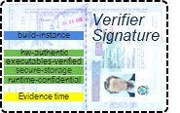
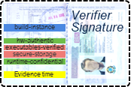


Trusted Path Routing draft-voit-rats-trustworthy-path-routing
Operational instance of draft-voit-rats-attestation-results
Network trust is established via each peer’s Link Layer credentials
Verifier
Signed Appraisal returned to Router
passed to peers over EAP / TLS / 802.1x

Slide 12
Example Trustworthiness Vector State Machine
Legend
Log received
Not Evaluated
Event
Pass
PCR Quote received
Fail
Vector = Null
Insufficient Data
Next Step
Setting each Trustworthiness Claim is explicit.
It is possible to not assert ANY conclusions after the appraisal.
Timer Expiry
Push Trustworthiness Claim into Trustworthiness Vector
Fresh signed Evidence?
Evaluate HW Integrity
hw-authentic
hw-verification-fail
Evaluate Identity
ae-instance-recognized
ae-instance-unknown
Evaluate Boot Integrity
executables-verified
executables-fail
Evaluate config
config-secure
config-insecure
Send Vector to
Attester

