Slide 1
A collection of imagery and icons to be used for SCITT presentations and/or documents
All imagery and icons must be free to distribute
For each image/icon, state the source and/or author

Slide 2
Color Palate
The images in this section use the following color palate, which is part of this sections template. Changing the color palate in the master slide should adjust all images in this section.

Slide 3
Notes
Yellow backgrounds
Many slides have yellow backgrounds to highlight how an image may look across light or dark themed backgrounds. By using yellow, you will see the black/white or other colors differentiated from the background
Save with a white box
To minimize conflicts with dark themed backgrounds, save the images with a white background to assure your visualizations won't get lost when the user views with a dark (black) themed viewer
Saving as SVG
Right-click, save as picture
Choose .svg
Assure you have transportable fonts. These templates use Arial as a best attempt. Please post changes for additional fonts that should be ubiquitous across platforms.

Slide 4
Imagery & Icons - Foundations
Individual imagery from various foundations

Slide 5

From: https://www.ietf.org/logo/ https://www.ietf.org/media/documents/ietf-logo.svg

Slide 6


CNCF Imagery
Notary v2
From: https://cncf-branding.netlify.app/projects/notary/
v2

Slide 7


































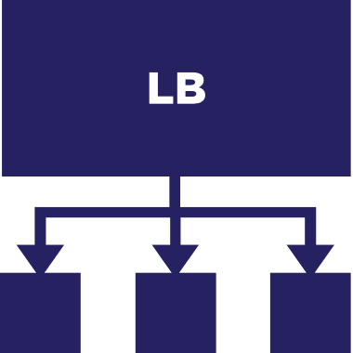























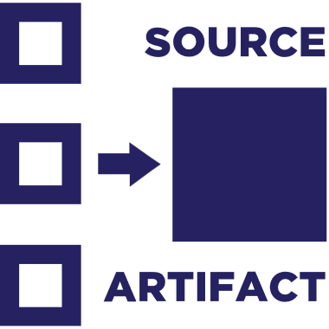






OCI Imagery
From: https://github.com/opencontainers/artwork

Slide 8
SCITT Specific Icons

Slide 9






Identity
Policy
Artifact
Evidence
SCITT
SCITT Logo
Free to use & distribute, provided by Steve Lasker

Slide 10
SCITT Logo
Currently using the Consolas font, with bold.
Select just the SCITT text
Choose save as picture
Save as svg
scitt-logo.svg
SCITT
Free to use & distribute, provided by Steve Lasker

Slide 11
SCITT Compositions

Slide 12
Consuming and Publishing Artifacts
ISVs
1
2
Community Developers
Published Artifacts
Product Engineering
5
ISV Products
Personal Development
Businesses
Open Source Projects
3
Internal Systems
Consumers
4
Apps

Slide 13
eNotary
eNotary Claims:
eNotary Evidence
SCITT Instance
SCITT Instance
3
3
2
2
5
eNotary
eNotary
1
Ledger
Evidence
1
Ledger
6
5
4
7
4
6
Storage
Storage

Slide 14
eNotary
Hosted SCITT Services
SCITT
Statement
eNotary
Statement
Evidence
Data Stores
Identity
Artifact
Evidence
OCI Artifacts
Package Managers
Blob Storage

Slide 15
eNotary
Hosted SCITT Services
Artifact, Claims, Evidence Relationships
Artifacts
SCITT
Evidence
1
3
4
2
purl w/hash?
4
purl w/hash?
eNotary
OCI Artifacts
Package Managers
Blob Storage
A
B
C
OCI Artifacts
Package Managers
Blob Storage

Slide 16





Extending Services
SCITT Interoperability
Spacley Cloud Provider
Multi Tenant Services
Registry Service
Key Vault Service
Signing Service
Wabbit Networks
2
1
ACME Rockets Environment
Security Service
SCITT
Virtual Private Network
3
registry.acme.io
keyvault.acme.io
signer.acme.io
1
SCITT
SCITT
2
4
SCITT

Slide 17
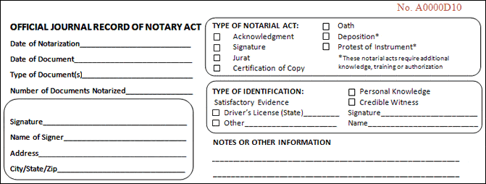
Notary Ledger
A Notary validates the intent of a user
E
A
B
C
D
F
H
G

Slide 18
Notary Act
Container Image
SBOM
Met ACME Security Policy – for base images
Notes:
Jurat is Latin for “to swear.” A jurat is a certificate attached to an affidavit or deposition to signify that the affidavit or deposition was properly made before a duly authorized officer.

Slide 19

Artifact Promotion
Wabbit Networks
Docker Hub ^{(Distributor)}
ACME Rockets
Air-gapped network
Artifact Build Environment
Trust Policy
Wabbit Networks
Docker Hub
Image
Spacely Sprockets
Image
Image
Image
Image
Image
Image
Image
Cogswell Cogs
Internal Registry
Private Registry
Container Host
SBoM
SBoM
SBoM
SBoM
SBoM
SBoM
SBoM
SBoM
Policy Management
Scan Results
Scan Results
Scan Results
Scan Results
Scan Results
Scan Results
Scan Results
Scan Results
Claims
Claims
Claims
Claims
Claims
Claims
Claims
Claims
Air-gapped network
Spacely Sprockets
Spacely Sprockets
Artifact Build Environment
Private Registry
Container Host
Policy Management
Image
Image
Image
SBoM
SBoM
SBoM
Scan Results
Air-gapped network
Scan Results
Scan Results
Cogswell Cogs
Private Registry
Artifact Build Environment
Wabbit Networks built the net-monitor:v1 image (software)
ACME Rockets Imports net-monitor:v1
ACME tests it for their security posture (SBOM, Scans, Claims)
If net-monitor:v1 meets ACME standards, it’s “approved”
Approved is indicated with a signature and a new claim
Container Host
Policy Management
Image
Image
SBoM
SBoM
Scan Results
Scan Results

Slide 20
SCITT Promotion
SCITT Claims Promotion
Internal team A
Public SCITT Service
Internal team B

Slide 21
Software Supply Chain
Software Supply Chain
Wabbit Networks (Publisher)
ACME Rockets (Consumer)
1
Creation
2
Verification
3
Distribution
4
Internal Distribution
5
Verification
6
Consumption
7
Archival
SCC
Functional Testing
Published Registries
Promotion
Environment Specific Registries
Functional Testing
Apps/Services
Artifacts, Claims & Evidence
Build Systems
Security Scanning
Security Scanning
End Users
8

Slide 22

Software Supply Chain: w/OCI Distribution and COSE Signatures
Software Supply Chain
Wabbit Networks (Publisher)
ACME Rockets (Consumer)
Creation
Verification
Distribution
Internal Distribution
Verification
Consumption
Archival
SCC
Functional Testing
Published Registries
Promotion
Environment Specific Registries
Functional Testing
Apps/Services
Artifacts, Claims & Evidence
Build Systems
Security Scanning
Security Scanning
End Users
1
2
3
4
5
6
7
Internal
Published
Internal
Verify
Archive
net-monitor:v1
net-monitor:v1
net-monitor:v1
net-monitor:v1
OCI Distribution
Wabbit-Networks Build Claims
Wabbit-Networks Verification
Wabbit-Networks Verification
Wabbit-Networks Verification
ACME Verification
Wabbit-Networks Verification
ACME Verification
Deployed Claims

Slide 23



Software Supply Chain: w/OCI Distribution and SCITT Receipts ^{(COSE)}
Software Supply Chain
Wabbit Networks (Publisher)
ACME Rockets (Consumer)
Creation
Verification
Distribution
Internal Distribution
Verification
Consumption
Archival
SCC
Functional Testing
Published Registries
Promotion
Environment Specific Registries
Functional Testing
Apps/Services
Artifacts, Claims & Evidence
Build Systems
Security Scanning
Security Scanning
End Users
6
Internal
Published
Internal
Verify
Archive
net-monitor:v1
net-monitor:v1
net-monitor:v1
net-monitor:v1
OCI Distribution
7
Wabbit-Networks Build Claims
Wabbit-Networks Verification
Wabbit-Networks Verification
Wabbit-Networks Verification
ACME Verification
Wabbit-Networks Verification
ACME Verification
Deployed Claims
1
Internal
SBOM
Publish
4
SBOM
ACME Rockets
5
SBOM
ACME Rockets Archive
SBOM
SCITT
2
3
Wabbit-Networks Build Claims
Wabbit-Networks Verification
Wabbit-Networks Verification
Wabbit-Networks Verification
ACME Verification
Wabbit-Networks Verification
ACME Verification
Deployed Claims

Slide 24
Wabbit-Networks Build Claims
Wabbit-Networks Build Claims

