Slide 1

ALTO Multi-Domain Use Cases and Services
Mario Lassnig, Ingmar Poese, Jordi Ros Giralt, Y. Richard Yang, Danny Lachos, Chin Guok
March 27, 2023
IETF 116

Slide 2
Problem (Relevance)
RFC 7971: "The ALTO protocol is designed for use cases where the ALTO server and client can be located in different organizations or trust domains. ALTO is inherently designed for use in multi-domain environments. Most importantly, ALTO is designed to enable deployments in which the ALTO server and the ALTO client are not located within the same administrative domain. ”
However, existing core ALTO services including Endpoint Cost Service (ECS) and Cost Map Service query a single ALTO server for the ALTO properties (e.g., routing cost, latency, …) of the whole network path, but the path may span multiple networks.
Notes:
Multiple projects (e.g., [1][2]) identify systematic multi-domain design as a key missing feature of ALTO.
[1] https://datatracker.ietf.org/doc/draft-lachos-alto-multi-domain-use-cases/ [2] https://datatracker.ietf.org/doc/draft-xiang-alto-multidomain-analytics/

Slide 3
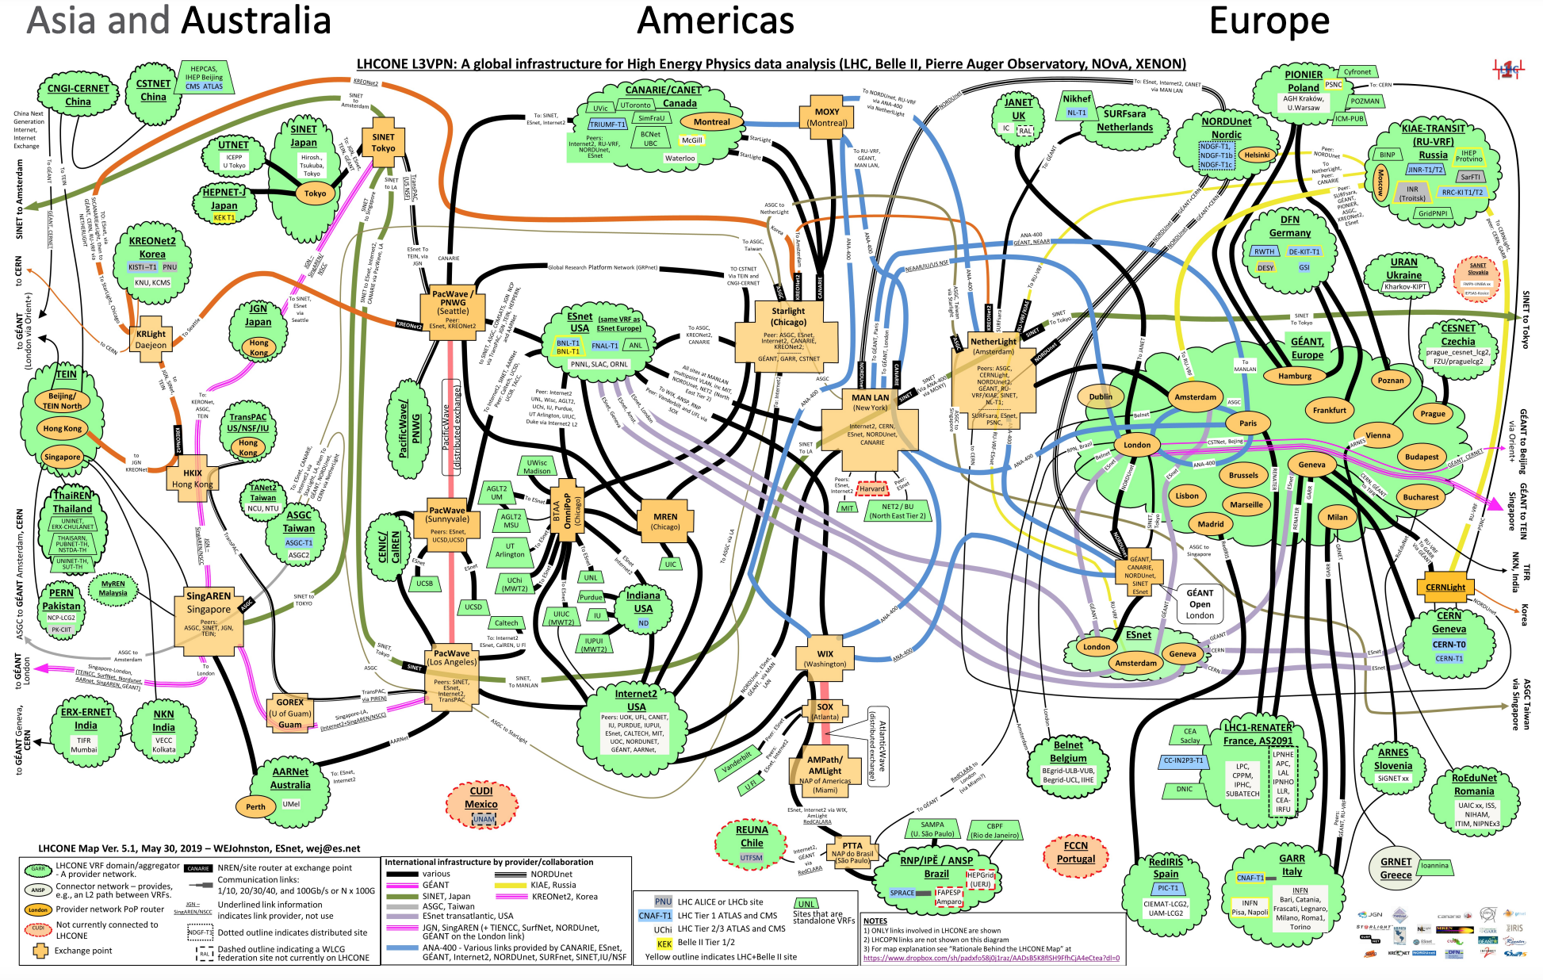
Use Case Driven by Deployment: Multi-Domain Path->Link Usage (Example: CERN FTS Scheduling Integration)
pipe[i].src
pipe[i].dst
AS 1
AS 2
AS 3
Link 1.1
Link 3.1
Multi-domain applications
App controls transfer pipe traversing a set of resources
Each resource (link) has resource allocation model
App supporting app-defined-networking need the ability to map pipe to the set of resources
More detail see CERN ALTO/FTS integration.
project
activity
pipe

Slide 4
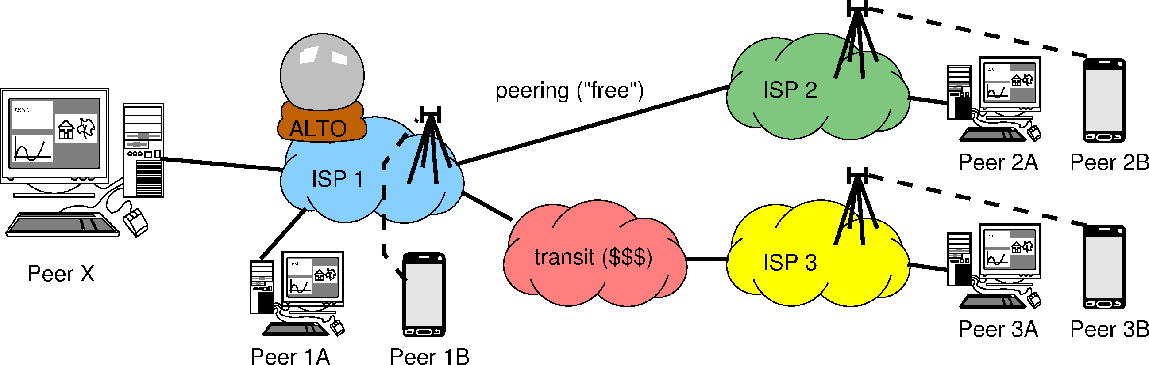
Use Case Driven by Deployment: Multi-domain Path Distance/Ranking (Example: Rucio Distance/Flow Director)
Node 2A
Node 2B
Node X
Node 3A
Node 3B
Node 1A
Node 1B
Node X has 6 potential sources, Node [1-3]A, Node [1-3]B
Sources span multiple domains
How to compute distance/ranking for Node X?

Slide 5
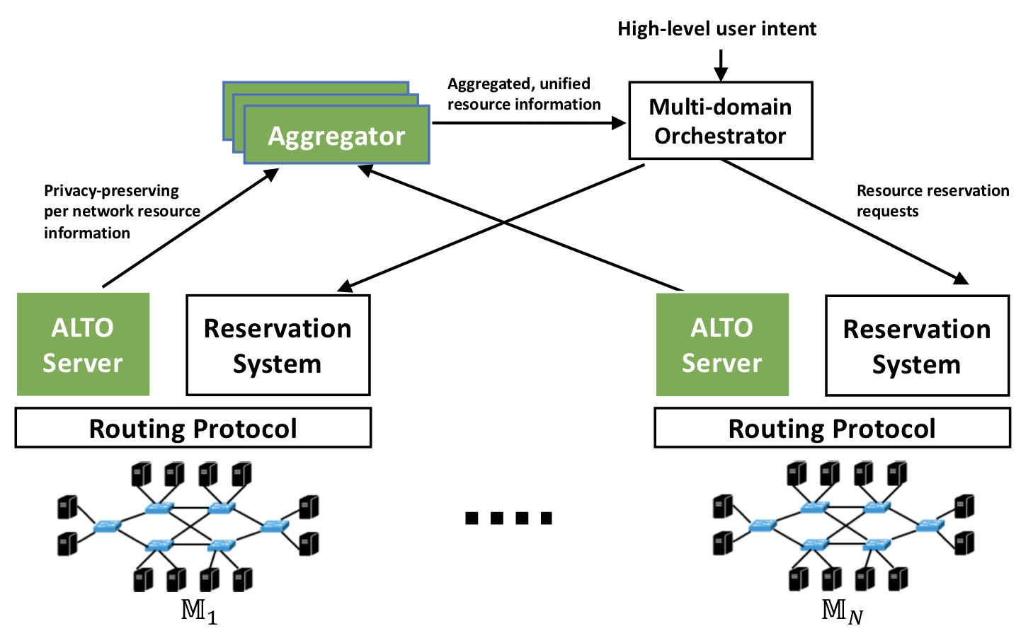
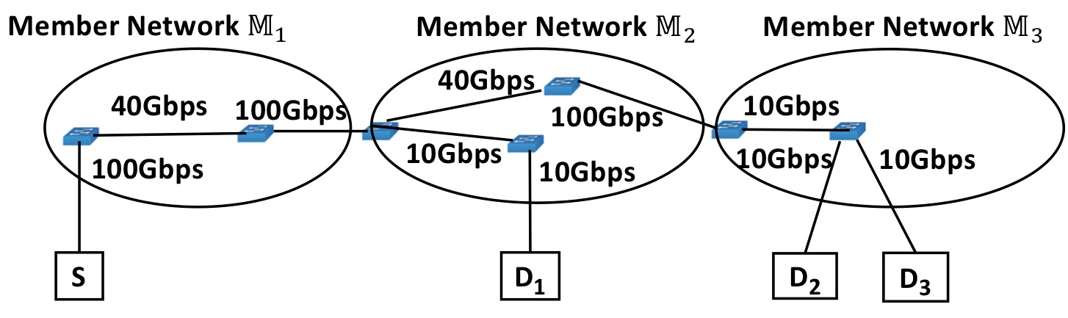
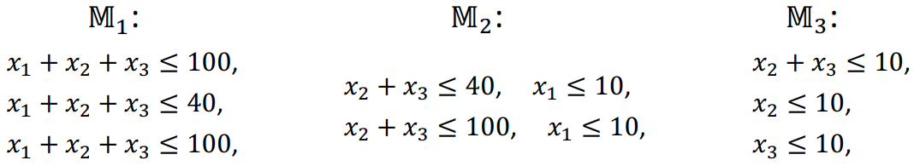
Use Case: Multi-domain Co-Flow Resource Discovery (Example: AutoGOLE/SENSE)
Large-scale data analytics jobs span multiple networks
Compute QoS (possible bandwidth) to optimize co-flow finishing time
"Fine-grained, multi-domain network resource abstraction as a fundamental primitive to enable high-performance, collaborative data sciences." ACM/IEEE Supercomputing 2018.
Notes:
The multi-domain networking abstraction is used to solve application-layer optimizations across multiple domains.
Typically, previous uses cases ca be modeled as an optimization problem F(x, y) where the F is an objective function based on two types of variables.

Slide 6
Additional Use Case
Multi-domain bottleneck structure
Details see https://datatracker.ietf.org/doc/draft-giraltyellamraju-alto-bsg-multidomain/

Slide 7
Gap in Current ALTO/Routing Systems
AS S AS A AS B AS D
+-------------+se1 +---------+ +-----+ +------------+
| src --|-----|ai1 ae1|---| |---|di1 dst |
|+--+ --/ | | | | | | +--+ |
|| | --/ | | | | | | | | |
|+--+ \ |se2 | | | | | +--+ |
| \__ |_____|ai2 ae2|---| |---|di2 |
+-------------+ +---------+ +-----+ +------------+
For the same (src-dst) flow path,
Information propagation is upstream
AS S can see the whole AS path S A B D; AS A sees only A B D
upstream does not notify downstream choice (egress, corresponding ingress at downstream)
AS A does not know (by protocol) AS S chooses se1->ai1 or se2->ai2
BGP does not have a CHOSEN message; ALTO has no resource to provide the info

Slide 8
Basic ALTO Extension
New ALTO service providing egress-notification resource (EN)
<flow-info, [ingress]> -> <egress, domid:next-ingress; [Sebastian proposal: next-alto-server-uri; handle blackhole…]>
Useful beyond ALTO (egress/ingress verification)
An east-west interface between ALTO/AS
AS S AS A AS B AS D
+-------------+se1 +---------+ +-----+ +------------+
| src --|-----|ai1 ae1|---| |---|di1 dst |
|+--+ --/ | | | | | | +--+ |
|| | --/ | | | | | | | | |
|+--+ \ |se2 | | | | | +--+ |
| \__ |_____|ai2 ae2|---| |---|di2 |
+-------------+ +---------+ +-----+ +------------+
Notes:
Destination based: no need for src, only ingress
Given the trend of general routing, need the full flow info

Slide 9
Multidomain Endpoint Cost Service using EN
Option 1 (Horizontal)
ALTO server coordination: Downstream queries upstream for ingress point (can detect anyway; but protocol convey intent, not error, before traffic)
Option 2 (Vertical)
ALTO client goes from upstream to downstream, collecting and informing info along the way
AS S AS A AS B AS D
+-------------+se1 +---------+ +-----+ +------------+
| src --|-----|ai1 ae1|---| |---|di1 dst |
|+--+ --/ | | | | | | +--+ |
|| | --/ | | | | | | | | |
|+--+ \ |se2 | | | | | +--+ |
| \__ |_____|ai2 ae2|---| |---|di2 |
+-------------+ +---------+ +-----+ +------------+

Slide 10
Important Technical Detail: Query and Trust Model
Option 1: Horizontal recursion trust
AS 1
AS 2
AS 3
2
3
1
Client
Option 2: Star trust

Slide 11
Important Technical Detail: Incremental Deployment
Incremental deployment: the chaining of domains may be broken due to incremental deployment (e.g., domain sequence is S -> A -> B -> C -> D, but A does not provide EN)
Provide guidance on
how to detect ingress point at B, and
how to respond if B cannot detect ingress (multi-answers)
See general path abstraction discussion on the mailing list
AS S AS A AS B AS D
+-------------+se1 +---------+ +-----+ +------------+
| src --|-----|ai1 ae1|---| |---|di1 dst |
|+--+ --/ | | | | | | +--+ |
|| | --/ | | | | | | | | |
|+--+ \ |se2 | | | | | +--+ |
| \__ |_____|ai2 ae2|---| |---|di2 |
+-------------+ +---------+ +-----+ +------------+

Slide 12
Related References on Multidomain
https://datatracker.ietf.org/doc/draft-lachos-alto-multi-domain-use-cases/
https://datatracker.ietf.org/doc/draft-lachos-sfc-multi-domain-alto/
https://datatracker.ietf.org/doc/draft-lachosrothenberg-alto-brokermdo/
https://datatracker.ietf.org/doc/draft-lachosrothenberg-alto-md-e2e-ns/
https://datatracker.ietf.org/doc/draft-giraltyellamraju-alto-bsg-multidomain/
Old CERN use case
https://ieeexplore.ieee.org/abstract/document/8756056
https://www.sciencedirect.com/science/article/abs/pii/S0167739X18302413
Inter-ALTO communication protocol
https://datatracker.ietf.org/doc/draft-dulinski-alto-inter-alto-protocol/
ALTO network-server, server-server API
https://datatracker.ietf.org/doc/draft-medved-alto-svr-apis/

Slide 13
Next Steps
Organizing interim meetings before May 2023
Discuss details of current design implementations
Involve operators
Notes:
Extensions of ALTO services to support multi-domain settings. The current ALTO framework has made clear how to provide network information from a single ALTO server for a single network (administrative domain), but the network devices traversed by a flow can be managed by multiple networks that are not in the same domain. The working group will investigate and extend the ALTO framework to (1) specify multi-ALTO-server protocol flow and usage guidelines when an ALTO service involves network paths spanning multiple domains with multiple ALTO servers, and (2) extend or introduce ALTO services allowing east-west interfaces for multiple ALTO server integration and collaboration. The specification and extensions should use existing services whenever possible. The specification and extensions should consider realistic complexities including incremental deployment, dynamicity, and security issues including access control, authorization (e.g., an ALTO server provides information for a network that the server has no authorization), and privacy protection in multi-domain settings.

Slide 14
Backup Slides

Slide 15
Additional Questions
The “routing cost” metric makes it difficult to aggregate different point of views
See also RFC 8686, Appendix C
The “ALTO advice” runs in the opposite direction of the money
will it always stop at the peering points / Tier-1 carriers?
what if the advice given by ISP1’s ALTO server impairs ISP2’s traffic engineering?
will ISP1 be legally liable? Thus, will ISP1 refuse to give details wrt. ISP2 even if they knew?
[Sebastian 9/30/2020]

Slide 16
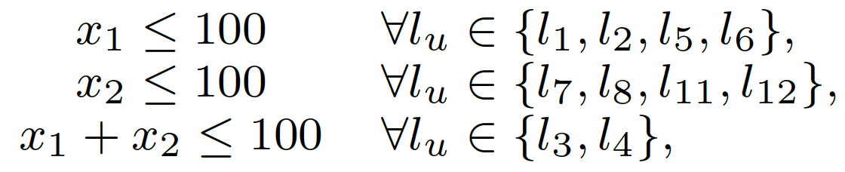
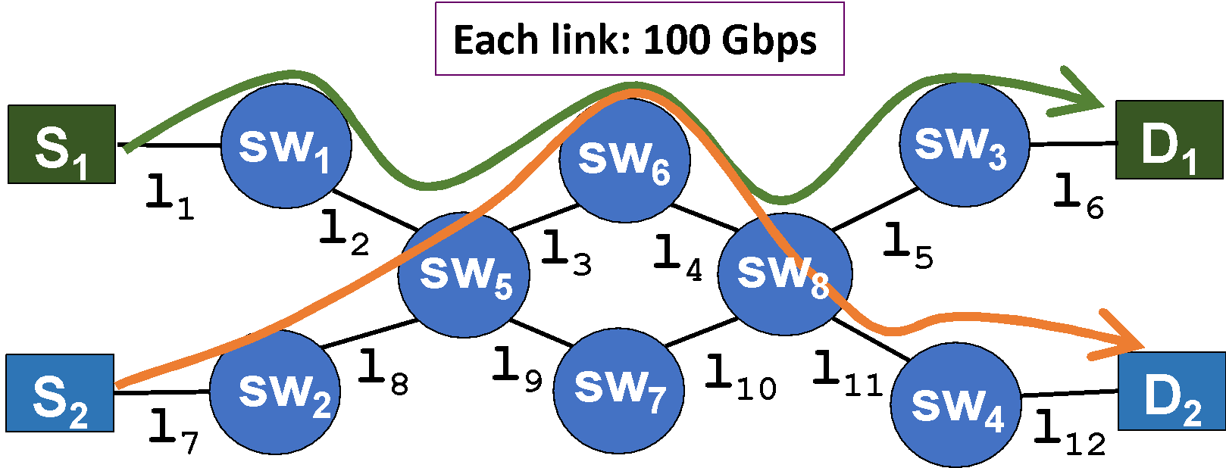


(R)PV: Mathematical Programming as Abstraction Representation to Support Third Use Case
GOAL: Use mathematical programming constraints to provide a compact representation of the available bandwidth of flows through a network.
100
100
Redundant inequalities can be removed via a polynomial-time, optimal algorithm.
Remaining bottlenecks represented as abstract network elements (ANE).
Notes:
Our idea: on-demand, partianl-instantiation

Slide 17
The Reverse View: Mathematical Constraints as Virtual Network Representation
Aggregate the abstraction in multiple networks into a unified, single, virtual representation:

Slide 18

Use Case: Multi-domain Path Distance/Ranking (Cost Map/Flow Director/Rucio Distance)
Node 2A
Node 2B
Node X
Node 3A
Node 3B
Node 1A
Node 1B
Which distance/ranking should Node X receive?
Node1A
Node 1 B
Node 2A, 2B (*)
Node 3A, 3B (*)
Node 1A
Node 2A, 2B (*)
Node1B
Node3A, 3B (*)
(*) = ?A and ?B are on the same level of preference, because ISP1 might not know that they are wireline vs. wireless, doesn’t care (monetary cost is the same for ISP1), and/or wouldn’t dare to tell even if they knew.
Is “all within my domain” or “not in my
wireless network” more preferable?

Slide 19
Feasibility: Simple ALTO Multi-Domain Abstraction
Starts with a simple architecture called ALTO Multi-Domain Abstractions (AMDA)
The path of a flow from a src to a dst consists of a sequence (vector) of domain segments
Domain[0]:{src -> net₀-e} -> Domain[i]{net_{i}-i -> … -> net_{i}-e -> net_{i+1}-i -> … -> net_{n}-e -> dst
Domain segments obtained from BGP at source => bootstrapping starts at source
net0-e
net1-i
netn-e
src
dst
Notes:
Same network: segment-src-dst
One hop: segment–src -> segment-dst

Slide 20
Gap in Current ALTO/Routing Systems
AS S AS A AS B AS D
+-------------+se1 +---------+ +-----+ +------------+
| src --|-----|ai1 ae1|---| |---|di1 dst |
|+--+ --/ | | | | | | +--+ |
|| | --/ | | | | | | | | |
|+--+ \ |se2 | | | | | +--+ |
| \__ |_____|ai2 ae2|---| |---|di2 |
+-------------+ +---------+ +-----+ +------------+
Missing standard protocol to stitch information across domains
Take computing cost/distance src->dst as an example
AS S alone has complete path property, but only for BGP path
AS S and AS D together can provide only distance from endpoints (e.g., GeoIP)
AS A/B in the middle can provide path segments, if it can detect/determine ingress point (not common for downstream to know)
Gap: provide an ability to provide ingress point from upstream

Slide 21
Important Technical Detail: Multi-Domain Path Ranking
The multi-domain path of a flow from a src to a dst consists of those of a sequence of domain segments
domain[0]:{src -> dom₀-egress-> dom₁-ingress} domain[i]{dom_{i}-ingress -> dom_{i}-egress -> dom_{i+1}-egress}
src = dom₀-ingress, dst = dom_{n}-egress
List of domains obtained from BGP at source by default => bootstrapping starts at source
A vector of path cost may no longer define a total order; candidate designs MUST discuss clear guidelines to applications on how to utilize partial ordering, and the consequences (i.e., operations considerations)
Leverage SIGCOMM’20 multi-criteria routing design
dom0-egress
dom1-ingress
src
dst
Notes:
Same network: segment-src-dst
One hop: segment–src -> segment-dst

Slide 22
Additional Issues
Operation models for extensions [mechanisms, not policies]
iterative (client aggregation)
recursive (network helped aggregation)
Hybrid
How to handle cost map, not only ECS
How to handle bandwidth use case

